Slide 1
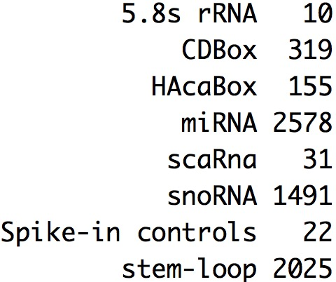
Here, consider the expression signal of miRNA from file shared by Victoria
Use this file “chipdata_5115.RMA-DABG - Group 3 VC.txt’ that contain the log2 scale expression signal of human miRNA (rma method to normalize the data)
3 young vs 4 old samples (match Victoria’s previous analysis: remove V17 and V18 )
Consider two condition groups:
Consider all types: 6658
2. Only consider the miRNA and stem-loop, Spike-in controls: 4625
RUVIII used to remove the batch effect and use spike-in control as negative control

Slide 2
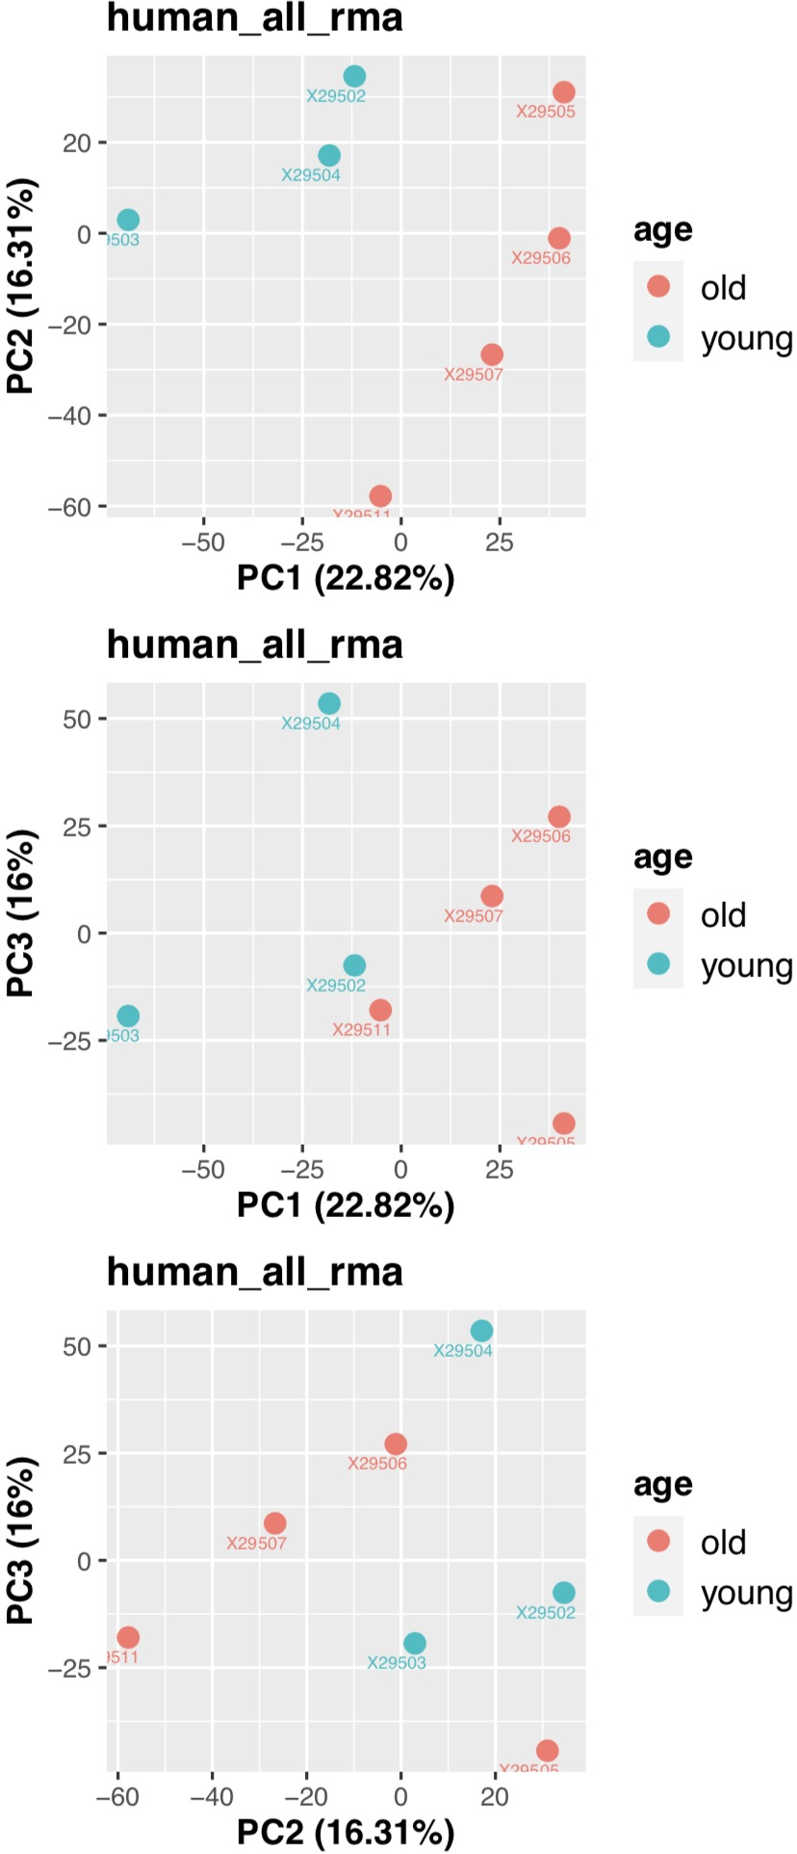
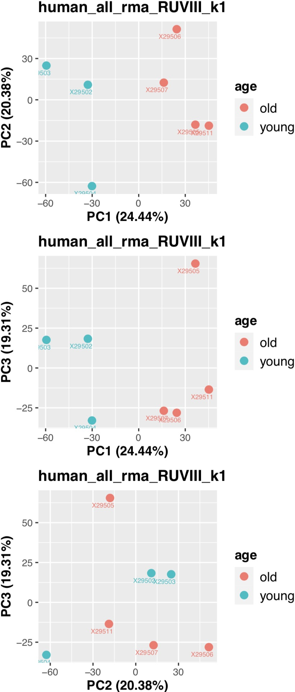
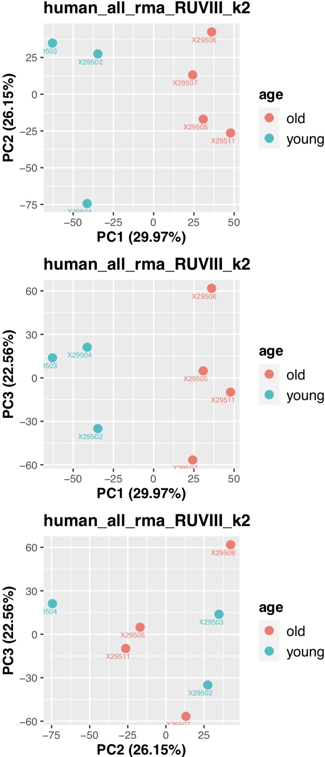
Analysis 1-1
3 young vs 4 old samples
match Victoria’s previous analysis: remove V17 and V18
Consider all types: 6658
RUVIII to remove the batch effect

Slide 3
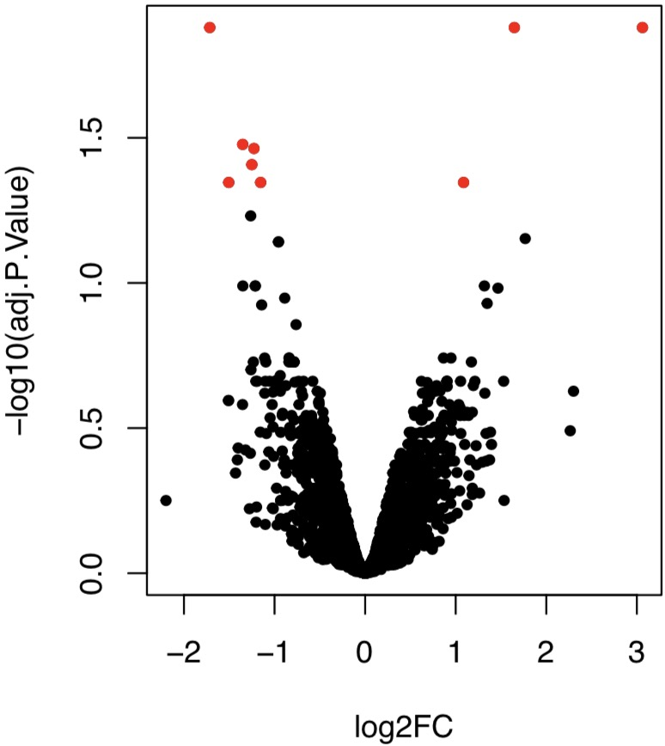
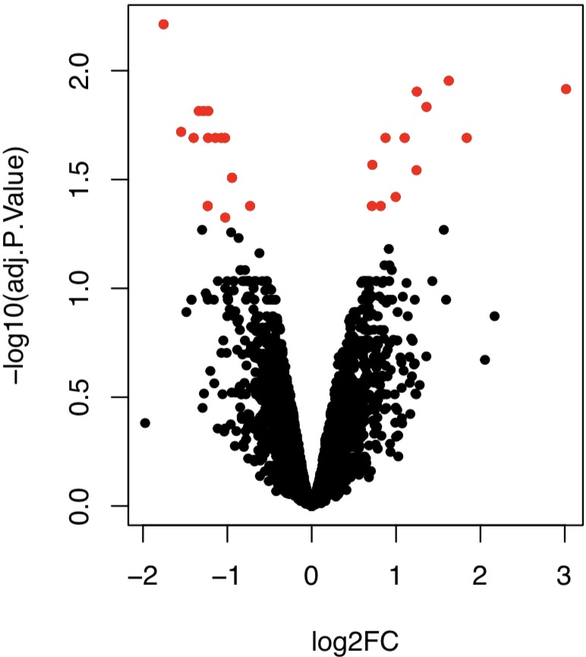
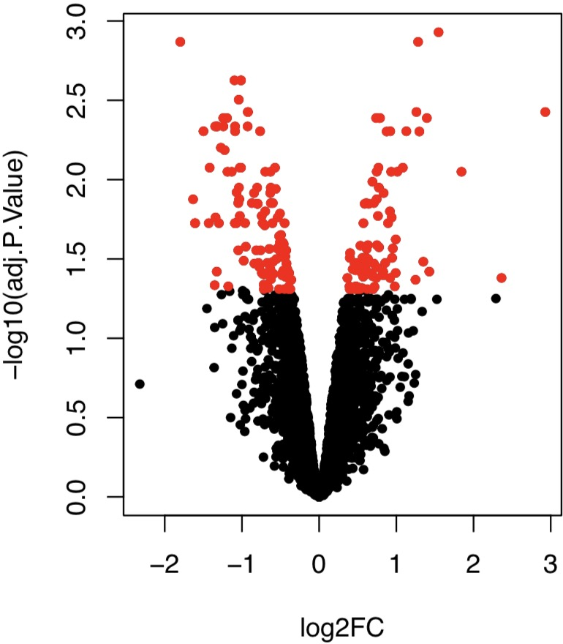
Analysis 1-1
DE miRNA analysis
limma used to calculate DE miRNA
Consider all types: 6658
adj.P.Val<0.05
RMA
Total 9 DE miRNA
RUVIII k=1
Total 28 DE miRNA
RUVIII k=2
Total 225 DE miRNA

Slide 4
Analysis 1-1
RMA: Total 9 DE miRNA
 | logFC | AveExpr | t | P.Value | adj.P.Val | B | X29502 | X29503 | X29504 | X29505 | X29506 | X29507 | X29511 | Type | Transcript.ID.Array.Design.
20534520 | -0.4986295 | 1.00477653 | -3.5312056 | 0.00645405 | 0.31365746 | -2.0798817 | 1.096087 | 1.338948 | 1.434088 | 0.9665256 | 0.7322328 | 0.6832349 | 0.7823194 | stem-loop | hsa-mir-196a-2
20535071 | -0.2806392 | 0.94437529 | -1.8553048 | 0.09670357 | 0.59967417 | -4.5538024 | 1.177281 | 1.316048 | 0.8208927 | 0.9305863 | 0.8208927 | 0.8208927 | 0.7240336 | stem-loop | hsa-mir-196b
20501772 | -0.42115 | 1.16068074 | -1.6791048 | 0.12761284 | 0.64160097 | -4.7926946 | 0.9844626 | 1.140634 | 2.078917 | 0.9411717 | 1.140634 | 1.04349 | 0.7954559 | miRNA | hsa-miR-196b-3p
20500456 | -0.1922783 | 0.98136176 | -0.9820408 | 0.35186953 | 0.82346128 | -5.5930769 | 1.370106 | 0.7193952 | 1.184204 | 0.6619476 | 1.188614 | 0.9797223 | 0.7655432 | miRNA | hsa-miR-196a-3p
20500393 | -0.1358285 | 0.89847116 | -0.8335448 | 0.42621435 | 0.86253349 | -5.7224983 | 0.7009029 | 1.241644 | 0.9857154 | 0.7227516 | 0.8368254 | 1.04349 | 0.7579688 | miRNA | hsa-miR-196a-5p
20534479 | -0.0385464 | 0.82755849 | -0.2680991 | 0.79469734 | 0.96623354 | -6.0367256 | 0.7857057 | 0.8308375 | 0.9322118 | 0.7939371 | 0.7079529 | 1.081551 | 0.6607134 | stem-loop | hsa-mir-196a-1
20501771 | -0.0222491 | 0.882054 | -0.1220537 | 0.90555202 | 0.98681181 | -6.0666019 | 0.8111457 | 0.8000516 | 1.073106 | 1.26886 | 0.555425 | 0.8000516 | 0.8657381 | miRNA | hsa-miR-196b-5p
RUVIII k=1: Total 28 DE miRNA
 | logFC | AveExpr | t | P.Value | adj.P.Val | B | X29502 | X29503 | X29504 | X29505 | X29506 | X29507 | X29511 | Type | Transcript.ID.Array.Design.
20534520 | -0.4945415 | 1.16424218 | -3.9440952 | 0.00378062 | 0.14773651 | -1.6642327 | 1.26275053 | 1.48614152 | 1.59161995 | 1.13183949 | 0.90615261 | 0.85081902 | 0.92037214 | stem-loop | hsa-mir-196a-2
20535071 | -0.2723631 | 1.26721629 | -1.9392506 | 0.08627684 | 0.44547874 | -4.6791062 | 1.51469423 | 1.61404385 | 1.13981889 | 1.26526717 | 1.1729964 | 1.16016969 | 1.0035238 | stem-loop | hsa-mir-196b
20500393 | -0.1189879 | 1.55539509 | -0.7907862 | 0.45054718 | 0.79253452 | -6.0309198 | 1.38747872 | 1.84801247 | 1.63467338 | 1.40376755 | 1.5532937 | 1.73385823 | 1.32668157 | miRNA | hsa-miR-196a-5p
20501771 | -0.0322928 | 0.49026487 | -0.1826577 | 0.85934431 | 0.96565644 | -6.3397622 | 0.4016722 | 0.43841372 | 0.68606776 | 0.8627024 | 0.12812364 | 0.38831631 | 0.52655807 | miRNA | hsa-miR-196b-5p
RUVIII k=2: Total 225 DE miRNA
 | logFC | AveExpr | t | P.Value | adj.P.Val | B | X29502 | X29503 | X29504 | X29505 | X29506 | X29507 | X29511 | Type | Transcript.ID.Array.Design.
20534520 | -0.5192428 | 1.0486753 | -4.6846023 | 0.00164065 | 0.04903635 | -0.9793834 | 1.12468081 | 1.36815059 | 1.54332509 | 0.9156144 | 0.80620447 | 0.77623476 | 0.80651697 | stem-loop | hsa-mir-196a-2
20535071 | -0.3122343 | 1.08067612 | -2.8404329 | 0.02215003 | 0.1595225 | -3.6476764 | 1.29183152 | 1.42359096 | 1.06186462 | 0.91625138 | 1.01166694 | 1.03978086 | 0.81974656 | stem-loop | hsa-mir-196b
20501771 | -0.1031357 | 0.15882132 | -0.6541053 | 0.53167736 | 0.76650247 | -6.4808756 | 0.00569094 | 0.10001807 | 0.54755905 | 0.24257305 | -0.1585257 | 0.17441011 | 0.20002366 | miRNA | hsa-miR-196b-5p
20500393 | -0.0763411 | 1.75492108 | -0.586283 | 0.57410153 | 0.7907257 | -6.52538 | 1.62585582 | 2.05172357 | 1.71805436 | 1.77707975 | 1.72585396 | 1.86262781 | 1.5232523 | miRNA | hsa-miR-196a-5p
20534479 | -0.0343521 | 0.12082409 | -0.3235163 | 0.75472847 | 0.88577334 | -6.6544206 | 0.0648132 | 0.19010802 | 0.16644043 | 0.16024541 | -0.0896224 | 0.2907349 | 0.06304911 | stem-loop | hsa-mir-196a-1
20501160 | 0.91970026 | 12.3700484 | 4.97964185 | 0.0011318 | 0.04166243 | -0.5964984 | 11.899416 | 12.0243762 | 11.6097239 | 12.6690581 | 13.2323183 | 12.5225093 | 12.6329369 | miRNA | hsa-miR-29c-3p
Problem about this analysis is that there are negative values after RUVIII

Slide 5
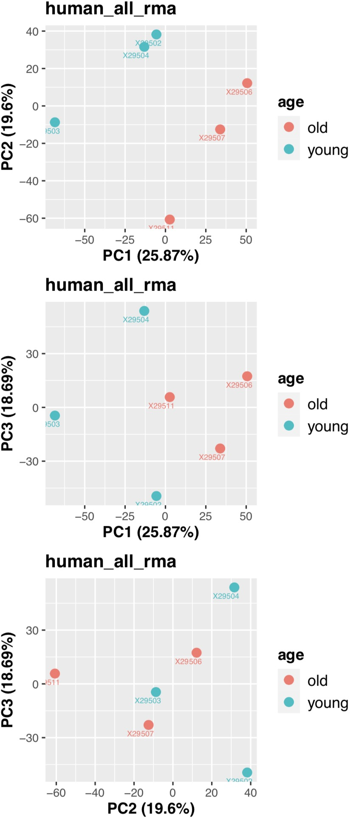
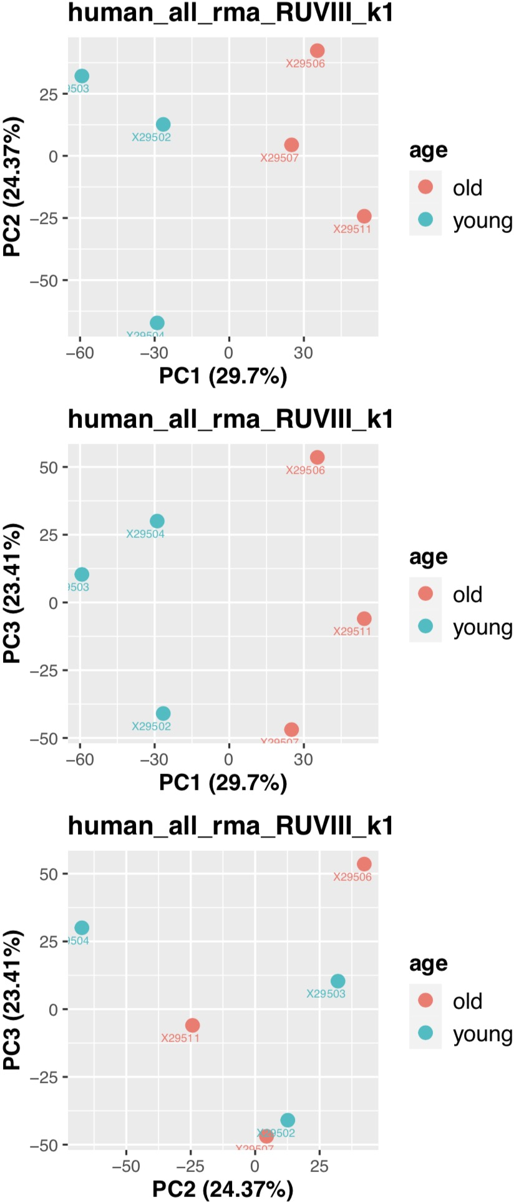
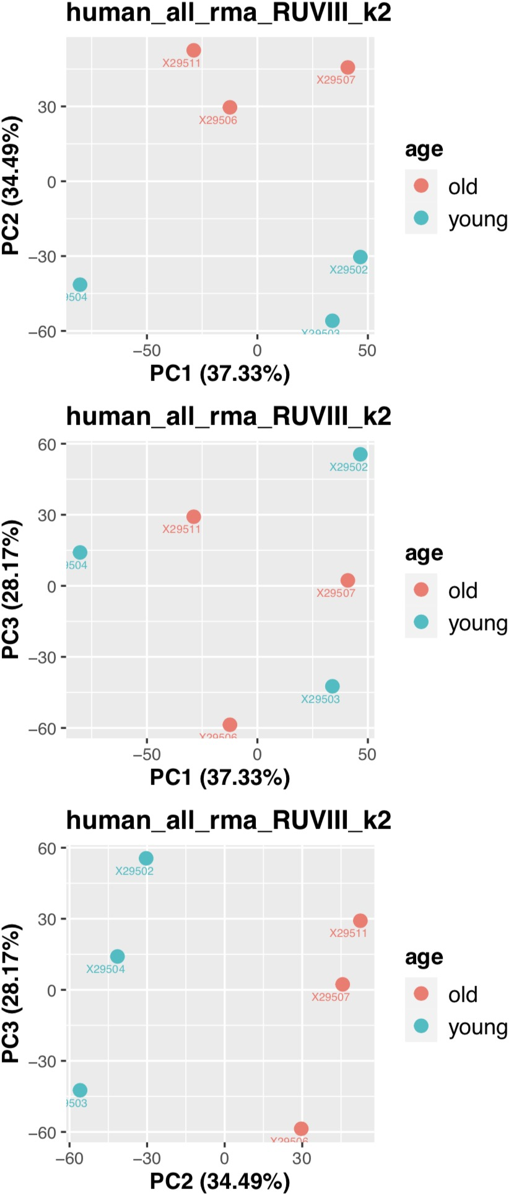
Analysis 1-2
3 young vs 3 old samples
match Victoria’s previous analysis: remove V17 and V18
Meanwhile remove the VC10 (29505) based on the PCA
Consider all types: 6658
RUVIII to remove the batch effect

Slide 6
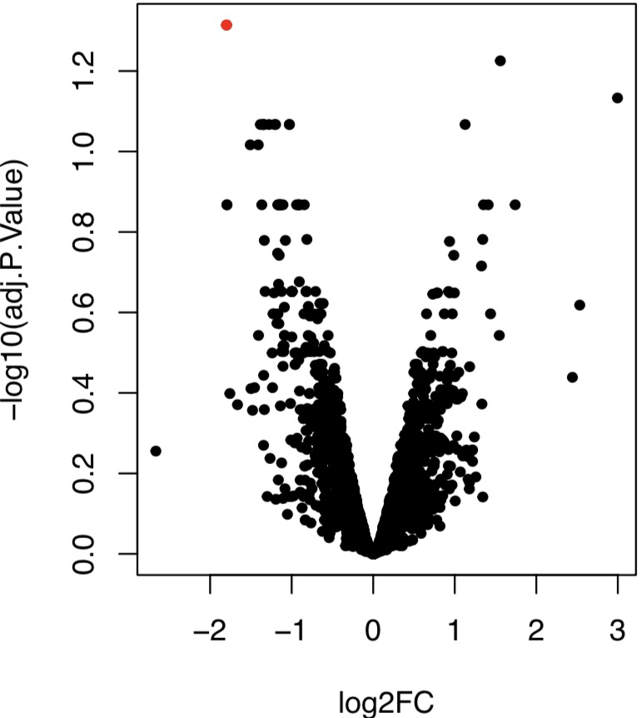
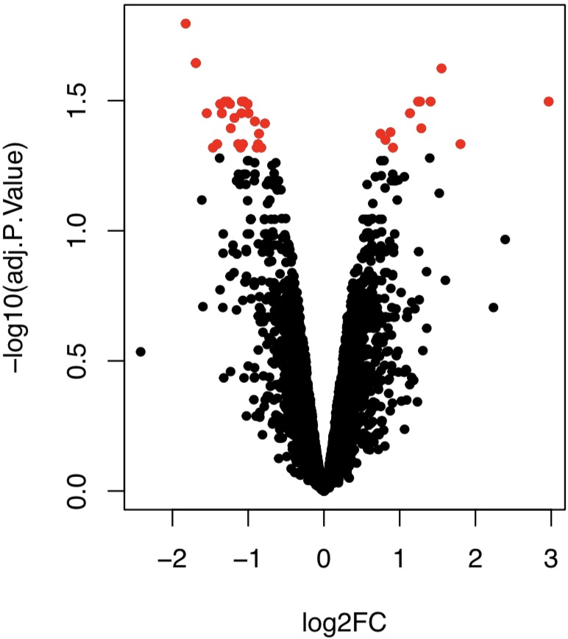
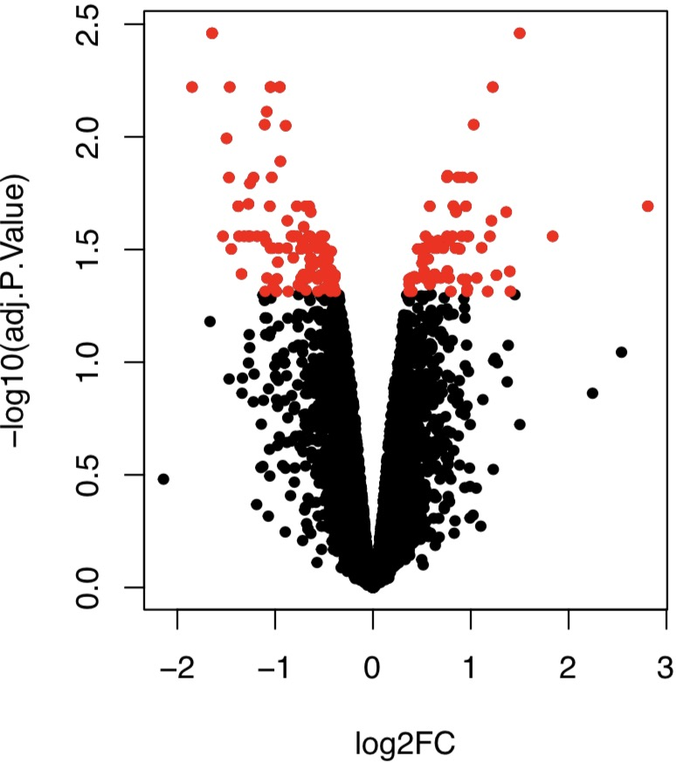
Analysis 1-2
DE miRNA analysis
limma used to calculate DE miRNA
Consider all types: 6658
adj.P.Val<0.05
RMA
Total 1 DE miRNA
RUVIII k=1
Total 42 DE miRNA
RUVIII k=2
Total 195 DE miRNA

Slide 7
Analysis 1-2
RMA: Total 1 DE miRNA
 | logFC | AveExpr | t | P.Value | adj.P.Val | B | X29502 | X29503 | X29504 | X29506 | X29507 | X29511 | Type | Transcript.ID.Array.Design.
20534520 | -0.557112 | 1.01115168 | -3.7477884 | 0.00564115 | 0.31415462 | -1.917961 | 1.096087 | 1.338948 | 1.434088 | 0.7322328 | 0.6832349 | 0.7823194 | stem-loop | hsa-mir-196a-2
20535071 | -0.3161342 | 0.94667345 | -1.888625 | 0.09562474 | 0.66484372 | -4.5552458 | 1.177281 | 1.316048 | 0.8208927 | 0.8208927 | 0.8208927 | 0.7240336 | stem-loop | hsa-mir-196b
20501772 | -0.4081446 | 1.19726558 | -1.4402609 | 0.18775337 | 0.75711045 | -5.1378716 | 0.9844626 | 1.140634 | 2.078917 | 1.140634 | 1.04349 | 0.7954559 | miRNA | hsa-miR-196b-3p
20501771 | -0.1543629 | 0.81758633 | -0.9750658 | 0.35808316 | 0.84608426 | -5.6403758 | 0.8111457 | 0.8000516 | 1.073106 | 0.555425 | 0.8000516 | 0.8657381 | miRNA | hsa-miR-196b-5p
20500456 | -0.1132752 | 1.03459745 | -0.5475097 | 0.59896532 | 0.9352512 | -5.962905 | 1.370106 | 0.7193952 | 1.184204 | 1.188614 | 0.9797223 | 0.7655432 | miRNA | hsa-miR-196a-3p
20500393 | -0.0966594 | 0.92775775 | -0.5366456 | 0.6061086 | 0.93957418 | -5.9689825 | 0.7009029 | 1.241644 | 0.9857154 | 0.8368254 | 1.04349 | 0.7579688 | miRNA | hsa-miR-196a-5p
20534479 | -0.0328459 | 0.83316205 | -0.2020713 | 0.84490456 | 0.97614973 | -6.0986442 | 0.7857057 | 0.8308375 | 0.9322118 | 0.7079529 | 1.081551 | 0.6607134 | stem-loop | hsa-mir-196a-1
RUVIII k=1: Total 42 DE miRNA
 | logFC | AveExpr | t | P.Value | adj.P.Val | B | X29502 | X29503 | X29504 | X29506 | X29507 | X29511 | Type | Transcript.ID.Array.Design.
20534520 | -0.547882 | 1.35724439 | -4.6135831 | 0.0022756 | 0.10621975 | -1.1003712 | 1.4584107 | 1.65166606 | 1.78347935 | 1.11820361 | 1.05705408 | 1.07465255 | stem-loop | hsa-mir-196a-2
20535071 | -0.3041197 | 1.39717597 | -2.0330159 | 0.08045179 | 0.41235412 | -4.6499925 | 1.6489111 | 1.72310735 | 1.275689 | 1.32330381 | 1.30748625 | 1.10455829 | stem-loop | hsa-mir-196b
20501771 | -0.148782 | 1.02685033 | -1.1266508 | 0.29605793 | 0.66638056 | -5.804794 | 1.03022372 | 0.98913571 | 1.28436451 | 0.78880118 | 1.02608033 | 1.04249653 | miRNA | hsa-miR-196b-5p
20500393 | -0.0878686 | 1.25738176 | -0.5407045 | 0.60503834 | 0.85837316 | -6.2938295 | 1.04598556 | 1.53948149 | 1.31848109 | 1.20442993 | 1.39952113 | 1.03639138 | miRNA | hsa-miR-196a-5p
20534479 | -0.0526553 | 0.09038092 | -0.3907311 | 0.70730773 | 0.90018898 | -6.3690631 | 0.00808976 | 0.15968474 | 0.18235116 | -0.1204143 | 0.27926357 | 0.03331056 | stem-loop | hsa-mir-196a-1
RUVIII k=2: Total 195 DE miRNA
 | logFC | AveExpr | t | P.Value | adj.P.Val | B | X29502 | X29503 | X29504 | X29506 | X29507 | X29511 | Type | Transcript.ID.Array.Design.
20534520 | -0.5354085 | 1.39729724 | -6.4185628 | 0.00061509 | 0.03598158 | 0.22874696 | 1.56002646 | 1.68852116 | 1.74645682 | 1.20109675 | 1.07168536 | 1.11599691 | stem-loop | hsa-mir-196a-2
20535071 | -0.3141741 | 1.36489078 | -2.5107669 | 0.04495511 | 0.22462652 | -4.2895159 | 1.56700222 | 1.69339976 | 1.30553155 | 1.25648656 | 1.29569249 | 1.07123206 | stem-loop | hsa-mir-196b
20501771 | -0.1227622 | 1.11040074 | -1.4218808 | 0.2037952 | 0.48222761 | -5.7631322 | 1.2421946 | 1.06601559 | 1.20713537 | 0.96171662 | 1.05660125 | 1.12874103 | miRNA | hsa-miR-196b-5p
20500393 | -0.0441795 | 1.39766892 | -0.2923114 | 0.77967214 | 0.89721665 | -6.715255 | 1.40189994 | 1.66856835 | 1.18880778 | 1.49476741 | 1.45076795 | 1.18120211 | miRNA | hsa-miR-196a-5p
20534479 | -0.0082066 | 0.23310714 | -0.0756368 | 0.94211171 | 0.97781299 | -6.7606612 | 0.37019212 | 0.29101593 | 0.05042333 | 0.17497108 | 0.33140138 | 0.18063898 | stem-loop | hsa-mir-196a-1
20501160 | 0.96097526 | 9.90620174 | 5.49786719 | 0.00140572 | 0.04852166 | -0.6352794 | 9.10849611 | 9.56628132 | 9.60236491 | 10.6331436 | 10.2358422 | 10.2910824 | miRNA | hsa-miR-29c-3p

Slide 8
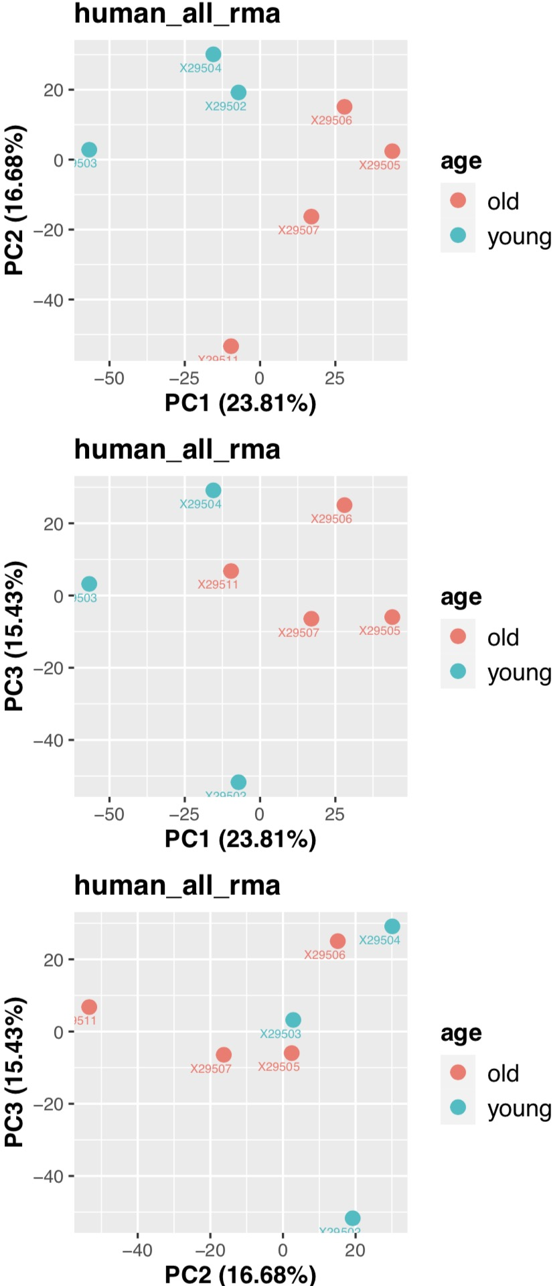
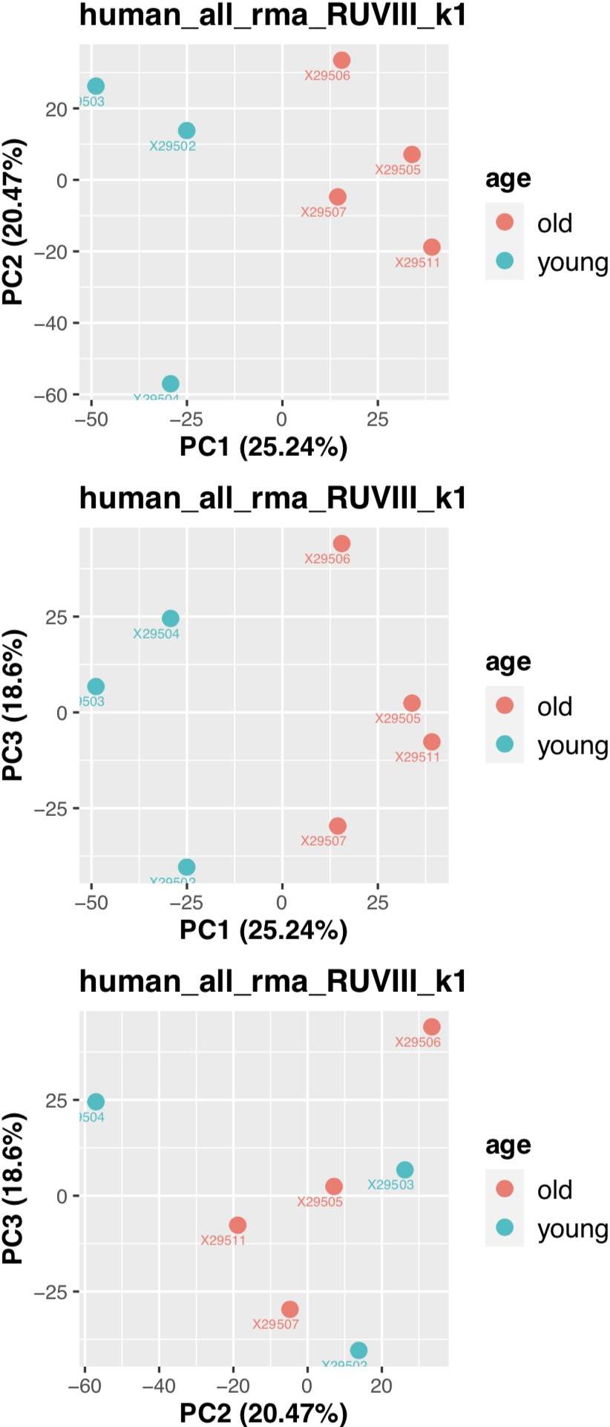
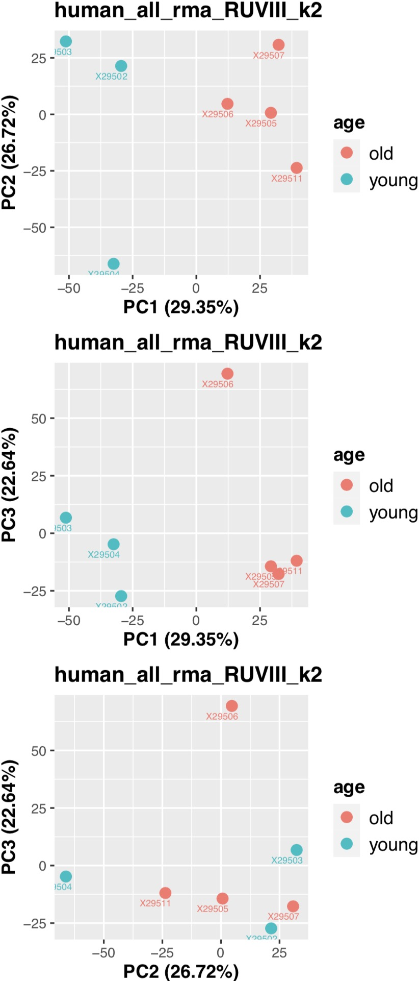
Analysis 2-1
3 young vs 4 old samples
match Victoria’s previous analysis: remove V17 and V18
Consider miRNA and stem-loop, Spike-in controls: 4625
RUVIII to remove the batch effect

Slide 9
Analysis 2-1
DE miRNA analysis
limma used to calculate DE miRNA
Consider miRNA and stem-loop, Spike-in controls: 4625
adj.P.Val<0.05
RMA: Total 3 DE miRNA
 | logFC | AveExpr | t | P.Value | adj.P.Val | B | X29502 | X29503 | X29504 | X29505 | X29506 | X29507 | X29511 | Type | Transcript.ID.Array.Design.
20534520 | -0.4986295 | 1.00477653 | -3.4813369 | 0.00714726 | 0.35034882 | -2.1378421 | 1.096087 | 1.338948 | 1.434088 | 0.9665256 | 0.7322328 | 0.6832349 | 0.7823194 | stem-loop | hsa-mir-196a-2
20535071 | -0.2806392 | 0.94437529 | -1.8306053 | 0.10109528 | 0.59644508 | -4.5031784 | 1.177281 | 1.316048 | 0.8208927 | 0.9305863 | 0.8208927 | 0.8208927 | 0.7240336 | stem-loop | hsa-mir-196b
20501772 | -0.42115 | 1.16068074 | -1.6626522 | 0.13145361 | 0.63251206 | -4.7251202 | 0.9844626 | 1.140634 | 2.078917 | 0.9411717 | 1.140634 | 1.04349 | 0.7954559 | miRNA | hsa-miR-196b-3p
20500456 | -0.1922783 | 0.98136176 | -0.9711495 | 0.35736547 | 0.81620509 | -5.5003754 | 1.370106 | 0.7193952 | 1.184204 | 0.6619476 | 1.188614 | 0.9797223 | 0.7655432 | miRNA | hsa-miR-196a-3p
20500393 | -0.1358285 | 0.89847116 | -0.8230821 | 0.4321636 | 0.85857244 | -5.6263478 | 0.7009029 | 1.241644 | 0.9857154 | 0.7227516 | 0.8368254 | 1.04349 | 0.7579688 | miRNA | hsa-miR-196a-5p
20534479 | -0.0385464 | 0.82755849 | -0.2643726 | 0.79756997 | 0.96666224 | -5.9291912 | 0.7857057 | 0.8308375 | 0.9322118 | 0.7939371 | 0.7079529 | 1.081551 | 0.6607134 | stem-loop | hsa-mir-196a-1
20501771 | -0.0222491 | 0.882054 | -0.1206382 | 0.90668258 | 0.98600247 | -5.9578656 | 0.8111457 | 0.8000516 | 1.073106 | 1.26886 | 0.555425 | 0.8000516 | 0.8657381 | miRNA | hsa-miR-196b-5p
RUVIII k=1: Total 22 DE miRNA
 | logFC | AveExpr | t | P.Value | adj.P.Val | B | X29502 | X29503 | X29504 | X29505 | X29506 | X29507 | X29511 | Type | Transcript.ID.Array.Design.
20534520 | -0.4991101 | 0.9897152 | -3.9194994 | 0.00400216 | 0.14790643 | -1.7263949 | 1.08039718 | 1.32495773 | 1.41940795 | 0.95034587 | 0.71607253 | 0.66764516 | 0.76917999 | stem-loop | hsa-mir-196a-2
20535071 | -0.2754756 | 1.10620509 | -1.9609837 | 0.08373565 | 0.42004054 | -4.6694087 | 1.34586374 | 1.46636956 | 0.97862582 | 1.10443306 | 0.99453034 | 0.9884002 | 0.86521289 | stem-loop | hsa-mir-196b
20500393 | -0.1103167 | 1.69801344 | -0.7386294 | 0.48021788 | 0.79834927 | -6.0939687 | 1.53380901 | 1.98432823 | 1.76501748 | 1.58166529 | 1.69470591 | 1.87108373 | 1.45548441 | miRNA | hsa-miR-196a-5p
20501771 | -0.0497829 | 0.01914114 | -0.2796597 | 0.78648806 | 0.92770798 | -6.3387919 | -0.0877754 | -0.0014967 | 0.23203755 | 0.34187004 | -0.3704499 | -0.093136 | 0.1129384 | miRNA | hsa-miR-196b-5p
RUVIII k=2: Total 195 DE miRNA
 | logFC | AveExpr | t | P.Value | adj.P.Val | B | X29502 | X29503 | X29504 | X29505 | X29506 | X29507 | X29511 | Type | Transcript.ID.Array.Design.
20534520 | -0.5094317 | 0.97153387 | -4.3555571 | 0.00257404 | 0.07659418 | -1.371395 | 1.04254958 | 1.30441602 | 1.44094751 | 0.89745536 | 0.69704597 | 0.67358225 | 0.74474039 | stem-loop | hsa-mir-196a-2
20535071 | -0.3028648 | 1.05795967 | -2.7243102 | 0.02667978 | 0.18158563 | -3.7445444 | 1.24543252 | 1.41186071 | 1.03578253 | 0.96408445 | 0.94404205 | 1.0041547 | 0.80036072 | stem-loop | hsa-mir-196b
20501771 | -0.0763859 | -0.0277194 | -0.4406348 | 0.67142683 | 0.8433865 | -6.5071284 | -0.1853237 | -0.0544409 | 0.28755361 | 0.20555008 | -0.4194889 | -0.0778337 | 0.04994779 | miRNA | hsa-miR-196b-5p
20500393 | -0.0519814 | 1.80076984 | -0.392978 | 0.70485132 | 0.86446325 | -6.5286523 | 1.74771432 | 2.10042491 | 1.64328119 | 1.88058939 | 1.80223932 | 1.83752871 | 1.59361101 | miRNA | hsa-miR-196a-5p

Slide 10
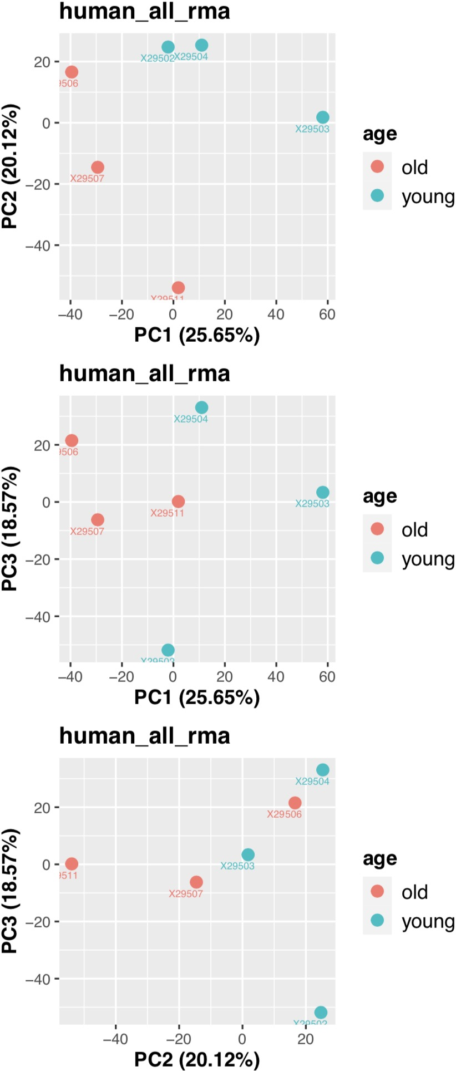
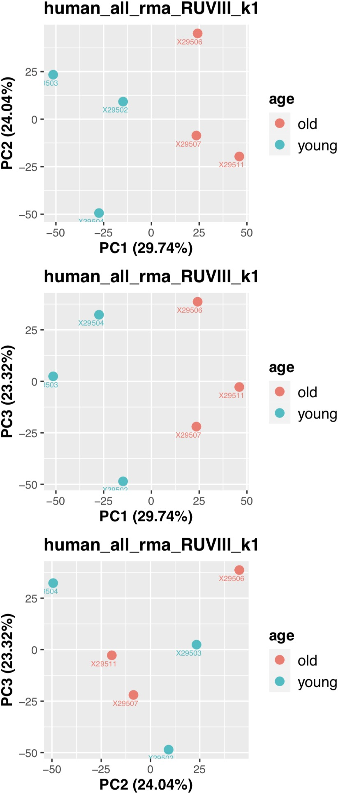
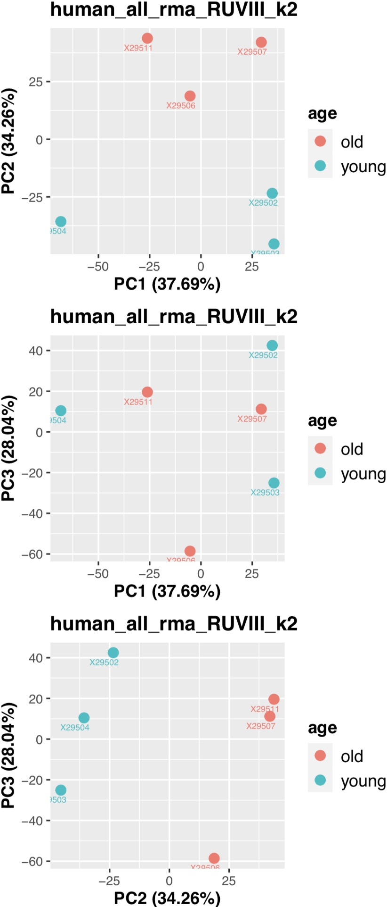
Analysis 2-2
3 young vs 3 old samples
match Victoria’s previous analysis: remove V17 and V18
Meanwhile remove the VC10 (29505) based on the PCA
Consider miRNA and stem-loop, Spike-in controls: 4625
RUVIII to remove the batch effect

Slide 11
Analysis 2-2
DE miRNA analysis
limma used to calculate DE miRNA
Consider miRNA and stem-loop, Spike-in controls: 4625
adj.P.Val<0.05
RMA: Total 1 DE miRNA
 | logFC | AveExpr | t | P.Value | adj.P.Val | B | X29502 | X29503 | X29504 | X29506 | X29507 | X29511 | Type | Transcript.ID.Array.Design.
20534520 | -0.557112 | 1.01115168 | -3.6544284 | 0.00653784 | 0.56798281 | -2.0115226 | 1.096087 | 1.338948 | 1.434088 | 0.7322328 | 0.6832349 | 0.7823194 | stem-loop | hsa-mir-196a-2
20535071 | -0.3161342 | 0.94667345 | -1.8497768 | 0.10179482 | 0.71457313 | -4.4340051 | 1.177281 | 1.316048 | 0.8208927 | 0.8208927 | 0.8208927 | 0.7240336 | stem-loop | hsa-mir-196b
20501772 | -0.4081446 | 1.19726558 | -1.4261803 | 0.19193018 | 0.78347493 | -4.9596692 | 0.9844626 | 1.140634 | 2.078917 | 1.140634 | 1.04349 | 0.7954559 | miRNA | hsa-miR-196b-3p
20501771 | -0.1543629 | 0.81758633 | -0.9531387 | 0.36863307 | 0.85531895 | -5.4484357 | 0.8111457 | 0.8000516 | 1.073106 | 0.555425 | 0.8000516 | 0.8657381 | miRNA | hsa-miR-196b-5p
20500456 | -0.1132752 | 1.03459745 | -0.5393584 | 0.60443139 | 0.93814374 | -5.7461416 | 1.370106 | 0.7193952 | 1.184204 | 1.188614 | 0.9797223 | 0.7655432 | miRNA | hsa-miR-196a-3p
20500393 | -0.0966594 | 0.92775775 | -0.5268043 | 0.61272643 | 0.94388212 | -5.752858 | 0.7009029 | 1.241644 | 0.9857154 | 0.8368254 | 1.04349 | 0.7579688 | miRNA | hsa-miR-196a-5p
20534479 | -0.0328459 | 0.83316205 | -0.1977158 | 0.84823573 | 0.98113673 | -5.8745139 | 0.7857057 | 0.8308375 | 0.9322118 | 0.7079529 | 1.081551 | 0.6607134 | stem-loop | hsa-mir-196a-1
RUVIII k=1: Total 8 DE miRNA
 | logFC | AveExpr | t | P.Value | adj.P.Val | B | X29502 | X29503 | X29504 | X29506 | X29507 | X29511 | Type | Transcript.ID.Array.Design.
20534520 | -0.5475907 | 1.35289878 | -4.5430547 | 0.00251946 | 0.15980989 | -1.1614958 | 1.45530003 | 1.64470077 | 1.78008154 | 1.11334378 | 1.05675297 | 1.06721358 | stem-loop | hsa-mir-196a-2
20535071 | -0.3051523 | 1.34084629 | -2.0249252 | 0.08168299 | 0.42443968 | -4.586123 | 1.59159914 | 1.6687048 | 1.21996341 | 1.26046805 | 1.25171035 | 1.052632 | stem-loop | hsa-mir-196b
20501771 | -0.1500561 | 0.97216837 | -1.1138476 | 0.30138646 | 0.66581224 | -5.7345226 | 0.97362808 | 0.93835237 | 1.22960883 | 0.72781246 | 0.96900457 | 0.99460393 | miRNA | hsa-miR-196b-5p
20500393 | -0.0898572 | 1.17190714 | -0.5476064 | 0.60063317 | 0.85501029 | -6.2036538 | 0.95753023 | 1.46007849 | 1.23289852 | 1.10909696 | 1.31033707 | 0.9615016 | miRNA | hsa-miR-196a-5p
20534479 | -0.0546098 | 0.05199174 | -0.4026071 | 0.69900471 | 0.90052836 | -6.277453 | -0.0353885 | 0.13194353 | 0.14133491 | -0.1631959 | 0.22775813 | 0.00949827 | stem-loop | hsa-mir-196a-1
RUVIII k=2: Total 75 DE miRNA
 | logFC | AveExpr | t | P.Value | adj.P.Val | B | X29502 | X29503 | X29504 | X29506 | X29507 | X29511 | Type | Transcript.ID.Array.Design.
20534520 | -0.5329681 | 1.35962492 | -6.6576057 | 0.00051056 | 0.04178737 | 0.45084875 | 1.54747764 | 1.63960161 | 1.69124758 | 1.16550153 | 1.03585337 | 1.07806777 | stem-loop | hsa-mir-196a-2
20535071 | -0.3097787 | 1.33871826 | -2.3248703 | 0.05820448 | 0.26110156 | -4.480256 | 1.56243572 | 1.67031809 | 1.24806896 | 1.24396623 | 1.25832263 | 1.04919792 | stem-loop | hsa-mir-196b
20501771 | -0.1302086 | 0.98129786 | -1.3739344 | 0.217644 | 0.5068497 | -5.7456525 | 1.09874212 | 0.93143121 | 1.10903317 | 0.79860695 | 0.94063722 | 1.00933648 | miRNA | hsa-miR-196b-5p
20500393 | -0.04112 | 1.19432536 | -0.266405 | 0.79867322 | 0.90758871 | -6.6455767 | 1.26475818 | 1.443083 | 0.93681495 | 1.28293873 | 1.24067868 | 0.99767861 | miRNA | hsa-miR-196a-5p
20534479 | -0.0149056 | 0.07025496 | -0.135649 | 0.89644932 | 0.96062977 | -6.6754673 | 0.21489786 | 0.11809799 | -0.0998726 | -0.021574 | 0.17101022 | 0.03897024 | stem-loop | hsa-mir-196a-1
20501160 | 0.97606181 | 9.7417217 | 6.21072906 | 0.00074441 | 0.04821167 | 0.06613821 | 9.02624245 | 9.38363268 | 9.35119726 | 10.4986083 | 10.075785 | 10.1148646 | miRNA | hsa-miR-29c-3p

Slide 12
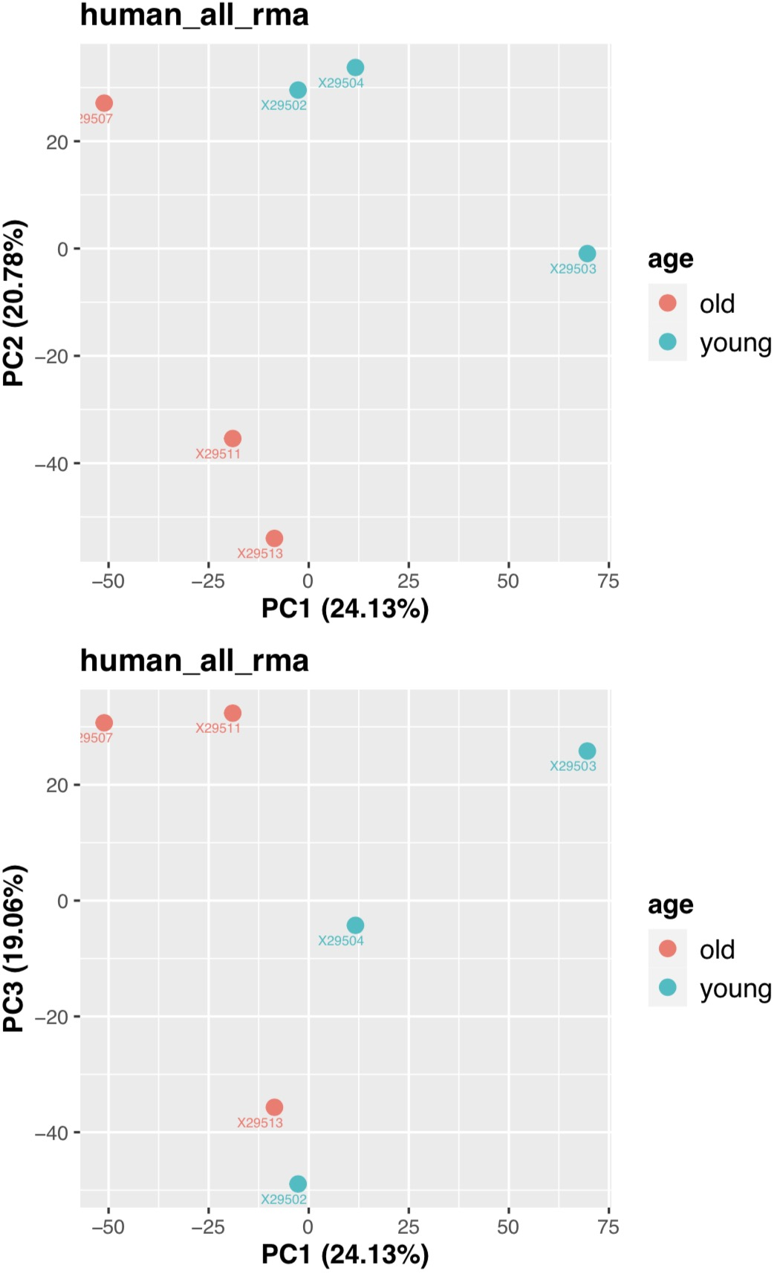
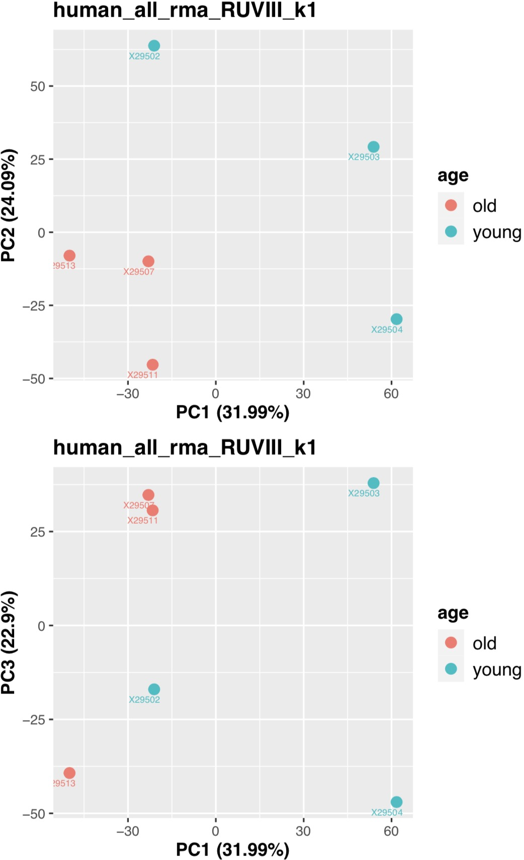
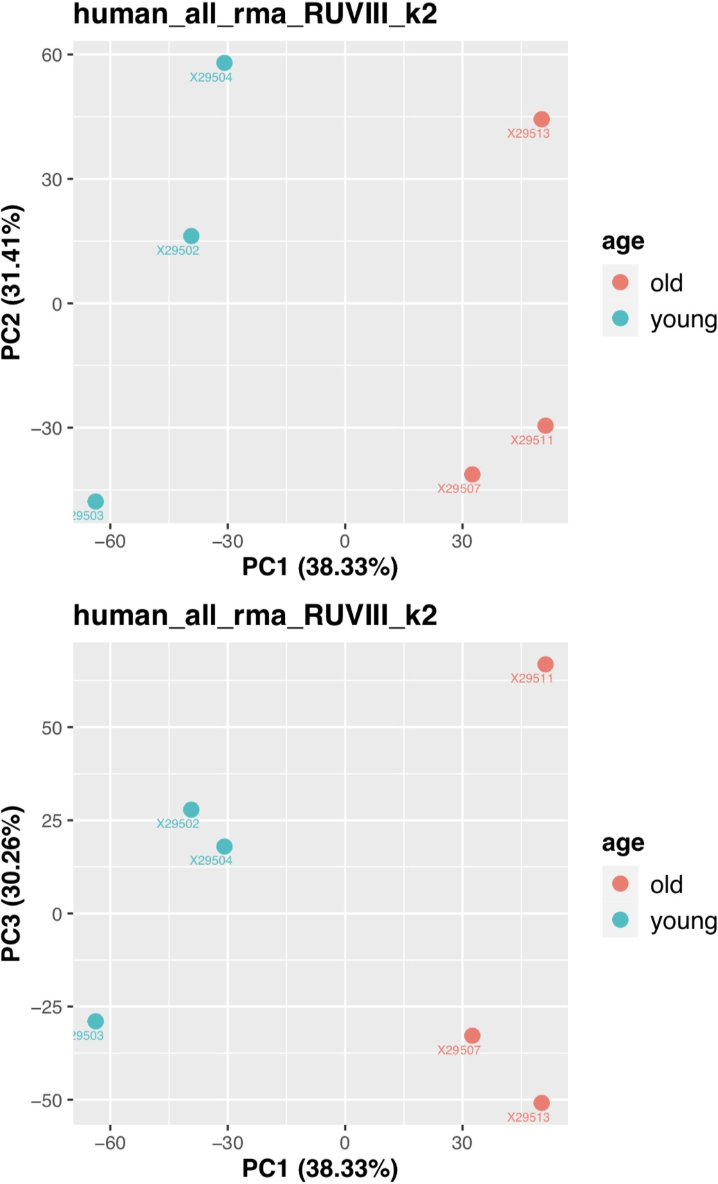
Analysis 3-1
3 young vs 3 old samples
Match previous transcriptome analysis
VC7, 8, 9 vs VC12,16,18
Consider all types: 6658
RUVIII to remove the batch effect

Slide 13
Analysis 3-1
DE miRNA analysis
limma used to calculate DE miRNA
Consider all types: 6658
adj.P.Val<0.05
RMA: No DE miRNA
RUVIII k=1: No DE miRNA
RUVIII k=2: Total 471 DE miRNA
 | logFC | AveExpr | t | P.Value | adj.P.Val | B | X29502 | X29503 | X29504 | X29507 | X29511 | X29513 | Type | Transcript.ID.Array.Design.
20534520 | -0.4564436 | 1.02156426 | -4.6681637 | 0.00319581 | 0.04837727 | -1.5609507 | 1.23084439 | 1.1937956 | 1.32471826 | 0.77218483 | 0.64652407 | 0.96131842 | stem-loop | hsa-mir-196a-2
20535071 | -0.3024879 | 1.51062727 | -2.8886873 | 0.0268763 | 0.13807283 | -3.8261023 | 1.59806244 | 1.81083604 | 1.57671516 | 1.46329359 | 1.20108302 | 1.41377334 | stem-loop | hsa-mir-196b
20500456 | -0.2244014 | 0.84326667 | -2.1034302 | 0.07881997 | 0.2466147 | -4.9294287 | 1.00987897 | 0.77023394 | 1.08628922 | 0.61225279 | 0.8080695 | 0.77287562 | miRNA | hsa-miR-196a-3p
20501772 | -0.2679904 | 0.22226311 | -1.2668712 | 0.25091918 | 0.47622002 | -6.0203747 | 0.34849036 | 0.11049577 | 0.60978878 | -0.0360292 | -0.193889 | 0.49472199 | miRNA | hsa-miR-196b-3p
20501771 | -0.0890928 | 0.45468727 | -1.1933556 | 0.27658648 | 0.49970683 | -6.1035772 | 0.53422692 | 0.43426655 | 0.52920761 | 0.36183562 | 0.51361619 | 0.35497075 | miRNA | hsa-miR-196b-5p
20500393 | -0.1016236 | 0.45661161 | -0.728242 | 0.49316563 | 0.69140954 | -6.5466357 | 0.43211816 | 0.76876047 | 0.32139154 | 0.57281831 | 0.30418388 | 0.34039731 | miRNA | hsa-miR-196a-5p
20534479 | 0.02533651 | 0.39854057 | 0.32713501 | 0.75437991 | 0.87350634 | -6.7778361 | 0.34745293 | 0.47756971 | 0.33259428 | 0.47481408 | 0.31789365 | 0.44091874 | stem-loop | hsa-mir-196a-1
20500187 | 1.89834427 | 2.86477583 | 17.4902255 | 1.72E-06 | 0.00286314 | 5.63844322 | 1.91710172 | 1.79245147 | 2.03725789 | 3.74941464 | 3.69846794 | 3.99396131 | miRNA | hsa-miR-29b-1-5p
20501160 | 0.95211745 | 6.02476185 | 12.4046472 | 1.36E-05 | 0.00754458 | 3.94682368 | 5.56183941 | 5.58318633 | 5.50108365 | 6.51323787 | 6.5983106 | 6.39091327 | miRNA | hsa-miR-29c-3p

Slide 14
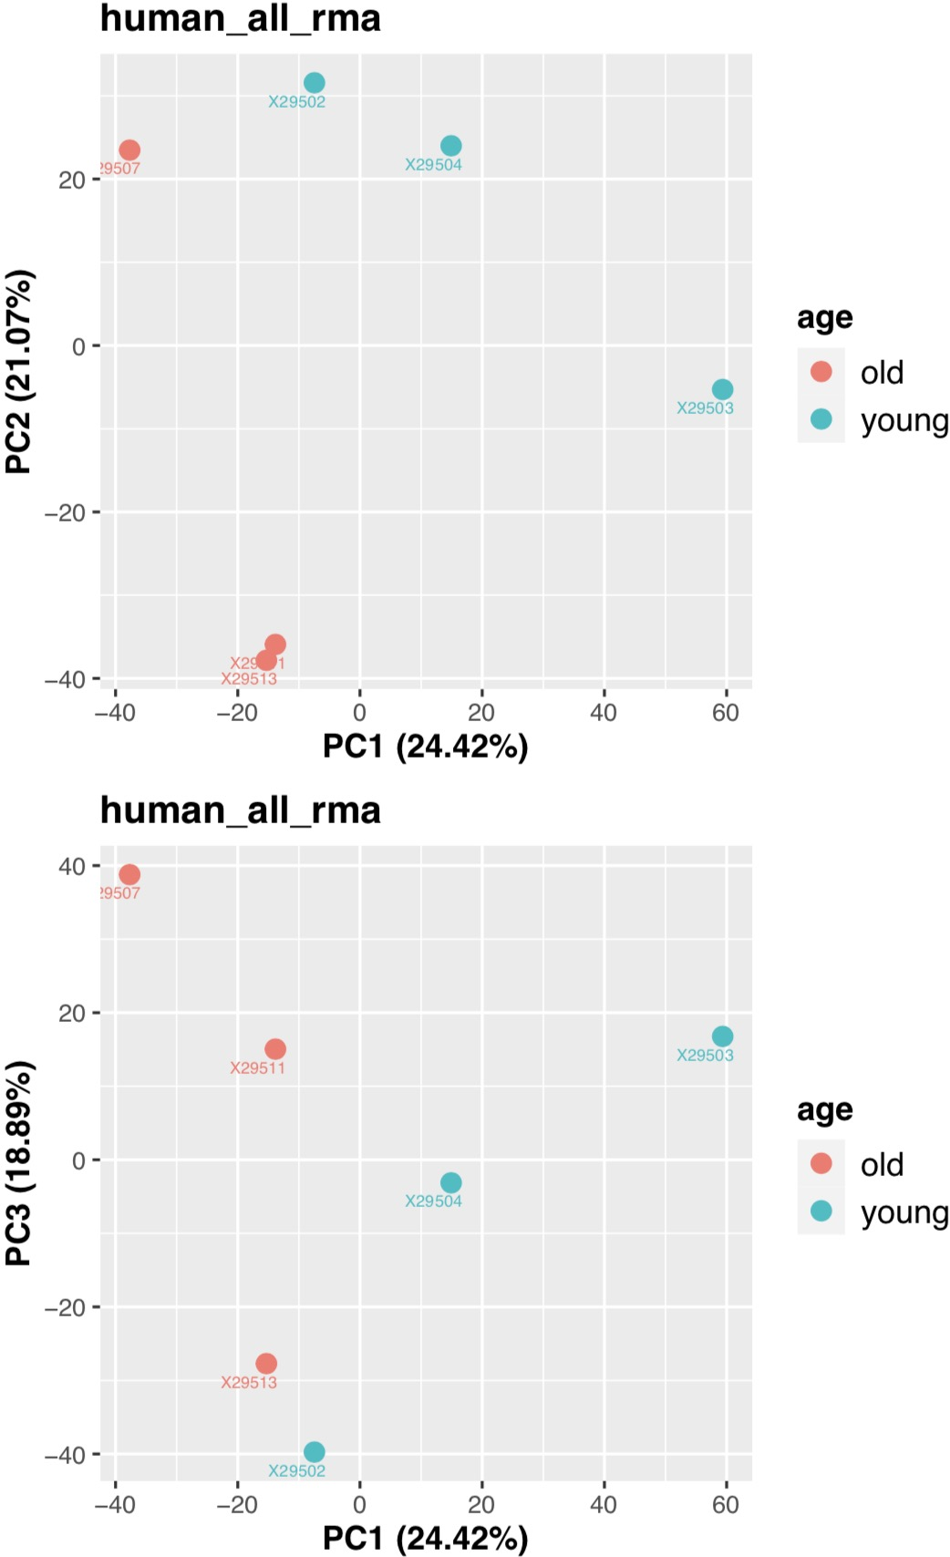
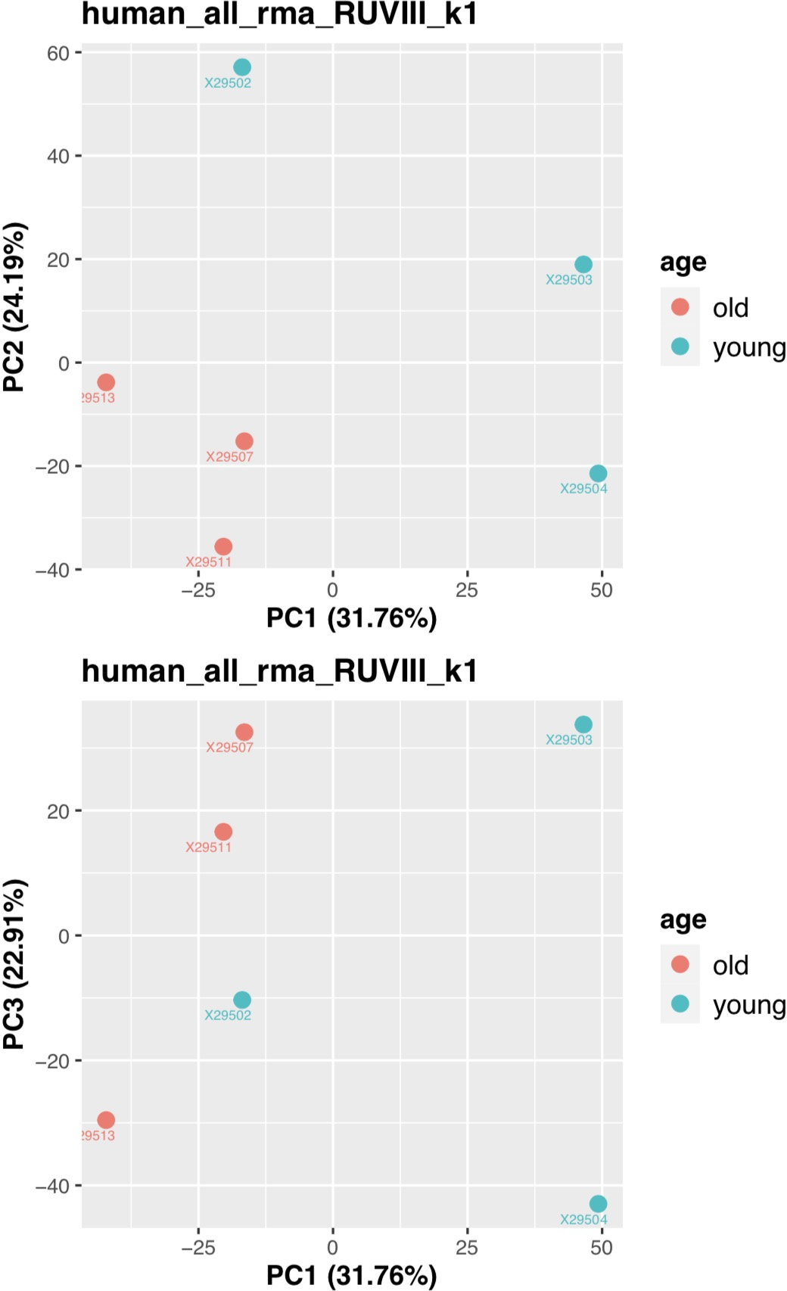
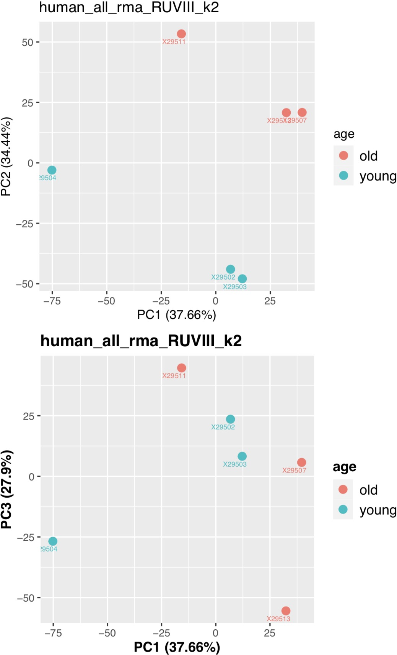
3 young vs 3 old samples
Match previous transcriptome analysis
VC7, 8, 9 vs VC12,16,18
Consider miRNA and stem-loop, Spike-in controls: 4625
RUVIII to remove the batch effect
Analysis 3-2

Slide 15
DE miRNA analysis
Analysis 3-2
limma used to calculate DE miRNA
Consider miRNA and stem-loop, Spike-in controls: 4625
adj.P.Val<0.05
RMA: No DE miRNA
RUVIII k=1: No DE miRNA
RUVIII k=2: Total 115 DE miRNA
 | logFC | AveExpr | t | P.Value | adj.P.Val | B | X29502 | X29503 | X29504 | X29507 | X29511 | X29513 | Type | Transcript.ID.Array.Design.
20534520 | -0.4676255 | 1.30929372 | -4.1919088 | 0.00549087 | 0.08127745 | -2.101364 | 1.44585006 | 1.49119811 | 1.69227116 | 1.030594 | 0.95562486 | 1.24022411 | stem-loop | hsa-mir-196a-2
20500456 | -0.2726727 | 0.45602085 | -2.5250781 | 0.04421767 | 0.21171046 | -4.3011154 | 0.5196442 | 0.4948808 | 0.76254653 | 0.25526836 | 0.45376138 | 0.25002382 | miRNA | hsa-miR-196a-3p
20535071 | -0.2572469 | 1.35607043 | -1.8791822 | 0.10831934 | 0.33221284 | -5.2007022 | 1.56281265 | 1.60889572 | 1.28237332 | 1.30689707 | 1.00913444 | 1.36630939 | stem-loop | hsa-mir-196b
20501772 | -0.3322338 | 0.64539253 | -1.4065193 | 0.20826156 | 0.46308159 | -5.814298 | 0.53642906 | 0.61610229 | 1.28199688 | 0.32676105 | 0.32553479 | 0.78553113 | miRNA | hsa-miR-196b-3p
20501771 | -0.1109908 | 0.59162204 | -1.1960548 | 0.27594792 | 0.54026308 | -6.0597379 | 0.61429789 | 0.58387583 | 0.74317864 | 0.49692985 | 0.6700199 | 0.44143015 | miRNA | hsa-miR-196b-5p
20534479 | 0.04579159 | 0.25462684 | 0.51758254 | 0.62291879 | 0.80836122 | -6.6467736 | 0.27877882 | 0.29885977 | 0.11755453 | 0.32133653 | 0.17529733 | 0.33593403 | stem-loop | hsa-mir-196a-1
20500393 | -0.0394198 | 0.58496184 | -0.2636128 | 0.80072984 | 0.90640002 | -6.7576856 | 0.73930066 | 0.76238231 | 0.3123322 | 0.67254416 | 0.40381671 | 0.61939503 | miRNA | hsa-miR-196a-5p

