Slide 1
TaRGET meeting
2021-03-03

Slide 2
Metilene, read coverage >=10
P-value <0.01, n>=3, M>=200

Slide 3
Liver treatment
up_comparison | up_DMR | down_comparison | dn_DMR
p001_up_Female_10_ppb_As_vs_ctrl_Hopkins_Zhibin | 6665 | DMR_p001_dn_Female_10_ppb_As_vs_ctrl_Hopkins_Zhibin | 10788
p001_up_Female_DEHP_vs_ctrl_Michigan | 2788 | DMR_p001_dn_Female_DEHP_vs_ctrl_Michigan | 2716
p001_up_Female_LOW_BPA_10UG.KGBW.DAY_vs_ctrl_Penn | 2167 | DMR_p001_dn_Female_LOW_BPA_10UG.KGBW.DAY_vs_ctrl_Penn | 4209
p001_up_Female_Lead_vs_ctrl_Michigan | 3325 | DMR_p001_dn_Female_Lead_vs_ctrl_Michigan | 3823
p001_up_Female_PM2.5_vs_ctrl_Chicago | 3925 | DMR_p001_dn_Female_PM2.5_vs_ctrl_Chicago | 11245
p001_up_Female_PM2.5_vs_ctrl_Hopkins_Biswal | 2233 | DMR_p001_dn_Female_PM2.5_vs_ctrl_Hopkins_Biswal | 3117
p001_up_Female_TBT_vs_ctrl_Baylor | 9950 | DMR_p001_dn_Female_TBT_vs_ctrl_Baylor | 14303
p001_up_Female_TCDD_vs_ctrl_NC_State | 2363 | DMR_p001_dn_Female_TCDD_vs_ctrl_NC_State | 3688
p001_up_Female_UP_BPA_10MG.KG_BW.DAY_vs_ctrl_Penn | 3428 | DMR_p001_dn_Female_UP_BPA_10MG.KG_BW.DAY_vs_ctrl_Penn | 2603
p001_up_Male_10_ppb_As_vs_ctrl_Hopkins_Zhibin | 6706 | DMR_p001_dn_Male_10_ppb_As_vs_ctrl_Hopkins_Zhibin | 17793
p001_up_Male_DEHP_vs_ctrl_Michigan | 3897 | DMR_p001_dn_Male_DEHP_vs_ctrl_Michigan | 3108
p001_up_Male_LOW_BPA_10UG.KGBW.DAY_vs_ctrl_Penn | 2566 | DMR_p001_dn_Male_LOW_BPA_10UG.KGBW.DAY_vs_ctrl_Penn | 2053
p001_up_Male_Lead_vs_ctrl_Michigan | 3427 | DMR_p001_dn_Male_Lead_vs_ctrl_Michigan | 2950
p001_up_Male_PM2.5_vs_ctrl_Chicago | 4660 | DMR_p001_dn_Male_PM2.5_vs_ctrl_Chicago | 3056
p001_up_Male_PM2.5_vs_ctrl_Hopkins_Biswal | 1986 | DMR_p001_dn_Male_PM2.5_vs_ctrl_Hopkins_Biswal | 2507
p001_up_Male_TBT_vs_ctrl_Baylor | 2118 | DMR_p001_dn_Male_TBT_vs_ctrl_Baylor | 1622
p001_up_Male_TCDD_vs_ctrl_NC_State | 3556 | DMR_p001_dn_Male_TCDD_vs_ctrl_NC_State | 3215
p001_up_Male_UP_BPA_10MG.KG_BW.DAY_vs_ctrl_Penn | 3364 | DMR_p001_dn_Male_UP_BPA_10MG.KG_BW.DAY_vs_ctrl_Penn | 2389

Slide 4
Blood treatment
up_comparison | up_DMR | down_comparison | dn_DMR
p001_up_Female_10_ppb_As_vs_ctrl_Hopkins_Zhibin | 2417 | p001_dn_Female_10_ppb_As_vs_ctrl_Hopkins_Zhibin | 3160
p001_up_Female_DEHP_vs_ctrl_Michigan | 1355 | p001_dn_Female_DEHP_vs_ctrl_Michigan | 1499
p001_up_Female_LOW_BPA_10UG.KGBW.DAY_vs_ctrl_Penn | 5804 | p001_dn_Female_LOW_BPA_10UG.KGBW.DAY_vs_ctrl_Penn | 3350
p001_up_Female_Lead_vs_ctrl_Michigan | 1724 | p001_dn_Female_Lead_vs_ctrl_Michigan | 1142
p001_up_Female_PM2.5_vs_ctrl_Hopkins_Biswal | 2718 | p001_dn_Female_PM2.5_vs_ctrl_Hopkins_Biswal | 4403
p001_up_Female_TBT_vs_ctrl_Baylor | 6400 | p001_dn_Female_TBT_vs_ctrl_Baylor | 14801
p001_up_Female_TCDD_vs_ctrl_NC_State | 3910 | p001_dn_Female_TCDD_vs_ctrl_NC_State | 6163
p001_up_Female_UP_BPA_10MG.KG_BW.DAY_vs_ctrl_Penn | 3180 | p001_dn_Female_UP_BPA_10MG.KG_BW.DAY_vs_ctrl_Penn | 20245
p001_up_Male_10_ppb_As_vs_ctrl_Hopkins_Zhibin | 2271 | p001_dn_Male_10_ppb_As_vs_ctrl_Hopkins_Zhibin | 1472
p001_up_Male_DEHP_vs_ctrl_Michigan | 1074 | p001_dn_Male_DEHP_vs_ctrl_Michigan | 523
p001_up_Male_LOW_BPA_10UG.KGBW.DAY_vs_ctrl_Penn | 1371 | p001_dn_Male_LOW_BPA_10UG.KGBW.DAY_vs_ctrl_Penn | 1546
p001_up_Male_Lead_vs_ctrl_Michigan | 965 | p001_dn_Male_Lead_vs_ctrl_Michigan | 835
p001_up_Male_PM2.5_vs_ctrl_Hopkins_Biswal | 2455 | p001_dn_Male_PM2.5_vs_ctrl_Hopkins_Biswal | 3617
p001_up_Male_TBT_vs_ctrl_Baylor | 4080 | p001_dn_Male_TBT_vs_ctrl_Baylor | 1939
p001_up_Male_TCDD_vs_ctrl_NC_State | 2223 | p001_dn_Male_TCDD_vs_ctrl_NC_State | 2027
p001_up_Male_UP_BPA_10MG.KG_BW.DAY_vs_ctrl_Penn | 1917 | p001_dn_Male_UP_BPA_10MG.KG_BW.DAY_vs_ctrl_Penn | 3820

Slide 5
Ctrl liver sex
up_comparison | up_DMR | down_comparison | dn_DMR
p001_up_ctrl_Male_vs_Female | 5425 | p001_dn_ctrl_Male_vs_Female | 24446
p001_up_ctrl_Male_vs_Female_Baylor | 7638 | p001_dn_ctrl_Male_vs_Female_Baylor | 15655
p001_up_ctrl_Male_vs_Female_Chicago | 5361 | p001_dn_ctrl_Male_vs_Female_Chicago | 18602
p001_up_ctrl_Male_vs_Female_Hopkins_Biswal | 8659 | p001_dn_ctrl_Male_vs_Female_Hopkins_Biswal | 15288
p001_up_ctrl_Male_vs_Female_Hopkins_Zhibin | 4856 | p001_dn_ctrl_Male_vs_Female_Hopkins_Zhibin | 9545
p001_up_ctrl_Male_vs_Female_Michigan | 6743 | p001_dn_ctrl_Male_vs_Female_Michigan | 18596
p001_up_ctrl_Male_vs_Female_NC_State | 6580 | p001_dn_ctrl_Male_vs_Female_NC_State | 25996
p001_up_ctrl_Male_vs_Female_Penn | 6625 | p001_dn_ctrl_Male_vs_Female_Penn | 17980

Slide 6
Ctrl blood sex
up_comparison | up_DMR | down_comparison | dn_DMR
p001_up_ctrl_Male_vs_Female | 3632 | p001_dn_ctrl_Male_vs_Female | 2152
p001_up_ctrl_Male_vs_Female_Baylor | 7662 | p001_dn_ctrl_Male_vs_Female_Baylor | 9120
p001_up_ctrl_Male_vs_Female_Hopkins_Biswal | 5863 | p001_dn_ctrl_Male_vs_Female_Hopkins_Biswal | 4424
p001_up_ctrl_Male_vs_Female_Hopkins_Zhibin | 3002 | p001_dn_ctrl_Male_vs_Female_Hopkins_Zhibin | 4443
p001_up_ctrl_Male_vs_Female_Michigan | 8446 | p001_dn_ctrl_Male_vs_Female_Michigan | 6198
p001_up_ctrl_Male_vs_Female_NC_State | 6046 | p001_dn_ctrl_Male_vs_Female_NC_State | 5532
p001_up_ctrl_Male_vs_Female_Penn | 7832 | p001_dn_ctrl_Male_vs_Female_Penn | 4552

Slide 7
Liver ctrl one to others
up_comparison | up_DMR | down_comparison | dn_DMR
p001_up_ctrl_liver_Baylor_vs_others | 1759 | p001_dn_ctrl_liver_Baylor_vs_others | 506
p001_up_ctrl_liver_Chicago_vs_others | 1560 | p001_dn_ctrl_liver_Chicago_vs_others | 5318
p001_up_ctrl_liver_Hopkins_Biswal_vs_others | 667 | p001_dn_ctrl_liver_Hopkins_Biswal_vs_others | 1766
p001_up_ctrl_liver_Hopkins_Zhibin_vs_others | 7362 | p001_dn_ctrl_liver_Hopkins_Zhibin_vs_others | 1024
p001_up_ctrl_liver_Michigan_vs_others | 5677 | p001_dn_ctrl_liver_Michigan_vs_others | 27931
p001_up_ctrl_liver_NC_State_vs_others | 2192 | p001_dn_ctrl_liver_NC_State_vs_others | 258
p001_up_ctrl_liver_Penn_vs_others | 290 | p001_dn_ctrl_liver_Penn_vs_others | 1139

Slide 8
Blood ctrl one to others
up_comparison | up_DMR | down_comparison | dn_DMR
p001_up_ctrl_blood_Baylor_vs_others | 2350 | p001_dn_ctrl_blood_Baylor_vs_others | 2314
p001_up_ctrl_blood_Hopkins_Biswal_vs_others | 1634 | p001_dn_ctrl_blood_Hopkins_Biswal_vs_others | 836
p001_up_ctrl_blood_Hopkins_Zhibin_vs_others | 1921 | p001_dn_ctrl_blood_Hopkins_Zhibin_vs_others | 313
p001_up_ctrl_blood_Michigan_vs_others | 4140 | p001_dn_ctrl_blood_Michigan_vs_others | 27965
p001_up_ctrl_blood_NC_State_vs_others | 3965 | p001_dn_ctrl_blood_NC_State_vs_others | 334
p001_up_ctrl_blood_Penn_vs_others | 924 | p001_dn_ctrl_blood_Penn_vs_others | 484

Slide 9
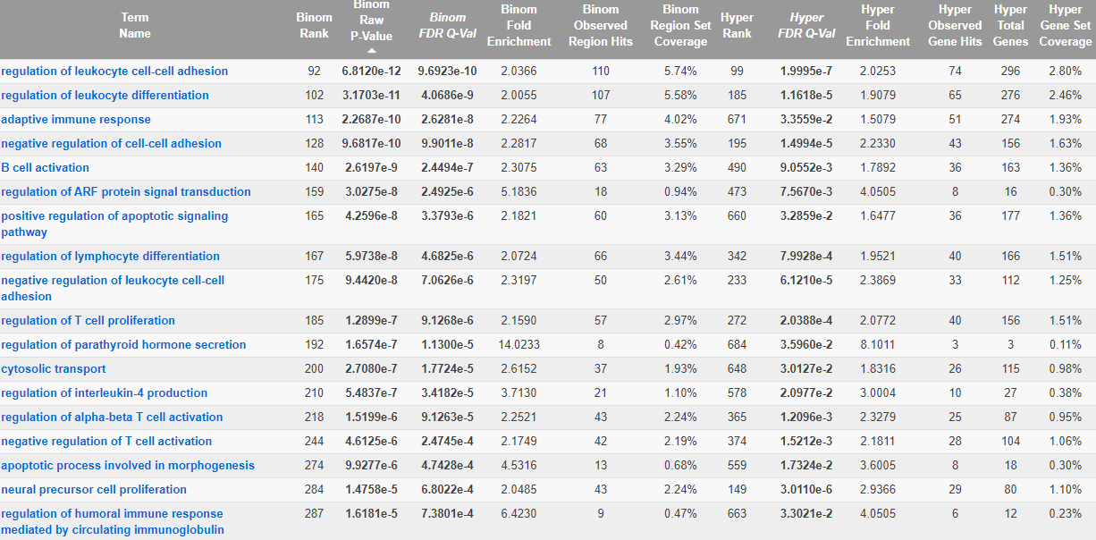
Blood: Up BPA vs Ctrl, Penn, male, hyper DMRs
“CLARITY-BPA: Effects of chronic Bisphenol A exposure on the immune system: Part 1 - Quantification of the relative number and proportion of leukocyte populations in the spleen and thymus”
“bisphenol A co-treated with Estradiol] results in decreased expression of ARFGAP1 mRNA”
“Bisphenol A exposure triggers apoptosis via three signaling pathways in Caenorhabditis elegans”

Slide 10
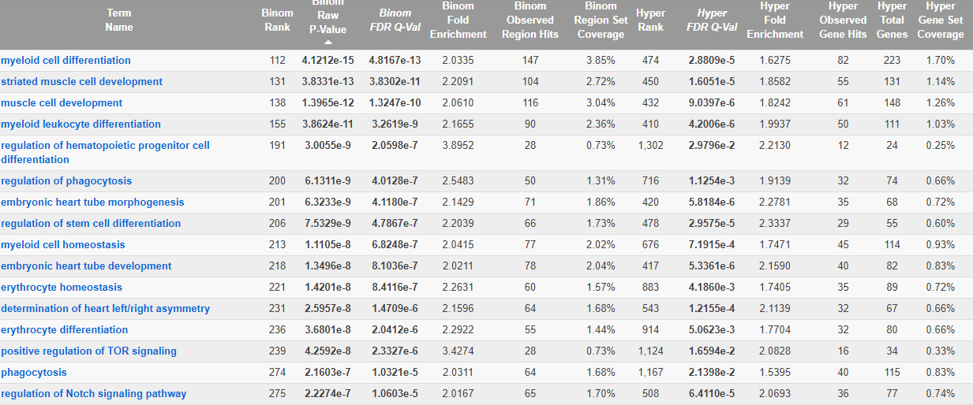
Blood: Up BPA vs Ctrl, Penn, male, hypo DMRs
“Molecular analysis of the apoptotic effects of BPA in acute myeloid leukemia cells”
“In the presence of BPA, the phagocytic activity was found to be elevated in the cells obtained from women and reduced in the cells from men. ”

Slide 11
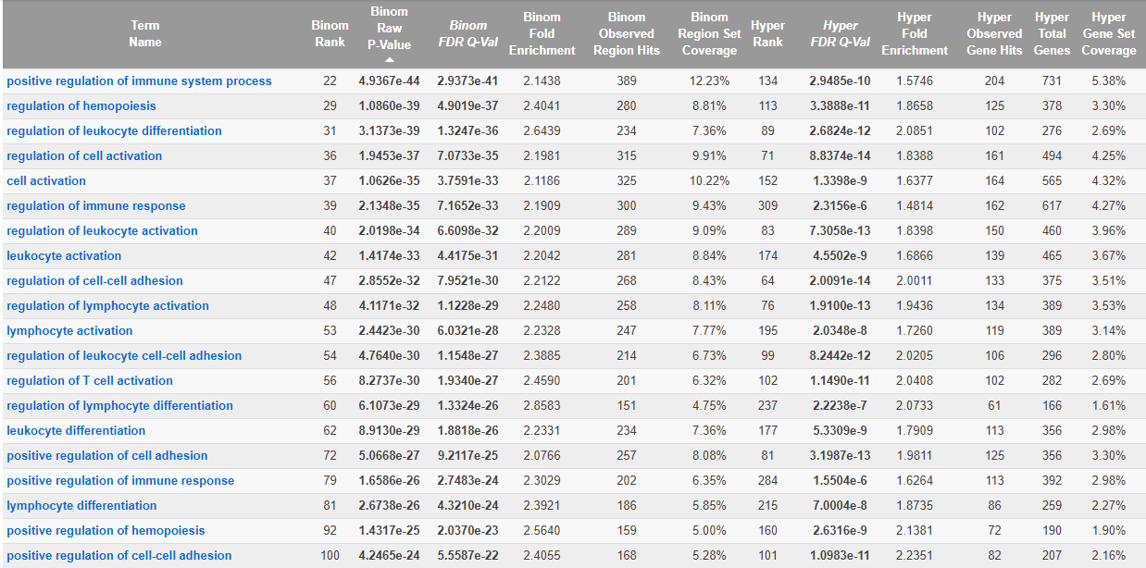
Blood: Up BPA vs Ctrl, Penn, female, hyper DMRs

Slide 12
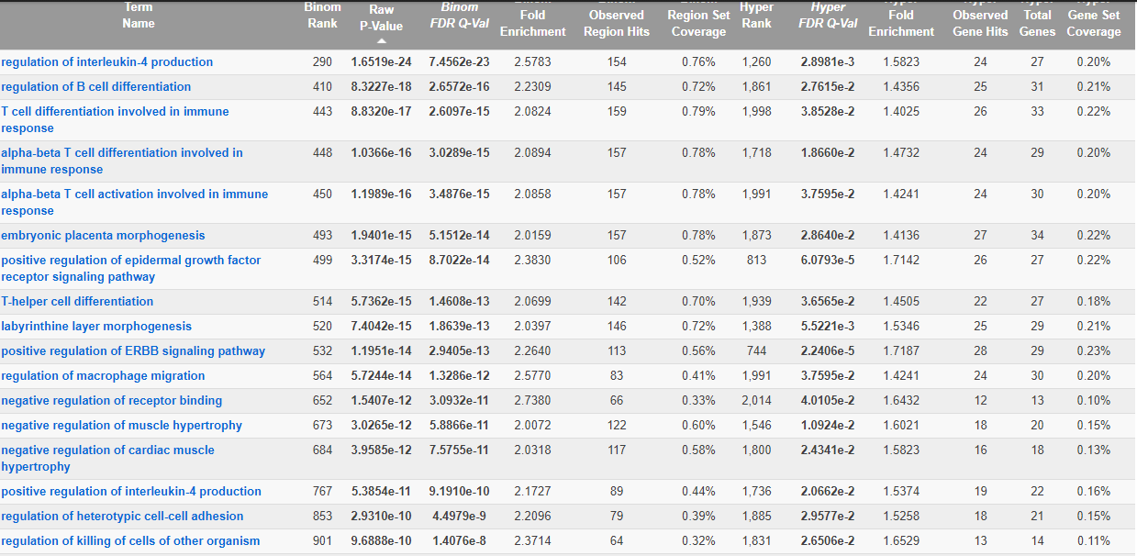
Blood: Up BPA vs Ctrl, Penn, female, hypo DMRs
“he ErbB family of proteins contains four receptor tyrosine kinases, structurally related to the epidermal growth factor receptor (EGFR),”
“Bisphenol A activates EGFR and ERK promoting proliferation, tumor spheroid formation and resistance to EGFR pathway inhibition in estrogen receptor-negative inflammatory breast cancer cells”

Slide 13
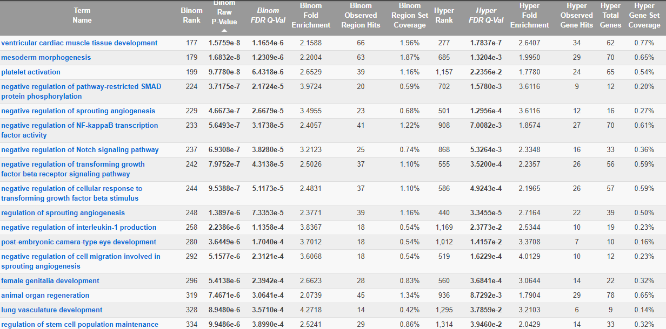
Liver: Up BPA vs Ctrl, Penn, male, hyper DMRs
“Novel Insights on Notch signaling pathways in liver fibrosis”

Slide 14
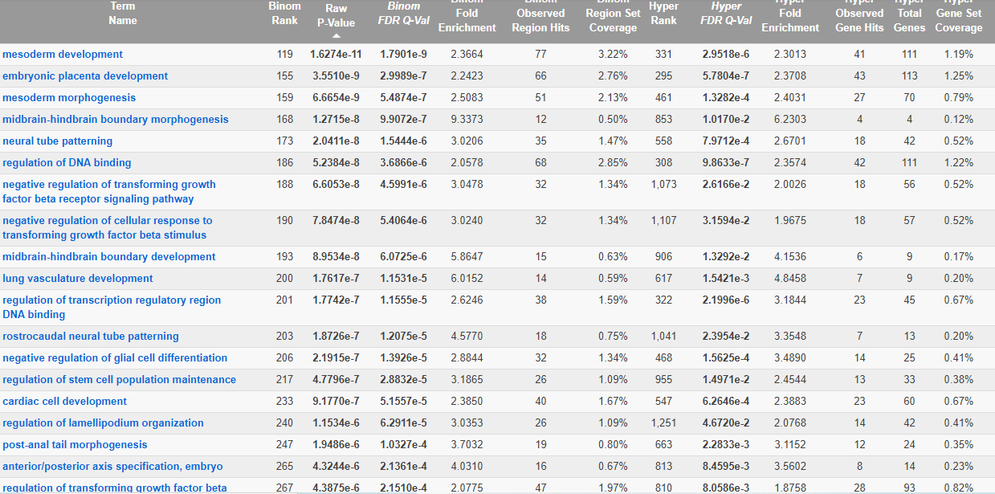
Liver: Up BPA vs Ctrl, Penn, male, hypo DMRs
“The liver consists of endoderm-derived hepatobiliary lineages and various mesoderm-derived cells”

Slide 15
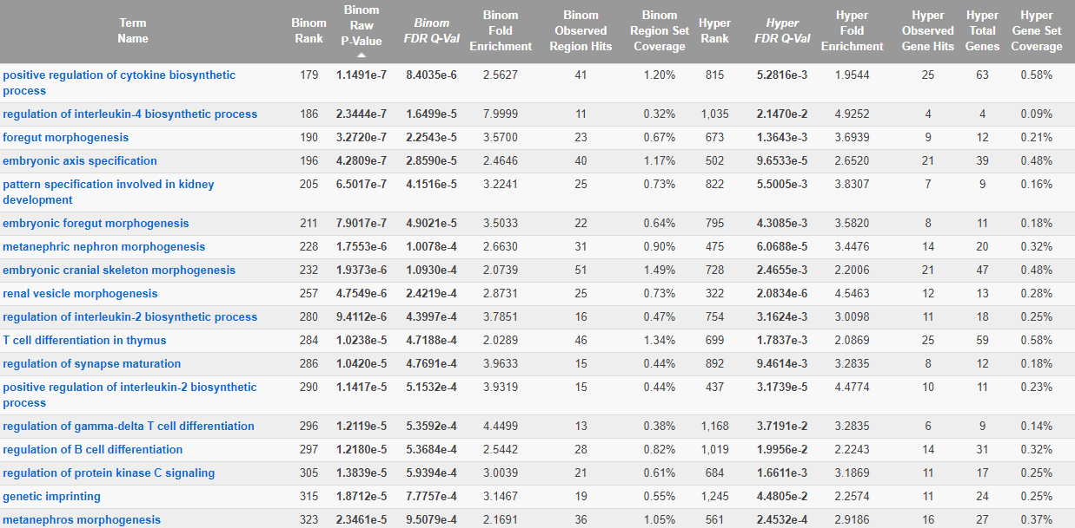
Liver: Up BPA vs Ctrl, Penn, female, hyper DMRs
“The foregut is the section of the upper gastrointestinal tract that includes the esophagus, stomach, pancreas, liver and bile ducts.”
“showed that low dose BPA disrupted whole body metabolism and insulin signaling in mice peripheral tissues during short time treatment by impairment of mitogen-activated protein kinases (MAPK) signaling in skeletal muscle and decreased phosphorylation of the insulin receptor b subunit in the liver ”

Slide 16
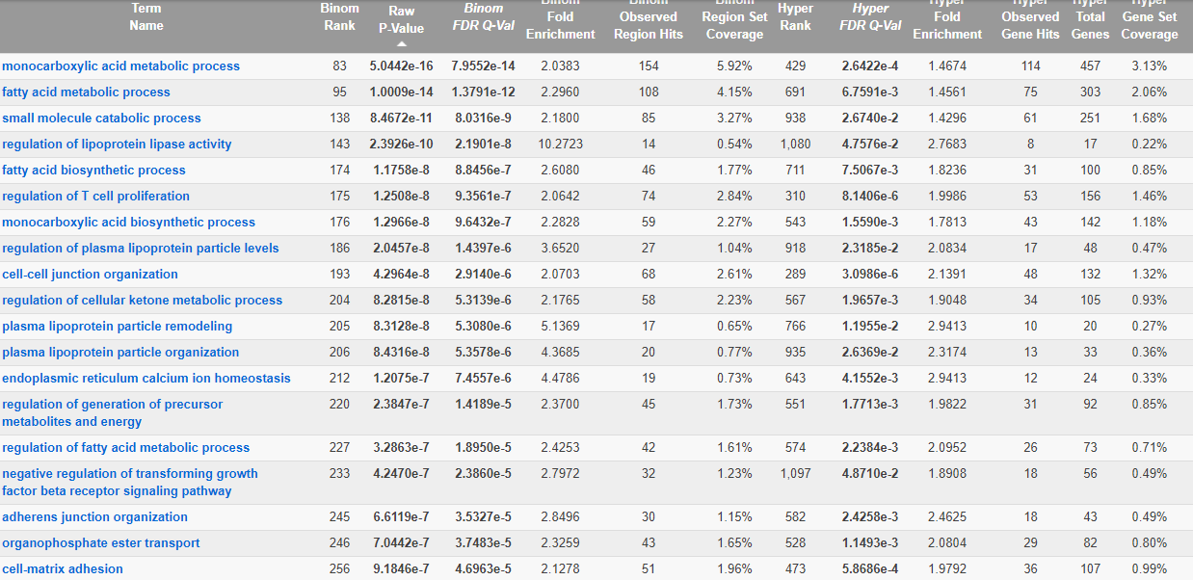
Liver: Up BPA vs Ctrl, Penn, female, hypo DMRs
“Bisphenol A induces endoplasmic reticulum stress-associated apoptosis in mouse non-parenchymal hepatocytes”

Slide 18
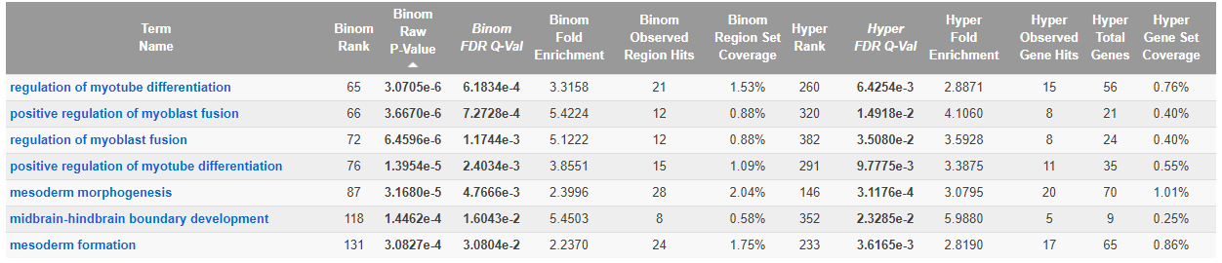
Blood: Low BPA vs Ctrl, Penn, male, hyper DMRs

Slide 19
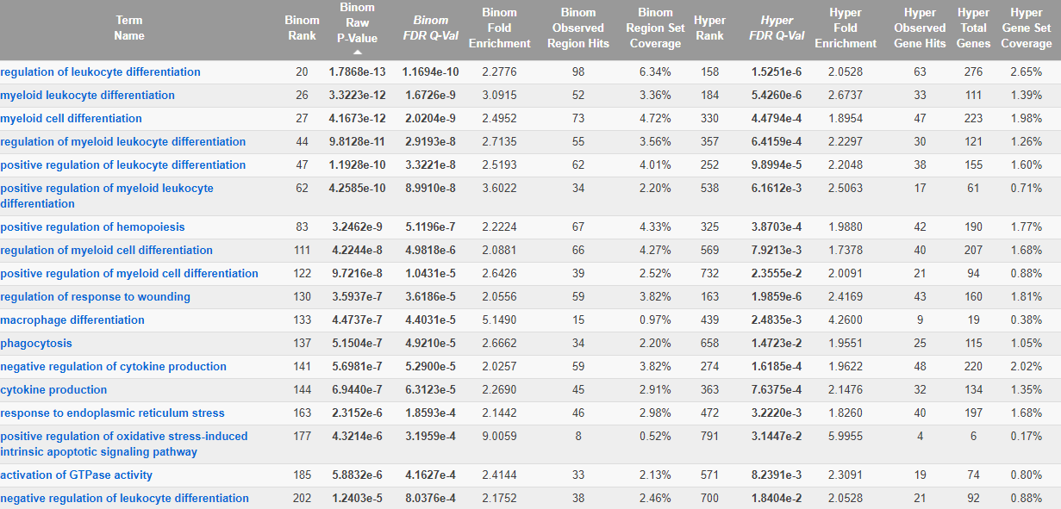
Blood: Low BPA vs Ctrl, Penn, male, hypo DMRs

Slide 20
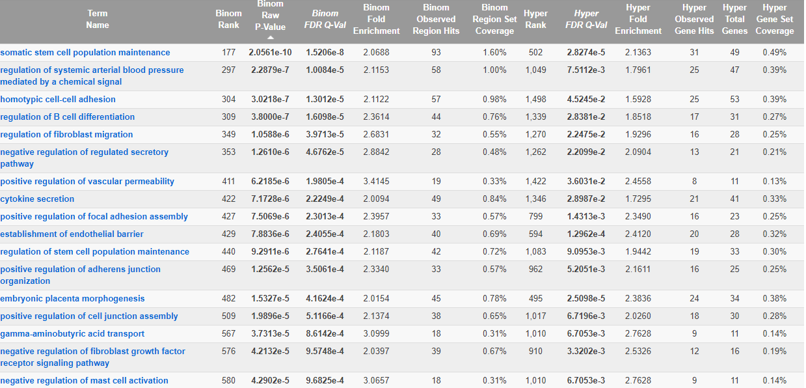
Blood: Low BPA vs Ctrl, Penn, female, hyper DMRs
“Association of Bisphenol A Exposure With Hypertension and Early Macrovascular Diseases in Chinese Adults”

Slide 21
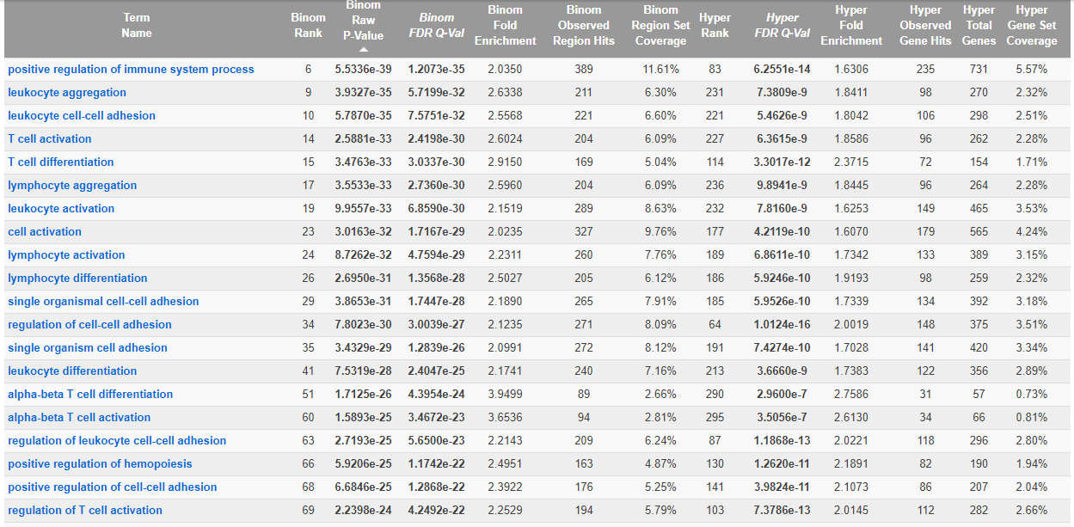
Blood: Low BPA vs Ctrl, Penn, female, hypo DMRs

Slide 22
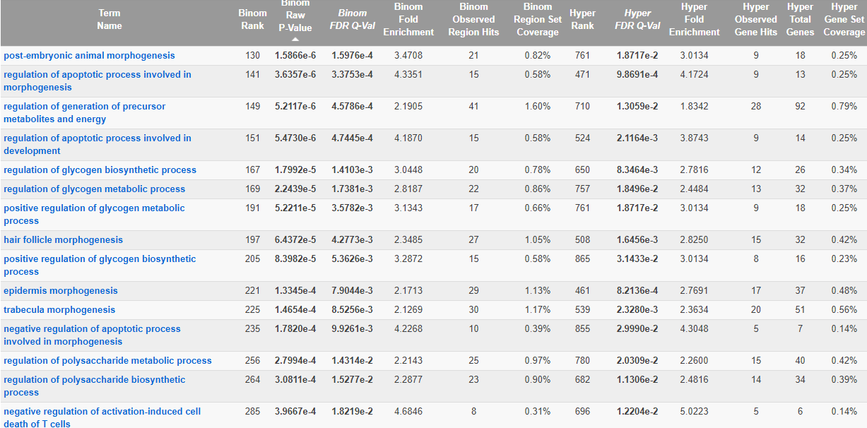
Liver: Low BPA vs Ctrl, Penn, male, hyper DMRs
“BPA increases glucose production and reduces glycogen synthesis in liver with a reduction of glucose oxidation and impairment in insulin signaling. ”

Slide 23
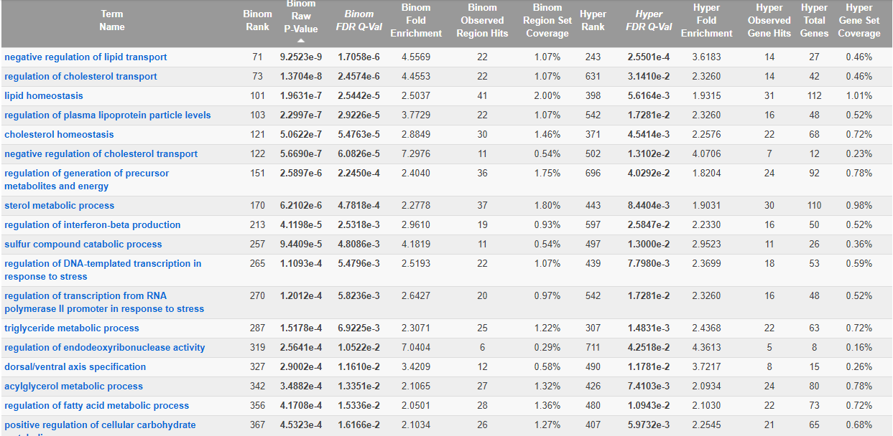
Liver: Low BPA vs Ctrl, Penn, male, hypo DMRs
“Bisphenol A exposure induces cholesterol synthesis and hepatic steatosis in C57BL/6 mice by down-regulating the DNA methylation levels of SREBP-2”

Slide 24
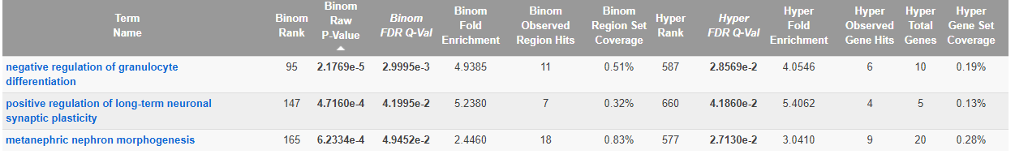
Liver: Low BPA vs Ctrl, Penn, female, hyper DMRs

Slide 25
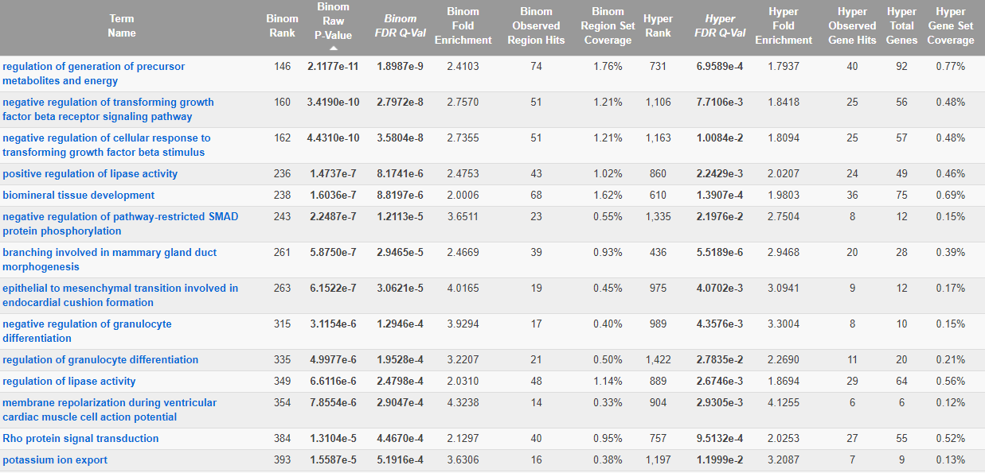
Liver: Low BPA vs Ctrl, Penn, female, hypo DMRs
“Bisphenol A Exposure May Induce Hepatic Lipid Accumulation via Reprogramming the DNA Methylation Patterns of Genes Involved in Lipid Metabolism”

Slide 29
“MAPK and NF-κB pathways are involved in bisphenol A-induced TNF-α and IL-6 production in BV2 microglial cells”
“All three bisphenols generally suppressed the secretion of cytokines/chemokines at 1 µM, while increased their secretion at 10 µM. The most increased cytokines/chemokines were interferon (IFN)-γ, interleukin (IL)-1RA, IL-8 and MIP-1β, and the most decreased was IL-10”
“Sprouting angiogenesis can therefore add blood vessels to portions of tissues previously devoid of blood vessels”

Slide 34
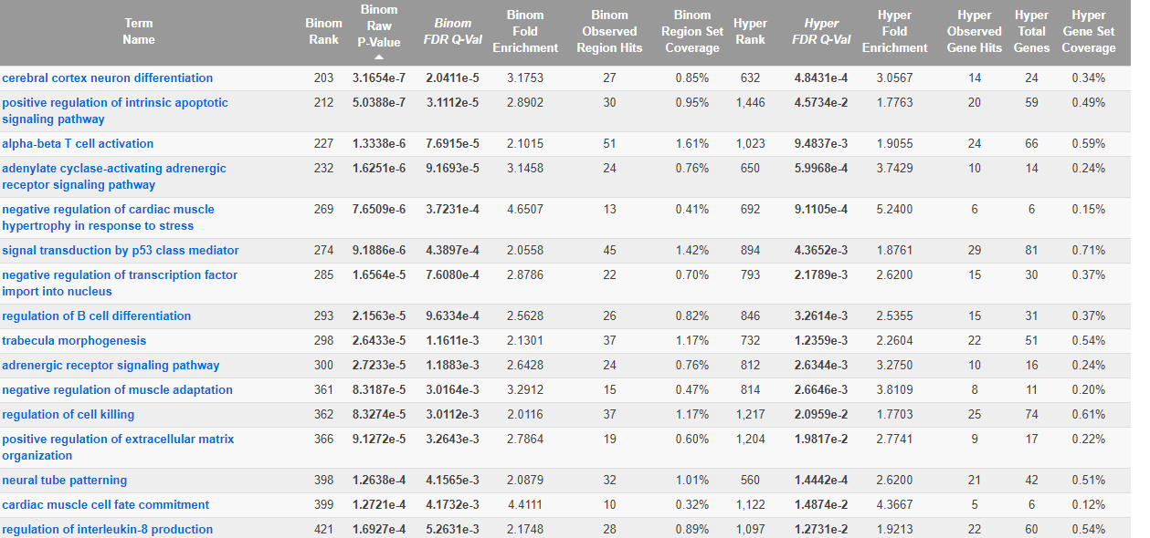
Blood 10 ppb As vs ctrl Female Hypo DMRs

Slide 35
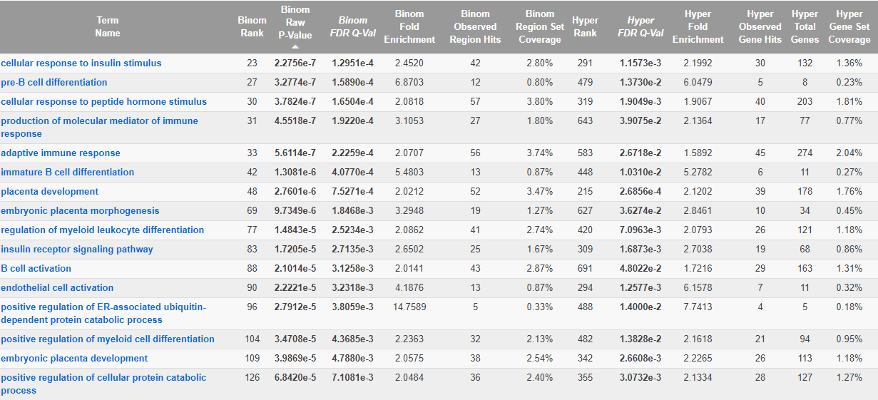
Blood DEHP vs ctrl Female Hypo DMRs

Slide 36
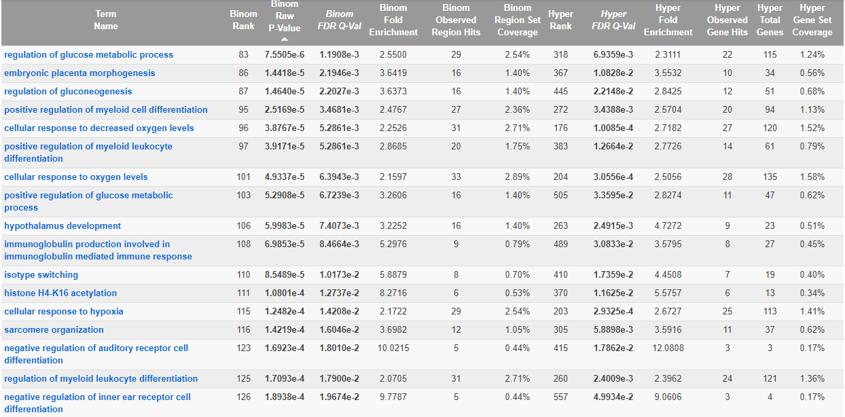
Blood Lead vs ctrl Female Hypo DMRs

Slide 37
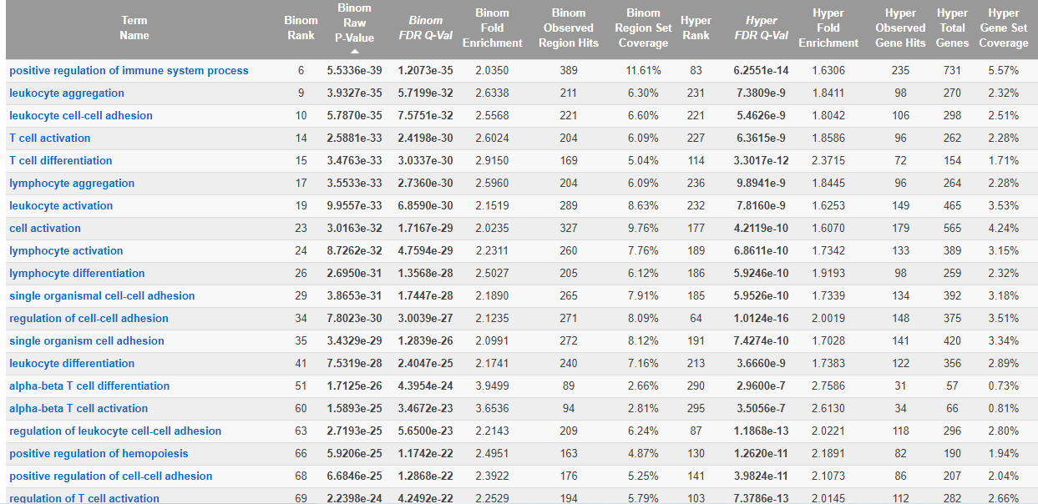
Blood low BPA vs ctrl Female Hypo DMRs

Slide 38
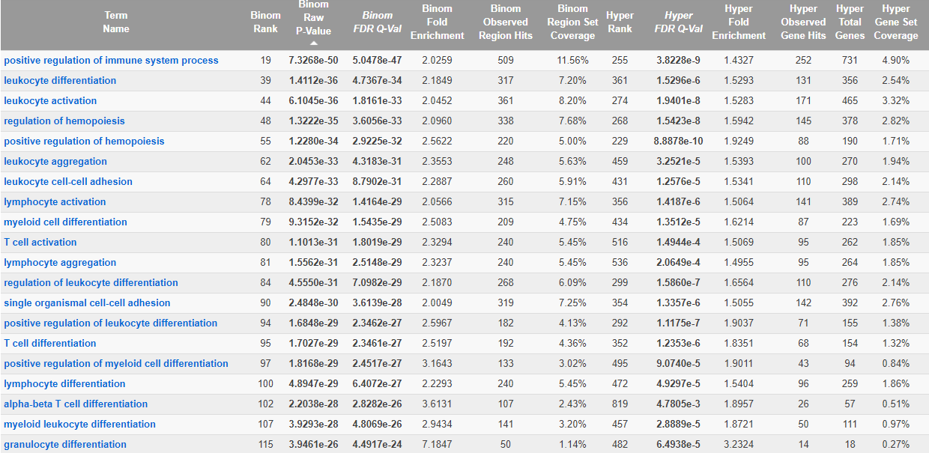
Blood PM2.5 vs ctrl Female Hypo DMRs

Slide 39
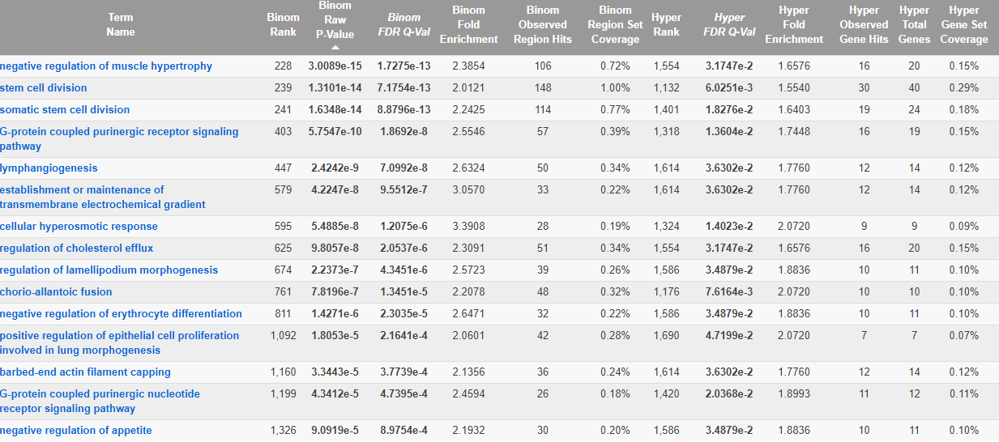
Blood TBT vs ctrl Female Hypo DMRs

Slide 40
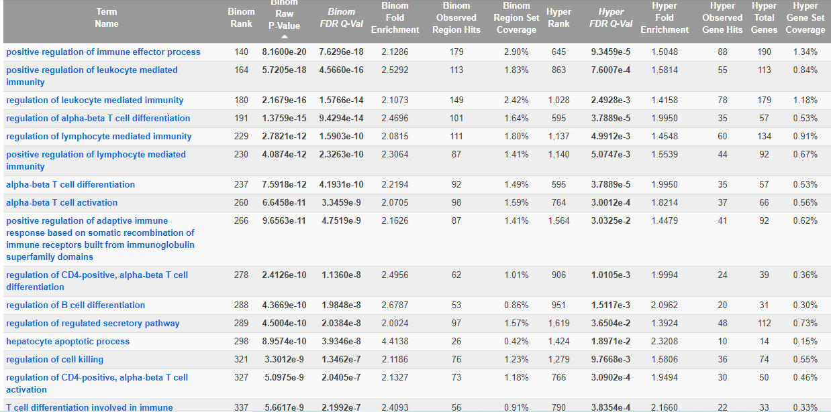
Blood TCDD vs ctrl Female Hypo DMRs

Slide 41
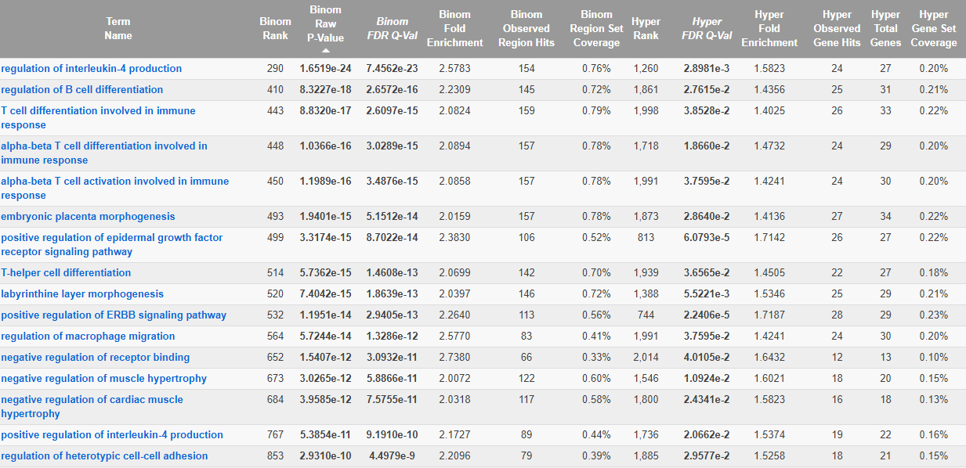
Blood up BPA vs ctrl Female Hypo DMRs

Slide 42
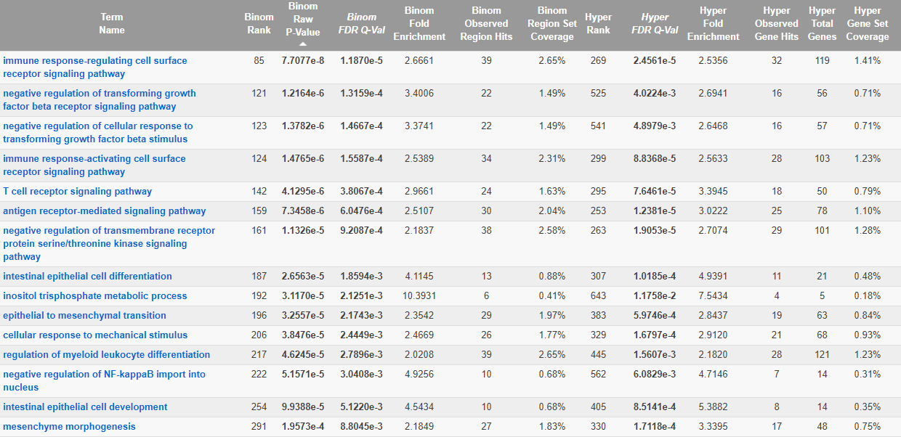
Blood 10 ppb As vs ctrl Male Hypo DMRs

Slide 43
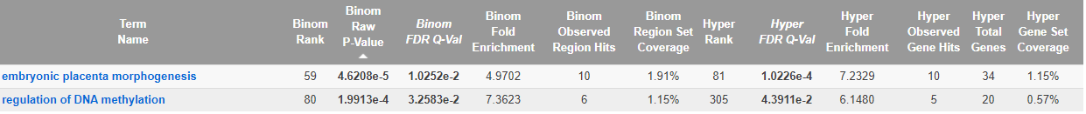
Blood DEHP vs ctrl Male Hypo DMRs

Slide 44
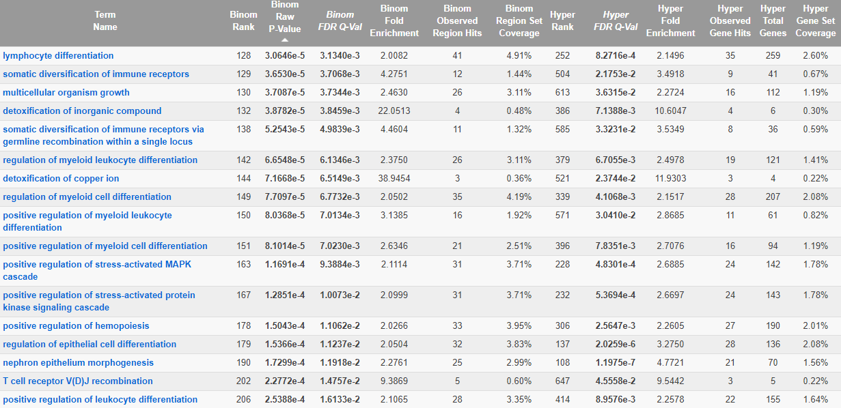
Blood Lead vs ctrl Male Hypo DMRs

Slide 45
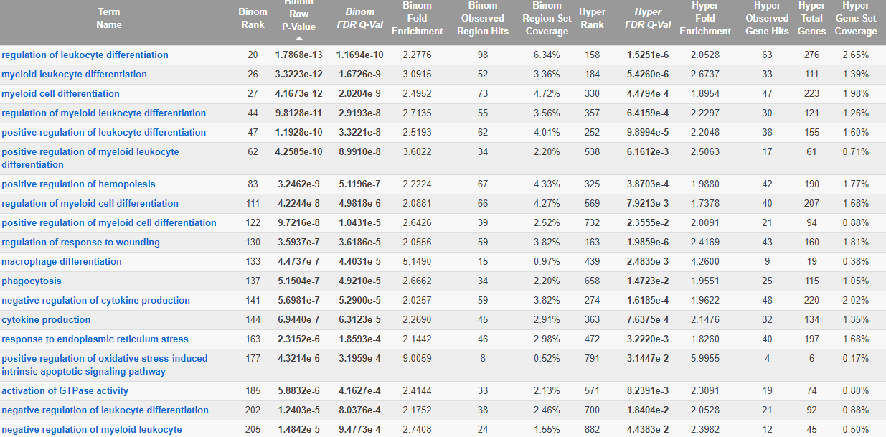
Blood low BPA vs ctrl Male Hypo DMRs

Slide 46
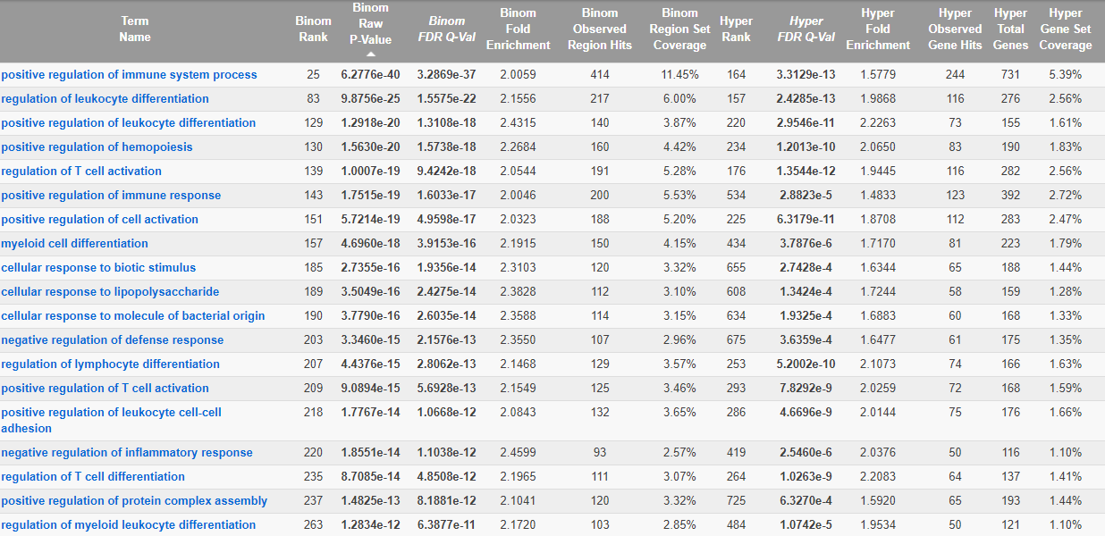
Blood PM 2.5 vs ctrl Male Hypo DMRs

Slide 47
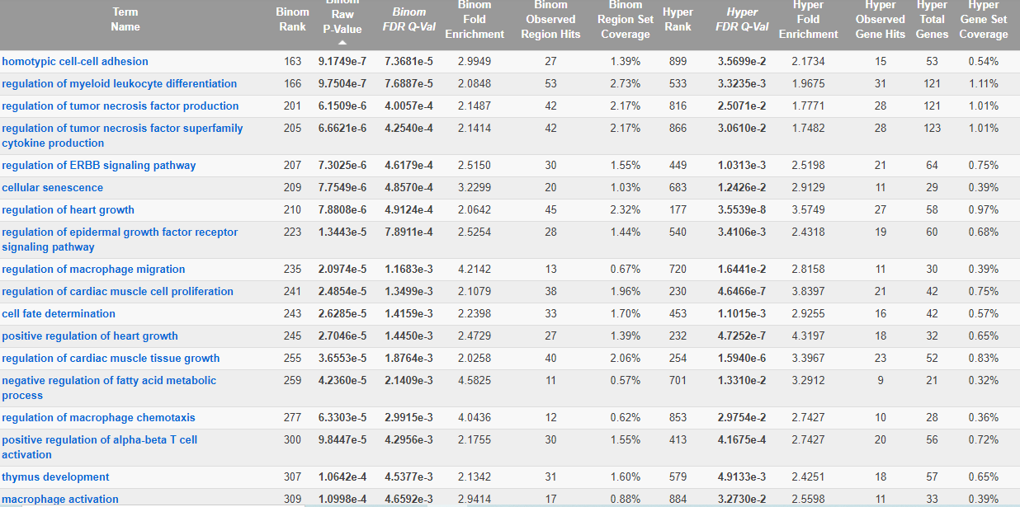
Blood TBT vs ctrl Male Hypo DMRs

Slide 48
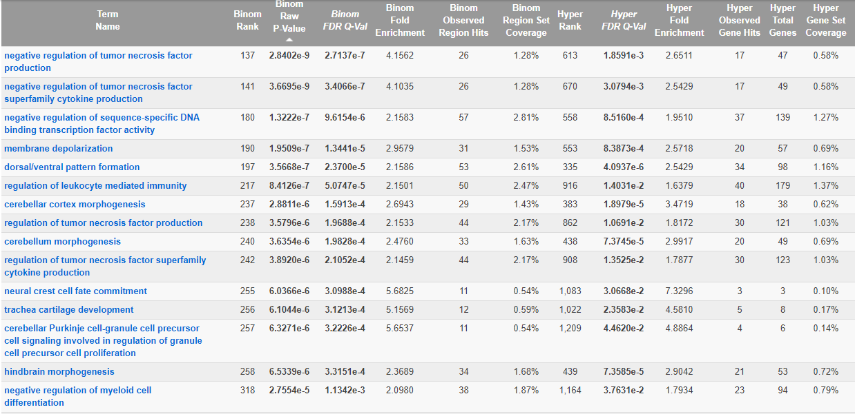
Blood TCDD vs ctrl Male Hypo DMRs

Slide 49
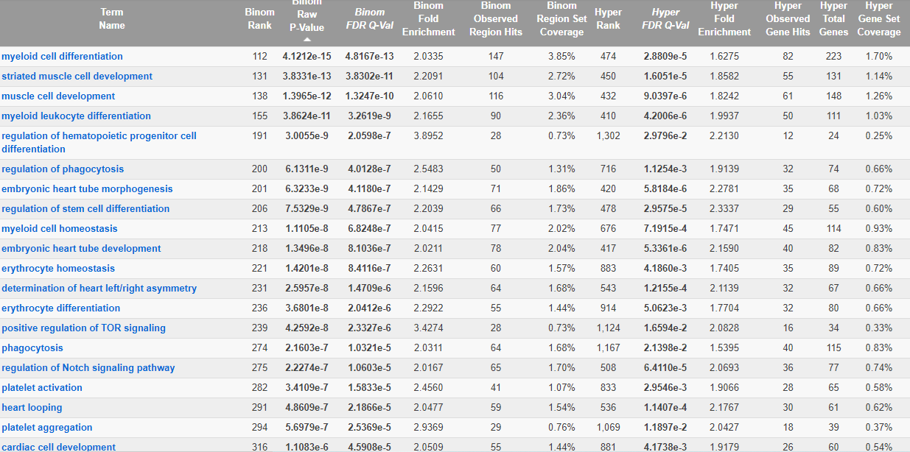
Blood up BPA vs ctrl Male Hypo DMRs

Slide 50
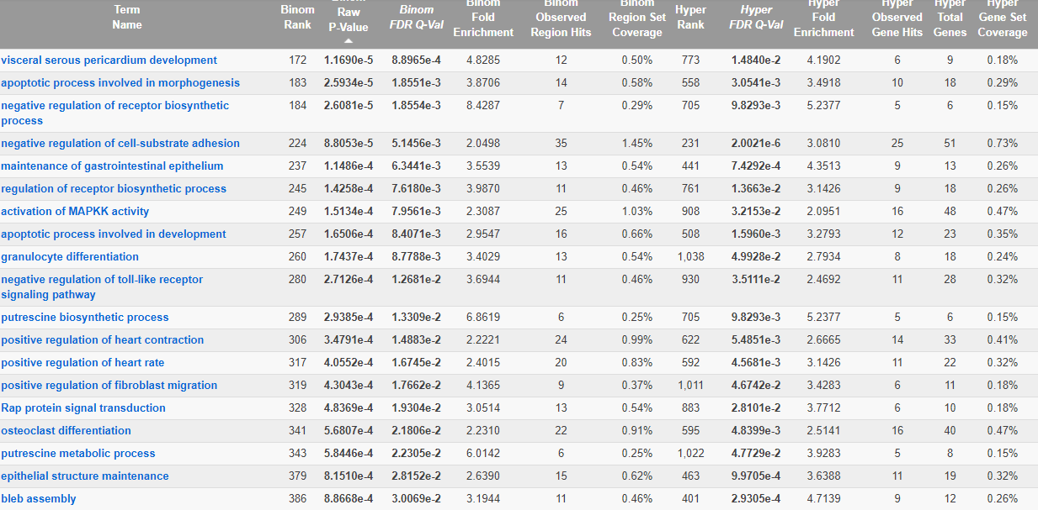
Blood 10 ppb As vs ctrl Female Hyper DMRs

Slide 51
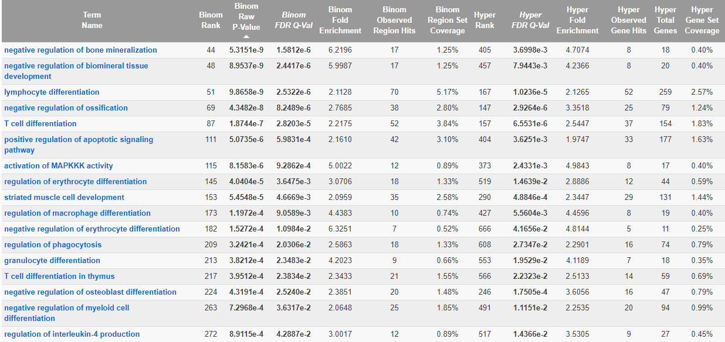
Blood DEHP vs ctrl Female Hyper DMRs

Slide 52
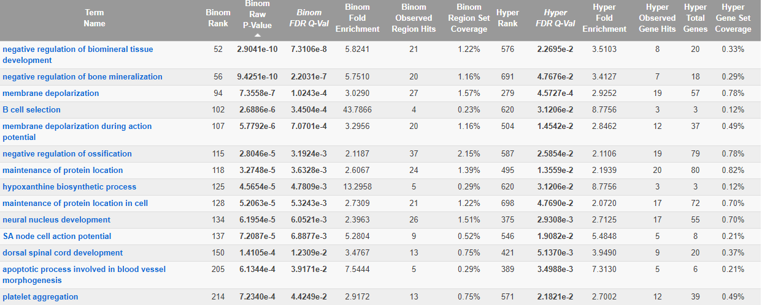
Blood lead vs ctrl Female Hyper DMRs

Slide 53
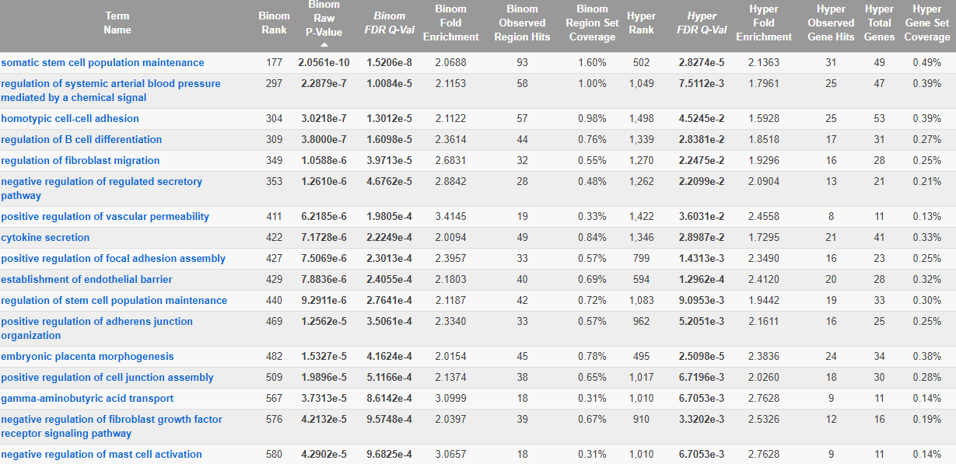
Blood low BPA vs ctrl Female Hyper DMRs

Slide 54
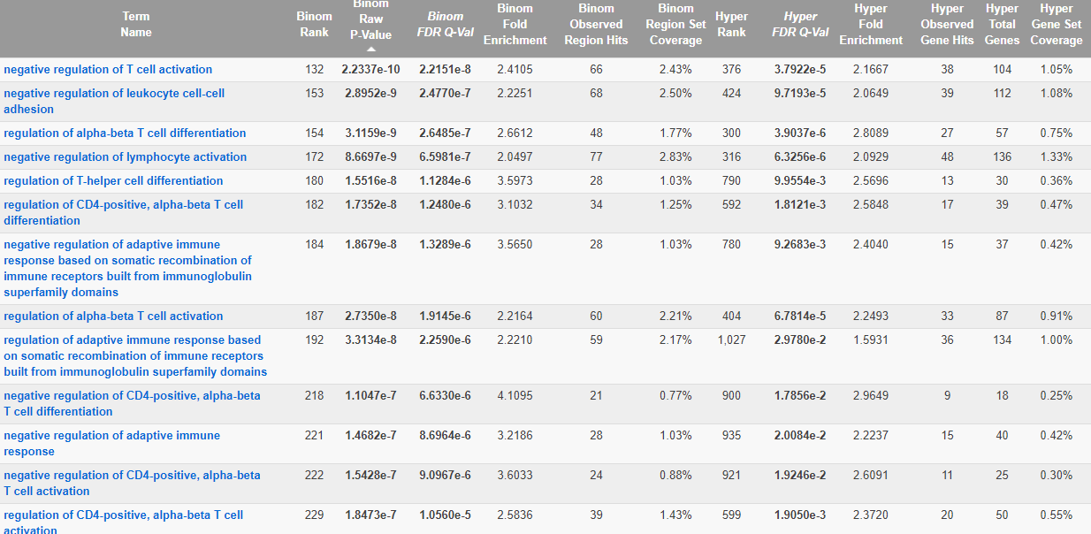
Blood PM 2.5 vs ctrl Female Hyper DMRs

Slide 55
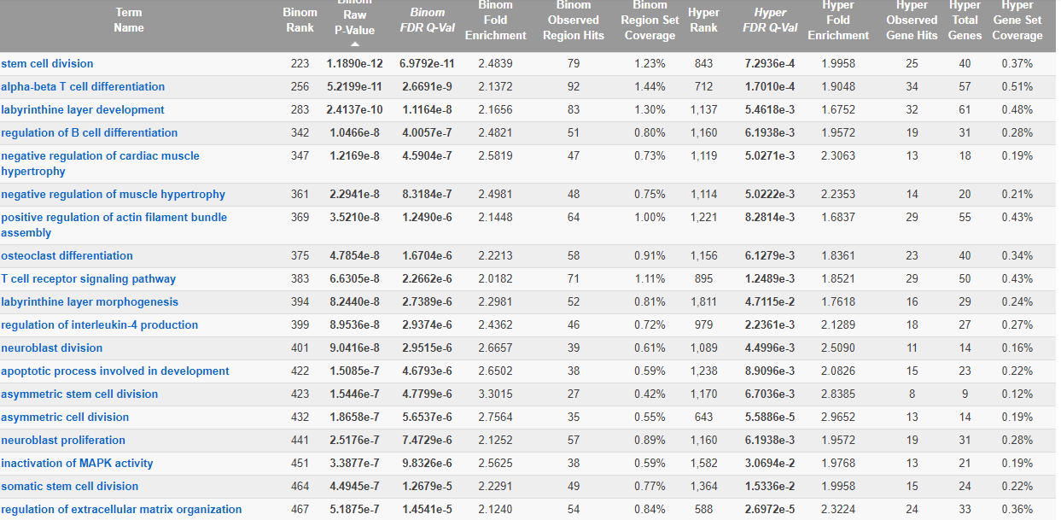
Blood TBT vs ctrl Female Hyper DMRs

Slide 56
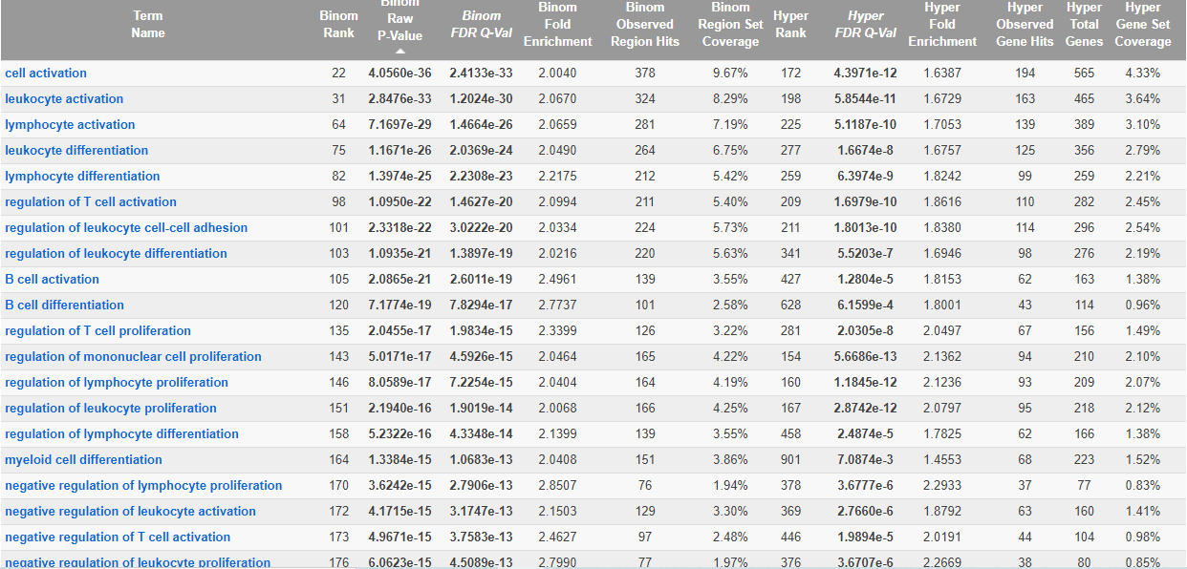
Blood TCDD vs ctrl Female Hyper DMRs

Slide 57
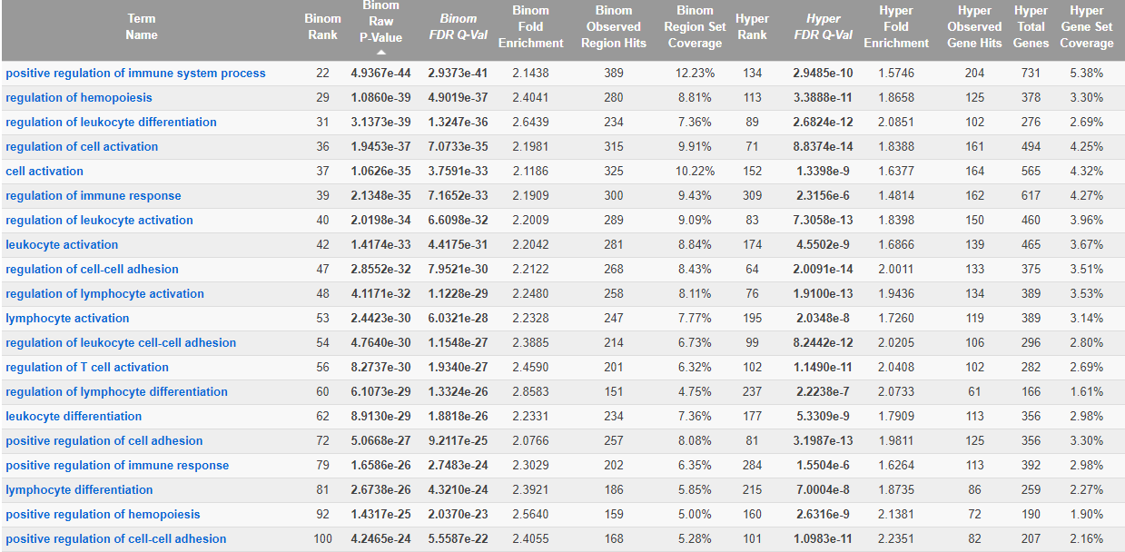
Blood up BPA vs ctrl Female Hyper DMRs

Slide 58
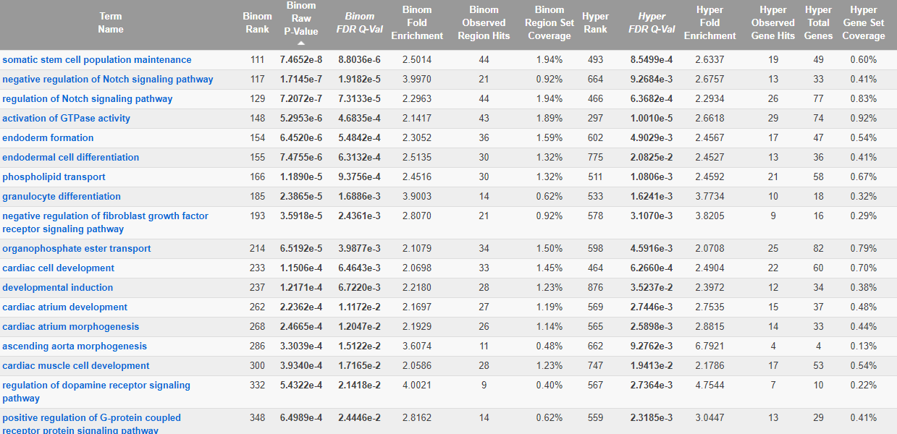
Blood 10 ppb As vs ctrl Male Hyper DMRs

Slide 59
Blood 10 ppb As vs ctrl Male Hyper DMRs

Slide 60
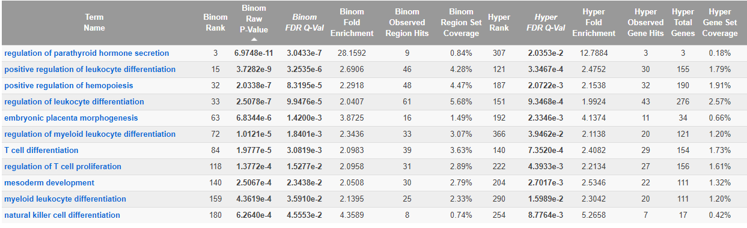
Blood DEHP vs ctrl Male Hyper DMRs

Slide 61
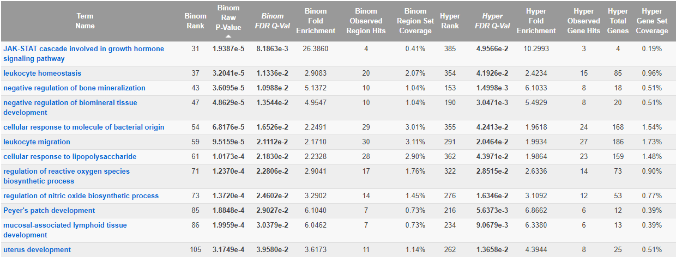
Blood Lead vs ctrl Male Hyper DMRs

Slide 62
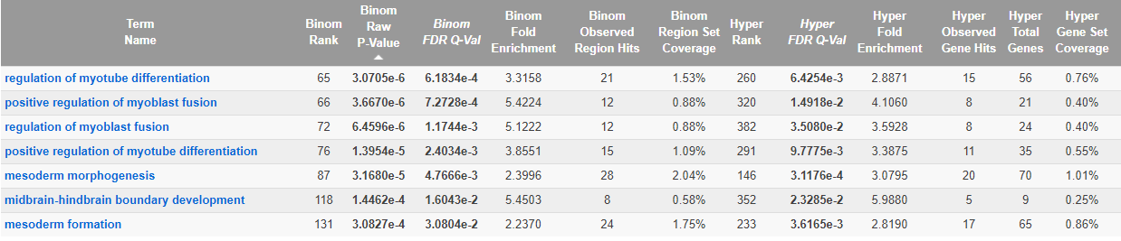
Blood low BPA vs ctrl Male Hyper DMRs

Slide 63
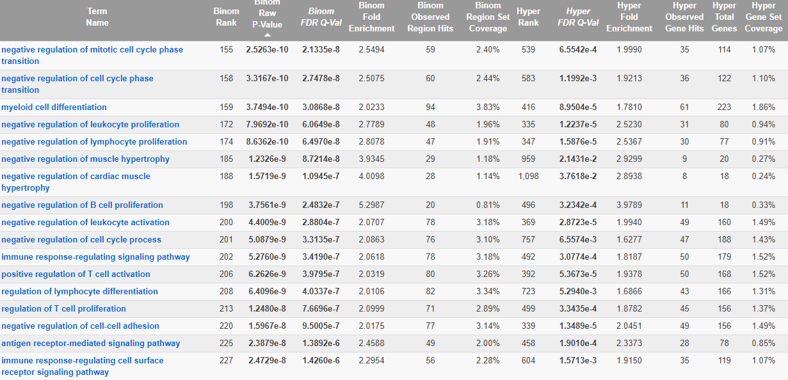
Blood PM 2.5 vs ctrl Male Hyper DMRs

Slide 64
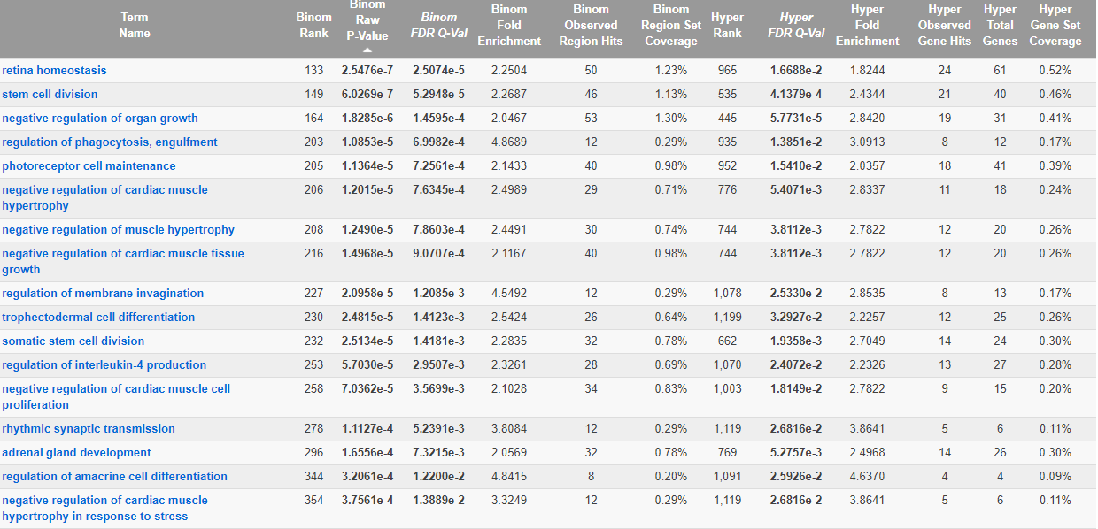
Blood TBT vs ctrl Male Hyper DMRs

Slide 65
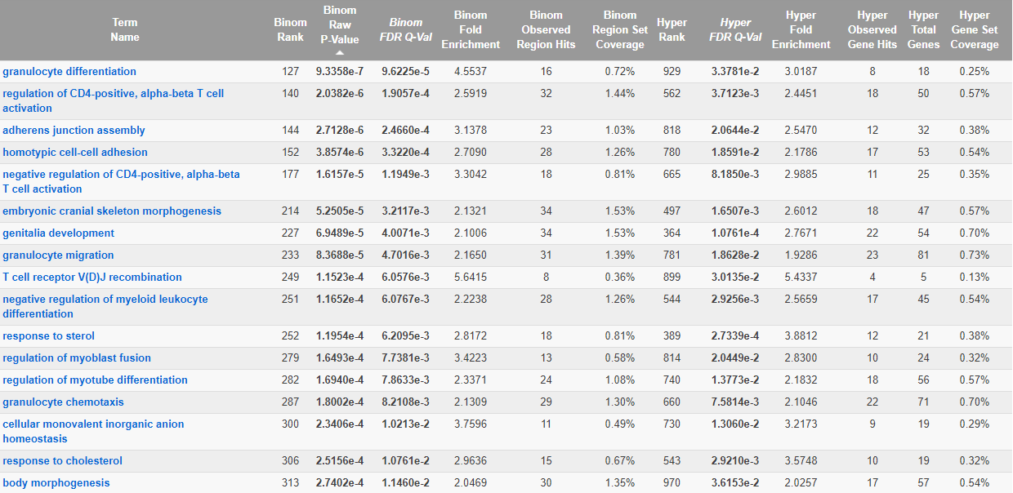
Blood TCDD vs ctrl Male Hyper DMRs

Slide 66
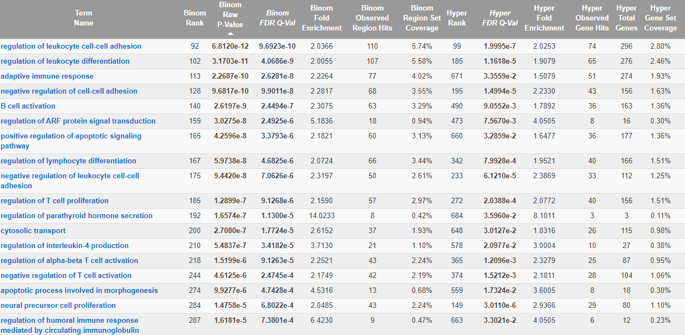
Blood up BPA vs ctrl Male Hyper DMRs

Slide 68
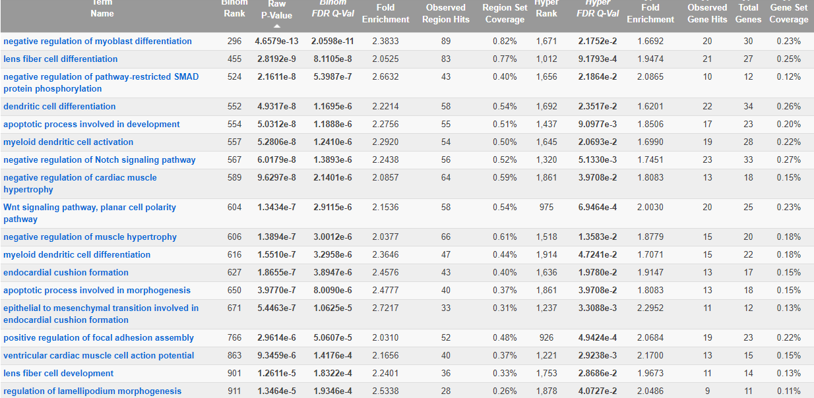
Liver 10 ppb As vs ctrl Female Hypo DMRs

Slide 69
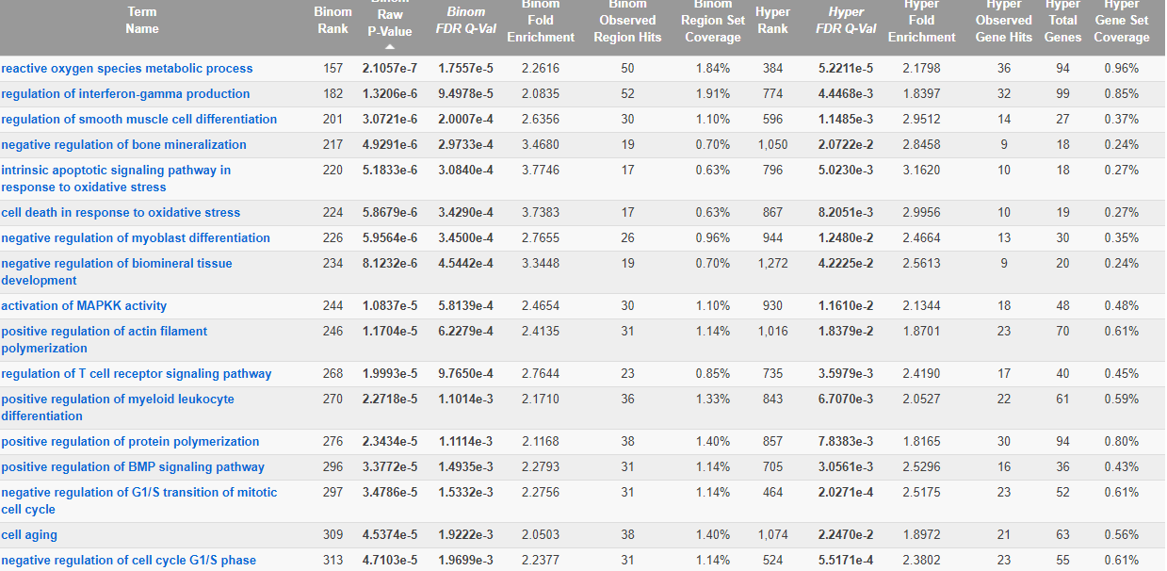
Liver DEHP vs ctrl Female Hypo DMRs

Slide 70

Liver lead vs ctrl Female Hypo DMRs

Slide 71

Liver low BPA vs ctrl Female Hypo DMRs

Slide 72

Liver Chicago PM 2.5 vs ctrl Female Hypo DMRs

Slide 73

Liver Hopkins PM2.5 vs ctrl Female Hypo DMRs

Slide 74
Liver vs ctrl Female Hypo DMRs

Slide 75
Liver vs ctrl Female Hypo DMRs

Slide 76
Liver vs ctrl Female Hypo DMRs

