Slide 1
CUT&RUN, ChIP-SEQ Analysis
1/30/2023

Slide 2
Data
CUT&RUN December 2021
  49 samples in total, with 12 samples as negative control
CUT&RUN December 2022
  74 samples (1 undetermined), with 14 samples as negative control
ChIP-SEQ November 2022
  28 samples, with 4 as negative control, and 4 as input

Slide 3
CUT&RUN December 2021
Notes:
37

Slide 4
CUT&RUN December 2021

Slide 5
CUT&RUN December 2022

Slide 6
CUT&RUN December 2022
Notes:
59

Slide 7
CUT&RUN December 2022

Slide 8
CUT&RUN December 2022

Slide 9
CUT&RUN December 2022

Slide 10
ChIP-SEQ November 2022

Slide 11
2/13/2023

Slide 12
CR2021 uniq mapped

Slide 13
CR2021 Uniq mapped

Slide 14
CR2021 Uniq mapped

Slide 15
CR2022 Uniq mapped

Slide 16
CR2022 Uniq mapped

Slide 17
Genome liftOver
65% minimum Match
  http://regmedsrv1.wustl.edu/Public_SPACE/yuz/Public_html/chen/shen/short_reads/short_read_65.json
  http://regmedsrv1.wustl.edu/Public_SPACE/yuz/Public_html/chen/shen/longrange_ext/longrange65.json

Slide 18
3/8/2023

Slide 19
Satb2
ChIP-SEQ
Antibody Target | AnalysisName | Peak_number | Merged Peak
Rb Satb2_Poly | p00_rbpcsatb2_bc808 | 19128 | 26660
Rb Satb2_Poly | p00_rbpcsatb2_bc816 | 23651
Ms Satb2 | p00_msxxsatb2_bc810 | 11872 | 19187
Ms Satb2 | p00_msxxsatb2_bc818 | 15748
Rb Satb2_Mono | p00_rbmcsatb2_bc809 | 15980 | 23358
Rb Satb2_Mono | p00_rbmcsatb2_bc817 | 20938
Ms satb2 chip-seq peaks
Ms satb2 C&R peaks
301
CUT&RUN
Antibody | sample_name | Peak_number | Merged Peak
Ms Satb2 | p00_mssatb2x_bc548 | 891 | 891
Ms Satb2 | p00_mssatb2x_bc550
Ms Satb2 | p00_mssatb2x_bc549 | 0
Rb Satb2 | p00_rbsatb2x_bc545 | 2969 | 3647
Rb Satb2 | p00_rbsatb2x_bc546
Rb Satb2 | p00_rbsatb2x_bc547 | 2129
Rb mcsatb2 chip-seq peaks
Rb satb2 C&R peaks
1095
Notes:
301 http://regmedsrv1.wustl.edu/Public_SPACE/yuz/Public_html/chen/motif/p00_mssatb2x_out/
1095 http://regmedsrv1.wustl.edu/Public_SPACE/yuz/Public_html/chen/motif/p00_rbsatb2_out/

Slide 20
Satb2
ChIP-SEQ
Antibody Target | AnalysisName | Peak_number | Merged Peak
Rb Satb2_Poly | p00_rbpcsatb2_bc808 | 19128 | 26660
Rb Satb2_Poly | p00_rbpcsatb2_bc816 | 23651
Ms Satb2 | p00_msxxsatb2_bc810 | 11872 | 19187
Ms Satb2 | p00_msxxsatb2_bc818 | 15748
Rb Satb2_Mono | p00_rbmcsatb2_bc809 | 15980 | 23358
Rb Satb2_Mono | p00_rbmcsatb2_bc817 | 20938
Ms satb2 chip-seq peaks
Ms satb2 C&R peaks
301
CUT&RUN
Antibody | sample_name | Peak_number | Merged Peak
Ms Satb2 | p00_mssatb2x_bc548 | 891 | 891
Ms Satb2 | p00_mssatb2x_bc550
Ms Satb2 | p00_mssatb2x_bc549 | 0
Rb Satb2 | p00_rbsatb2x_bc545 | 2969 | 3647
Rb Satb2 | p00_rbsatb2x_bc546
Rb Satb2 | p00_rbsatb2x_bc547 | 2129
Rb pcsatb2 chip-seq peaks
Rb satb2 C&R peaks
1315
Notes:
301 http://regmedsrv1.wustl.edu/Public_SPACE/yuz/Public_html/chen/motif/p00_mssatb2x_out/
1315 http://regmedsrv1.wustl.edu/Public_SPACE/yuz/Public_html/chen/motif/p00_rbsatb2_cr_chipPC_overlap_merged_out/
1095 http://regmedsrv1.wustl.edu/Public_SPACE/yuz/Public_html/chen/motif/p00_rbsatb2_out/

Slide 21
Satb2
ChIP-SEQ
Antibody Target | AnalysisName | Peak_number | Merged Peak
Rb Satb2_Poly | p00_rbpcsatb2_bc808 | 19128 | 26660
Rb Satb2_Poly | p00_rbpcsatb2_bc816 | 23651
Ms Satb2 | p00_msxxsatb2_bc810 | 11872 | 19187
Ms Satb2 | p00_msxxsatb2_bc818 | 15748
Rb Satb2_Mono | p00_rbmcsatb2_bc809 | 15980 | 23358
Rb Satb2_Mono | p00_rbmcsatb2_bc817 | 20938
14155 overlapped peaks
CUT&RUN
Antibody | sample_name | Peak_number | Merged Peak
Ms Satb2 | p00_mssatb2x_bc548 | 891 | 891
Ms Satb2 | p00_mssatb2x_bc550
Ms Satb2 | p00_mssatb2x_bc549 | 0
Rb Satb2 | p00_rbsatb2x_bc545 | 2969 | 3647
Rb Satb2 | p00_rbsatb2x_bc546
Rb Satb2 | p00_rbsatb2x_bc547 | 2129
3928 merged peaks
768 of C&R peaks overlap with above chip peaks
Notes:
14155 http://regmedsrv1.wustl.edu/Public_SPACE/yuz/Public_html/chen/motif/p00_msxxsatb2_rbmcsatb2_rbpcsatb2_overlap_chip_out/ (AT-rich)
3928 http://regmedsrv1.wustl.edu/Public_SPACE/yuz/Public_html/chen/motif/p00_ms_rb_satb2_CR_out/
768 http://regmedsrv1.wustl.edu/Public_SPACE/yuz/Public_html/chen/motif/CR_overlap_ChIP_p0_satb2_out/

Slide 22
Satb2
ChIP-SEQ
Antibody Target | AnalysisName | Peak_number | Merged Peak
Rb Satb2_Poly | p00_rbpcsatb2_bc808 | 19128 | 26660
Rb Satb2_Poly | p00_rbpcsatb2_bc816 | 23651
Ms Satb2 | p00_msxxsatb2_bc810 | 11872 | 19187
Ms Satb2 | p00_msxxsatb2_bc818 | 15748
Rb Satb2_Mono | p00_rbmcsatb2_bc809 | 15980 | 23358
Rb Satb2_Mono | p00_rbmcsatb2_bc817 | 20938
14155 overlapped peaks
557 out of 14155 overlap with gene promoter region
5’
TSS
3’
CUT&RUN
Antibody | sample_name | Peak_number | Merged Peak
Ms Satb2 | p00_mssatb2x_bc548 | 891 | 891
Ms Satb2 | p00_mssatb2x_bc550
Ms Satb2 | p00_mssatb2x_bc549 | 0
Rb Satb2 | p00_rbsatb2x_bc545 | 2969 | 3647
Rb Satb2 | p00_rbsatb2x_bc546
Rb Satb2 | p00_rbsatb2x_bc547 | 2129
-500
+500
3928 merged peaks
2352 out of 3928 overlap with gene promoter region
Notes:
14155 http://regmedsrv1.wustl.edu/Public_SPACE/yuz/Public_html/chen/motif/p00_msxxsatb2_rbmcsatb2_rbpcsatb2_overlap_chip_out/ (AT-rich)
3928 http://regmedsrv1.wustl.edu/Public_SPACE/yuz/Public_html/chen/motif/p00_ms_rb_satb2_CR_out/
557 http://regmedsrv1.wustl.edu/Public_SPACE/yuz/Public_html/chen/motif/p00_msxxsatb2_rbmcsatb2_rbpcsatb2_ChIP_overlap_promoter_merged_out/
2352 http://regmedsrv1.wustl.edu/Public_SPACE/yuz/Public_html/chen/motif/p00_ms_rb_satb2_CR_overlap_promoter_merged_out/

Slide 23
Satb2
Antibody | sample_name | Peak_number | Merged Peak
Rabbit Satb2 | e15_satb2wt_rasatb2xxx_BCH850 | 16357 | 16310
Rabbit Satb2 | e15_satb2wt_rasatb2xxx_BCH851 | 1603
2268 overlapped peaks
Rb Satb2 | p00_rbsatb2x_bc545 | 2969 | 3647
Rb Satb2 | p00_rbsatb2x_bc546
Rb Satb2 | p00_rbsatb2x_bc547 | 2129
Notes:
2268 http://regmedsrv1.wustl.edu/Public_SPACE/yuz/Public_html/chen/motif/e15_satb2wt_rasatb2_overlaps_p00_rbsatb2_out/

Slide 24
Satb2
14155 overlapped peaks
3928 merged peaks
Antibody Target | AnalysisName | Peak_number | Merged Peak
Rb Satb2_Poly | p00_rbpcsatb2_bc808 | 19128 | 26660
Rb Satb2_Poly | p00_rbpcsatb2_bc816 | 23651
Ms Satb2 | p00_msxxsatb2_bc810 | 11872 | 19187
Ms Satb2 | p00_msxxsatb2_bc818 | 15748
Rb Satb2_Mono | p00_rbmcsatb2_bc809 | 15980 | 23358
Rb Satb2_Mono | p00_rbmcsatb2_bc817 | 20938
Antibody | sample_name | Peak_number | Merged Peak
Ms Satb2 | p00_mssatb2x_bc548 | 891 | 891
Ms Satb2 | p00_mssatb2x_bc550
Ms Satb2 | p00_mssatb2x_bc549 | 0
Rb Satb2 | p00_rbsatb2x_bc545 | 2969 | 3647
Rb Satb2 | p00_rbsatb2x_bc546
Rb Satb2 | p00_rbsatb2x_bc547 | 2129
Antibody | sample_name | Peak_number | Merged Peak
Rabbit Satb2 | e15_satb2wt_rasatb2xxx_BCH850 | 16357 | 16310
Rabbit Satb2 | e15_satb2wt_rasatb2xxx_BCH851 | 1603
2514 out of 16310 e15 peaks
overlapped with p0 ChIP-seq peaks
2387 out of 16310 e15 peaks
overlapped with p0 cut&run peaks
Notes:
E15 bcl11a with e15 satb2

Slide 25
ChIP-Seq
Antibody Target | AnalysisName | Narrow Peak_number
Rb Satb2_Poly | p00_rbpcsatb2_bc808 | 13491
Rb Satb2_Poly | p00_rbpcsatb2_bc816 | 15550
Ms Satb2 | p00_msxxsatb2_bc810 | 7476
Ms Satb2 | p00_msxxsatb2_bc818 | 8408
Rb Satb2_Mono | p00_rbmcsatb2_bc809 | 10325
Rb Satb2_Mono | p00_rbmcsatb2_bc817 | 12707
Notes:
7476 step3.1_methylQA_p00_msxxsatb2_bc810_1_chip_peaks.narrowPeak
8408 step3.1_methylQA_p00_msxxsatb2_bc818_1_chip_peaks.narrowPeak
10325 step3.1_methylQA_p00_rbmcsatb2_bc809_1_chip_peaks.narrowPeak
12707 step3.1_methylQA_p00_rbmcsatb2_bc817_1_chip_peaks.narrowPeak
13491 step3.1_methylQA_p00_rbpcsatb2_bc808_1_chip_peaks.narrowPeak
15550 step3.1_methylQA_p00_rbpcsatb2_bc816_1_chip_peaks.narrowPeak

Slide 26
5/22/2023

Slide 27
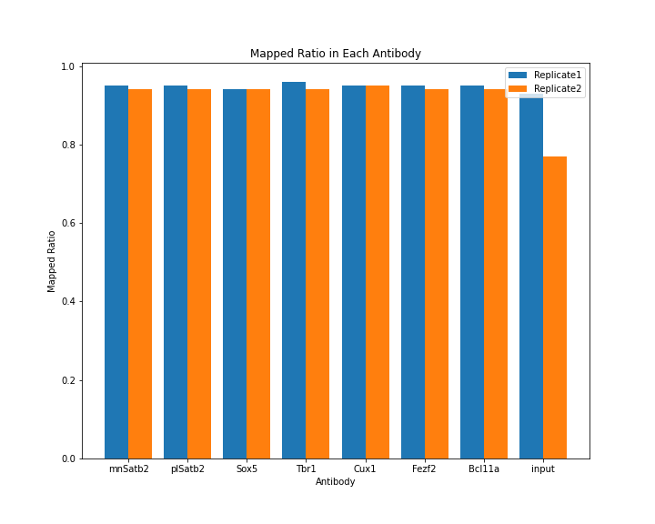
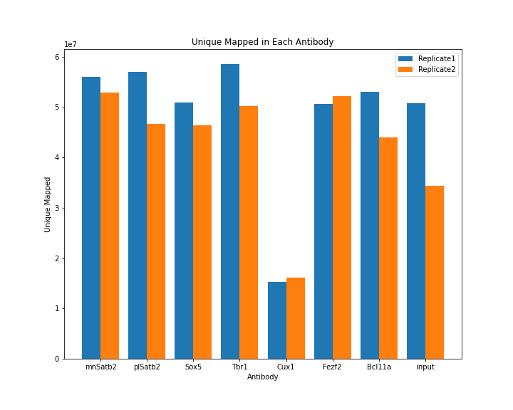
ChIP-Seq

Slide 28
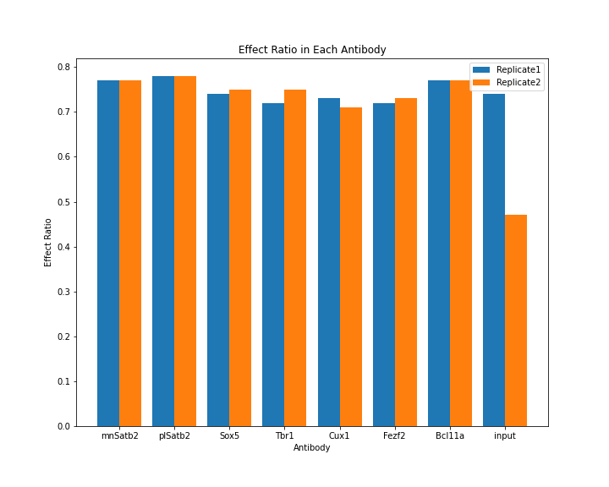
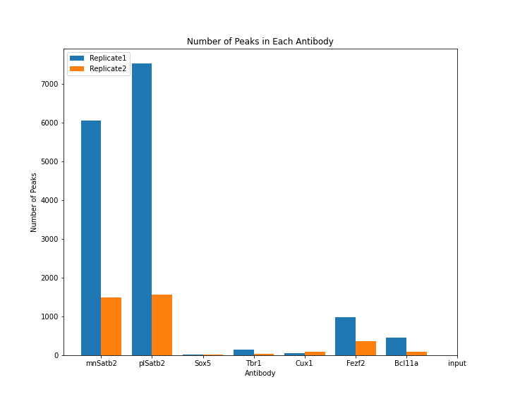
ChIP-Seq
Notes:
Combine input 1,2
Not use input

Slide 29
ChIP-Seq
Sample | MACS Peak | Overlap with rmsk
e15_wt_rb_Bcl11a_BCH1007_R1 | 461 | 142
e15_wt_rb_Bcl11a_BCH1008_R1 | 85 | 46
e15_wt_rb_Cux1_BCH1001_R1 | 50 | 40
e15_wt_rb_Cux1_BCH1002_R1 | 92 | 64
e15_wt_rb_Fezf2_BCH1003_R1 | 978 | 331
e15_wt_rb_Fezf2_BCH1004_R1 | 367 | 108
e15_wt_rb_Satb2_BCH993_R1 | 6054 | 5249
e15_wt_rb_Satb2_BCH994_R1 | 1485 | 1349
e15_wt_rb_Satb2_BCH995_R1 | 7539 | 6482
e15_wt_rb_Satb2_BCH996_R1 | 1563 | 1422
e15_wt_rb_Sox5_BCH997_R1 | 20 | 13
e15_wt_rb_Sox5_BCH998_R1 | 24 | 13
e15_wt_rb_Tbr1_BCH1000_R1 | 36 | 19
e15_wt_rb_Tbr1_BCH999_R1 | 138 | 43
Notes:
E15, p0

Slide 30
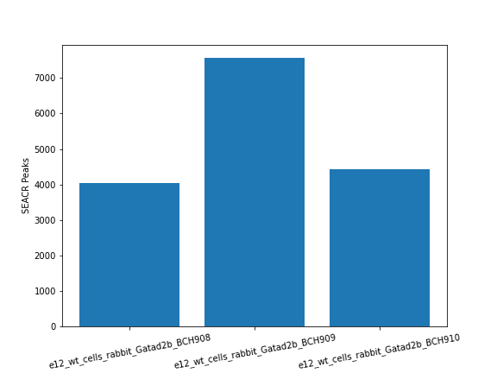
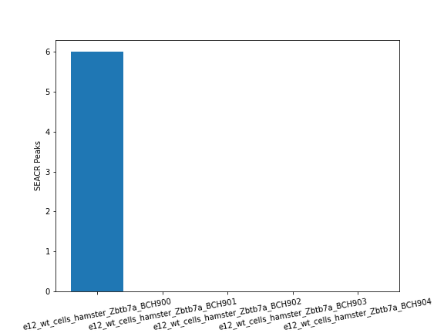
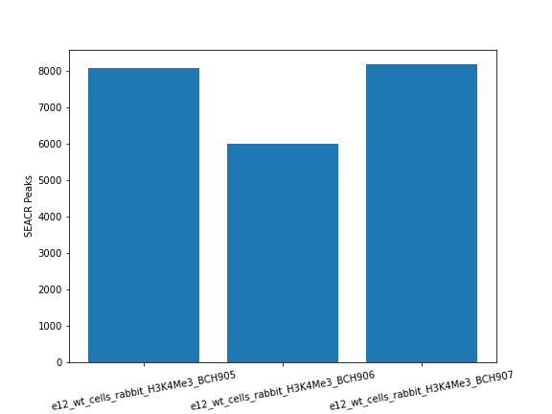
CUT&RUN
E12 Gatad2b
E12 Zbtb7a
E12 H3K4Me3

Slide 31
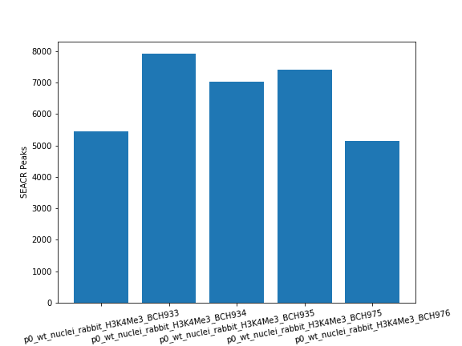
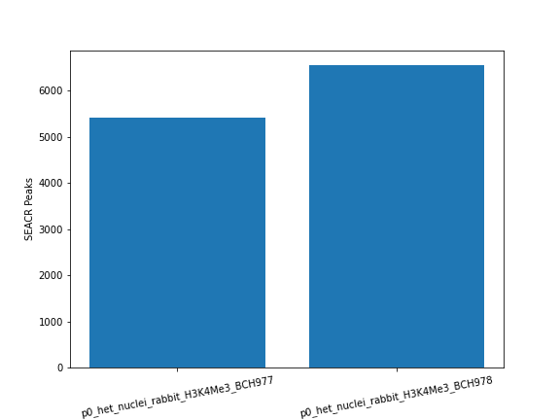
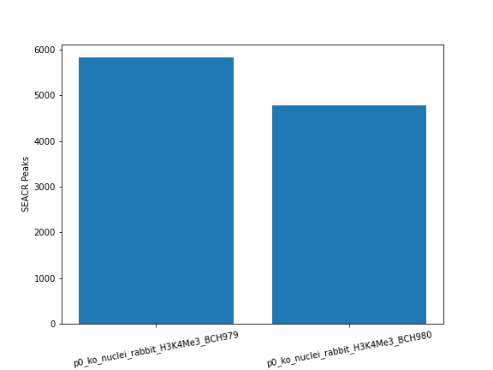
CUT&RUN
H3K4Me3

Slide 32
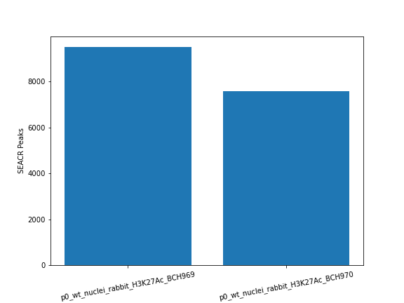
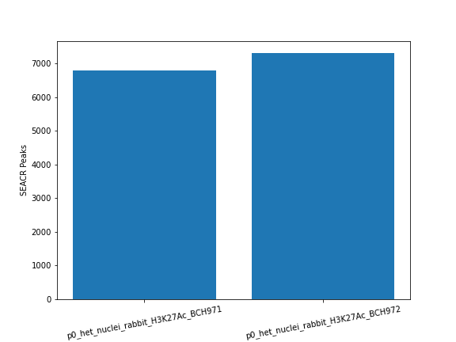

CUT&RUN
H3K27Ac

Slide 33
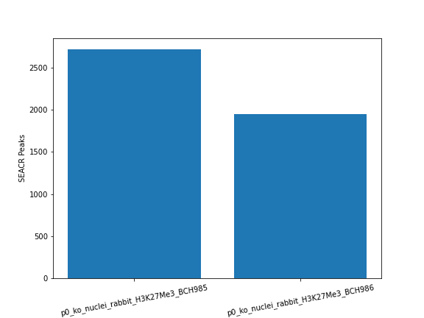
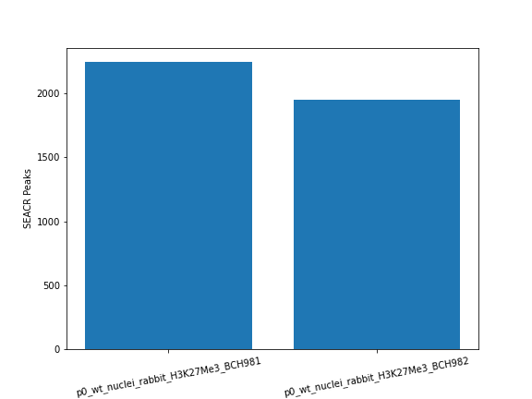
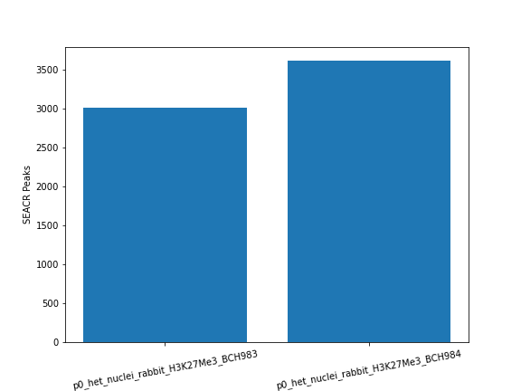
CUT&RUN
H3K27Me3

Slide 34
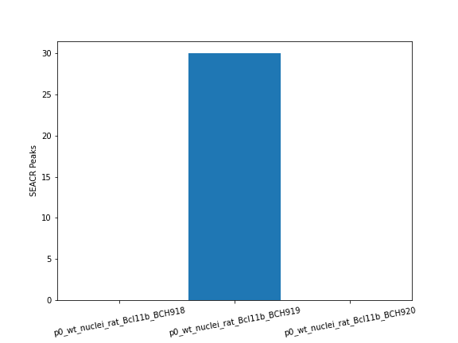
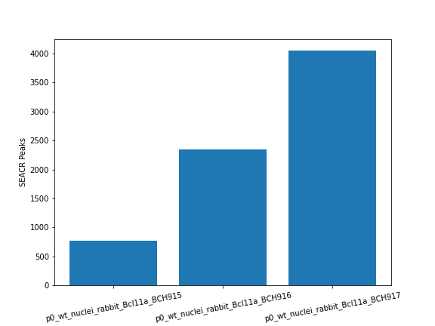
CUT&RUN
Bcl11a

Slide 35
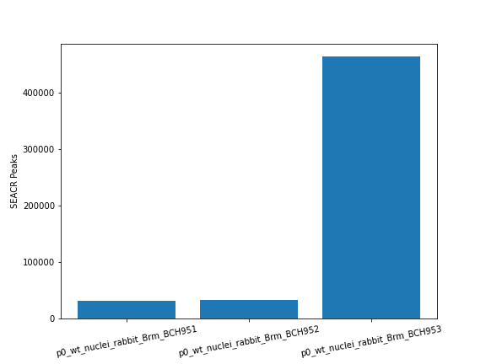
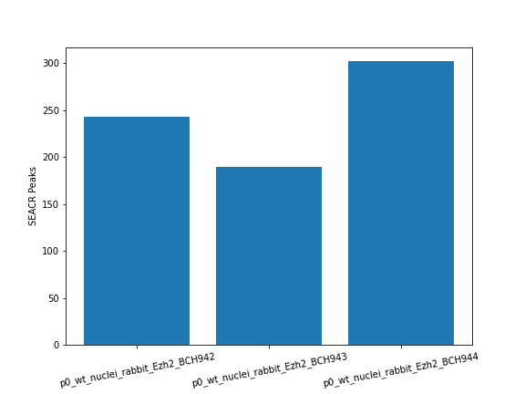
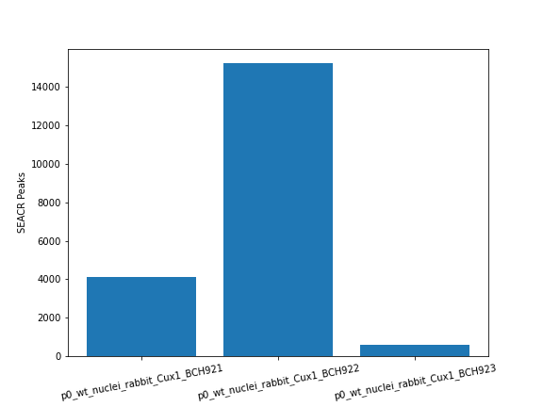
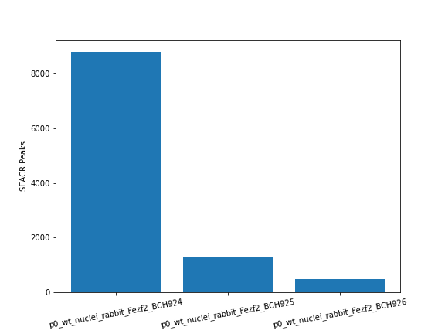
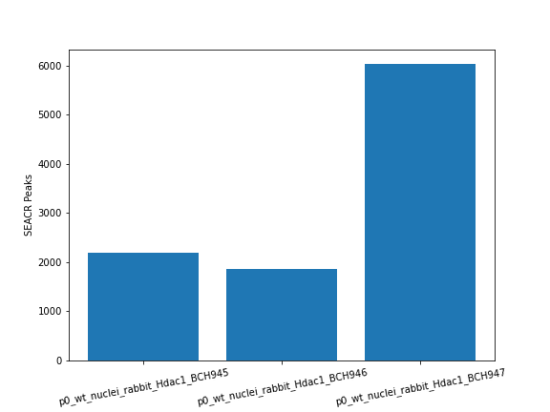
CUT&RUN
Brm
Ezh2
Gatad2b
Cux1
Fezf2
Hdac1

Slide 36
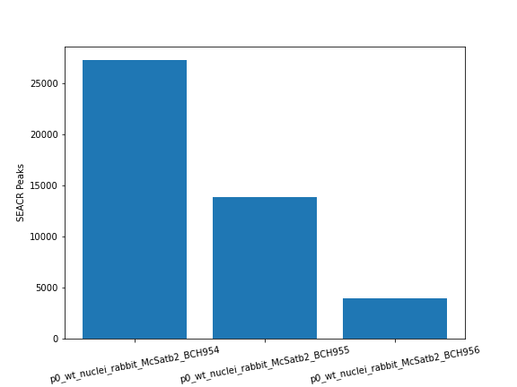
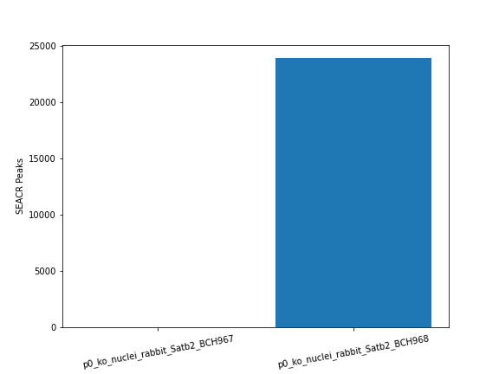
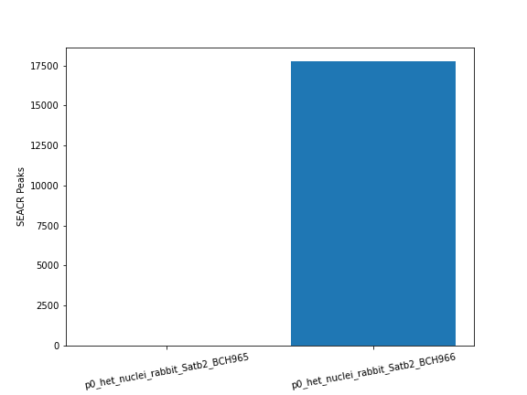
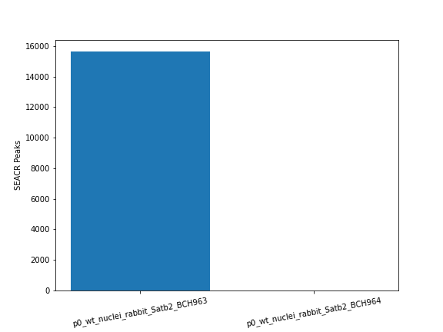
CUT&RUN
Satb2

Slide 37
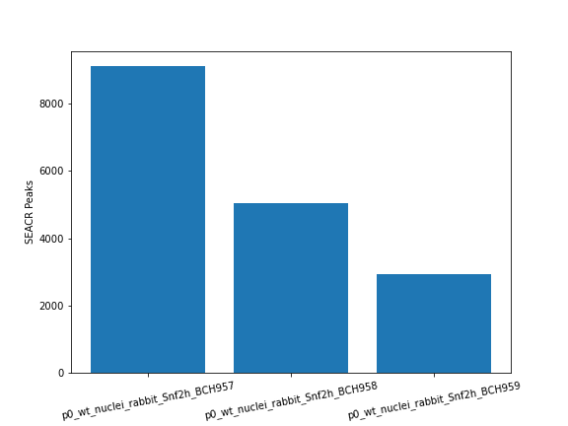
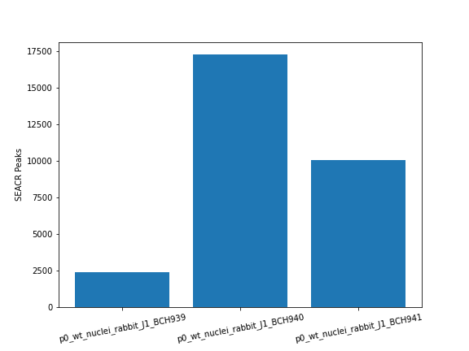
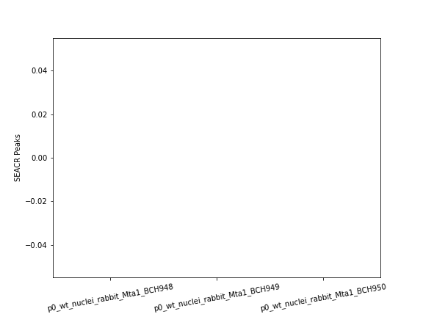
CUT&RUN
Snf2h
J1
Mta1

Slide 38
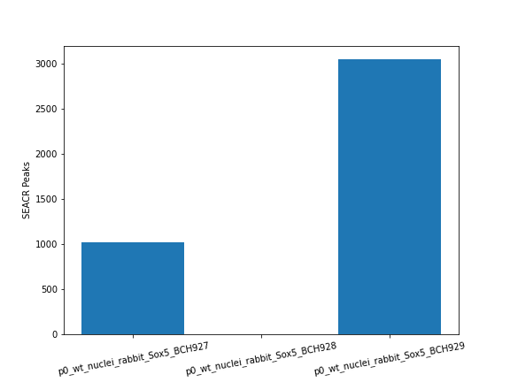
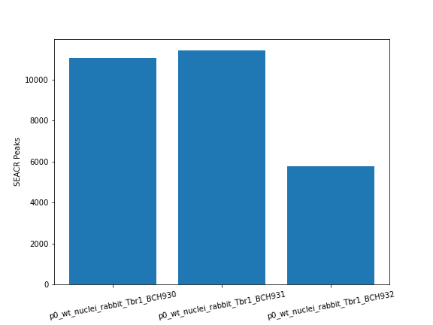
CUT&RUN
Sox5
Tbr1
Zbtb7a

Slide 39
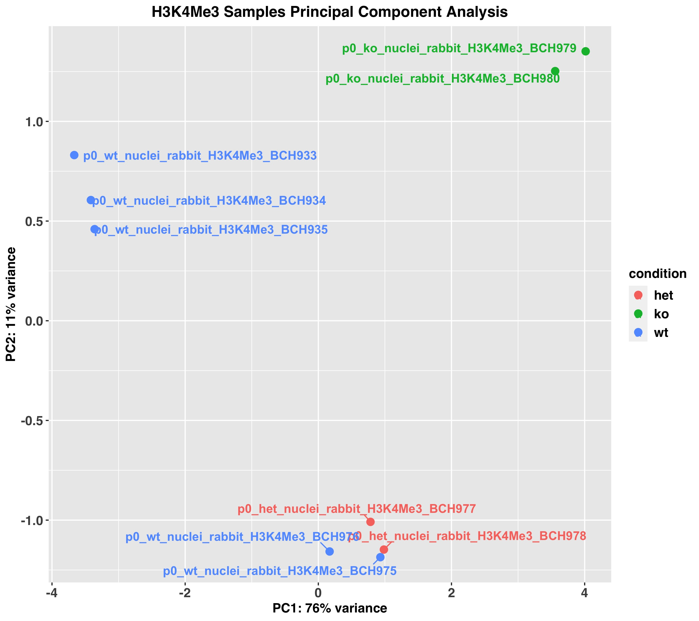
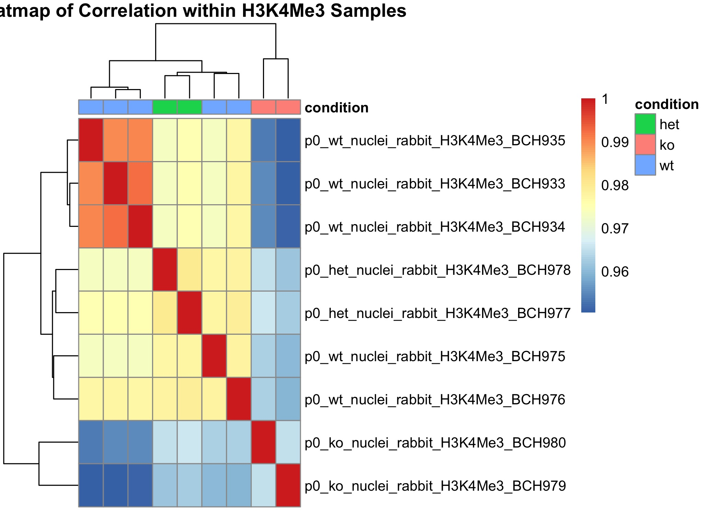
CUT&RUN (wt/het/ko)

Slide 40
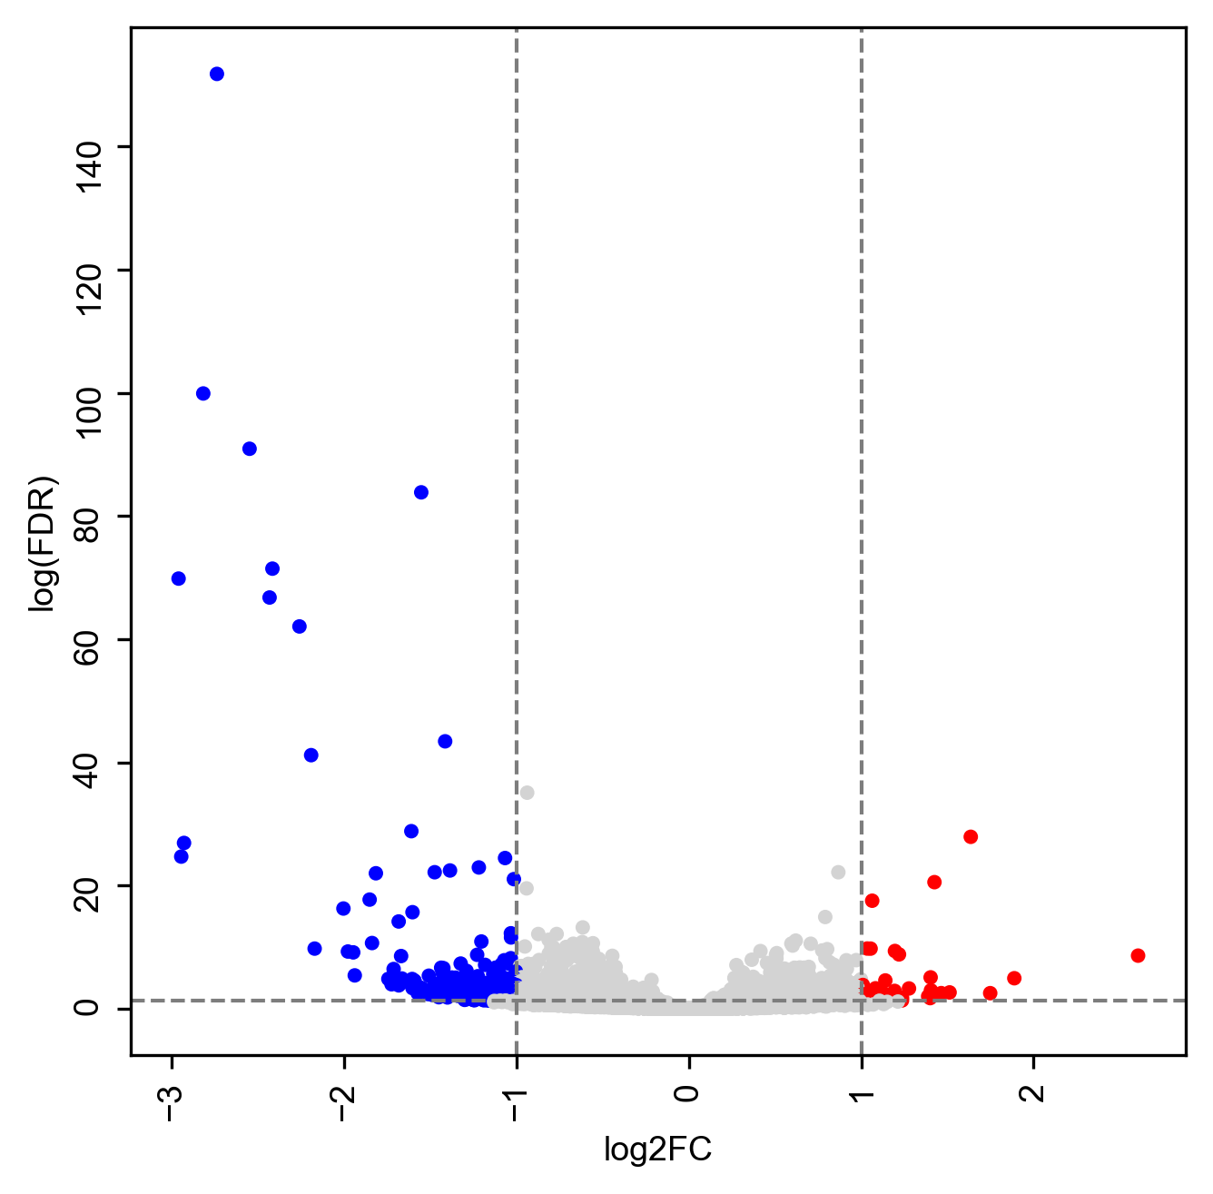
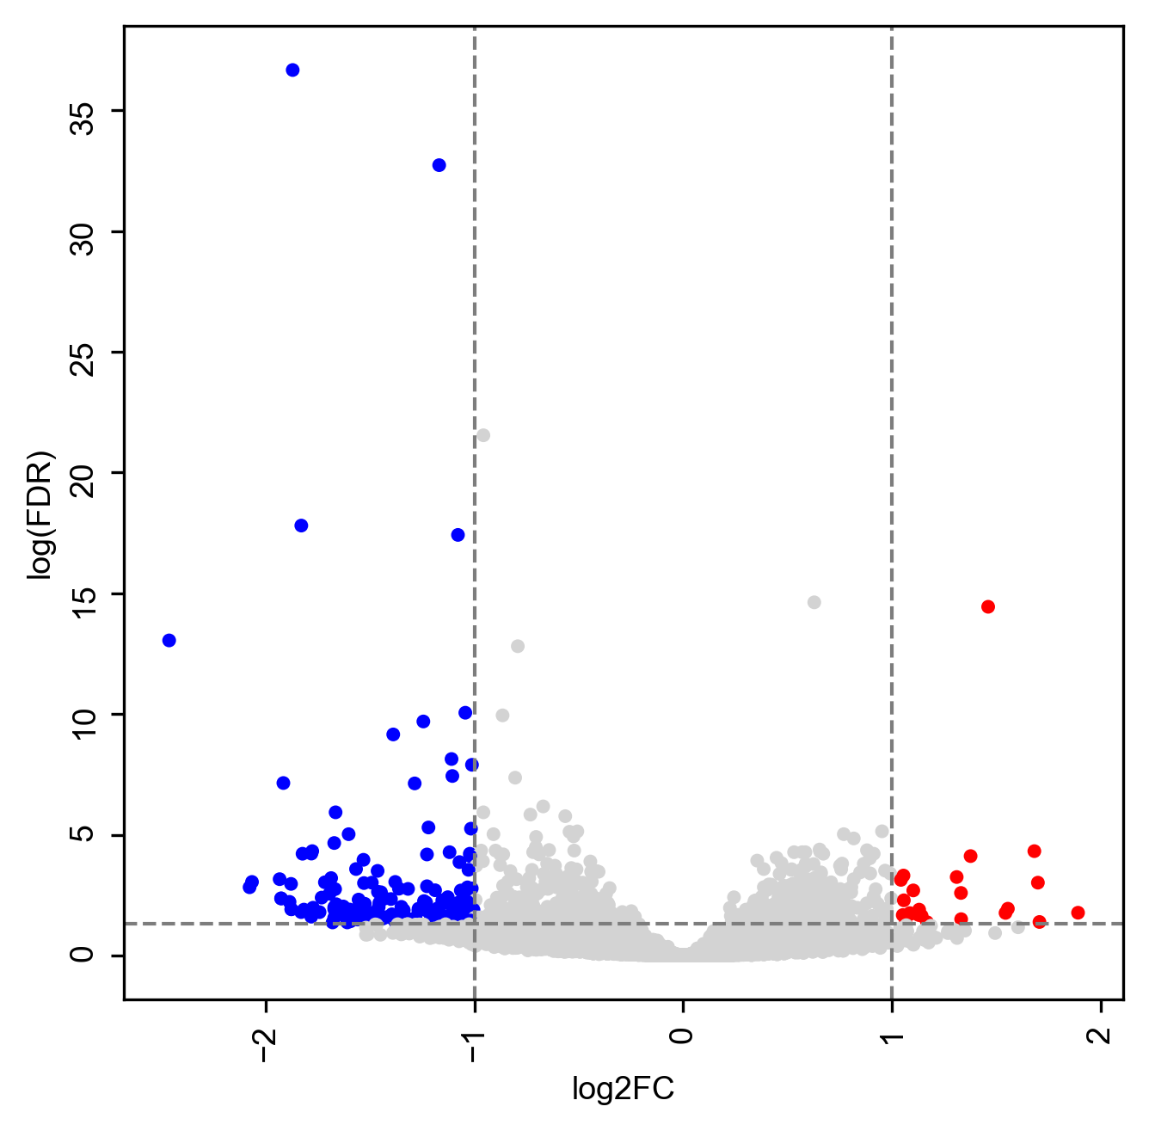
CUT&RUN (H3K4Me3)
WT vs KO
HET vs KO
329 H3K4Me3_wt_down
31 H3K4Me3_wt_up
156 H3K4Me3_het_down
23 H3K4Me3_het_up
Notes:
FDR < 0.01, |logFC|>0.58

Slide 41
GREAT
WT vs KO up
WT vs KO down (GO Molecular Function)
  transcription factor activity, sequence-specific DNA binding
  regulatory region DNA binding
  transcription regulatory region DNA binding
  transcription regulatory region sequence-specific DNA binding
  RNA polymerase II transcription factor activity, sequence-specific DNA binding
  double-stranded DNA binding
  sequence-specific double-stranded DNA binding
  RNA polymerase II regulatory region sequence-specific DNA binding
  RNA polymerase II regulatory region DNA binding
  transcription factor activity, RNA polymerase II core promoter proximal region sequence-specific binding
  protein heterodimerization activity
  transcriptional activator activity, RNA polymerase II transcription regulatory region sequence-specific binding
  enhancer sequence-specific DNA binding
  enhancer binding
  core promoter proximal region sequence-specific DNA binding
  RNA polymerase II core promoter proximal region sequence-specific DNA binding
  transcription factor activity, RNA polymerase II distal enhancer sequence-specific binding
  core promoter proximal region DNA binding
  transcriptional activator activity, RNA polymerase II core promoter proximal region sequence-specific binding
HET vs KO up
HET vs KO down (GO Biological Process)
  Establishment of spindle orintation

Slide 42
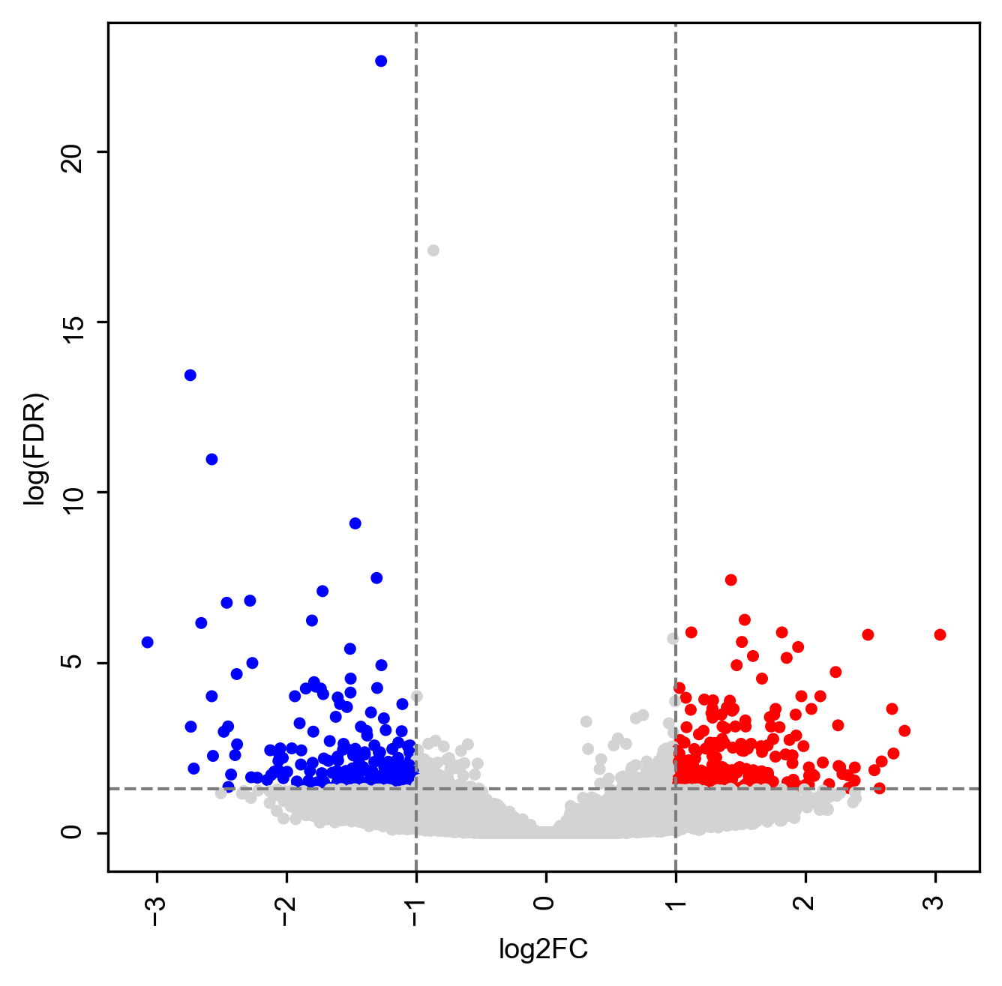
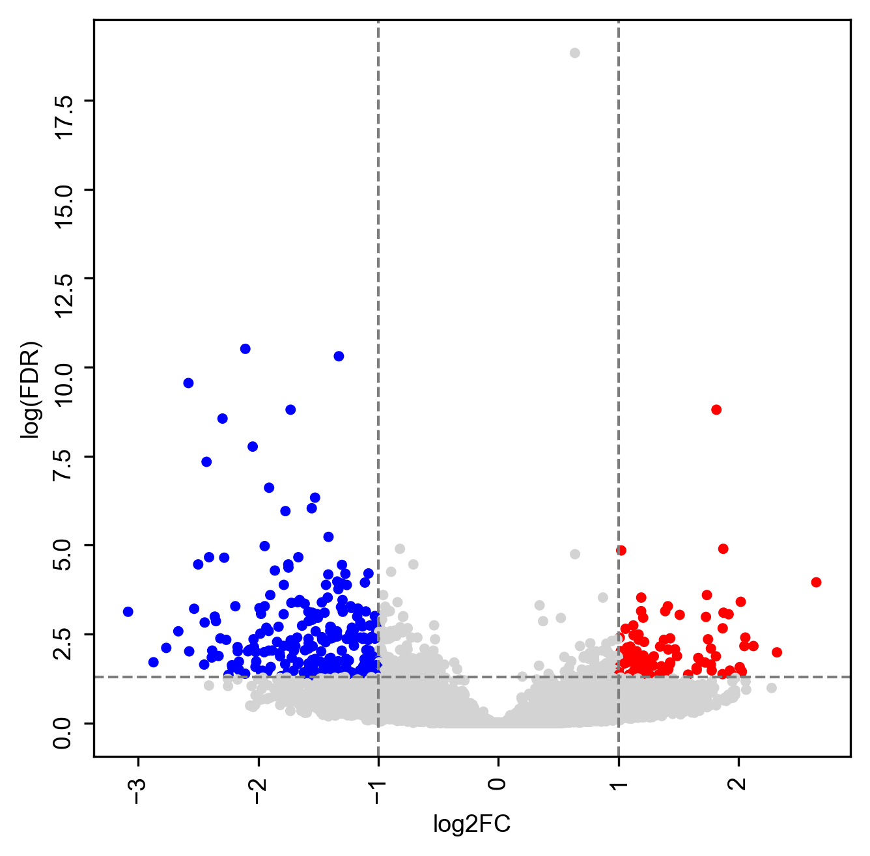
CUT&RUN (H3K27Ac)
WT vs KO
HET vs KO
187 H3K27Ac_wt_down
218 H3K27Ac_wt_up
236 H3K27Ac_het_down
96 H3K27Ac_het_up
Notes:
187 H3K27Ac_wt_down
218 H3K27Ac_wt_up
236 H3K27Ac_het_down
96 H3K27Ac_het_up

Slide 43
GREAT
WT vs KO up (GO Molecular Function)
  GPI-linked ephrin receptor activity
WT vs KO down
HET vs KO up
HET vs KO down

Slide 44
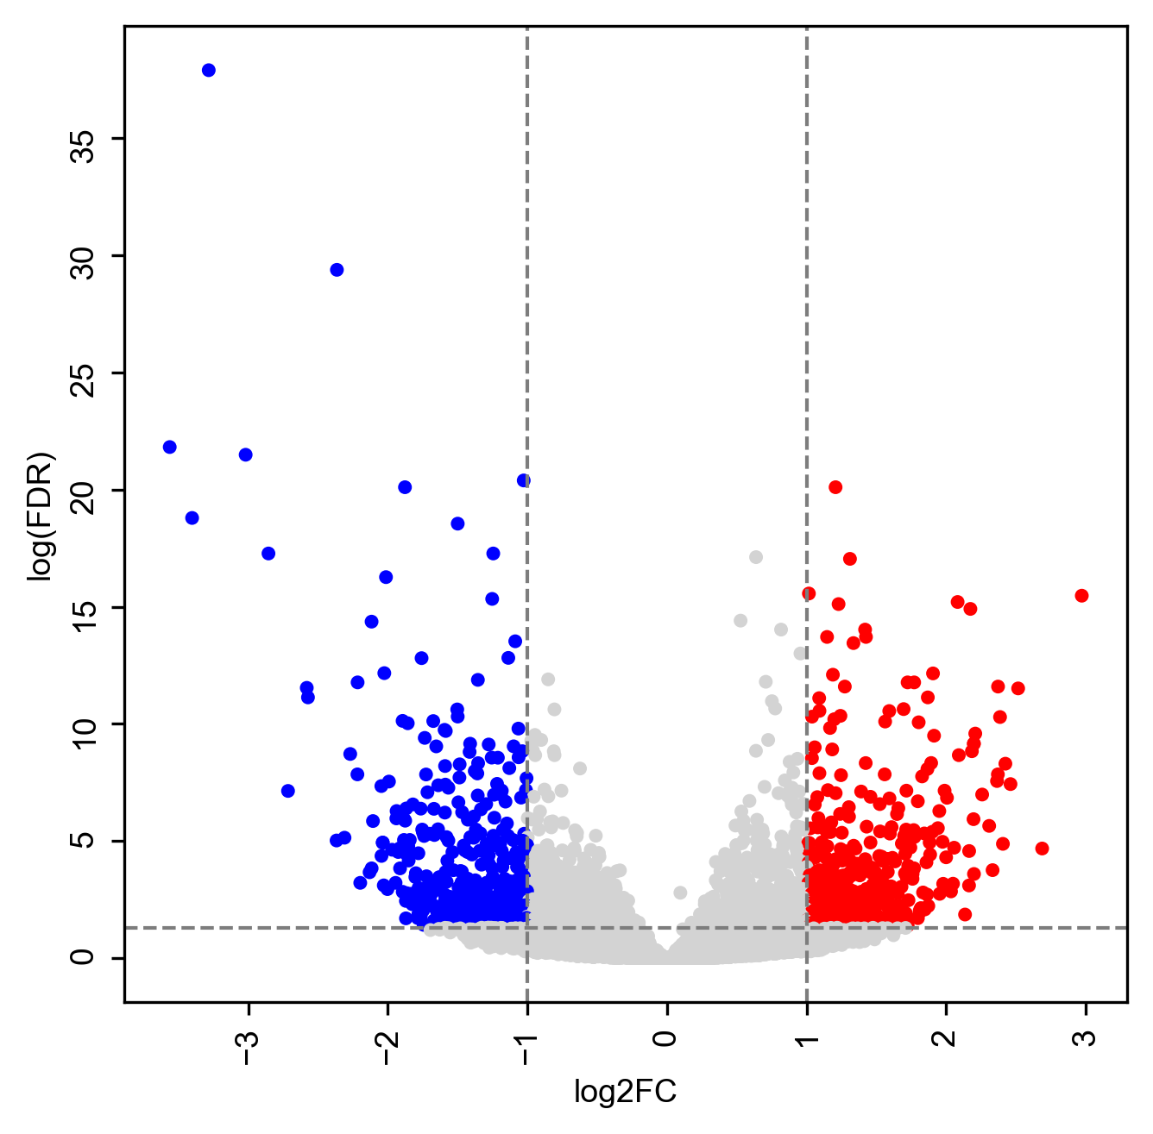
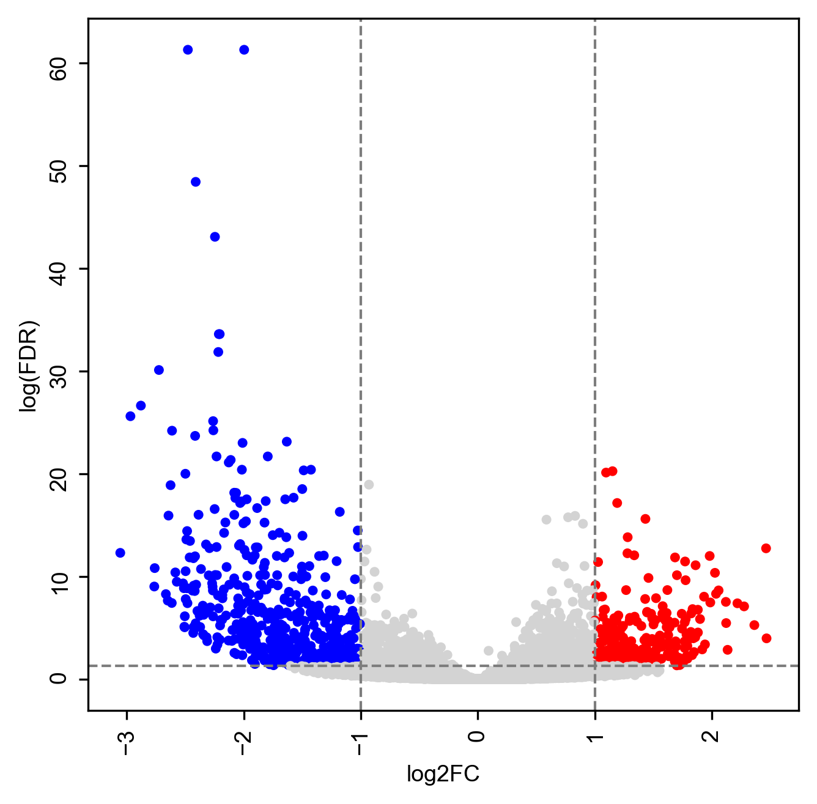
CUT&RUN (H3K27Me3)
WT vs KO
HET vs KO
395 H3K27Me3_wt_down
408 H3K27Me3_wt_up
499 H3K27Me3_het_down
269 H3K27Me3_het_up

Slide 45
GREAT
WT vs KO up (Biological Process, Molecular Function)
WT vs KO down
positive regulation of potassium ion transport
hair follicle development
skin epidermis development
hair cycle process
hair cycle
regulation of membrane depolarization
regulation of endothelial cell chemotaxis
regulation of cardiac muscle tissue development
regulation of cardiac muscle tissue growth
regulation of cardiac muscle cell proliferation
regulation of cation transmembrane transport
regulation of heart growth
glycosphingolipid biosynthetic process
Growth factor binding

Slide 46
GREAT
HET vs KO up (Biological Process, Molecular Function)
HET vs KO down
  positive regulation of potassium ion transport
  glycosylceramide metabolic process
  regulation of cell growth
  axonal fasciculation
  regulation of cardiac muscle tissue development
  glycosphingolipid biosynthetic process
transcriptional repressor activity, RNA polymerase II transcription regulatory region sequence-specific binding
RNA polymerase II regulatory region sequence-specific DNA binding
RNA polymerase II regulatory region DNA binding
UDP-glycosyltransferase activity

Slide 47
ChIP-Seq peaks with rmsk
Sample | MACS Peak | Overlap with rmsk | Overlap with low complexity & simple repeat
e15_wt_rb_Bcl11a_BCH1007_R1 | 461 | 142 | 64
e15_wt_rb_Bcl11a_BCH1008_R1 | 85 | 46 | 13
e15_wt_rb_Cux1_BCH1001_R1 | 50 | 40 | 8
e15_wt_rb_Cux1_BCH1002_R1 | 92 | 64 | 36
e15_wt_rb_Fezf2_BCH1003_R1 | 978 | 331 | 119
e15_wt_rb_Fezf2_BCH1004_R1 | 367 | 108 | 37
e15_wt_rb_mcSatb2_BCH993_R1 | 6054 | 5249 | 4574
e15_wt_rb_mcSatb2_BCH994_R1 | 1485 | 1349 | 1166
e15_wt_rb_pcSatb2_BCH995_R1 | 7539 | 6482 | 5544
e15_wt_rb_pcSatb2_BCH996_R1 | 1563 | 1422 | 1205
e15_wt_rb_Sox5_BCH997_R1 | 20 | 13 | 4
e15_wt_rb_Sox5_BCH998_R1 | 24 | 13 | 8
e15_wt_rb_Tbr1_BCH1000_R1 | 36 | 19 | 8
e15_wt_rb_Tbr1_BCH999_R1 | 138 | 43 | 11
Sample | MACS Peak | Overlap with rmsk | Overlap with low complexity & simple repeat
p00_gtcvangl2_bc812 | 3 | 3 | 1
p00_gtcvangl2_bc820 | 2 | 2 | 0
p00_msxxsatb2_bc810 | 11872 | 5224 | 2103
p00_msxxsatb2_bc818 | 15748 | 7534 | 3173
p00_rbmcsatb2_bc809 | 15980 | 5419 | 1550
p00_rbmcsatb2_bc817 | 20938 | 8696 | 3197
p00_rbnvangl2_bc813 | 120 | 48 | 42
p00_rbnvangl2_bc821 | 803 | 353 | 266
p00_rbpcsatb2_bc808 | 19128 | 6694 | 1886
p00_rbpcsatb2_bc816 | 23651 | 9331 | 2892
p00_rbpvangl2_bc811 | 8201 | 4130 | 2714
p00_rbpvangl2_bc819 | 1293 | 670 | 470
Notes:
E15, p0

Slide 48
Tbr1
GSE71384 : ChIP-seq for Tbr1 on mouse whole cortex dissected from embryonic day 15.5 (E15.5) embryos
7324 peaks in GSM1833461_mm9.tbr1.idr01.MACS2.bed
7324
GSM1833461_mm9.tbr1.idr01.MACS2.bed
7324
GSM1833461_mm10.tbr1.idr01.MACS2.bed
liftOver
6175 out of 7324 (84%)
overlapped with mm10 pipeline output peaks
12658
step3.2_peakcall_e15_rabbit_Tbr1_R1_peaks.broadPeak
Raw fastq data
GSM1833461 Tbr1_ChIPSeq
GSM1833462 input_DNA
Mm10 ChIP-seq pipeline

Slide 49
Tbr1
Peak comparison
Samples | MACS Peak | Overlap w/ benchmark | SEACR Peak | Overlap w/ benchmark
E15.5 Tbr1 benchmark | 12658 | - | - | -
p0_wt_nuclei_rabbit_Tbr1_BCH930 | 934 | 424 | 11081 | 2132
p0_wt_nuclei_rabbit_Tbr1_BCH931 | 292 | 121 | 11421 | 2016
p0_wt_nuclei_rabbit_Tbr1_BCH932 | 516 | 221 | 5772 | 1423
e15_wt_rb_Tbr1_BCH999 | 138 | 106 | - | -
e15_wt_rb_Tbr1_BCH1000 | 36 | 13 | - | -
C&R
ChIP
Notes:
http://epigenomegateway.wustl.edu/browser/?blob=5Vpdc.K4Ev0rU95XvmRCZsxblkrtTu2d2WxCZR62brlku8Fa5I.VZBhC5b9PyxhjEgcwjEPCPlBlWd2t7qOj0y7jhTGGMArgKw3A6BtBQDpGw5gymH0OFYgp5UZ_YUhFhTL6n6xPVs80L0jDgNDLxpfdnvXYMJSg7kQa_b8XRriMdZtwEBhMzWM9FNmQUwcwaD4dxYpFIXounkxh0EToIRoFoKhHFdVWQ73Sh42oaMrkHXBwFWBeI8olNIwR4_Cn888ygh7o9P5fSBWvmRzCdywtc1E4GEThiI1xJYxKY1Yc_puAmF.HXhyxEJ0Wj4.NvFwBo98ghHXBCCzQMIwU1QUWKl9bltS.mtyr.idLnAyGRsaiFYMKsOCEG3kwiIL4_ovZ2wOe5x4lMD01Ohe4biEGqr5QOdk4O.ndYHU3PyebxmUnqWiRY.QrFct.uz1lD37itGaJVLwFXtKOE4czt62TaotATshly3G2Hr9iYm_hFALp2YI6DlP20BHEdpAnfkDFZA2mw8YzDLWGcZtPAVM34pHQ_jzRZ9fB9MciSrQQGr8MOtfdwWCvoBvbgLsgYByAJ8WUFHbiJt0J..7manDdnicPqxu.Cnjb9SFsp1Fd5D8VTEZhWyqIuy1i4175c_7Xlf00g1s091ncwvq_pfUXd1XSIOYpOlsAo.MMYrzeoEFmccIDpetALuMiA8QwCj7oQYEXS3RMG.k6cSnnz9ApqxuLWG9opQgltBFptB2sqbBIrTTakgHSSM_JliMi6t3gZUtGAje8NX6oQCodYyulEK43zCeNykzZwlmC8uvgd9Lp6EenbSJT6nCUwpREfE15eb78nirzMl7npjElEAXUlZVU5uUYP1VnXlrmNZWmnFGVBecZv85ObizLqqQ2S_ufKDY64Om0BlffX2rKsTpvpdEAHSk0hRA16ky.yulkJiPTISqzQa13LjJxR.MSJi4HtvHIp.vsbnu42e15sPDsCv1aErQjjwpiVIrkkjOxnnpnWrQLmG0itKfvoeqzV_iaCLRj7bXMHCY7RRJtyE4Jhd616tgSqFt4FVaNQCvnuhi0jH8iCkklWIhvElULQalOm5vrqz_OlTbk4GalPWtqVuSNNKt9XwW.iOS5NitE8OBmlfvWIzVZ.JMoDTm6WRVIdM7NihzTrNbOdTHohM2KHNSs_iO0MQ9uVtqzpmZlvpFmZVZpVmVInmuzMo9oVrlvPVKThT.J0phHN6sCic5adY5pVmvnuhh0wmZlHtSs3jltMPKqtiHgtx.42KrArK5lQWiHm4Bbfgcqyygf36efjXnw3eg38RuxNOv_AeLofWOe8o0.MTtIDKQEh8.aFpcXowtCoNMcjbyLJl55TYd0nab10eqBRT5a3ZF.BkCk_GiGO_KVTtmYKs0yJRKsPp.5v80R4XQeJVmtPhv7HH.rVD38D3rogz4eqfXjDw--

Slide 50
DBR Analysis
Sample | Age | Genotype | Antibody Target | Merged Region
BCH933, BCH934, BCH935, BCH975, BCH976 | P0 | WT | H3K4Me3 | 20534
BCH977, BCH978 | P0 | HET | H3K4Me3
BCH979, BCH980 | P0 | KO | H3K4Me3
BCH981, BCH982 | P0 | WT | H3K27Me3 | 33551
BCH983, BCH984 | P0 | HET | H3K27Me3
BCH985, BCH986 | PO | KO | H3K27Me3
BCH969, BCH970 | P0 | WT | H3K27Ac | 31394
BCH971, BCH972 | P0 | HET | H3K27Ac
BCH973, BCH974 | PO | KO | H3K27Ac
Notes:
http://epigenomegateway.wustl.edu/browser/?blob=7Z3vb5s6F8f_lYm9bRMIaZL2XZc73U332e6ertpeXD1CBtzADYE8YNp1Vf_3HVJ.mOA2JobGYUSKFMf2OcdfDp8gjpM8KAvsByv8Ga2wcqGsVpqqnCi3Lr776BMc3iJPuXhQIoJColxoqj6eatpEP1Gwb6dtfTaePJ4oJETWMlIu_nlQ_CdbV7GHQzBG7tdJM0ybHjIxGM27gzVxAx9mPmx1gdE4TJowaIUJshFByajrxNObklUY6kZfsYctgiGuG.RF.ES5cT38t_nvk4WkkYT3PypUeO1G1_gHLC2dQqAxD_wbdwGewCpau3Tz_zEO79_79jpwfZj08Ph4ki83xDd_Yh8XCwZhMfL9gKBkgdTKi5GMtWedXKvfcnEwGU7SLMoyiJIFOqzAxvNgtf72aXTGIU91BkOm7UFdkesKrzEin1C0LJ07m3dX2bv5eVIezDqT6BG5Rg4h6.hiOLx1fzqxObiLI.INsB0P17HpudYwCWoYrqKlNhmY5ounHx2YDGfhBzcigY.NP95dFfJZiOBFELoW0KxQrzyUEi8dfp.8dvTlaIosw8HEuCOGHdz5ydupN1bviWIFXhBC79ubGxUeiS5bA.P180agr2RifFY2sQxeCITqpIzoI8vWR1UjzDDyLsqAqs7ohayw_pIg290lQ5Mx21A1lnInZcQaYU3dnPL5uOdF2eotSZscH4YZdigsXSYTy0YoNTF.UZZKL2Vmhs41O4uEHrgdyVYfrYl9Zp1ZtInnJNnupIzg8_PJtLQctiDlLsqAaZvTianACck8y0oAAv6EeLHCdhTeahSDvmwYZHz9cjl_P7yPf2ZvOGTlDS0H.0MrJmHsGyN1pA8dMA.mk1ASXZbBcNNyiWMUpB.Y2B5EQQhYGix.vsQzmhQH_HhIYgMyg5M56BKs3iQNinJrNVmwH1sedo0QmaZLjA_6X.NPcFzezT.c67pxpRmW4yZHJ12a6S7uwGVxZGoZofGYHm3Ti5NrGBPWvQiDOLkgVN7O1ff6fL6fl1dJj4jgtT7QDEgB597776XBH.AAJPy.kZDOnwit1t7mo.dpEnSjxdNBgpfJB316AO4ItEvZlh6S4060FbIiKstgBbUOfjqdkV_hxpR4em08vEpu7Q5mYIYBsr9gtDTgwmkZFe1n.SSSX6DgMSfXuAmK0Ubao1jhRVKK5QH2FGOJI0SxfHprFEs9yEGxcU.xOsl11gTFaCPtUazwIinF8gB7irHEEaJYPr01iqUe5KDYWU.xGsk1bYJiJSOtUYzyIifFigB7irHEEaFYMb0timUepKDYtKdYreSaNEEx2kh7FCu8SEqxPMCeYixxhCiWT2.NYqkHOSgGZcaeYnRyQXHlBbnO.SjGb0SEYrxeDkYxzgAFKbYMjpJiu8TZQTHO6QIU4_LwWhTbEUybFGPk13FTbKY2QLGSkdYoRnmRk2JFgD3FWOKIUKyY3hbFMg9SUGym9hQrJ1ci3AvUn_JhrIYVEY5xuzkYyHgjFCQZuDlKlO2UZwfLeOcLwIzPxWvRbFc0beKMlWTHzrNZIzyjrbTIs8KNrDzLI.x5xpZHjGf5_PZ4lrqQhGeznmc8GTaa5he0nHth65hpnGhMP3IhjRXibqZtZv0eUCsJtA_VWAaaxlrVx0G5RocjCLb6mXb0ZOPcH1vHTJtkk2CPLHeIPdmeE0iQbE3sleX0IQvZRPfLdpBsrFuQlGKcm81qWGm6NsB0I1VxgBWhKNU6VB4oybNHfYA1v.ECQdXFISsEdDStAq0rlU5KMM5tZzWstMgzCTae8UbY84wtjxjPmth8xudCEp6Jbj_rHs9Y2_UowbT9t9E.Y6XpfbRMN1JtpGVFKMqzDm2lLcmzx15a1vyGN9NWXRxyNy0dTas868q3AijBRo3wjLbSIs8KN7LyLI.w5xlbHjGe5fPb41nqQhKejXqe8d2mvbSeisSc12c1rLRQF6i6ka0sUImQh2eX1u9SFCjk2a8mUJnffElgy8WBKwJ5NMI8q5lkx84zzuuzGlZa5JkE12e8EfY8Y8sjxrMmrs_4XEjCM_Hrs67xjH3DMdOLc0cav5HmqwFVL5IVAyoBCrKsU6WAQpy9KgGV6Y0XArY8HLYOkAfTJsa6U9XM5OLcfcZvpD2KSbDzjDPAnmIscYQo1sSOMy4PclBMfLdZxyjGvrmYyjXh_C0NfiPN3_mvepHsxn8lQEGKdeq2fyHOXnf9K9Mbv.m_5eGw9_zzYNqkWHcqmBn0OX9Lg99IaxSjvMhJsSLAnmIscUQoVkxvi2KZBykoNhX9LY0uUAwsZ8u7xvCnUuAsWyO1HBgFhwhS4ismaTx5.9vm3.hs_EO5ONXSmP.DYar93bWJA_9DN1IhcSBlPPwxSRt7ok9U01JPVdU8P9U0jE_N2Q06hb.3gf8OGo_PR7Mk1UAnJ7hz_cVndOsuEEmyEA43rD3v.XaV6.Gh.yBOV.q4C8eDZxaqjcLltYOTU2gz.vEX

Slide 51
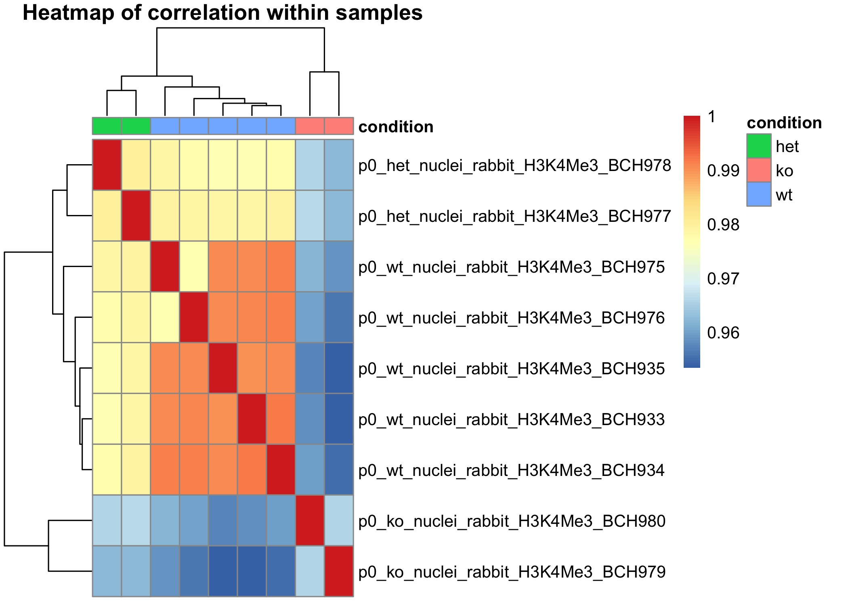
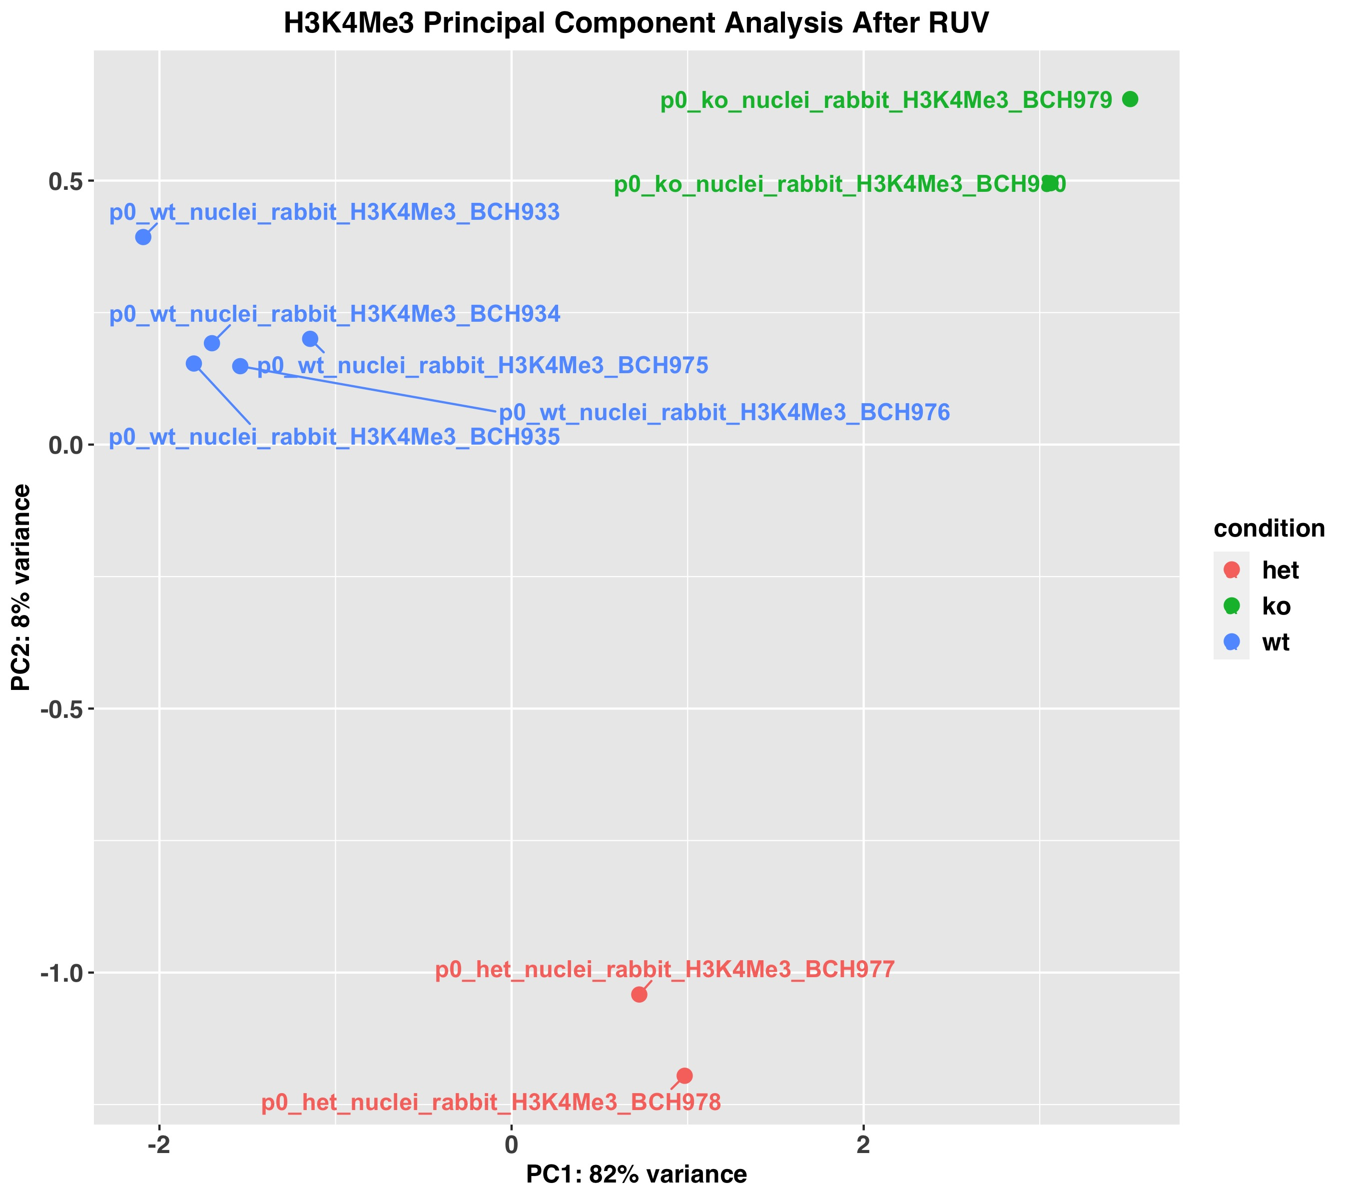
CUT&RUN (H3K4Me3)
RUV k = 1

Slide 52
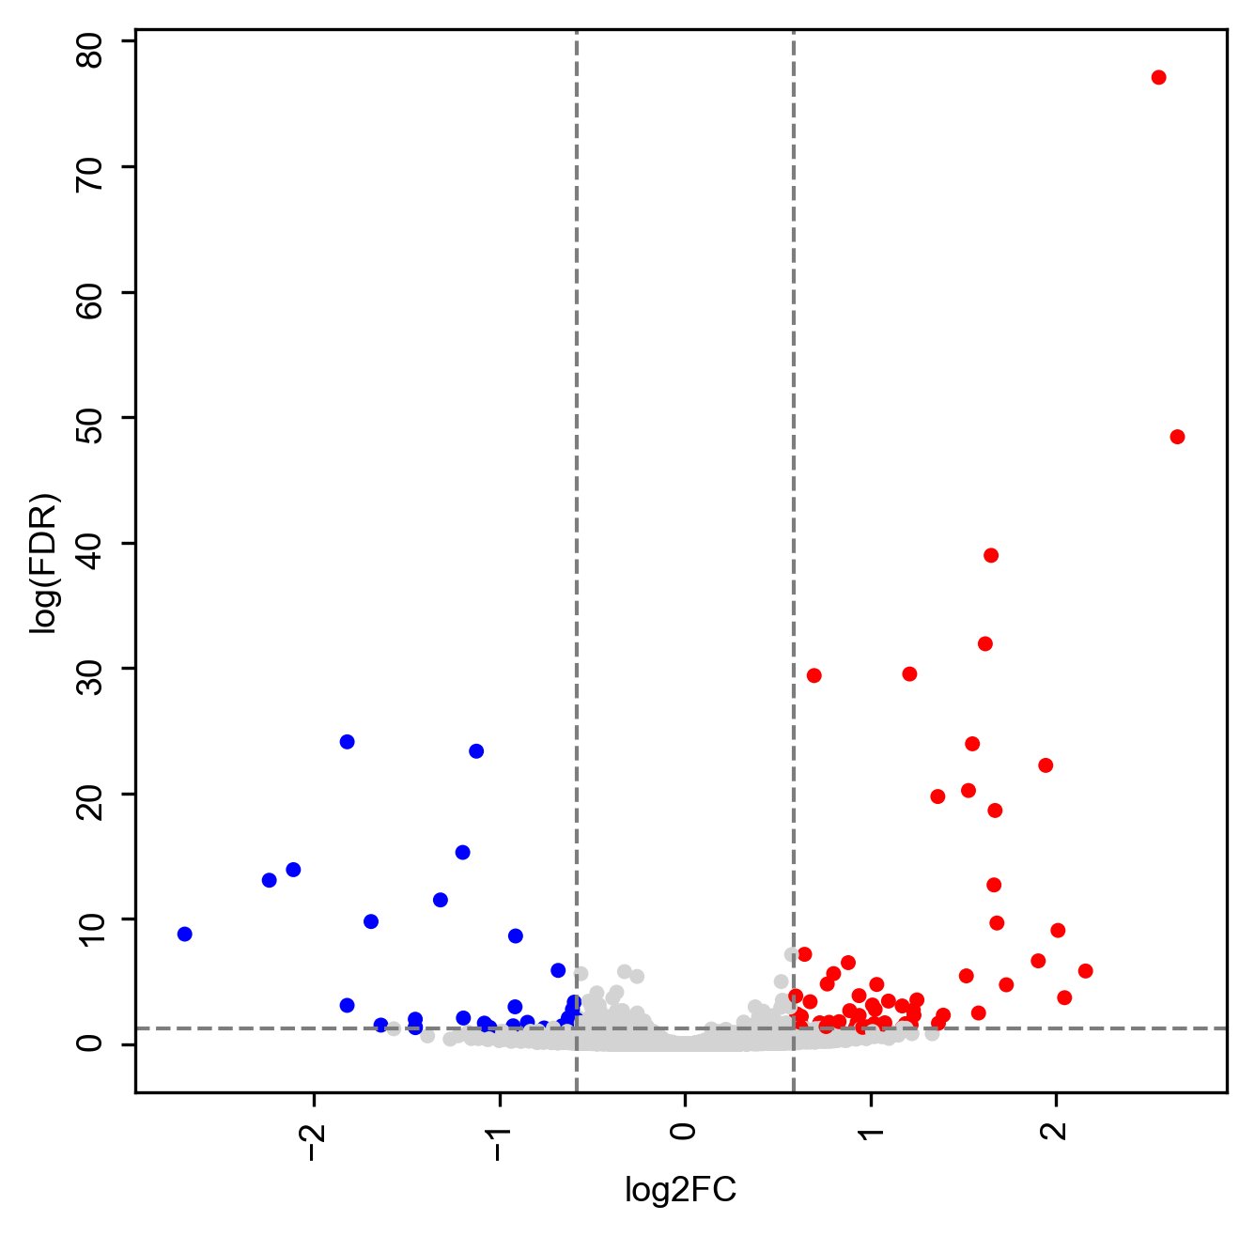
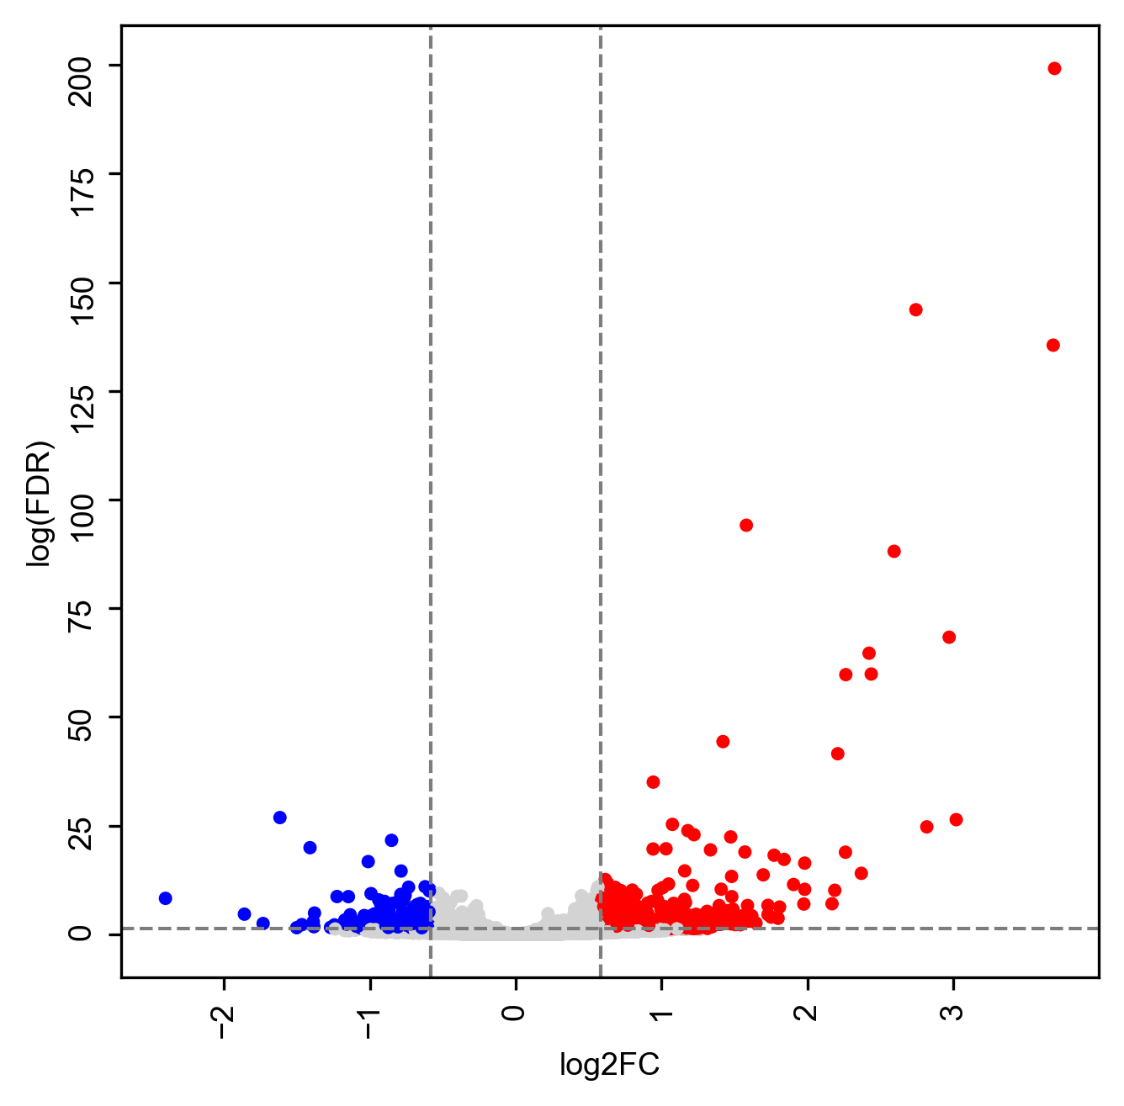
CUT&RUN (H3K4Me3)
Cutoff FDR<0.05 and |logFC|>log2(1.5)
h3k4me3_het_wt_DBR
63 up regulated DBR
33 down regulated DBR
h3k4me3_ko_wt_DBR
673 up regulated DBR
205 down regulated DBR
42
4
Notes:
2763 DBR totally

Slide 53
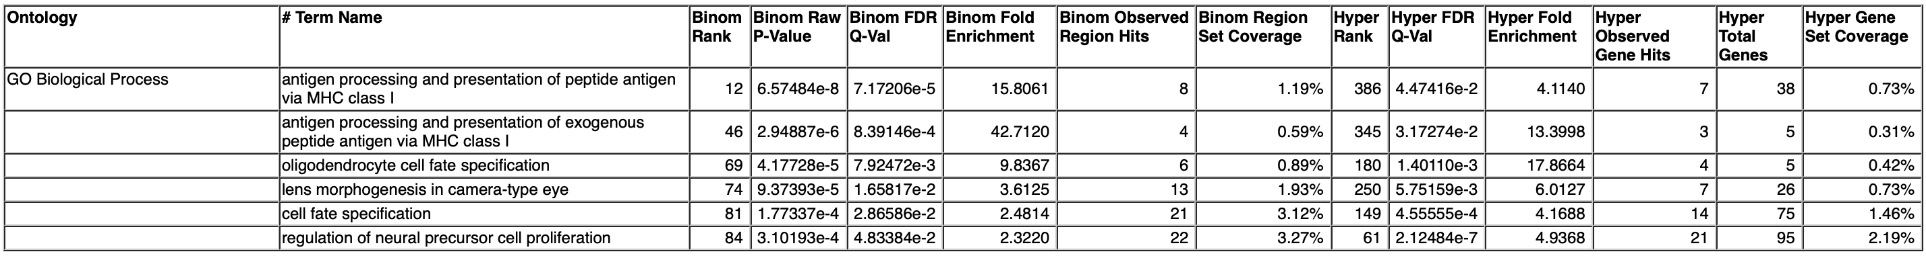
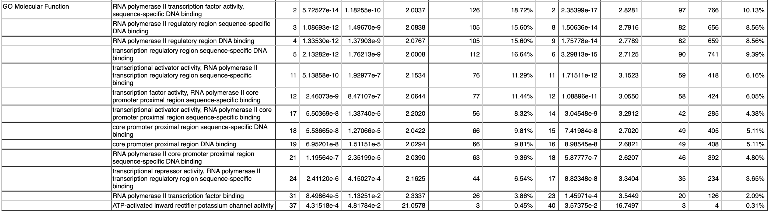
GREAT - H3K4Me3
Up DBR in ko vs wt
Down DBR in ko vs wt
  No terms

Slide 54
GREAT - H3K4Me3
Up DBR in het vs wt
  No terms
Down DBR in het vs wt

Slide 55
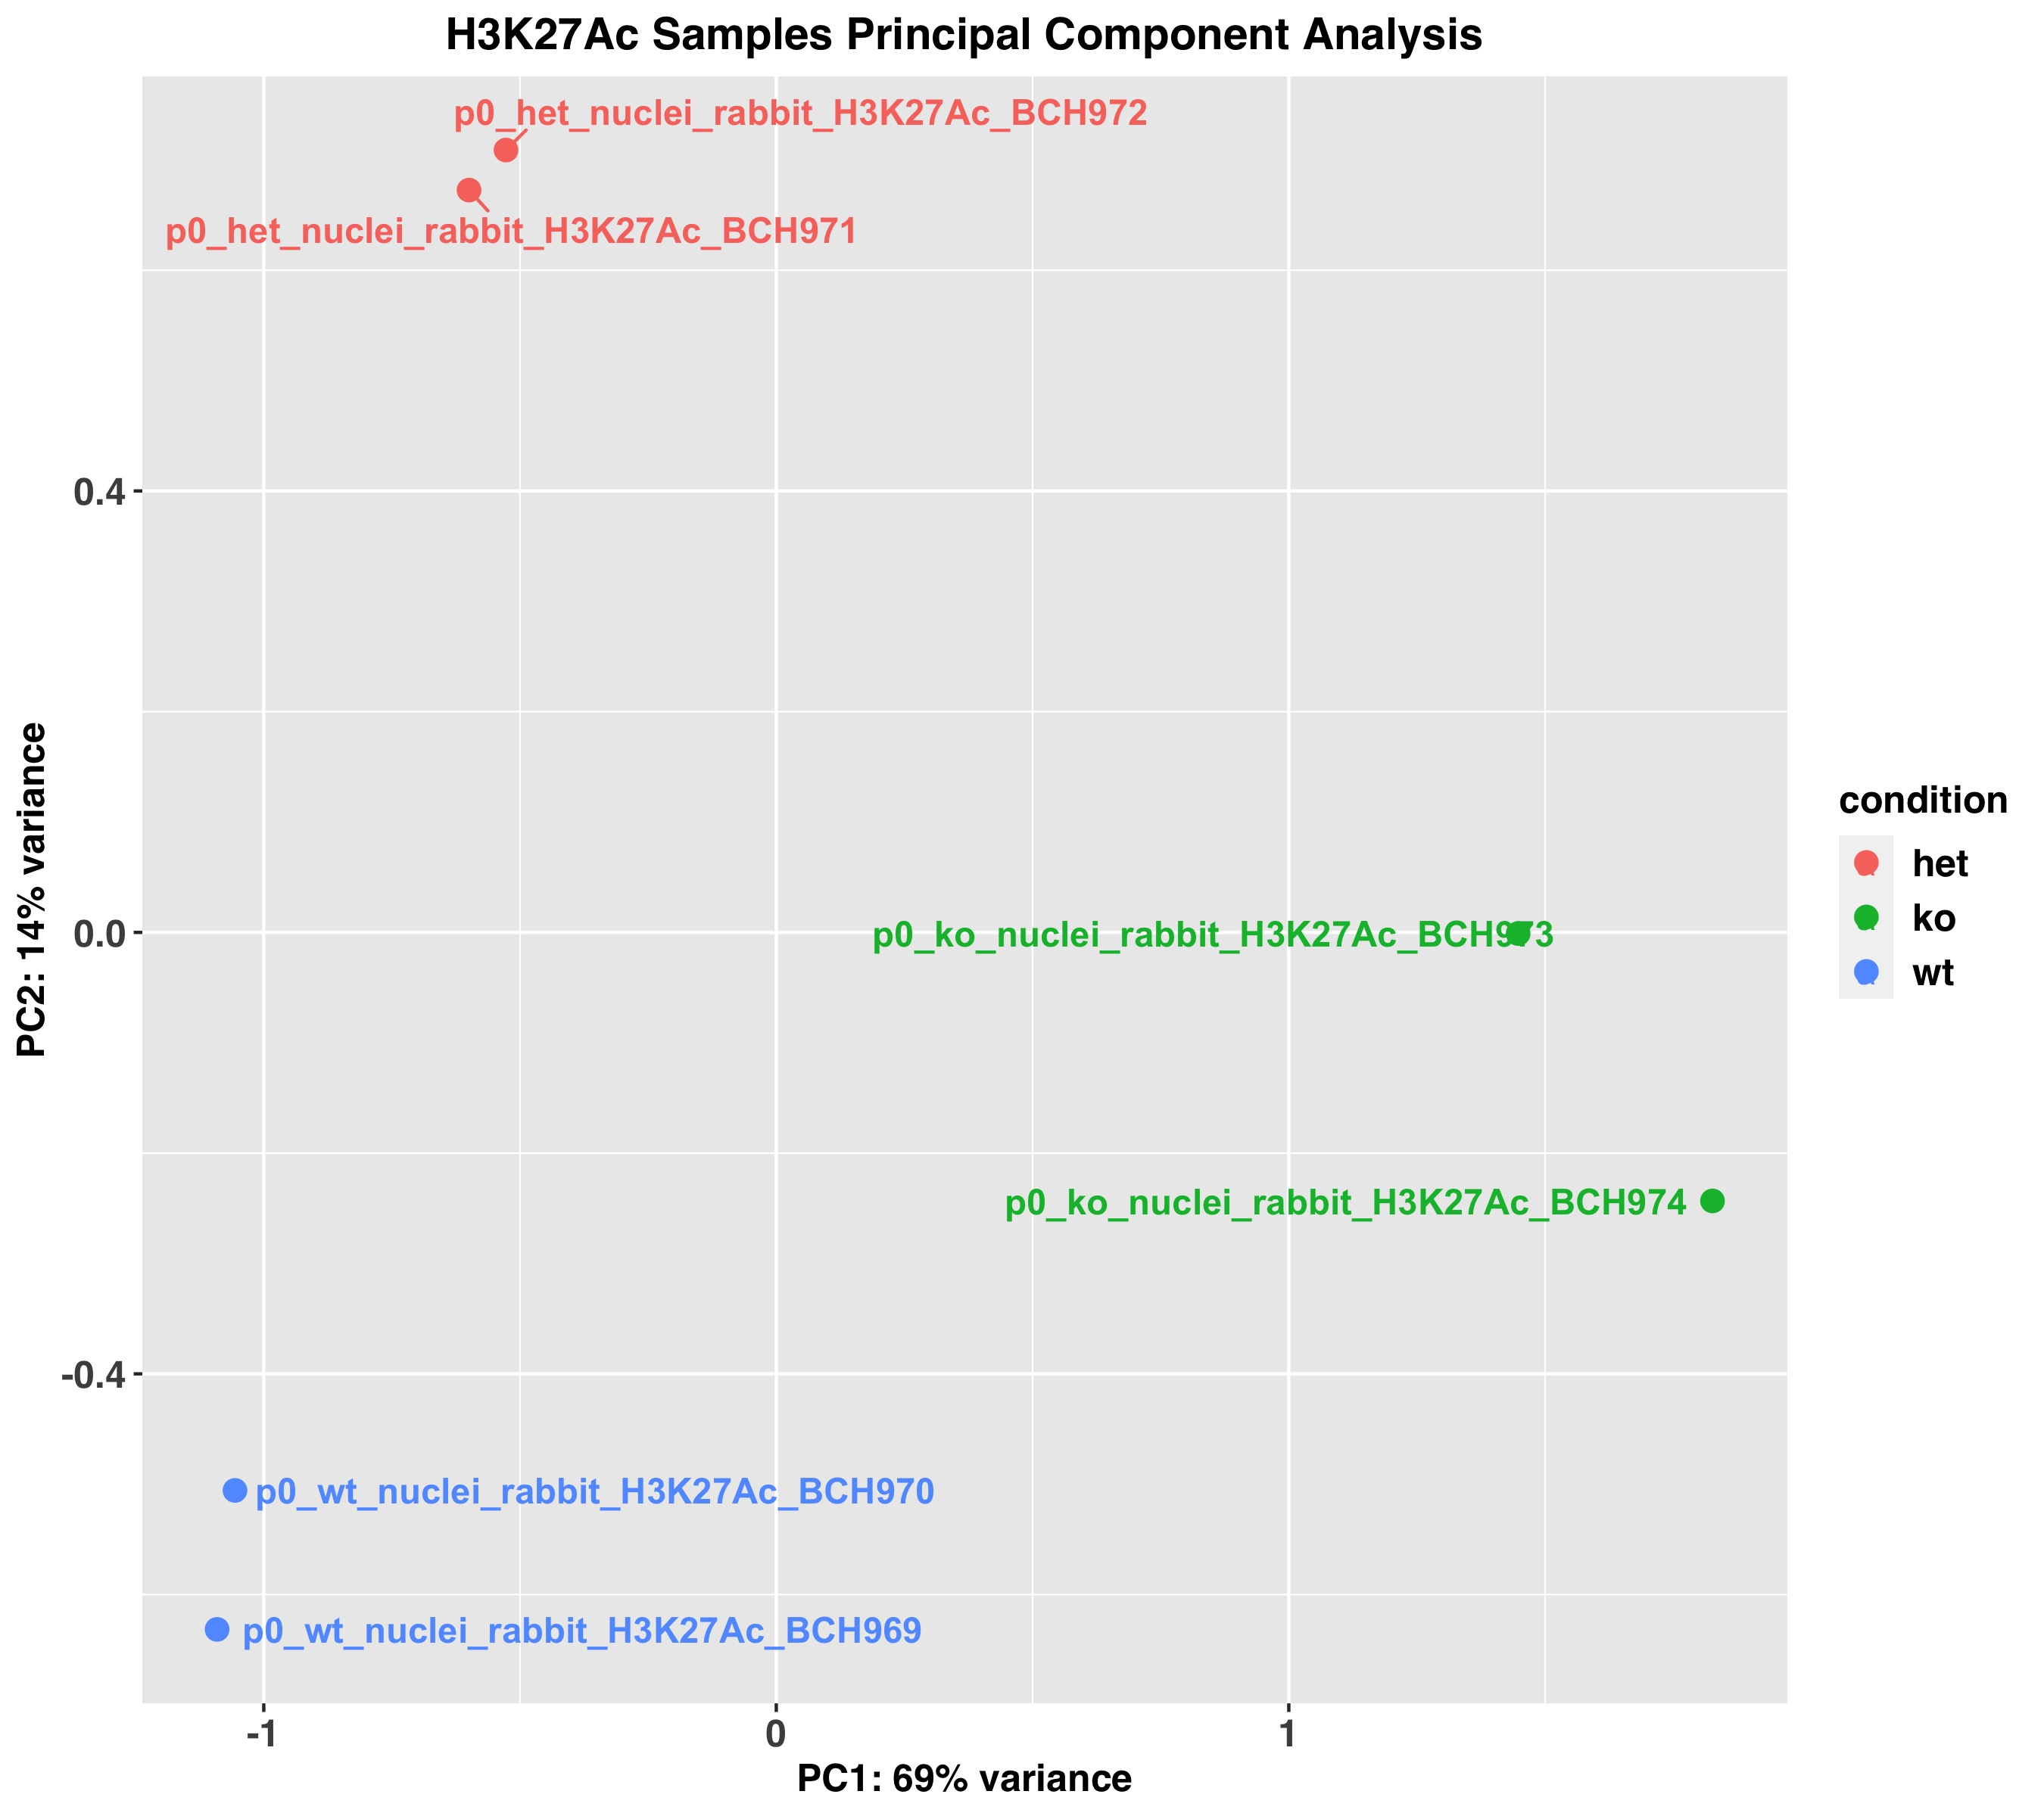
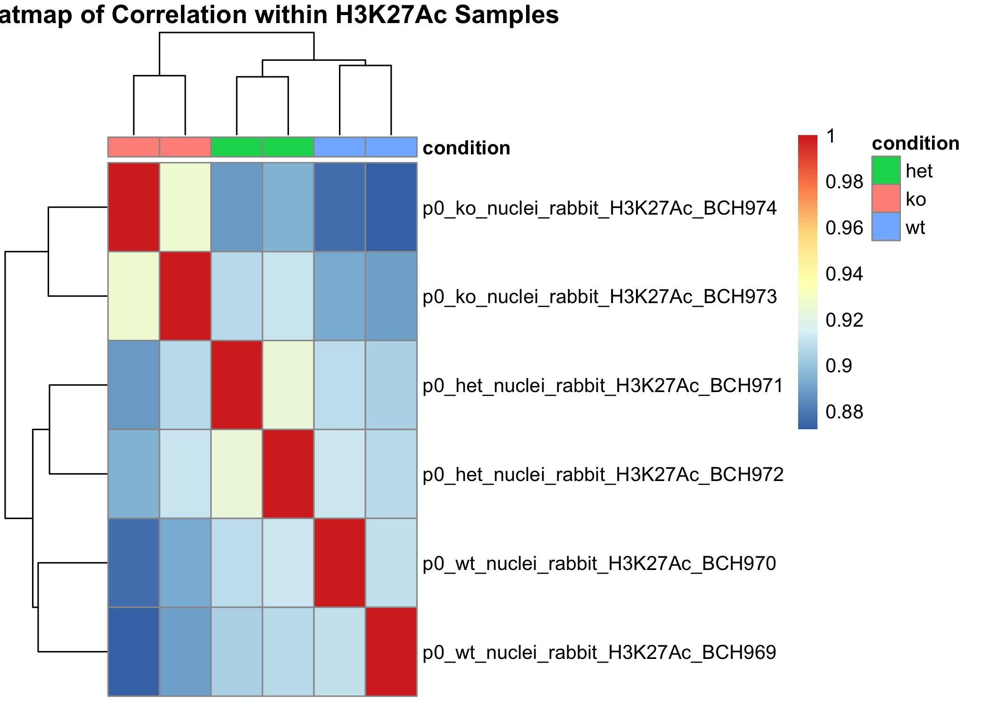
CUT&RUN (H3K27Ac)

Slide 56
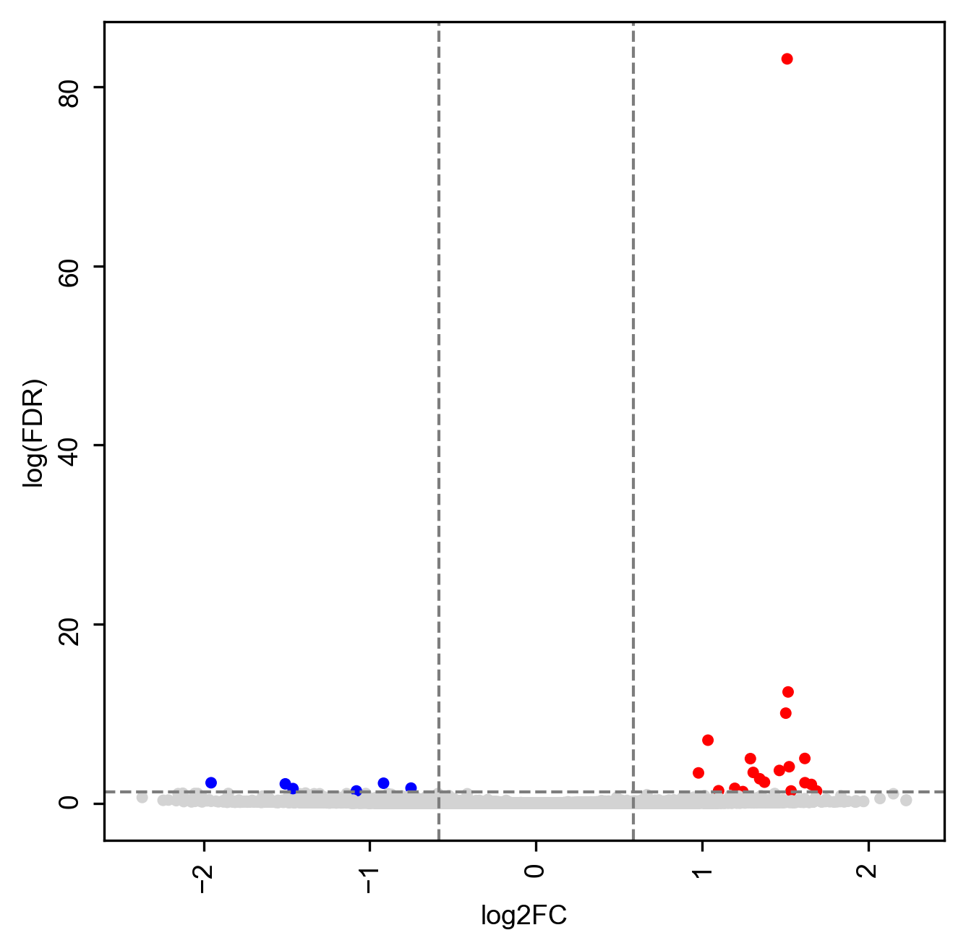
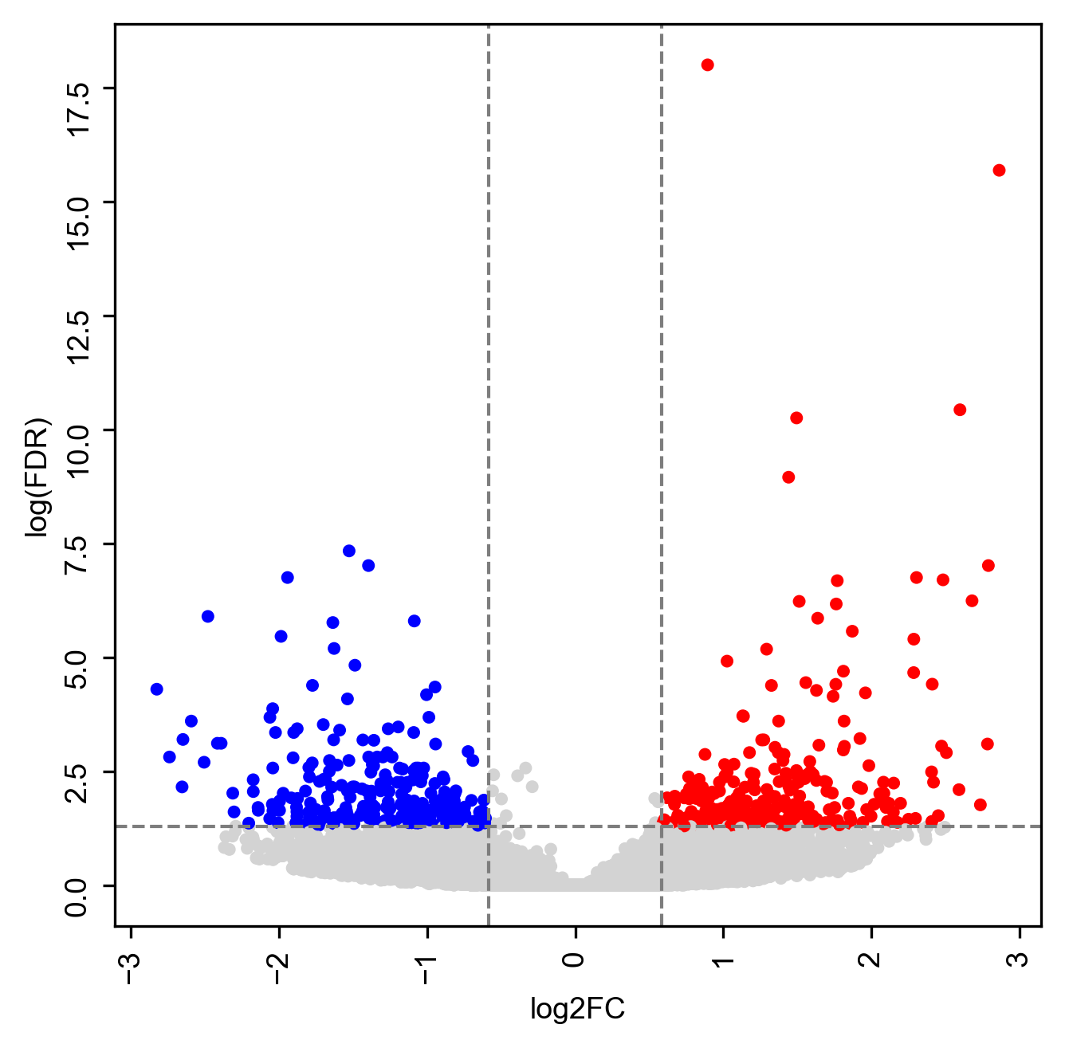
CUT&RUN (H3K27Ac)
h3k27ac_het_wt_DBR
19 up regulated DBR
6 down regulated DBR
h3k27ac_ko_wt_DBR
250 up regulated DBR
262 down regulated DBR
12
3

Slide 57
GREAT - H3K27Ac
Up DBR in ko vs wt
  No terms
Down DBR in ko vs wt
Up DBR in het vs wt
  No terms
Down DBR in het vs wt
  No terms

Slide 58
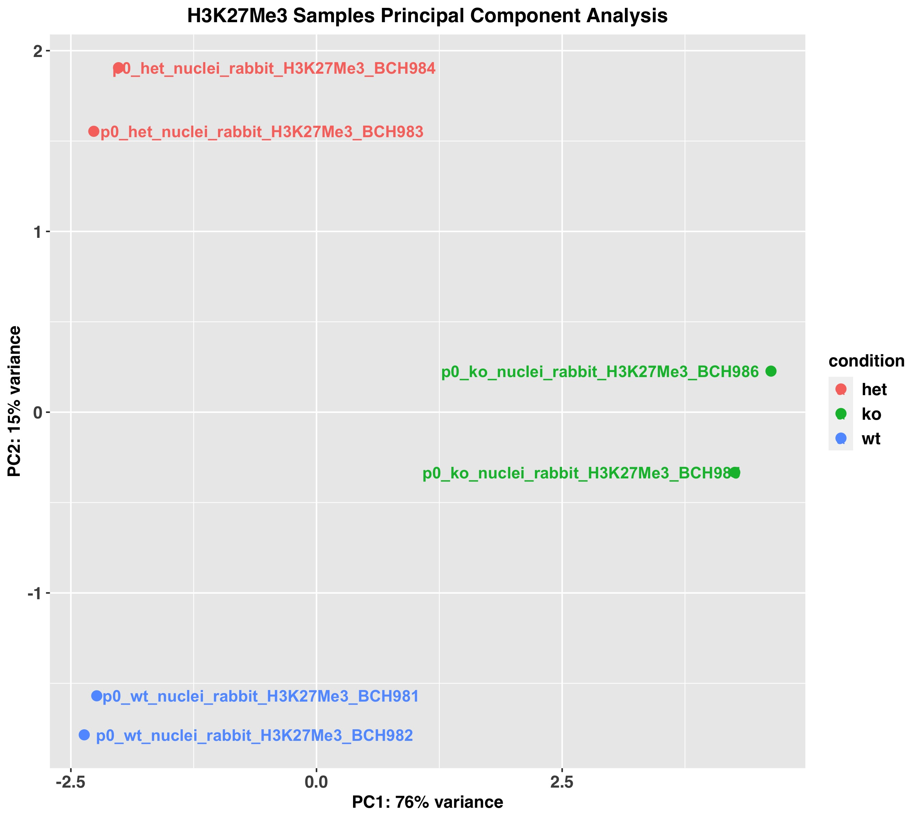

CUT&RUN (H3K27Me3)

Slide 59


CUT&RUN (H3K27Me3)
h3k27me3_het_wt_DBR
21 up regulated DBR
50 down regulated DBR
h3k27me3_ko_wt_DBR
560 up regulated DBR
621 down regulated DBR
12
8

Slide 60

GREAT - H3K27Me3
Up DBR in ko vs wt

Slide 61

GREAT - H3K27Me3
Down DBR in ko vs wt

Slide 62
GREAT - H3K27Me3
Up DBR in het vs wt
  No terms
Down DBR in het vs wt

Slide 63
Satb2
Sample | Age | Genotype | Antibody Target | MACS | SEACR
BCH963 | P0 | WT | Satb2 | 8 | 15622
BCH964 | P0 | WT | Satb2 | 2 | 0
BCH965 | P0 | HET | Satb2 | 11 | 0
BCH966 | P0 | HET | Satb2 | 1 | 17742
BCH967 | P0 | KO | Satb2 | 1 | 1
BCH968 | P0 | KO | Satb2 | 0 | 23921
Notes:
2763 DBR totally

Slide 64
Satb2
Sample | Age | Genotype | Antibody Target | MACS | Merged peaks
BCH954 | P0 | HET | McSatb2 | 2308 | 3536
BCH955 | P0 | KO | McSatb2 | 2172 | 1
BCH956 | P0 | KO | McSatb2 | 951 | 23921
98/3536 overlapped with DBR
Previous merged ChIP-seq p00_rbmcsatb2_peaks: 23358
3116 out of 3536 overlapped with previous peaks.

Slide 65
H3K4Me3 and H3K27Me3
4609 H3K4Me3 peaks overlap with 4602 H3K27Me3 peaks
4609
  13 Het up
  10 Het down
  316 Ko up
  50 Ko down
4602
  6 Het up
  6 Het down
  136 Ko up
  48 Ko down
4609
(4602)
15925
28949
H3K4Me3 peaks
20534
H3K27Me3 peaks
33551

Slide 66

H3K4Me3 and H3K27Me3
In the H3K4Me3 and H3K27Me3 co-peak regions
Ko vs wt
  6 Up regulated in both H3K4Me3 and H3K27Me3
  0 Down regulated in both H3K4Me3 and H3K27Me3
  10 Up in H3K4Me3 but down in H3K27Me3
  6 Down in H3K4Me3 but up in H3K27Me3
Notes:
Chr1 20477700 20478841 up-down
Chr10 73821609 73822414 up-up

Slide 67
H3K4Me3 and H3K27Ac
11010 H3K4Me3 peaks overlap with 28949 H3K27Ac peaks
11010
  25 Het up
  17 Het down
  269 Ko up
  145 Ko down
12291
  5 Het up
  3 Het down
  70 Ko up
  36 Ko down
11010
(12291)
9524
19103
H3K4Me3 peaks
20534
H3K27Ac peaks
31394

Slide 68

H3K4Me3 and H3K27Ac
In the H3K4Me3 and H3K27Ac co-peak regions
Het vs wt
  2 Up regulated in both H3K4Me3 and H3K27Ac
  1 Down regulated in both H3K4Me3 and H3K27Ac
  0 Up in H3K4Me3 but down in H3K27Ac
  0 Down in H3K4Me3 but up in H3K27Ac
Ko vs wt
  11 Up regulated in both H3K4Me3 and H3K27Ac
  3 Down regulated in both H3K4Me3 and H3K27Ac
  0 Up in H3K4Me3 but down in H3K27Ac
  1 Down in H3K4Me3 but up in H3K27Ac

Slide 69


CUT&RUN (H3K4Me3)

Slide 70


CUT&RUN (H3K4Me3)
Cutoff FDR<0.05 and |logFC|>log2(1.5)
h3k4me3_het_wt_DBR
34 up regulated DBR
14 down regulated DBR
h3k4me3_ko_wt_DBR
175 up regulated DBR
69 down regulated DBR
31
3
Notes:
2763 DBR totally

Slide 71
6/7/2023

Slide 72
Satb2 in p0
Antibody Target | AnalysisName | Peak_number | Overlapped Peak | Overlapped Peak
Rb Satb2_Poly | p00_rbpcsatb2_bc808 | 19128 | 13736 | 4025
Rb Satb2_Poly | p00_rbpcsatb2_bc816 | 23651
Ms Satb2 | p00_msxxsatb2_bc810 | 11872 | 5946
Ms Satb2 | p00_msxxsatb2_bc818 | 15748
Rb Satb2_Mono | p00_rbmcsatb2_bc809 | 15980 | 10734
Rb Satb2_Mono | p00_rbmcsatb2_bc817 | 20938
HOMER
MEME

Slide 73
Satb2 in p0 and e15
Antibody Target | AnalysisName | Peak_number | Merged Peak
Rb Satb2_Poly | p00_rbpcsatb2_bc808 | 19128 | 26660
Rb Satb2_Poly | p00_rbpcsatb2_bc816 | 23651
Ms Satb2 | p00_msxxsatb2_bc810 | 11872 | 19187
Ms Satb2 | p00_msxxsatb2_bc818 | 15748
Rb Satb2_Mono | p00_rbmcsatb2_bc809 | 15980 | 23358
Rb Satb2_Mono | p00_rbmcsatb2_bc817 | 20938
p0
14155 overlapped peaks
Antibody Target | AnalysisName | Peak_number
mono Satb2 | e15_wt_rb_Satb2_BCH993 | 6054
mono Satb2 | e15_wt_rb_Satb2_BCH994 | 1485
Poly Satb2 | e15_wt_rb_Satb2_BCH995 | 7539
Poly Satb2 | e15_wt_rb_Satb2_BCH996 | 1563
e15
4421 overlapped peaks
Notes:
~240 overlaps between p0 and e15

Slide 74
6/26/2023

Slide 75
E-coli Normalization
Normalize to 50,000
sample | p0_het_H3K27Ac_BCH971 | p0_het_H3K27Ac_BCH972 | p0_het_H3K27Me3_BCH983 | p0_het_H3K27Me3_BCH984 | p0_het_H3K4Me3_BCH977 | p0_het_H3K4Me3_BCH978 | p0_ko_H3K27Ac_BCH973 | p0_ko_H3K27Ac_BCH974 | p0_ko_H3K27Me3_BCH985 | p0_ko_H3K27Me3_BCH986 | p0_ko_H3K4Me3_BCH979 | p0_ko_H3K4Me3_BCH980 | p0_wt_H3K27Ac_BCH969 | p0_wt_H3K27Ac_BCH970 | p0_wt_H3K27Me3_BCH981 | p0_wt_H3K27Me3_BCH982 | p0_wt_H3K4Me3_BCH933 | p0_wt_H3K4Me3_BCH934 | p0_wt_H3K4Me3_BCH935 | p0_wt_H3K4Me3_BCH975 | p0_wt_H3K4Me3_BCH976
non-redundant uniquely mapped reads (pair) | 53886 | 62821 | 53904 | 56164 | 102642 | 89411 | 45436 | 39077 | 45854 | 36779 | 57500 | 60104 | 48144 | 51045 | 49681 | 68343 | 49153 | 38179 | 50841 | 104592 | 101173
factor | 0.928 | 0.796 | 0.928 | 0.890 | 0.487 | 0.559 | 1.100 | 1.280 | 1.090 | 1.359 | 0.870 | 0.832 | 1.039 | 0.980 | 1.006 | 0.732 | 1.017 | 1.310 | 0.983 | 0.478 | 0.494

Slide 76


CUT&RUN (H3K4Me3)
RUVseq k=3

Slide 77


CUT&RUN (H3K4Me3)
H3k4me3 het vs wt
45 up regulated DBR
22 down regulated DBR
H3k4me3 ko vs wt
591 up regulated DBR
215 down regulated DBR
29
3

Slide 78


CUT&RUN (H3K27Ac)

Slide 79


CUT&RUN (H3K27Ac)
H3k27ac het vs wt
12 up regulated DBR
6 down regulated DBR
H3k27ac ko vs wt
290 up regulated DBR
262 down regulated DBR
8
3

Slide 80


CUT&RUN (H3K27Me3)

Slide 81


CUT&RUN (H3K27Me3)
H3k27me3 het vs wt
17 up regulated DBR
26 down regulated DBR
H3k27me3 ko vs wt
522 up regulated DBR
621 down regulated DBR
12
3

Slide 82
Satb2 (broad)
Antibody Target | AnalysisName | Peak_number | Merged Peak | Overlapped Peak
Rb Satb2_Poly | p00_rbpcsatb2_bc808 | 19128 | 26660 | 14155
Rb Satb2_Poly | p00_rbpcsatb2_bc816 | 23651
Ms Satb2 | p00_msxxsatb2_bc810 | 11872 | 19187
Ms Satb2 | p00_msxxsatb2_bc818 | 15748
Rb Satb2_Mono | p00_rbmcsatb2_bc809 | 15980 | 23358
Rb Satb2_Mono | p00_rbmcsatb2_bc817 | 20938
Antibody Target | AnalysisName | Peak_number | Overlapped Peak | Overlapped Peak
Rb Satb2_Poly | p00_rbpcsatb2_bc808 | 19128 | 13736 | 4025
Rb Satb2_Poly | p00_rbpcsatb2_bc816 | 23651
Ms Satb2 | p00_msxxsatb2_bc810 | 11872 | 5946
Ms Satb2 | p00_msxxsatb2_bc818 | 15748
Rb Satb2_Mono | p00_rbmcsatb2_bc809 | 15980 | 10734
Rb Satb2_Mono | p00_rbmcsatb2_bc817 | 20938
Merge replicates first, and then check
overlapped peaks between 3 groups.
(73% overlapped with mouse forebrain ATAC peaks)
Get overlapped peaks among 6 samples
with overlapped ratio > 0.5.
(80% overlapped with mouse forebrain ATAC peaks)
homer
homer

Slide 83
Satb2 (narrow)
Antibody Target | AnalysisName | Peak_number | Merged Peak | Overlapped Peak
Rb Satb2_Poly | p00_rbpcsatb2_bc808 | 17726 | 23781 | 11765
Rb Satb2_Poly | p00_rbpcsatb2_bc816 | 20233
Ms Satb2 | p00_msxxsatb2_bc810 | 9820 | 15747
Ms Satb2 | p00_msxxsatb2_bc818 | 12706
Rb Satb2_Mono | p00_rbmcsatb2_bc809 | 13222 | 19668
Rb Satb2_Mono | p00_rbmcsatb2_bc817 | 17435
Antibody Target | AnalysisName | Peak_number | Overlapped Peak | Overlapped Peak
Rb Satb2_Poly | p00_rbpcsatb2_bc808 | 17726 | 13666 | 5012
Rb Satb2_Poly | p00_rbpcsatb2_bc816 | 20233
Ms Satb2 | p00_msxxsatb2_bc810 | 9820 | 6197
Ms Satb2 | p00_msxxsatb2_bc818 | 12706
Rb Satb2_Mono | p00_rbmcsatb2_bc809 | 13222 | 10588
Rb Satb2_Mono | p00_rbmcsatb2_bc817 | 17435
Merge replicates first, and then check
overlapped peaks between 3 groups.
(74% overlapped with mouse forebrain ATAC peaks)
Get overlapped peaks among 6 samples
with overlapped ratio > 0.5.
(81% overlapped with mouse forebrain ATAC peaks)

Slide 84
Satb2 Peaks Distribution
Category | Count
3' UTR | 73
5' UTR | 13
Intergenic | 7895
TTS | 84
exon | 52
intron | 5687
non-coding | 24
promoter-TSS | 327

Slide 85
Satb2 Peaks Distribution (narrow)
Category | Count
3' UTR | 57
5' UTR | 6
Intergenic | 6630
TTS | 65
exon | 39
intron | 4725
non-coding | 20
promoter-TSS | 223

Slide 86
DBR (ko vs wt) with Satb2
H3k27ac
  218 down DBRs overlapped with Satb2 peaks
  24 up DBRs overlapped with Satb2 peaks
H3k27me3
  15 down DBRs overlapped with Satb2 peaks
  10 up DBRs overlapped with Satb2 peaks
H3k4me3
  19 down DBRs overlapped with Satb2 peaks
  51 up DBRs overlapped with Satb2 peaks
Notes:
2698 DBRs

Slide 87
Satb2 with H3K4Me3/H3K27Me3/H3K27Ac
1242 satb2 peaks overlapped with H3K4Me3
  862 of them also overlapped with H3K27Ac
  76 of them also overlapped with H3K27Me3
245 satb2 peaks overlapped with H3K27Me3
4359 satb2 peaks overlapped with H3K27Ac

Slide 88
Satb2 with H3K4Me3/H3K27Me3/H3K27Ac
Satb2 homer:
wt h3k4me3
wt h3k27me3
wt h3k27ac
Notes:
Satb2, wt/het/ko H3K4Me3
1237, 683, 305
Satb2, wt/het/ko H3K27Me3
132, 192, 123
Satb2, wt/het/ko H3K27Ac
2917, 3661, 1463
18246 ../p0_het_H3K27Ac_merged.broadPeak
20607 ../p0_het_H3K27Me3_merged.broadPeak
14390 ../p0_het_H3K4Me3_merged.broadPeak
8877 ../p0_ko_H3K27Ac_merged.broadPeak
18001 ../p0_ko_H3K27Me3_merged.broadPeak
9189 ../p0_ko_H3K4Me3_merged.broadPeak
12728 ../p0_wt_H3K27Ac_merged.broadPeak
19005 ../p0_wt_H3K27Me3_merged.broadPeak
19219 ../p0_wt_H3K4Me3_merged.broadPeak

