Slide 1
9/5/2024

Slide 2
Conservation of TAD
2005 TADs identified from WT in 100k resolution by HiCExplorer.
HiC (top) HiChIP(bottom) A/B distribution on the chromosome
Notes:
50k bin based A B transition in different conditions

Slide 3
HiC Global Interaction Changes in TAD Scale
DNMT-TKO VS WT
TET-TKO VS WT
Notes:
Pseudo count 0.5 was added to the normalized values
WT: 2 reps, e14-wt + j1-wt

Slide 4
HiC Global Interaction Changes in TAD Level
TAD Log2ratio>1 | Counts
A | 42
B1 | 10
B2 | 37
HiC
HiChIP
*
*
*
*
* Mann Whitney U test if it is significantly different from the WT

Slide 5
HiC Global Interaction Changes in 100 KB
Inter-chromosome Only
For each sample
  Extract all inter-chromosomal interactions
  Only select interactions whose counts are within top 1% of non-zero normalized counts
For each comparison
  Combine selected interactions of two samples
  Add pseudo counts (0.1)
  Calculate ratios between two conditions
|log2FC| > 1 as cutoff
  DNMT-TKO VS WT
    110: 10 up, 100 down
  TET-TKO VS WT
    92: all down
DNMT-TKO / WT left, TET-TKO / WT right
A potential significantly weak inter-chromosomes interaction in DNMT-TKO VS WT:
Chr14:103000000-103100000 & chr7:126000000-126100000
Notes:
WT: e14-wt + j1-wt from same batch
If the potential regions enriched by k9me2/k9me3

Slide 6
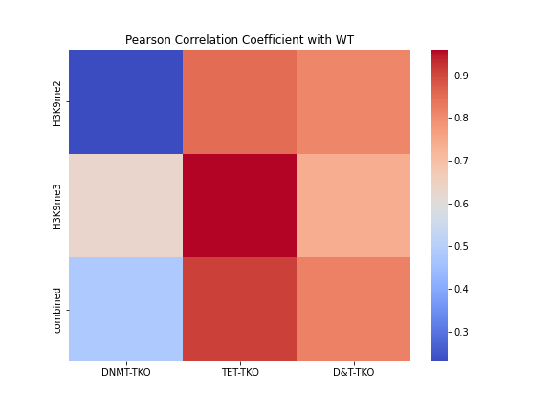
Histone Changes in TAD level
H3K9me2
H3K9me3
Intra-TAD RPKM in A/B1/B2
A
A
B2
B
B1
H3K9me2 RPKM
H3K9me3 RPKM
B1/B2 dividing line at log2FC = 0

Slide 7
Histone Changes in TAD level
H3K9me2 RPKM
H3K9me3 RPKM
*
*
*
*
*
*
*
*
*
*
*
*
*
*
*
* Mann Whitney U test if it is significantly different from the WT
Intra-TAD RPKM in A/B1/B2

Slide 8
window size across genome: 5kb
log2(0.1+Ratio over WT)
Copy from Shuhua’s slides

Slide 9
WT/input | K9me2 | K9me3
Enriched (>=2) | 65774 | 59302
Depleted (<=0.5) | 90125 | 67436
65774 | K9me2 |  | 59302 | K9me3
 | ChIP Increased | Overlap to WT/input |  | ChIP Increased | Overlap to WT/input
D / WT | 73277 | 5261 | D / WT | 29136 | 3090
T / WT | 6254 | 128 | T / WT | 2655 | 44
D&T / WT | 13941 | 230 | D&T / WT | 18493 | 1563
Copy from Shuhua’s slides

Slide 10
WT/input | K9me2 | K9me3
Enriched (>=2) | 65774 | 59302
Depleted (<=0.5) | 90125 | 67436
65774 | K9me2 |  | 59302 | K9me3
 | ChIP Increased | Overlap to WT/input |  | ChIP Increased | Overlap to WT/input
D / WT | 73277 | 5261 | D / WT | 29136 | 3090
T / WT | 6254 | 128 | T / WT | 2655 | 44
D&T / WT | 13941 | 230 | D&T / WT | 18493 | 1563

Slide 11
10/17/2024

Slide 12
HiC Compartment Changes (100 KB)
PC1 were from AB compartment in 100k resolution
  A: PC>0, B: PC<0
Two-pass Mahalanobis distance was calculated by PC1 of two groups
Significancy was determined by one-sided chi-squared test with P < 0.01
  A to A 530
  B to B 356
  A to B 326
  B to A 84
  No sig. 24604
Ma, F., Cao, Y., Du, H. et al. Three-dimensional chromatin reorganization regulates B cell development during ageing. Nat Cell Biol 26, 991–1002 (2024). https://doi.org/10.1038/s41556-024-01424-9
Notes:
26k in total

Slide 13
HiC Compartment Changes (100 KB)
Gene Expression
*
Log2FC
RPKM
*
*p<0.01

Slide 14
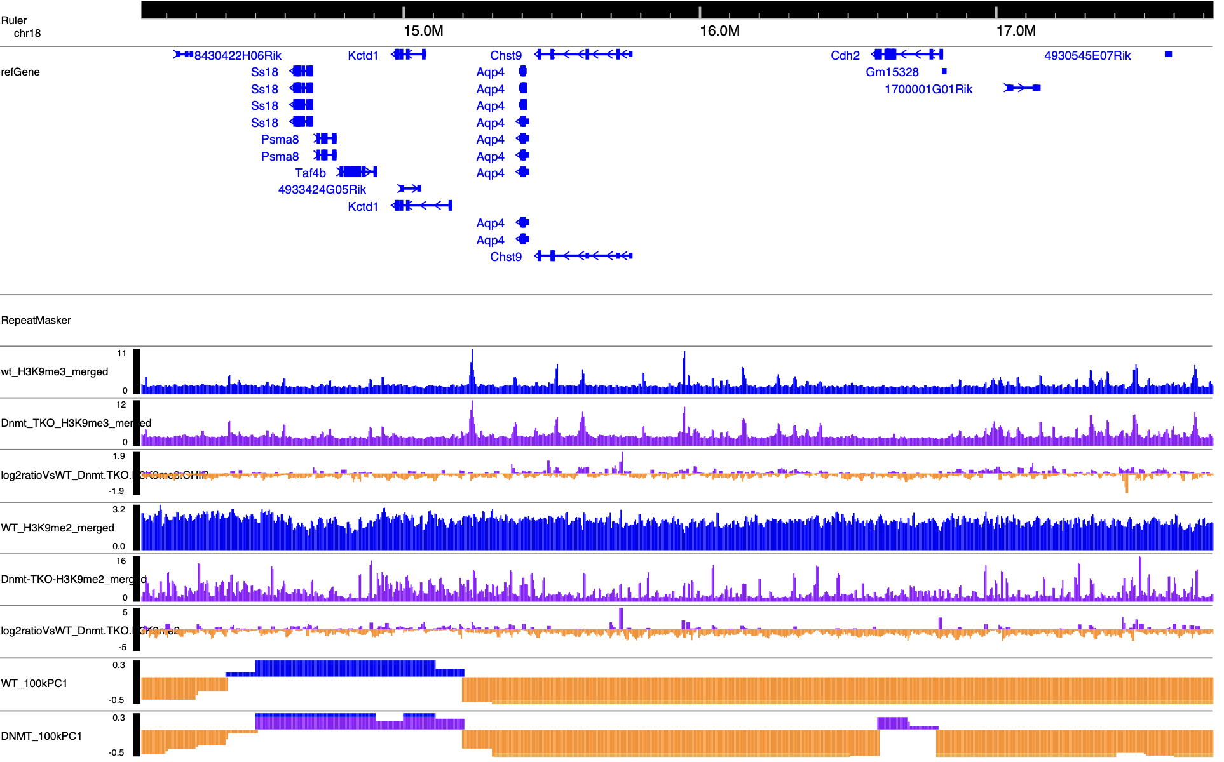
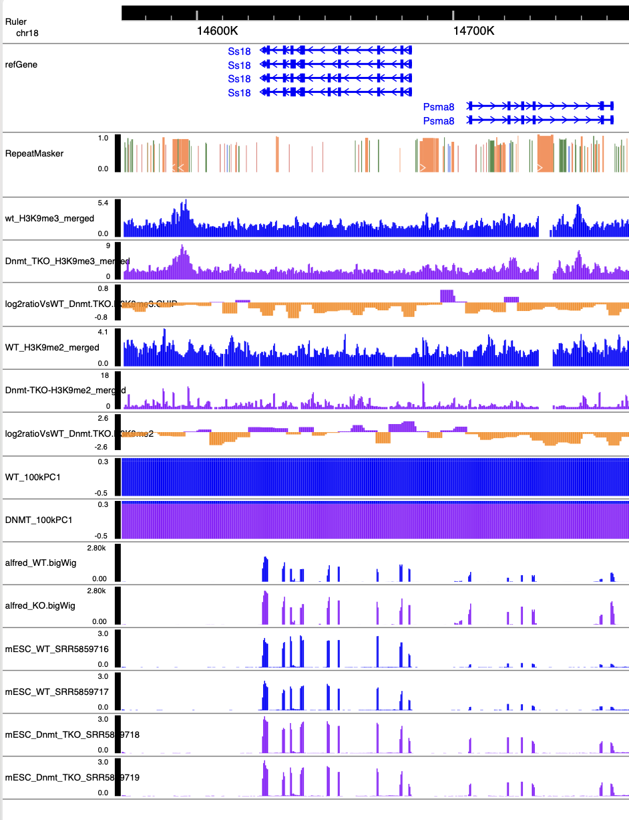
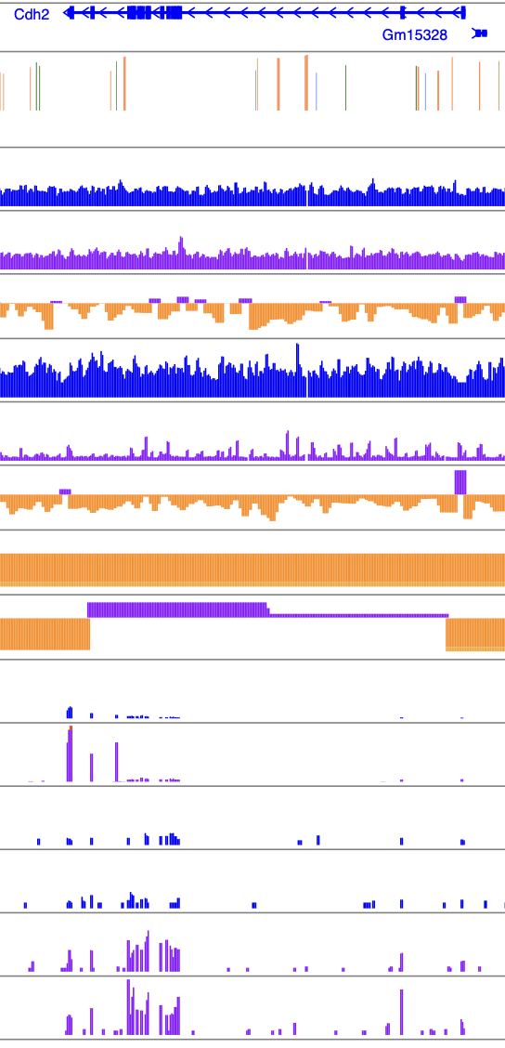

Slide 15
ChIP-Seq Signal Changes (100 KB)
11350 A bins
  4.5% LAD associated
12501 B bins
  71.7% LAD associated
  |log2FC| > 0.2 as cutoff
    1946 positive bins, 82.6% LAD associated
    203 negative bins, 65.5% LAD associated
Notes:
If the TAD contains B 100k bins whose me3 log2(D/WT) > 0.2

Slide 16
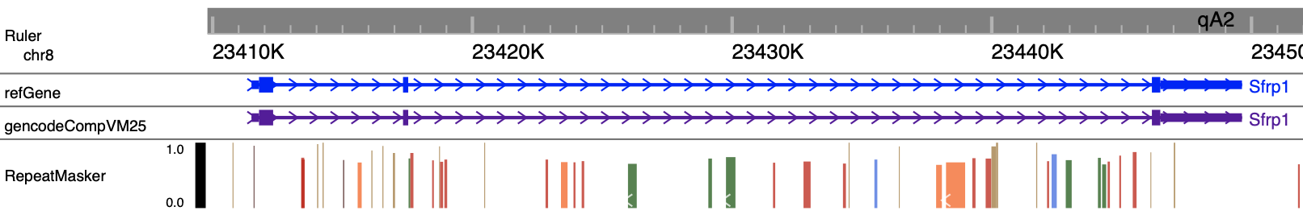
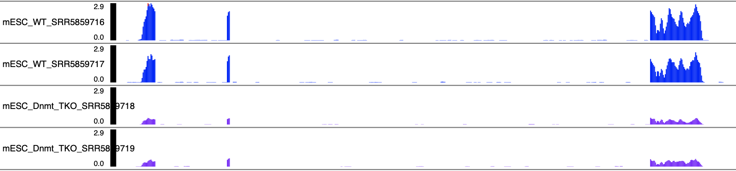
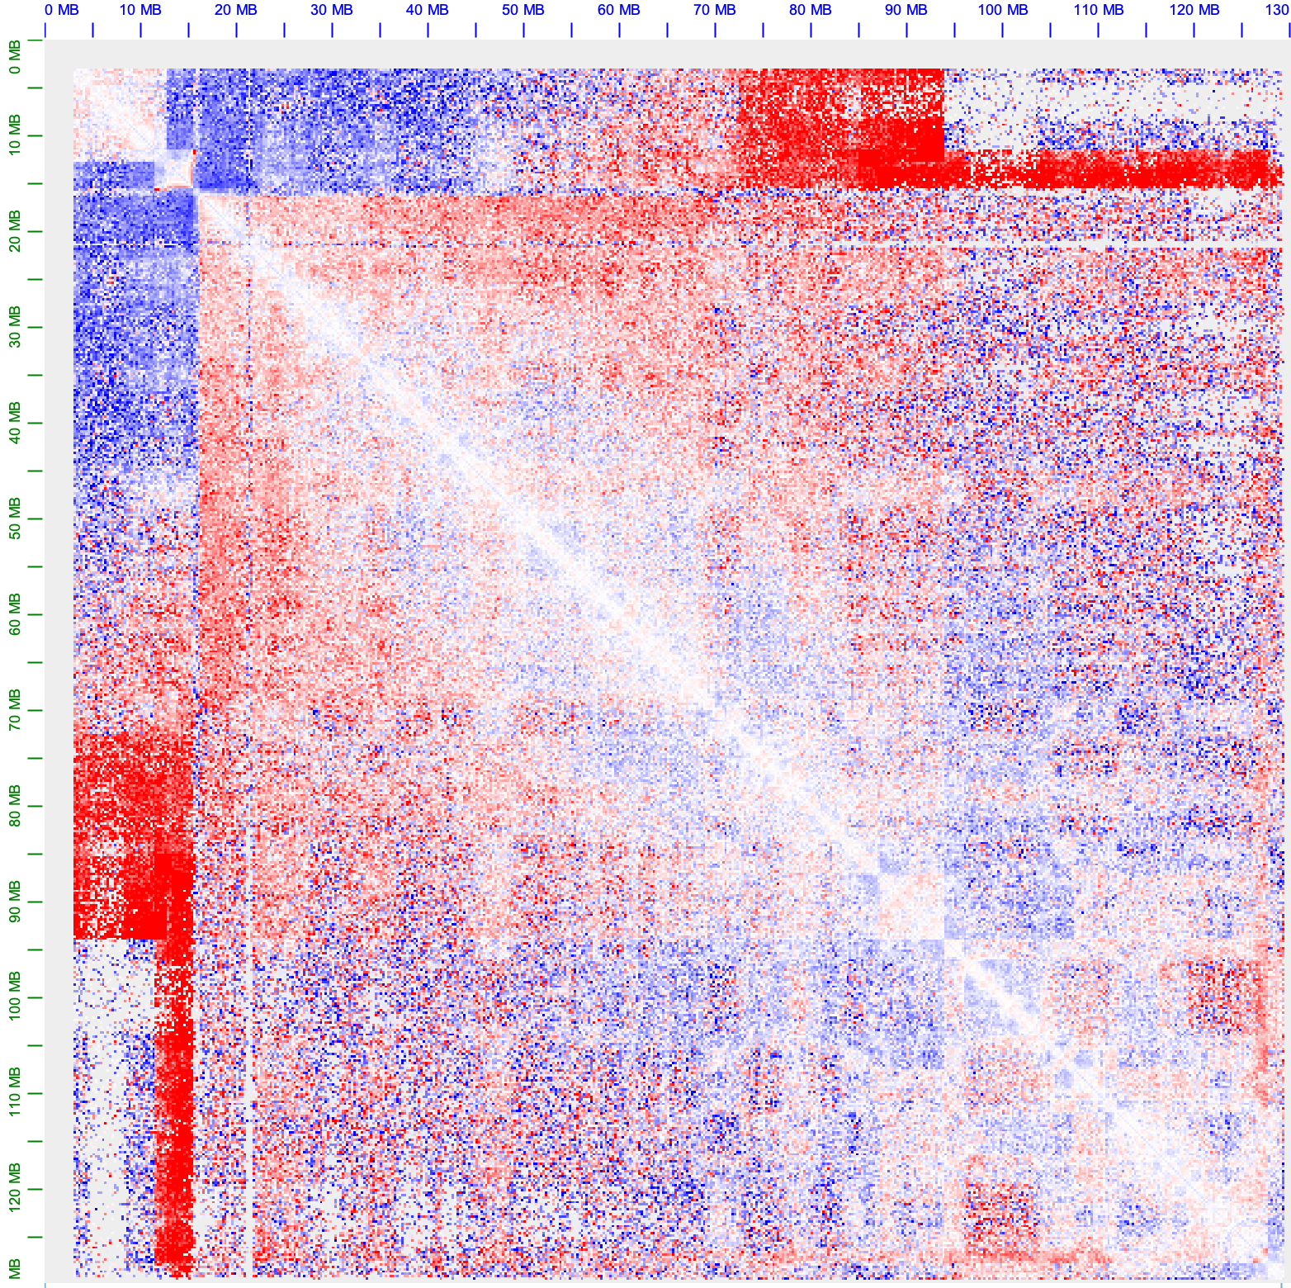
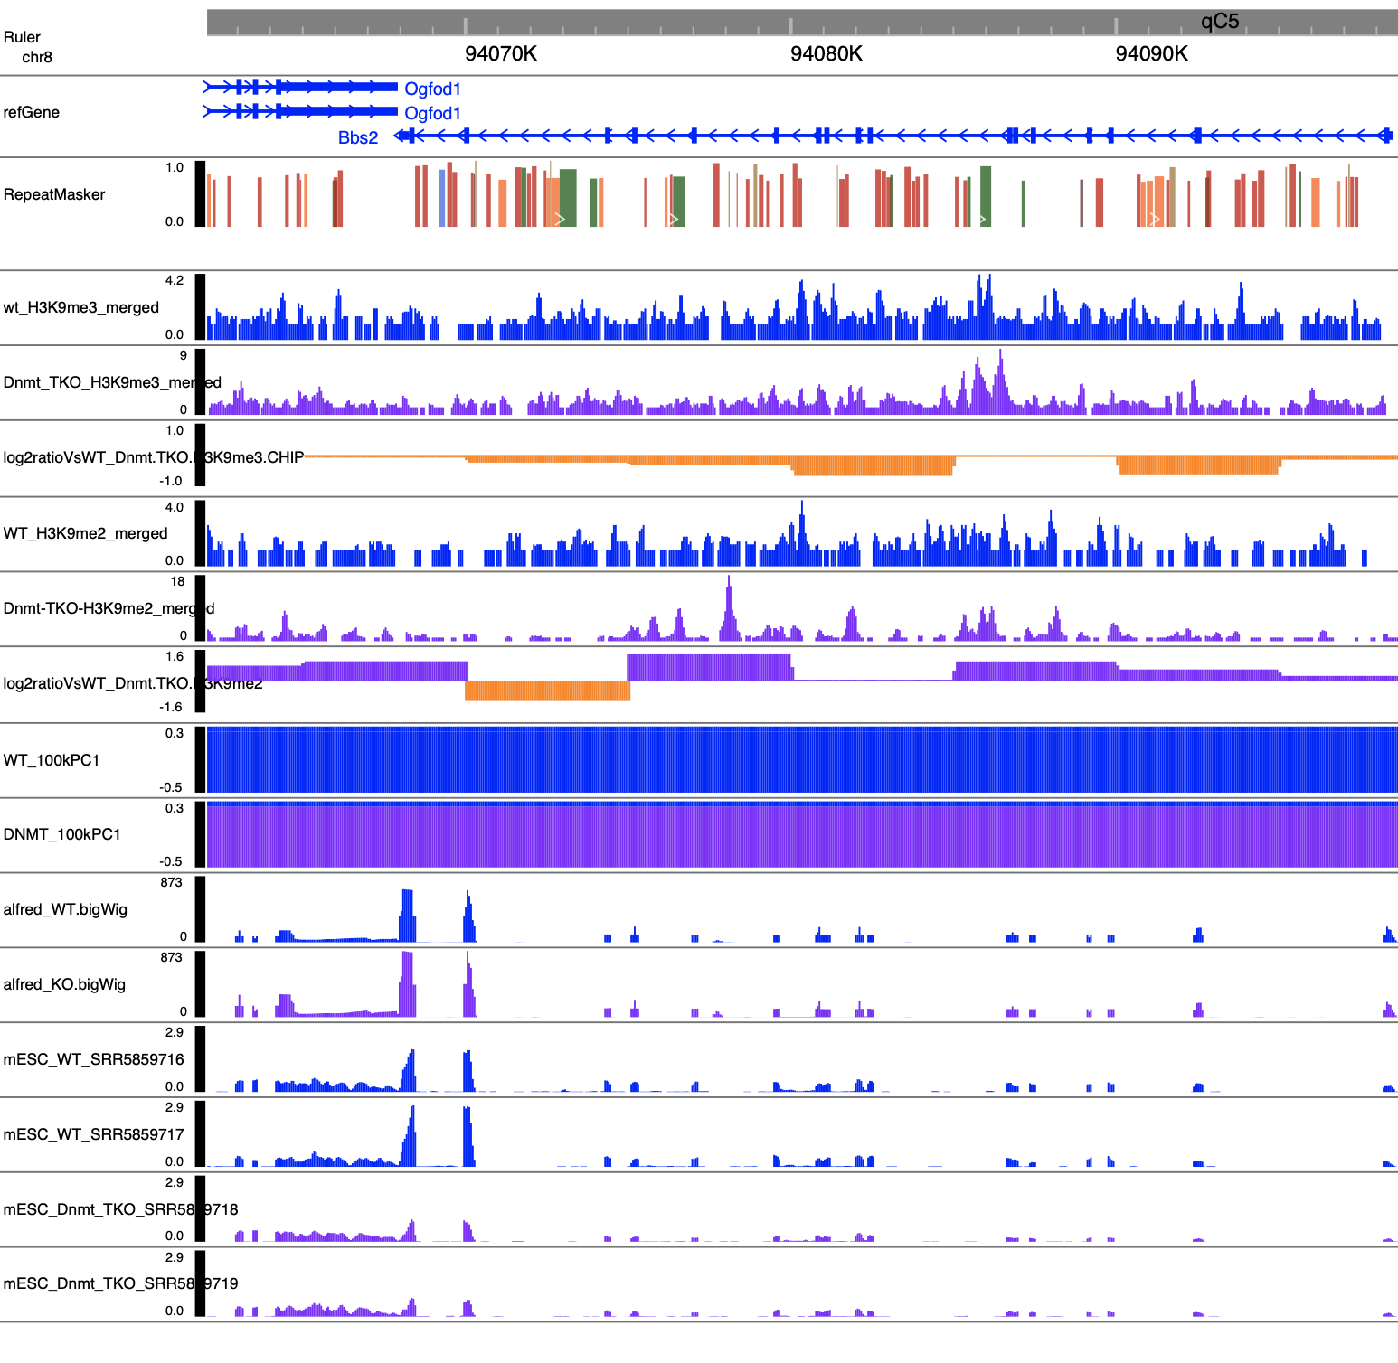
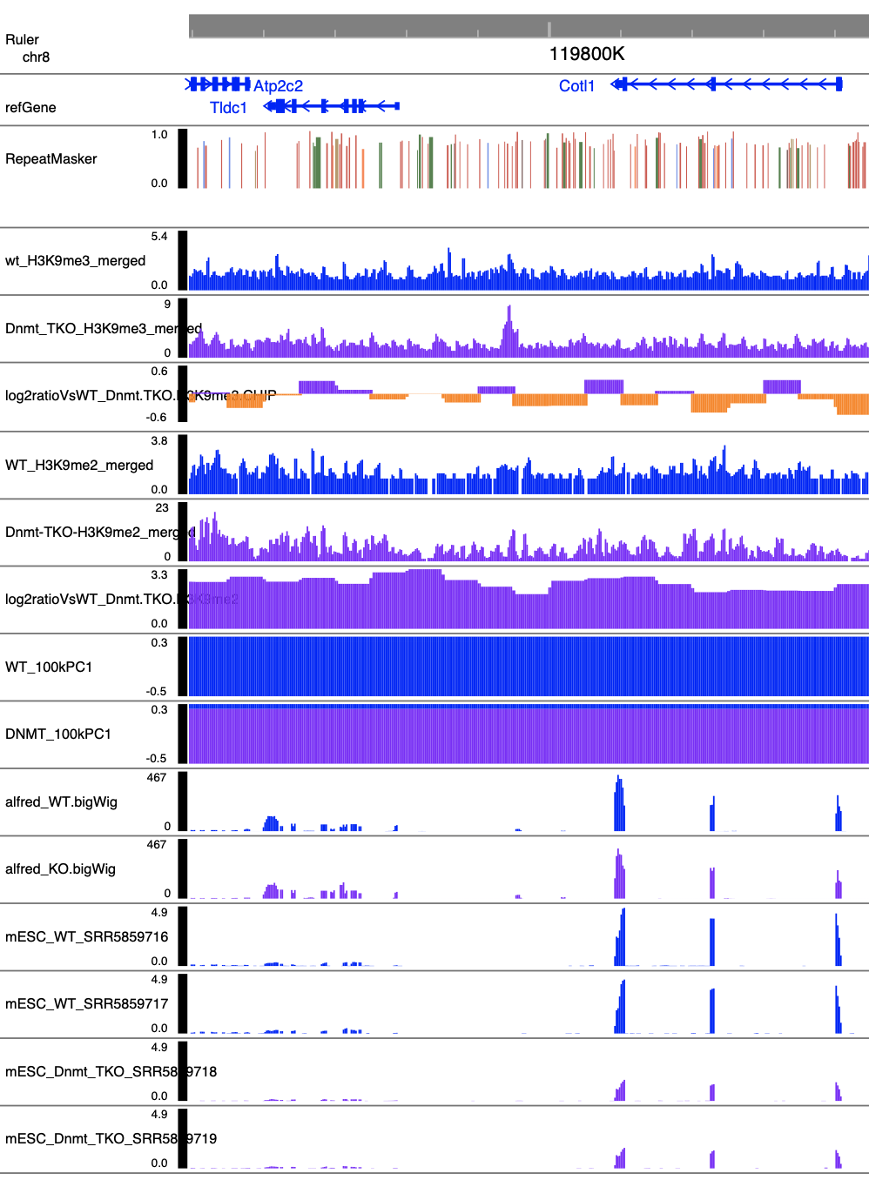

Slide 17
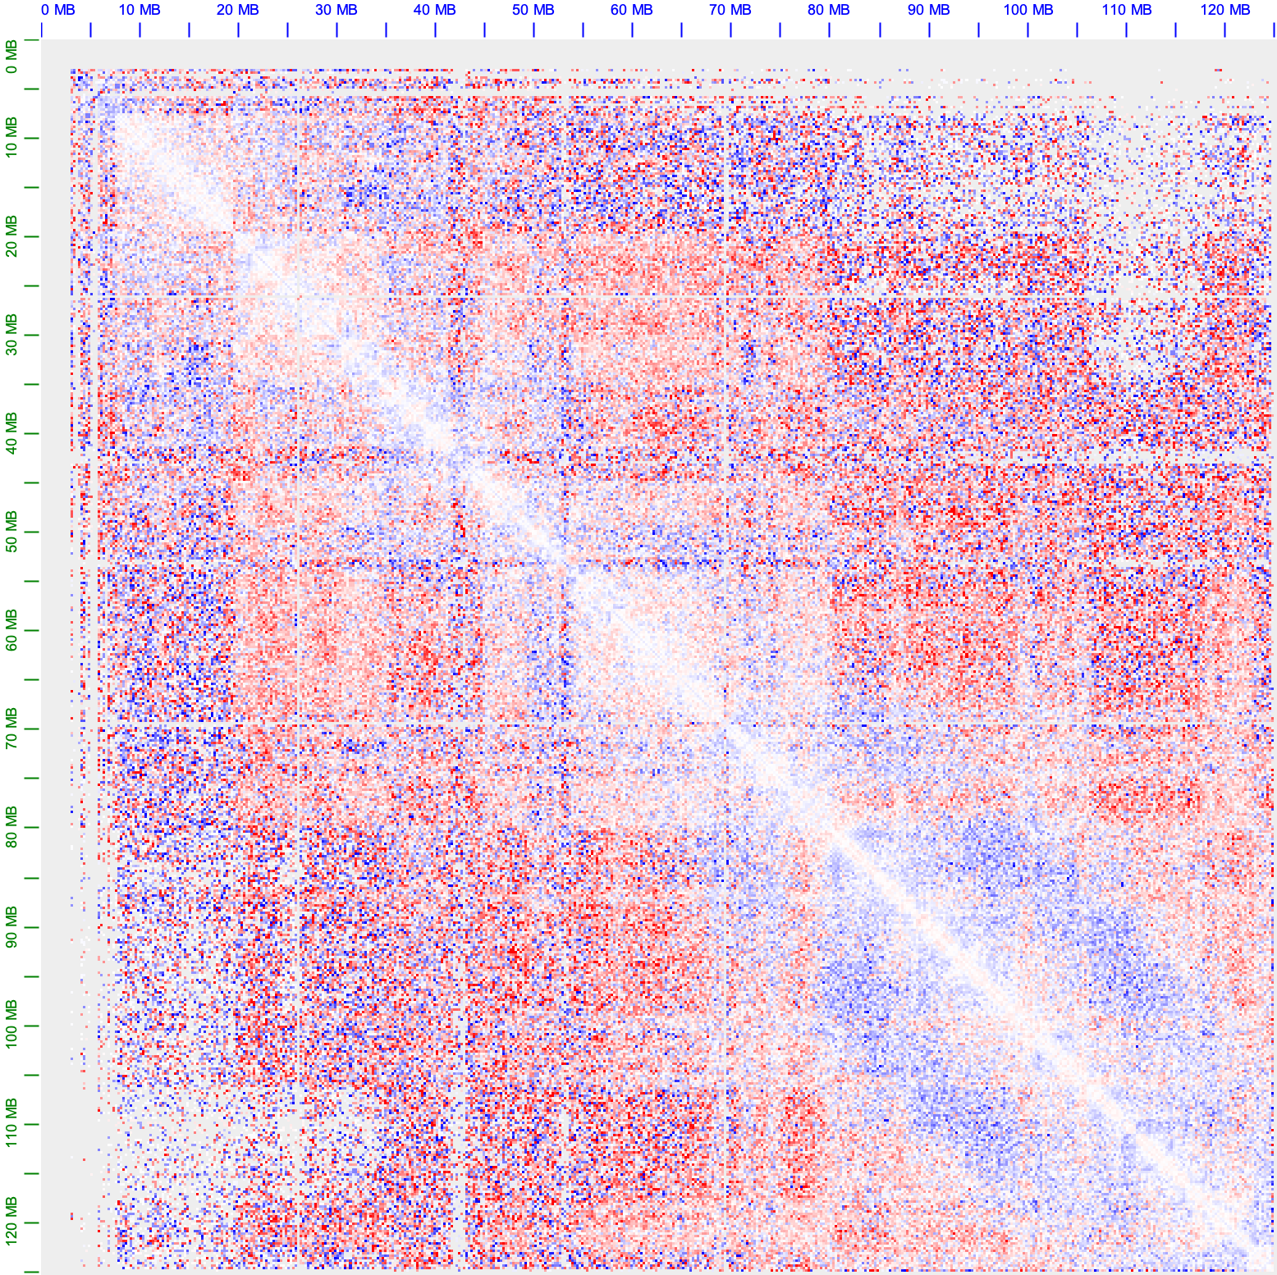
Notes:
Adk, Arhgef3, myh6

Slide 18
10/24/2024

Slide 19
Intra-Chromosomal Interactions
logFC > 2, chr8
CHR | START | END | CHR | START | END
chr8 | 11600000 | 11700000 | chr8 | 86900000 | 87000000
chr8 | 11600000 | 11700000 | chr8 | 87000000 | 87100000
chr8 | 12500000 | 12600000 | chr8 | 93600000 | 93700000
chr8 | 11500000 | 11600000 | chr8 | 86900000 | 87000000
chr8 | 12400000 | 12500000 | chr8 | 93700000 | 93800000
chr8 | 13400000 | 13500000 | chr8 | 87200000 | 87300000
chr8 | 12500000 | 12600000 | chr8 | 93800000 | 93900000
chr8 | 12600000 | 12700000 | chr8 | 93800000 | 93900000
chr8 | 13300000 | 13400000 | chr8 | 87100000 | 87200000
chr8 | 12600000 | 12700000 | chr8 | 93700000 | 93800000
chr8 | 12300000 | 12400000 | chr8 | 93800000 | 93900000
chr8 | 12500000 | 12600000 | chr8 | 93500000 | 93600000
chr8 | 12400000 | 12500000 | chr8 | 93900000 | 94000000
chr8 | 12600000 | 12700000 | chr8 | 93600000 | 93700000
chr8 | 11600000 | 11700000 | chr8 | 86800000 | 86900000
chr8 | 11600000 | 11700000 | chr8 | 87100000 | 87200000
chr8 | 11800000 | 11900000 | chr8 | 87000000 | 87100000
chr8 | 12400000 | 12500000 | chr8 | 93800000 | 93900000
chr8 | 12500000 | 12600000 | chr8 | 93700000 | 93800000
chr8 | 11700000 | 11800000 | chr8 | 87000000 | 87100000
chr8 | 13300000 | 13400000 | chr8 | 87300000 | 87400000
chr8 | 13300000 | 13400000 | chr8 | 87400000 | 87500000
chr8 | 13300000 | 13400000 | chr8 | 87500000 | 87600000
chr8 | 11500000 | 11600000 | chr8 | 87000000 | 87100000
chr8 | 11700000 | 11800000 | chr8 | 87100000 | 87200000
chr8 | 13300000 | 13400000 | chr8 | 87200000 | 87300000
chr8 | 11700000 | 11800000 | chr8 | 86900000 | 87000000
chr8 | 126400000 | 126500000 | chr8 | 127600000 | 127700000
chr8 | 126400000 | 126500000 | chr8 | 127500000 | 127600000
chr8 | 126400000 | 126500000 | chr8 | 127300000 | 127400000
chr8 | 126700000 | 126800000 | chr8 | 127500000 | 127600000
chr8 | 14800000 | 14900000 | chr8 | 15300000 | 15400000

Slide 20
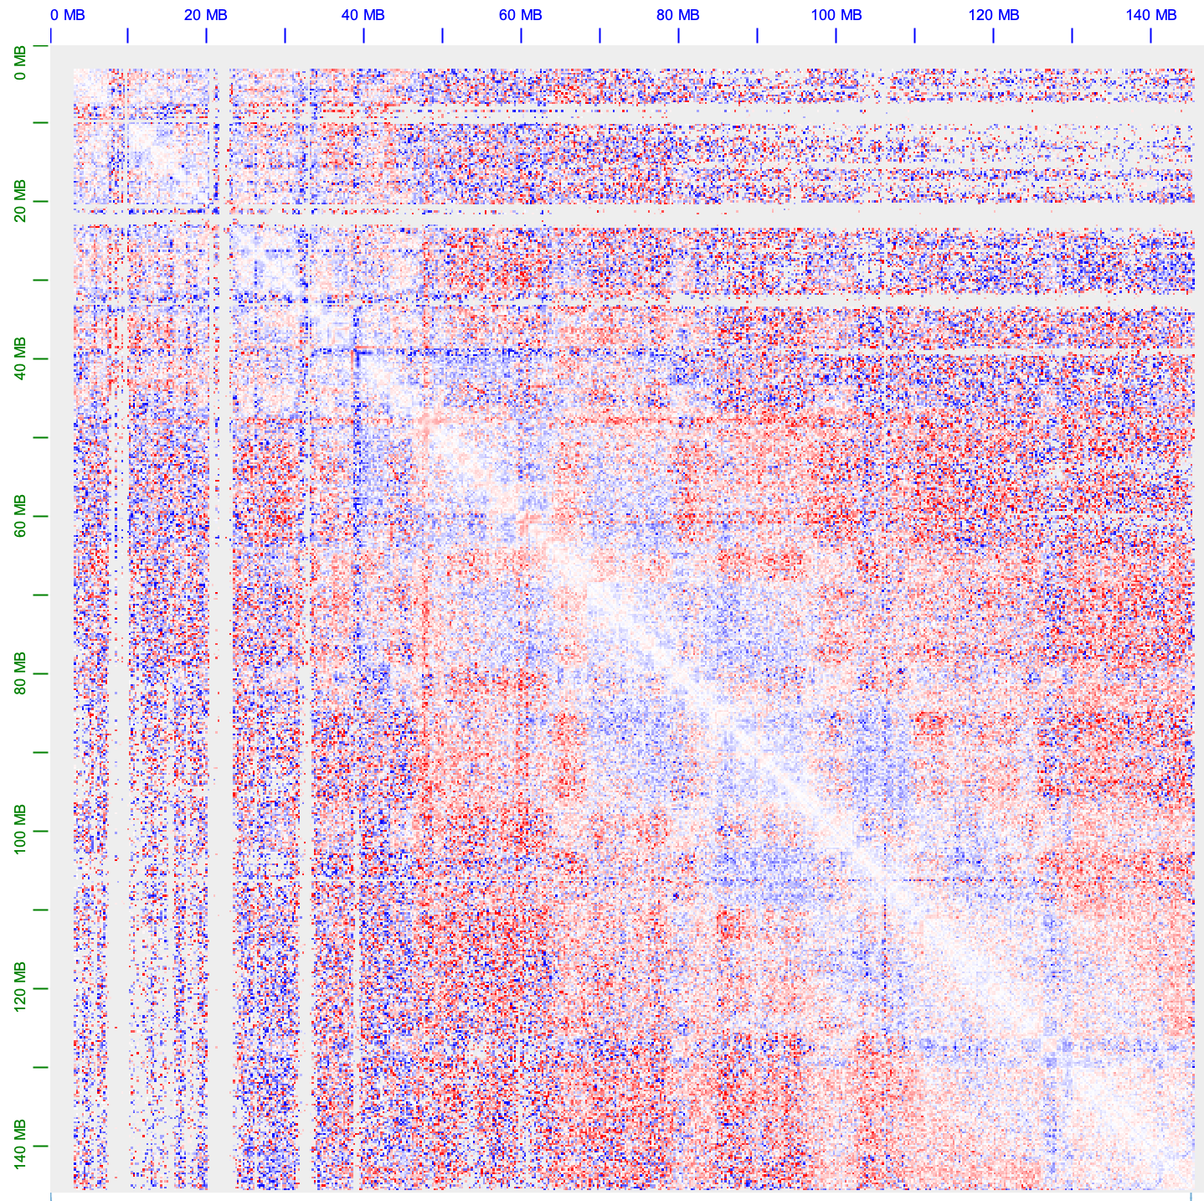
Intra-Chromosomal Interactions
logFC > 2, chr7
CHR | START | END | CHR | START | END
chr7 | 60000000 | 60100000 | chr7 | 60200000 | 60300000
chr7 | 60000000 | 60100000 | chr7 | 60500000 | 60600000
chr7 | 60100000 | 60200000 | chr7 | 60500000 | 60600000
chr7 | 60100000 | 60200000 | chr7 | 60200000 | 60300000
chr7 | 60500000 | 60600000 | chr7 | 61200000 | 61300000
chr7 | 60600000 | 60700000 | chr7 | 61000000 | 61100000
chr7 | 47800000 | 47900000 | chr7 | 48100000 | 48200000
chr7 | 59900000 | 60000000 | chr7 | 60200000 | 60300000
chr7 | 47800000 | 47900000 | chr7 | 47900000 | 48000000
chr7 | 47900000 | 48000000 | chr7 | 48100000 | 48200000
chr7 | 60500000 | 60600000 | chr7 | 61100000 | 61200000
chr7 | 47200000 | 47300000 | chr7 | 47400000 | 47500000
chr7 | 47600000 | 47700000 | chr7 | 47700000 | 47800000
chr7 | 60500000 | 60600000 | chr7 | 61000000 | 61100000
chr7 | 47200000 | 47300000 | chr7 | 47500000 | 47600000
chr7 | 60200000 | 60300000 | chr7 | 60300000 | 60400000
chr7 | 47800000 | 47900000 | chr7 | 48000000 | 48100000
chr7 | 47700000 | 47800000 | chr7 | 47800000 | 47900000
chr7 | 47400000 | 47500000 | chr7 | 47500000 | 47600000
chr7 | 60200000 | 60300000 | chr7 | 60500000 | 60600000
chr7 | 59300000 | 59400000 | chr7 | 59400000 | 59500000
chr7 | 60600000 | 60700000 | chr7 | 60800000 | 60900000
chr7 | 60500000 | 60600000 | chr7 | 60800000 | 60900000
chr7 | 47900000 | 48000000 | chr7 | 48000000 | 48100000
chr7 | 47800000 | 47900000 | chr7 | 48200000 | 48300000
chr7 | 47800000 | 47900000 | chr7 | 48300000 | 48400000
chr7 | 47500000 | 47600000 | chr7 | 47700000 | 47800000
CHR | START | END | CHR | START | END
chr7 | 47500000 | 47600000 | chr7 | 47600000 | 47700000
chr7 | 47300000 | 47400000 | chr7 | 47400000 | 47500000
chr7 | 60400000 | 60500000 | chr7 | 60500000 | 60600000
chr7 | 48000000 | 48100000 | chr7 | 48100000 | 48200000
chr7 | 48100000 | 48200000 | chr7 | 48700000 | 48800000
chr7 | 60200000 | 60300000 | chr7 | 60400000 | 60500000
chr7 | 47200000 | 47300000 | chr7 | 47700000 | 47800000
chr7 | 47600000 | 47700000 | chr7 | 47800000 | 47900000
chr7 | 47700000 | 47800000 | chr7 | 48100000 | 48200000
chr7 | 47500000 | 47600000 | chr7 | 47800000 | 47900000
chr7 | 47300000 | 47400000 | chr7 | 47500000 | 47600000
chr7 | 48000000 | 48100000 | chr7 | 48200000 | 48300000
chr7 | 60300000 | 60400000 | chr7 | 60500000 | 60600000
chr7 | 47900000 | 48000000 | chr7 | 48200000 | 48300000
chr7 | 47300000 | 47400000 | chr7 | 47600000 | 47700000
chr7 | 47300000 | 47400000 | chr7 | 47700000 | 47800000
chr7 | 47300000 | 47400000 | chr7 | 47800000 | 47900000
chr7 | 48100000 | 48200000 | chr7 | 48400000 | 48500000
chr7 | 47700000 | 47800000 | chr7 | 47900000 | 48000000
chr7 | 60500000 | 60600000 | chr7 | 60600000 | 60700000
chr7 | 48100000 | 48200000 | chr7 | 48200000 | 48300000
chr7 | 47900000 | 48000000 | chr7 | 48600000 | 48700000
chr7 | 47200000 | 47300000 | chr7 | 47300000 | 47400000
chr7 | 47700000 | 47800000 | chr7 | 48000000 | 48100000
chr7 | 52100000 | 52200000 | chr7 | 52600000 | 52700000
chr7 | 48200000 | 48300000 | chr7 | 48400000 | 48500000

Slide 21
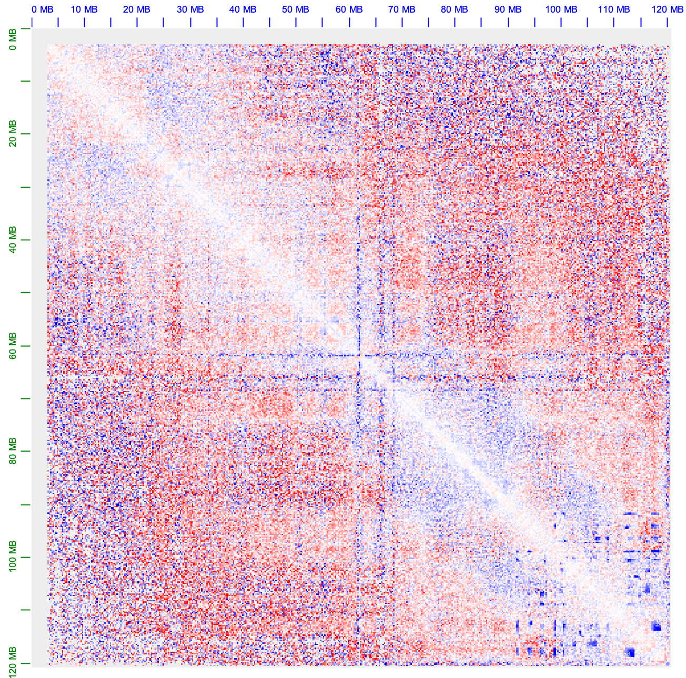
Intra-Chromosomal Interactions
logFC < -2
CHR | START | END | CHR | START | END
chr13 | 61800000 | 61900000 | chr13 | 61900000 | 62000000
chr4 | 112000000 | 112100000 | chr4 | 112100000 | 112200000
chr4 | 112400000 | 112500000 | chr4 | 112500000 | 112600000
chr13 | 98700000 | 98800000 | chr13 | 117100000 | 117200000
chr7 | 25900000 | 26000000 | chr7 | 26000000 | 26100000
chr13 | 98700000 | 98800000 | chr13 | 117000000 | 117100000
chr13 | 93700000 | 93800000 | chr13 | 98900000 | 99000000
chr13 | 113600000 | 113700000 | chr13 | 118500000 | 118600000
chr13 | 98600000 | 98700000 | chr13 | 117000000 | 117100000
chr13 | 113600000 | 113700000 | chr13 | 118400000 | 118500000
chr13 | 113300000 | 113400000 | chr13 | 118400000 | 118500000
chr13 | 93700000 | 93800000 | chr13 | 98800000 | 98900000
chr13 | 100400000 | 100500000 | chr13 | 112600000 | 112700000
chr13 | 113700000 | 113800000 | chr13 | 118500000 | 118600000
chr13 | 100500000 | 100600000 | chr13 | 112600000 | 112700000
chr13 | 113600000 | 113700000 | chr13 | 118300000 | 118400000
chr7 | 39300000 | 39400000 | chr7 | 39400000 | 39500000
chr7 | 39100000 | 39200000 | chr7 | 39200000 | 39300000
chr13 | 100400000 | 100500000 | chr13 | 112900000 | 113000000
chr13 | 119800000 | 119900000 | chr13 | 120100000 | 120200000
chr4 | 114000000 | 114100000 | chr4 | 114100000 | 114200000
chr7 | 38400000 | 38500000 | chr7 | 38500000 | 38600000
chr13 | 120100000 | 120200000 | chr13 | 120200000 | 120300000
chr13

Slide 22
10/30/2024

Slide 23
RNA-SEQ LR vs SR
Protein coding gene CPM
Notes:
r2

Slide 24
Long Reads MA Plots

Slide 25
Long Reads MA Plots
A/B
H3K9me2
H3K9me3
AB Compartment
ChIP-Seq Signals
A
B
D/WT > 2
D/WT < 0.5
Notes:
M = log2(D+1) - log2(W+1)

Slide 26
Long Reads MA Plots (Singleton Only)
A/B
H3K9me2
H3K9me3
AB Compartment
ChIP-Seq Signals
A
B
D/WT > 2
D/WT < 0.5

Slide 27
Singleton TSS Methylation
Singleton TSS +/- 1kb
TSS Methylation
Singleton Expression
WT
Notes:
Expression: TPM
Scatter: logFC expression, Delta methylation

Slide 28
Singleton TSS Methylation
Singleton TSS +/- 1kb
TSS Methylation
Singleton Expression
WT
Notes:
Expression: TPM
Scatter: logFC expression, Delta methylation

Slide 29
Singleton TSS Methylation
Singleton TSS +/- 1kb
TSS Methylation
Singleton Expression
logFC expression vs delta methylation
Notes:
Expression: TPM
Scatter: logFC expression, Delta methylation

Slide 30
Singleton TSS Methylation
Singleton TSS +/- 1kb
 | WT
count | 21168
mean | 59.5
std | 28.7
min | 0
25% | 40.3
50% | 72.3
75% | 81.9
max | 100
<25%
>75%
Notes:
Cov 10; scatter of methyl vs exp

Slide 31
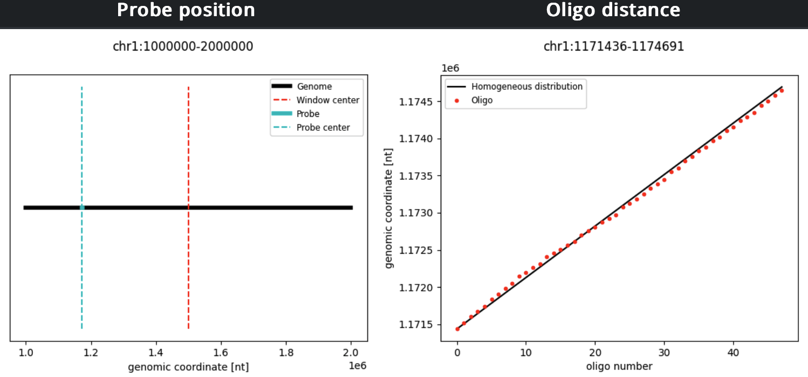
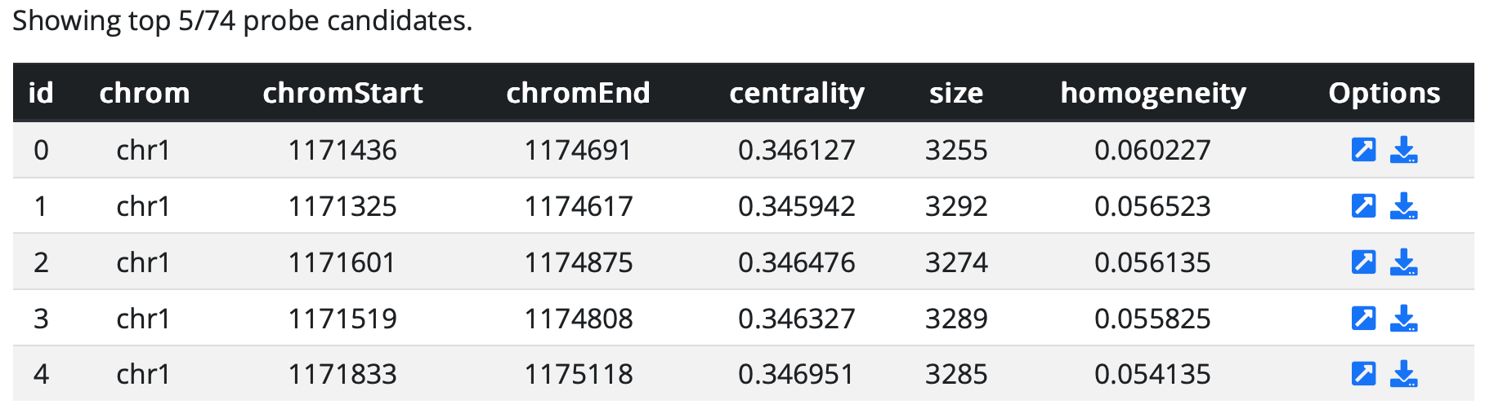
Probe Design
Creation of 40-mer database
Unique 40-mers
40-mers wo. homopolymers
(>=7nt)
40-mers CG% in 35-80%;
Avg. melting T
40-mers within 70% homology
40-mers with positive free energy at 65℃
40-mers in 20℃ melting T range w. Avg
Optional: mismatch < 6
Interested region query (ifpd)
http://ifish4u.com/probe-design/

Slide 32
1/21/2025

Slide 33
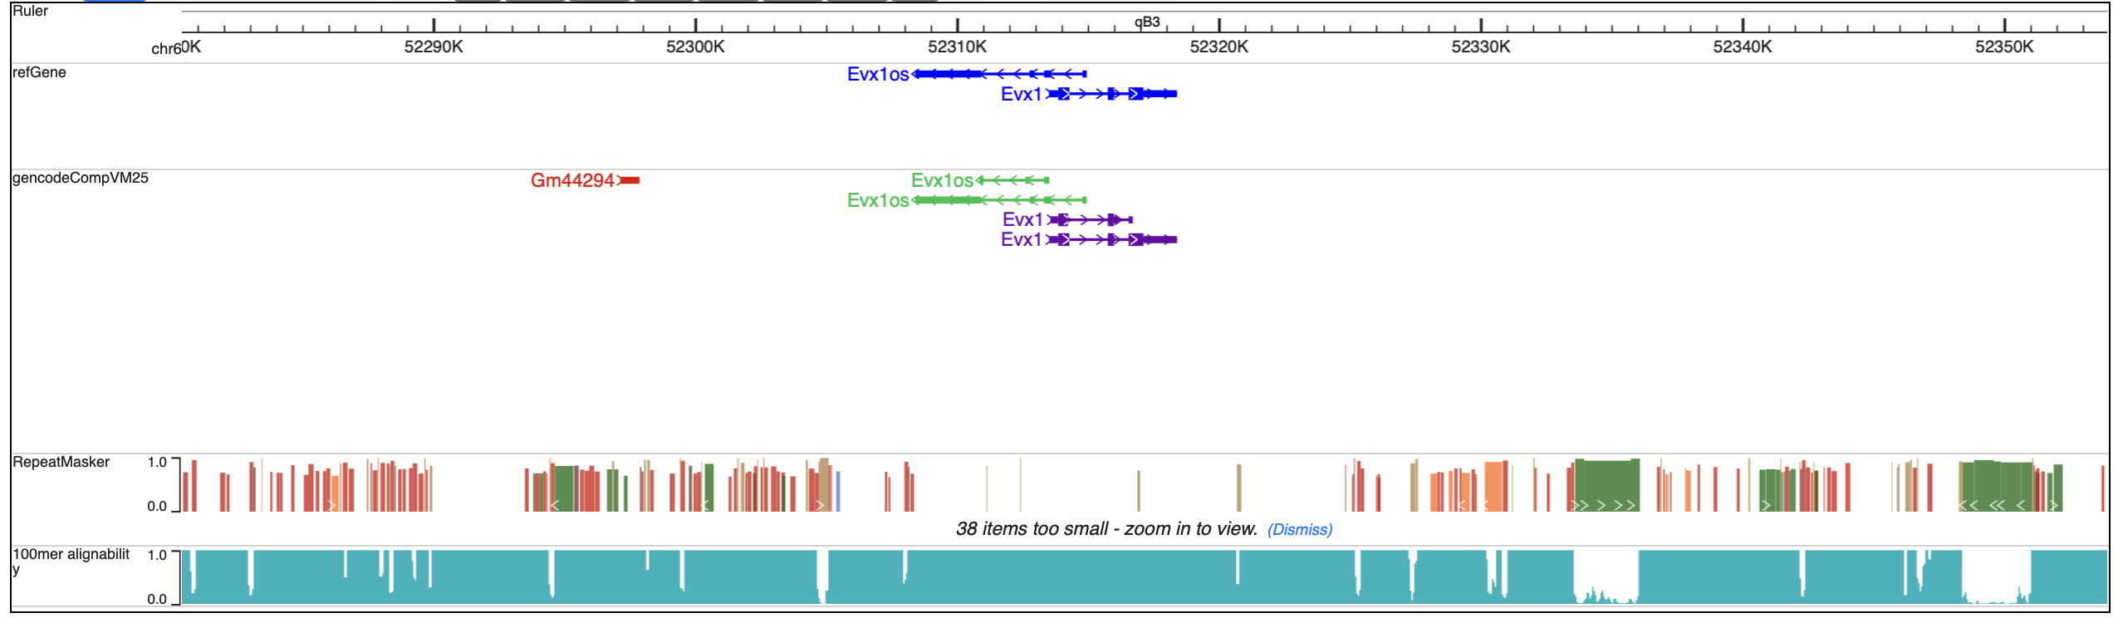
Short Read Unmappability
1,083,307 bins obtained with the cutoff mappability < 0.25 (100mer, 500 bp bin)

Slide 34
Short Read Unmappability
Transcripts in unmappable regions
All transcripts
Novel transcripts
31,826 transcripts located in unmappable regions,
13,619 of them were novel transcripts.
Notes:
All show significant difference with MannwhitneyuResult (expression: TPM)

Slide 35
Short Read Unmappability
Genes in unmappable regions
TE | Count
B2_Mm2:B2:SINE | 3556
B3:B2:SINE | 2670
B1_Mus1:Alu:SINE | 2242
ID_B1:B4:SINE | 2159
RSINE1:B4:SINE | 2050
B1_Mus2:Alu:SINE | 1832
B4A:B4:SINE | 1694
B3A:B2:SINE | 1561
B2_Mm1a:B2:SINE | 1436
B2_Mm1t:B2:SINE | 1287
B1_Mm:Alu:SINE | 1160
PB1D10:Alu:SINE | 1130
B4:B4:SINE | 948
B1_Mur4:Alu:SINE | 840
B1F:Alu:SINE | 747
B1_Mur1:Alu:SINE | 733
MTD:ERVL-MaLR:LTR | 705
B1_Mur2:Alu:SINE | 609
PB1D9:Alu:SINE | 607
Lx8:L1:LINE | 575
17,933 genes located in unmappable regions,
6,419 of them were novel genes.
6,250 of them were novel gene with Tes.

Slide 36
3/26/2025

Slide 37
Histone Changes in TAD Level
H3K9me2
H3K9me3
H2AK119Ub

Slide 38
Novel Genes Expression
Single-exon
5,815 novel genes after low filtration
5,341 single-exon genes
474 multi-exon genes
Multi-exon

Slide 39
4/3/2025

Slide 40
Gene Length
5,341 single-exon genes

Slide 41
TE Association
97.1% genes overlapped with TE
Top 10 TE subfamilies
Among 5,341 single-exon genes,
5,183 genes were overlapped with 437 TE subfamilies.

Slide 42
TSS
Single-exon genes expression level (RPKM) – methylation level (beta) in WT
TSS: 1kb towards 5 prime

Slide 43
4/23/2025

Slide 44
Long TE (> 1 kb)
TE filtration
No simple repeats
No satellite
No overlap with exons except the 1st exon
~142 K TE individuals left
Low expression filtration
WT CPM > 1
KO CPM > 1
16,286 TE individuals left

Slide 45
Long TE (> 1 kb)
logFC
Up (> 1): 2247
Down (< -1): 1053
Unchanged: 12986

Slide 46
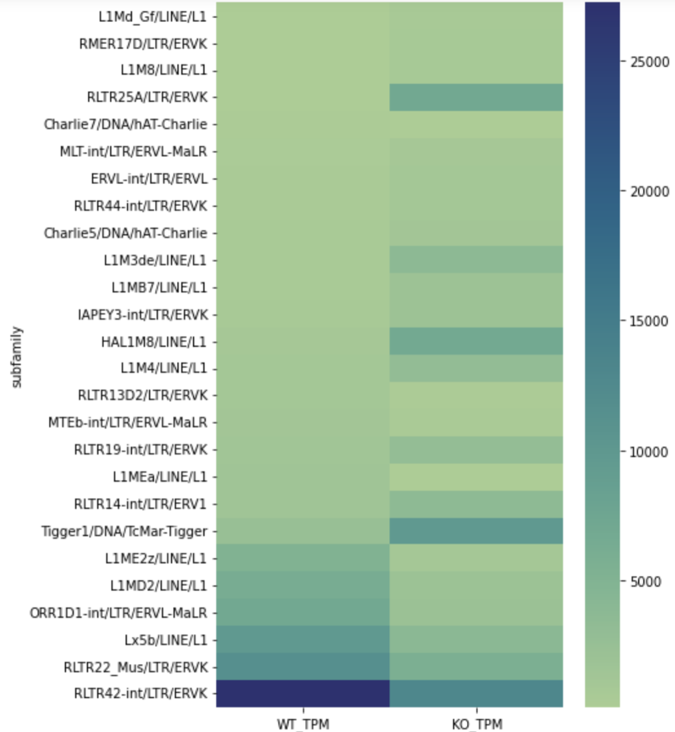
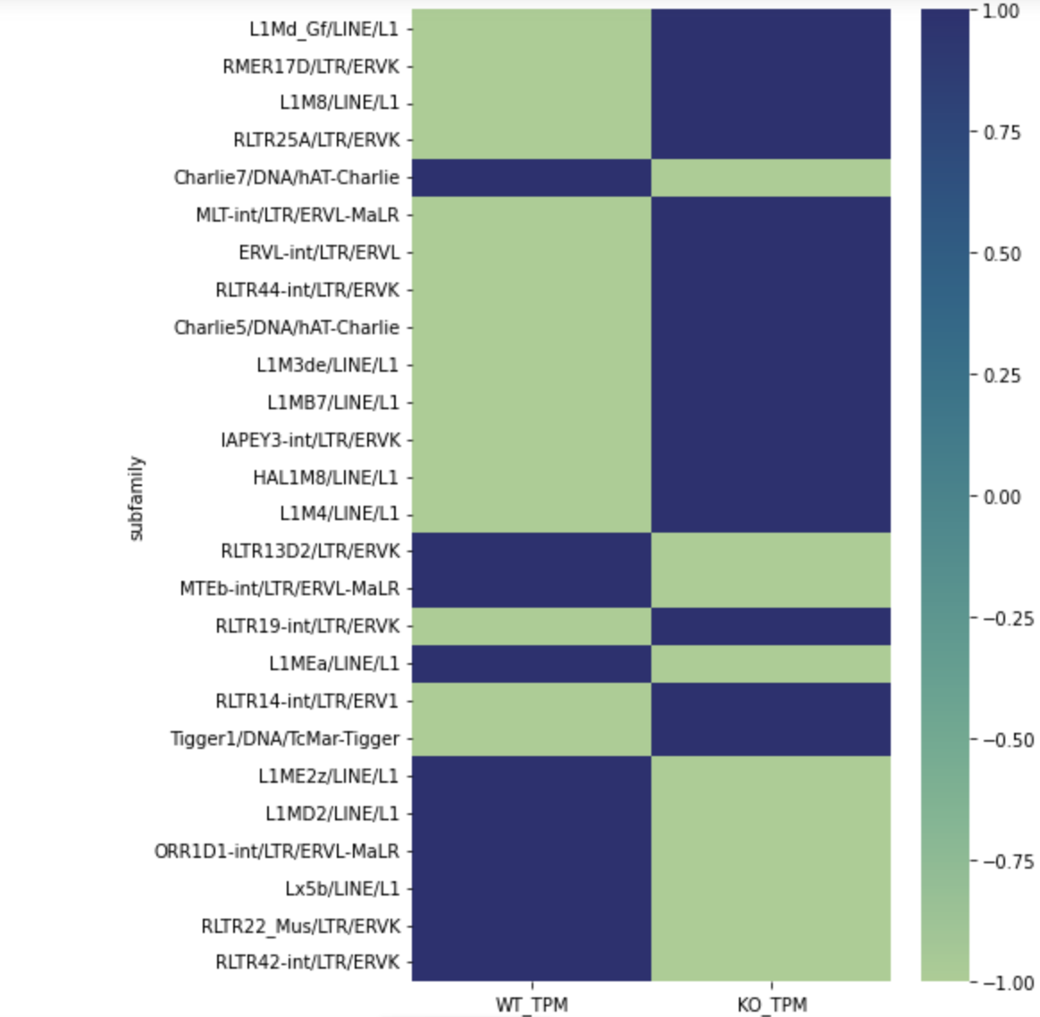
Long TE (> 1 kb)
Subfamily Level
TPM
Z score
Notes:
26 DE subfamilies

Slide 47
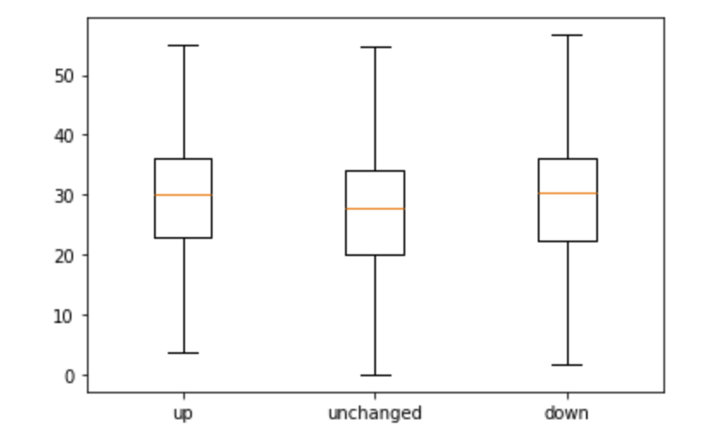
TE - Methylation
WT sample methylation levels in TEs
Notes:
Average beta inside TE

Slide 48
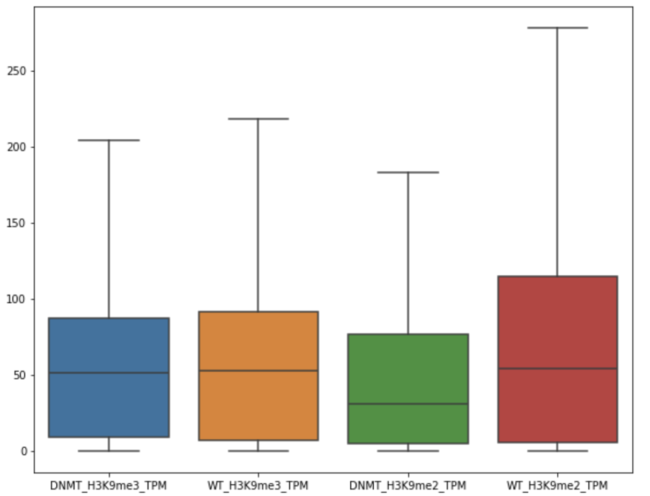

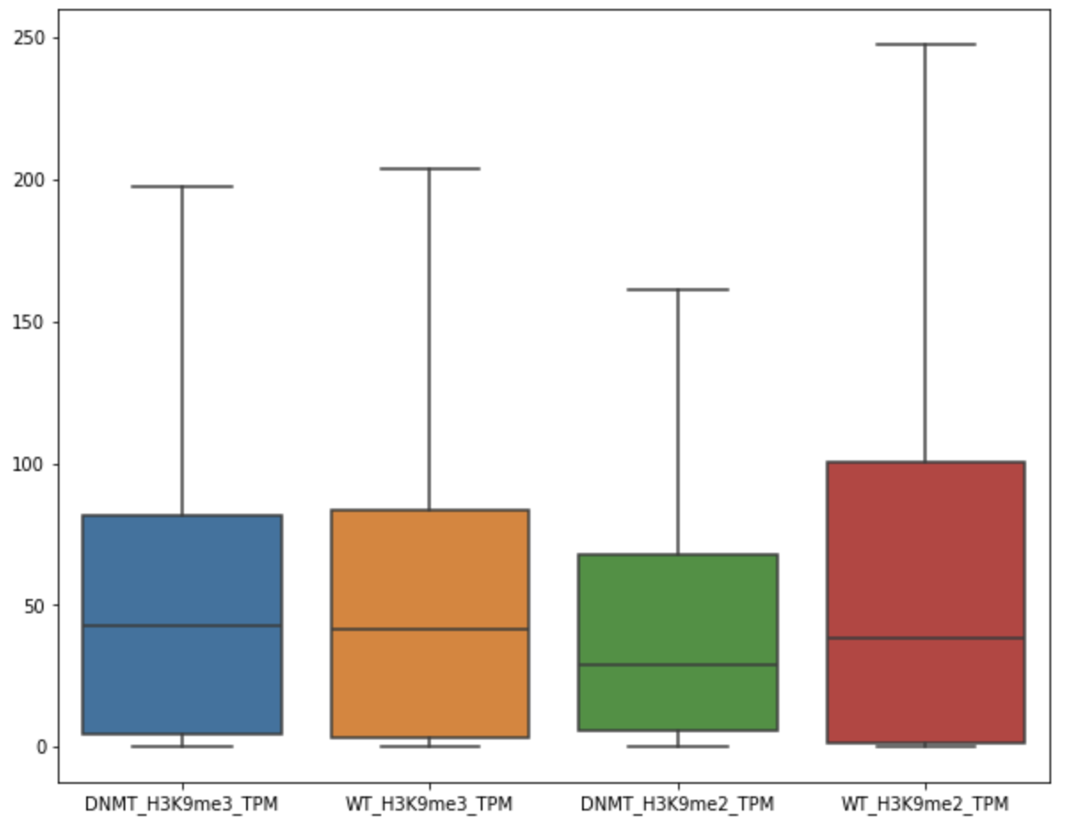
TE - ChIP
Up
Down
Unchanged

Slide 49
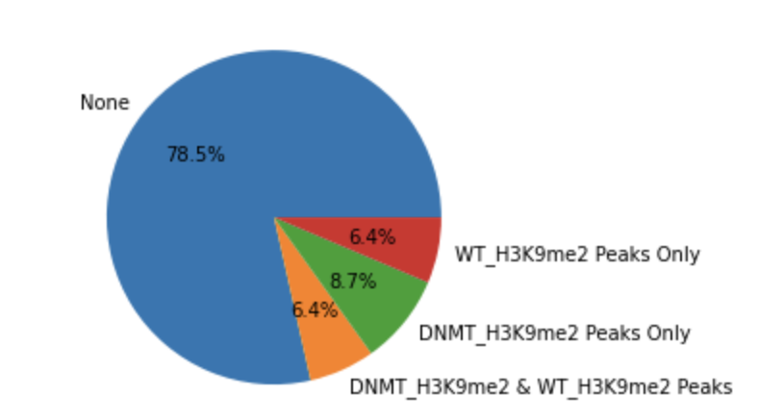
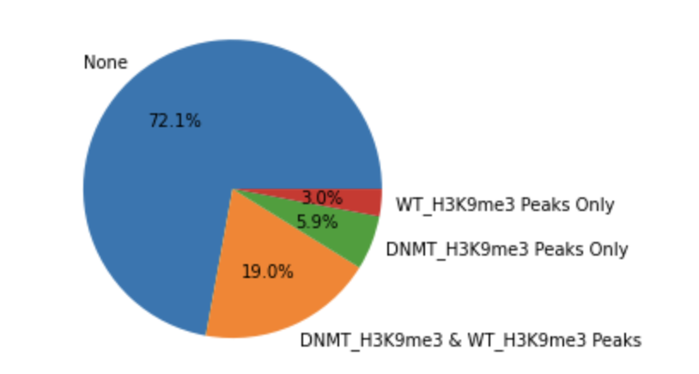
TE - ChIP
Pie: 16286 TEs in total

Slide 50
4/30/2025

Slide 51
Long TE (> 1 kb)
TE filtration
No simple repeats
No satellite
No overlap with exons except the 1st exon
~142 K TE individuals left
TE quantification
Only count uniquely mapped reads
-split
Low expression filtration
WT CPM > 1 or KO CPM > 1
11,960 TE individuals left

Slide 52
TE - Methylation
Category
both_cpm_0
  CPM = 0 in both WT and KO
WT = 0, ko > 1
  WT CPM = 0 and KO CPM > 1
WT > 1, ko = 1
  WT CPM > 1 and KO CPM = 0
both_gt1
  CPM > 1 in both WT and KO

Slide 53
5/7/2025

Slide 54
Heatmap
Cut&tag 100 kb

Slide 55
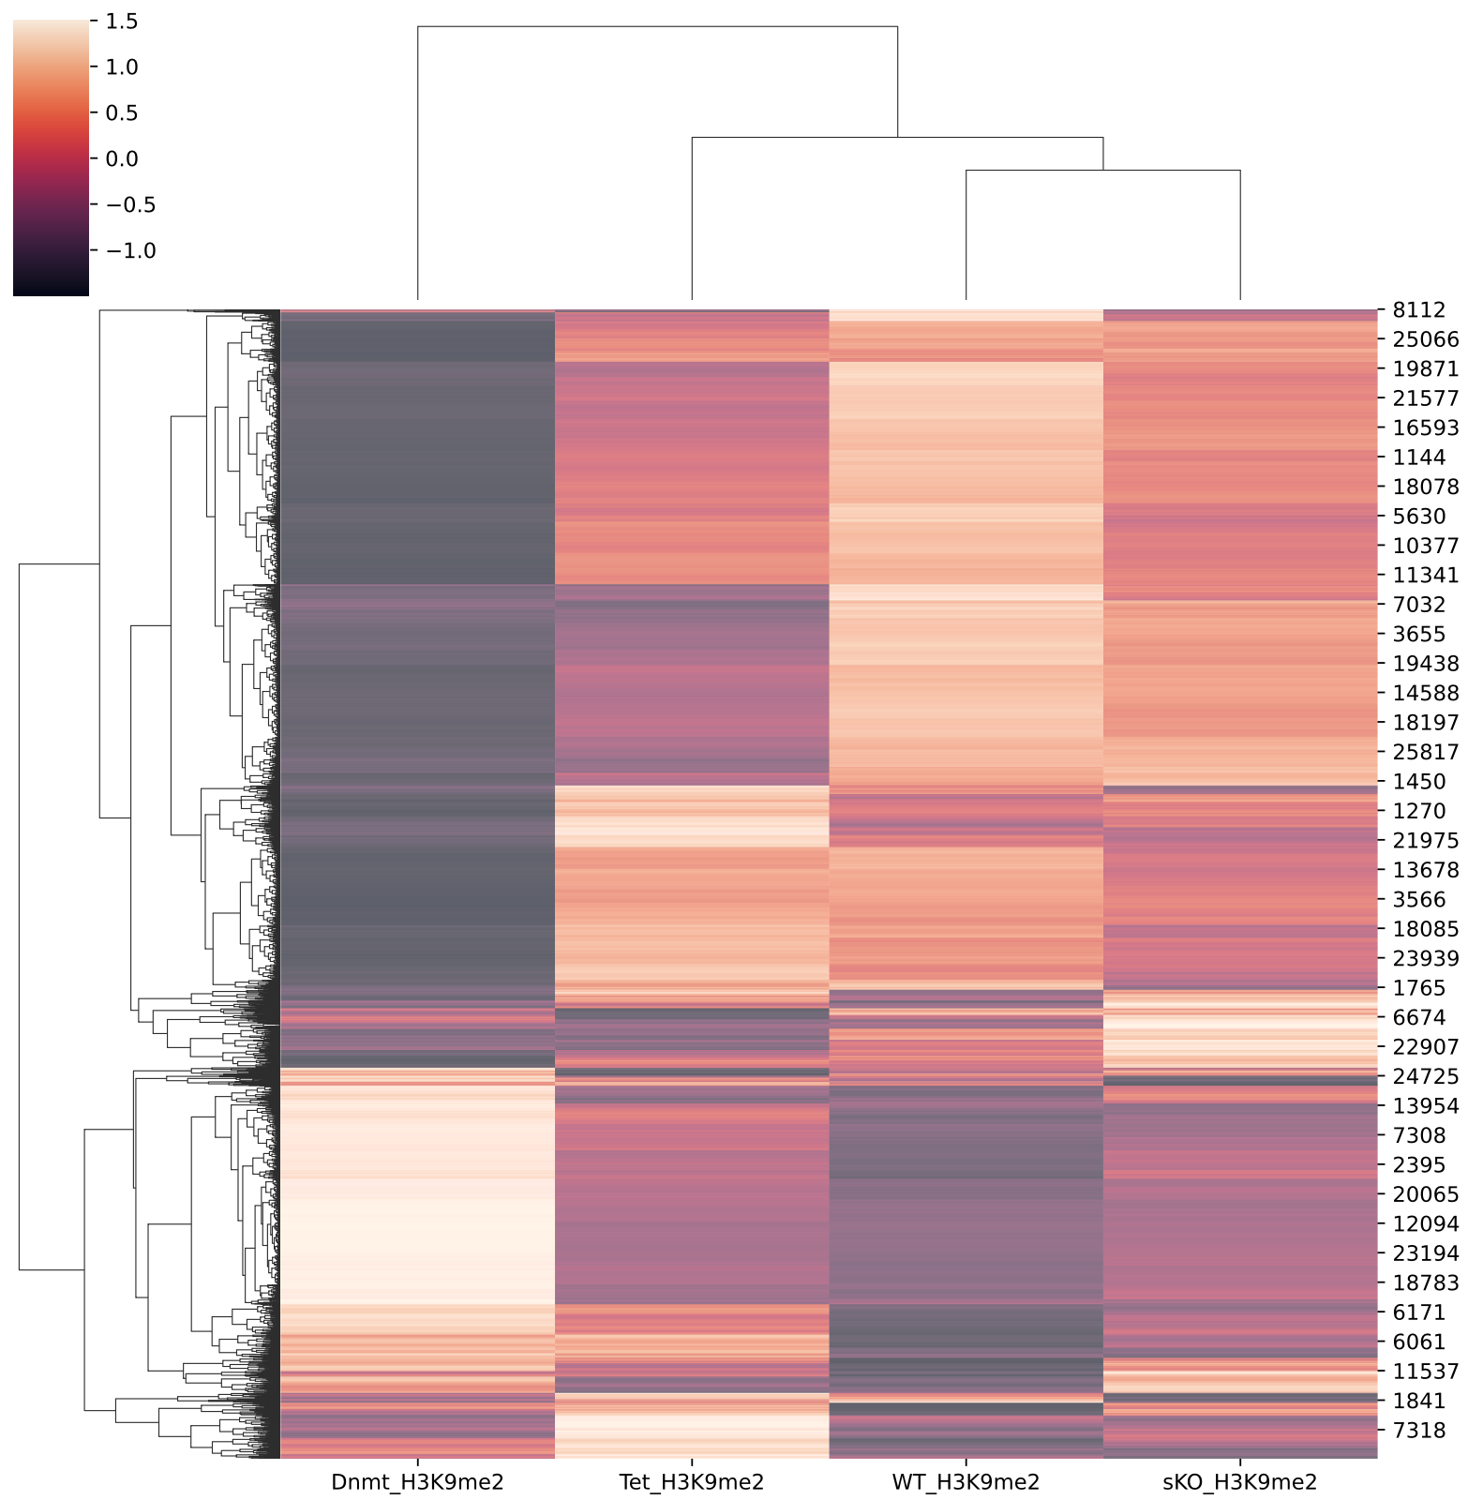
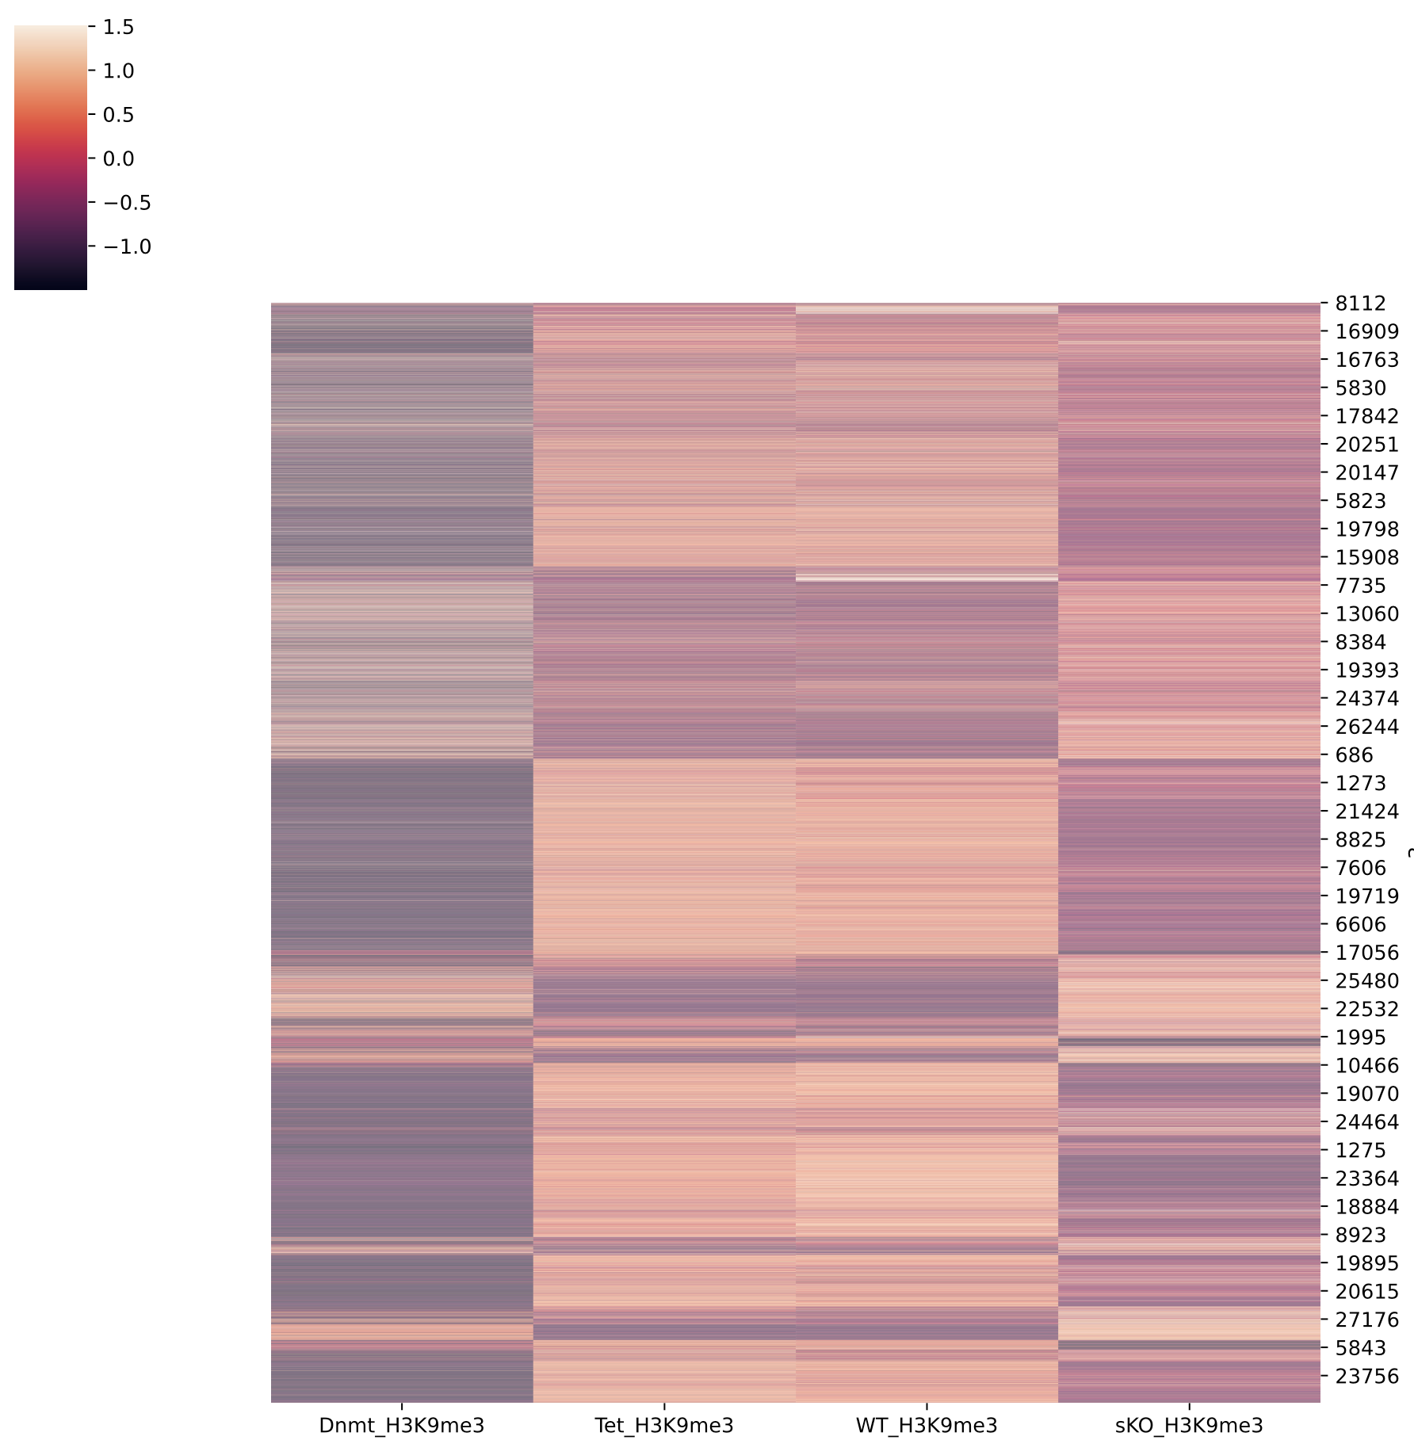
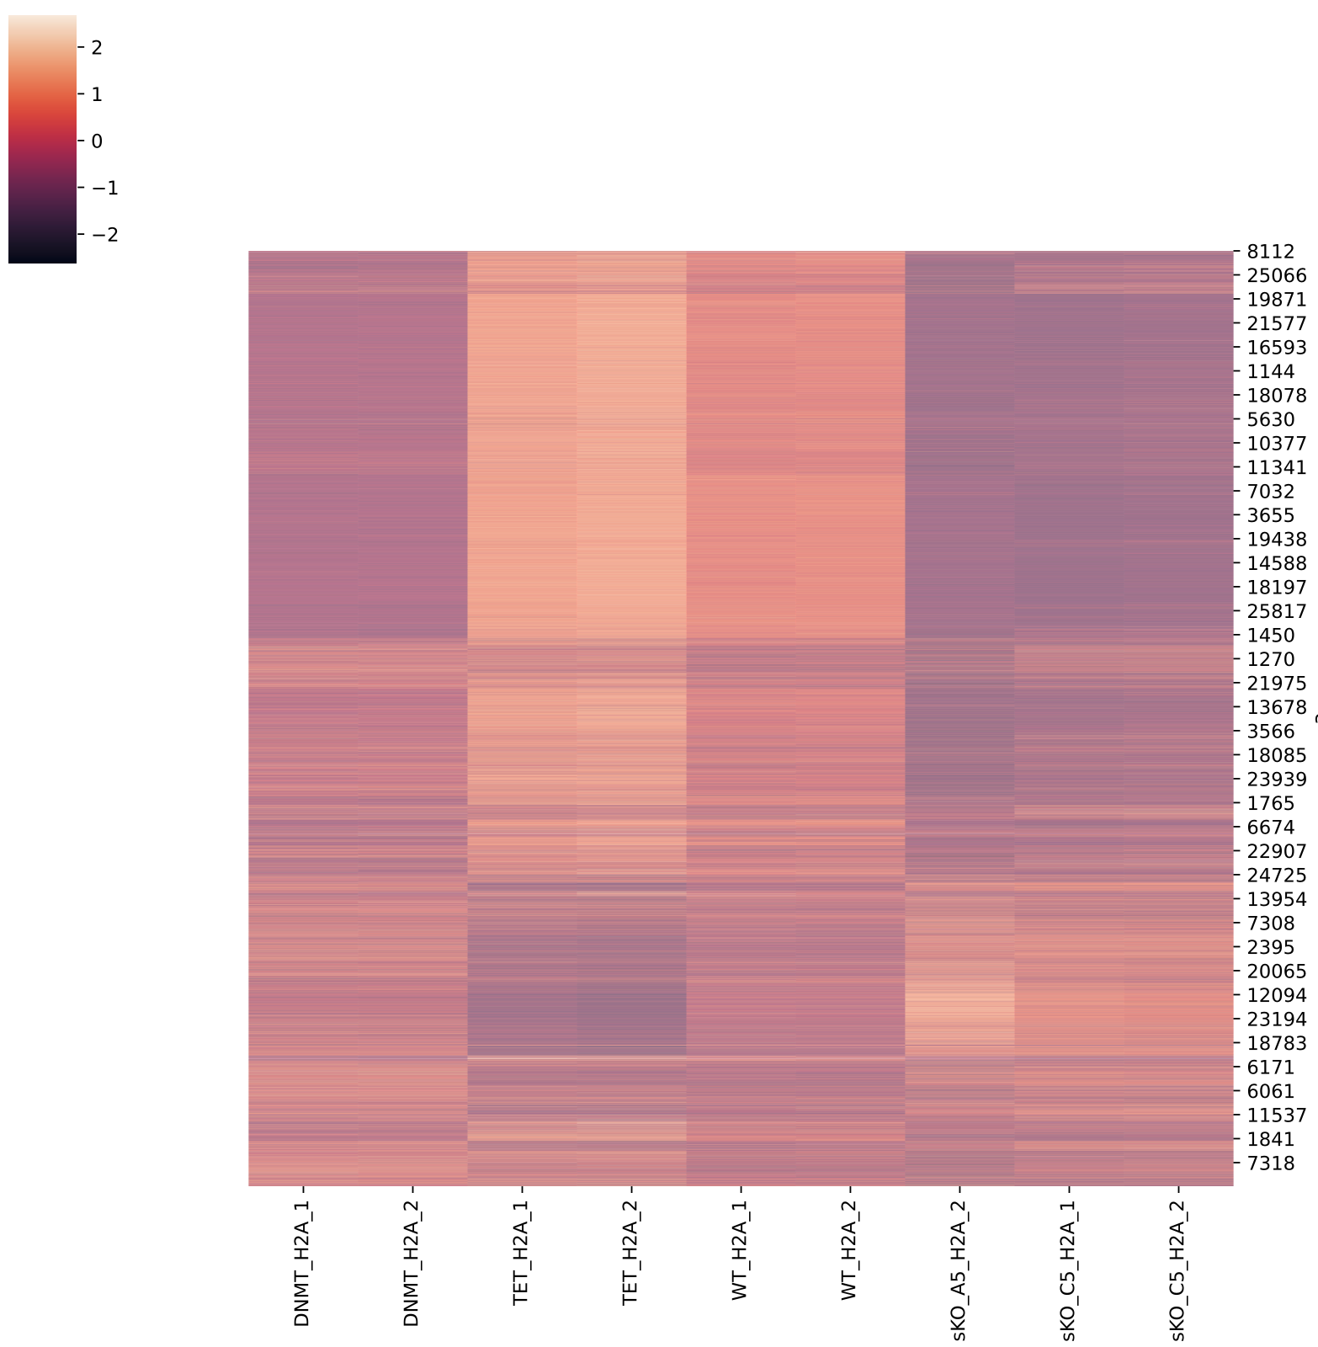
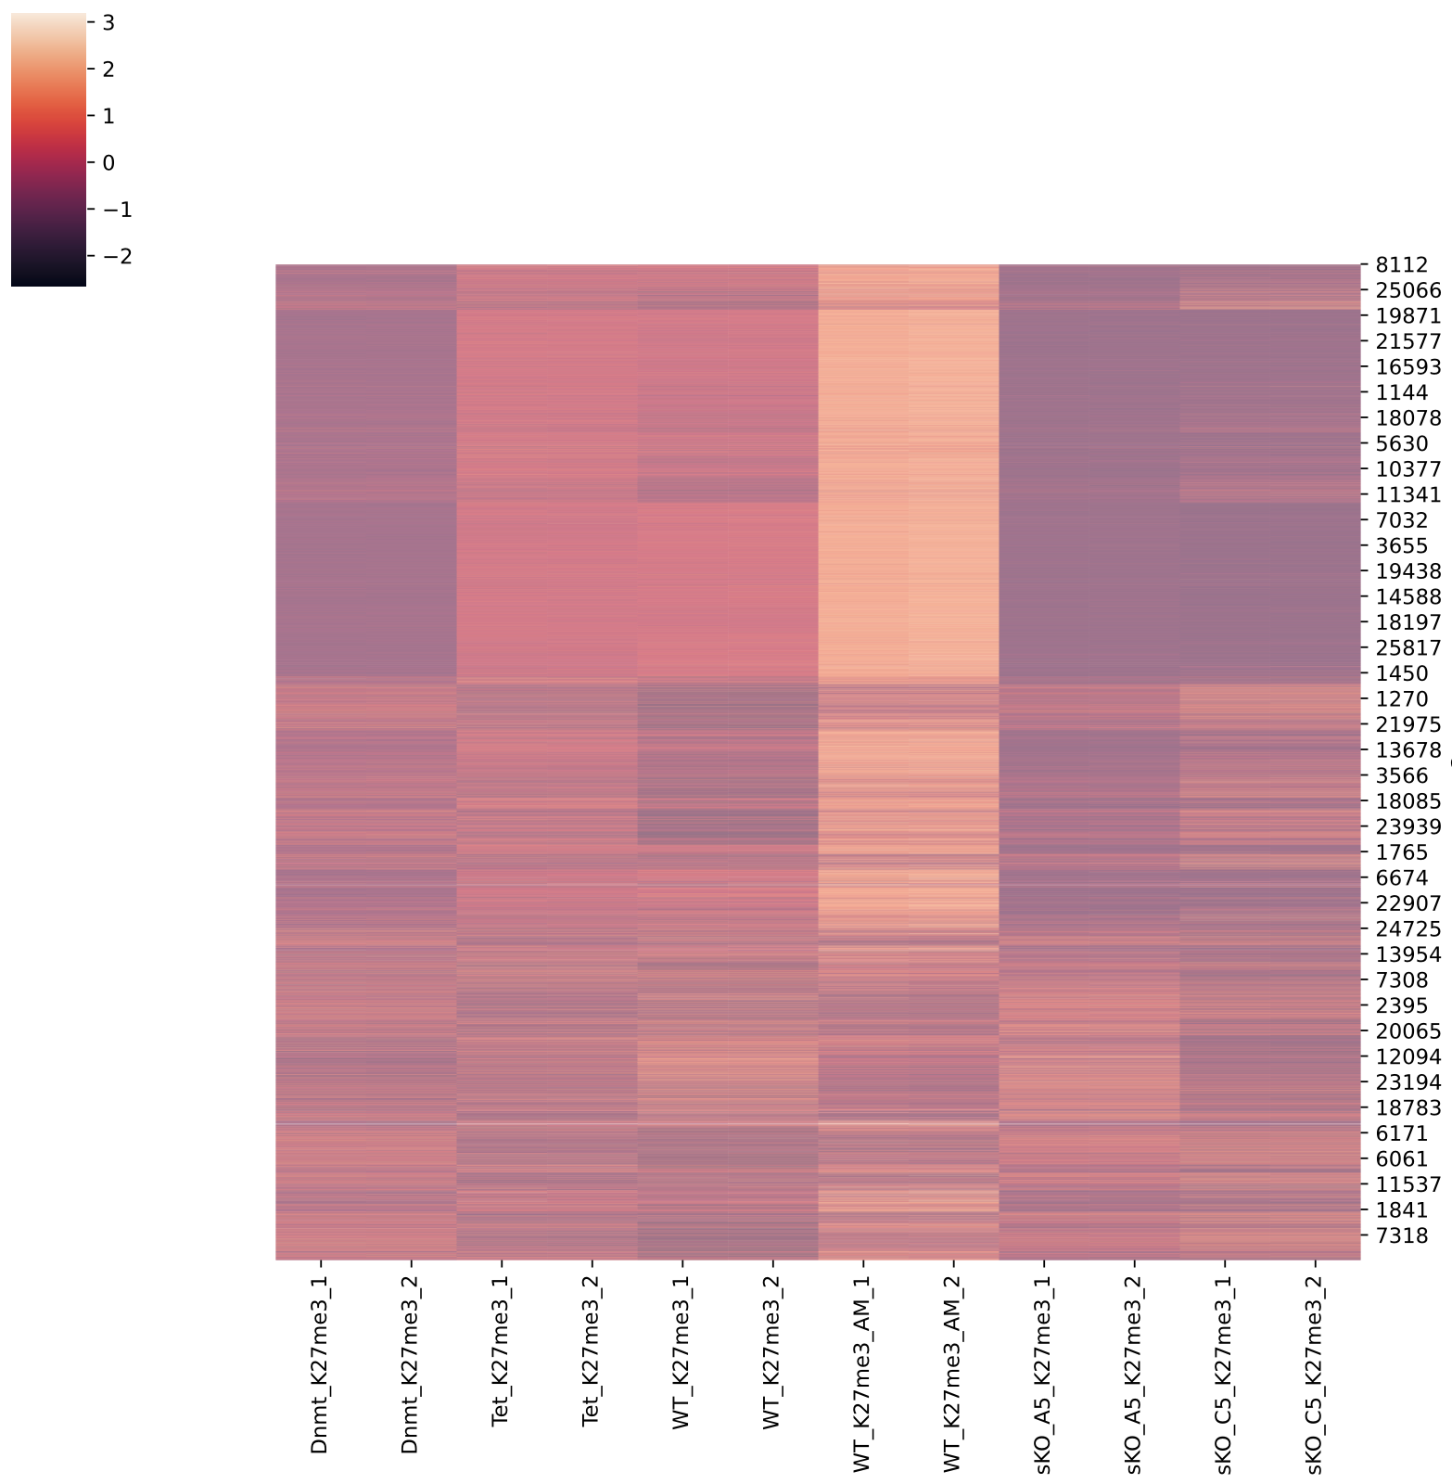
Heatmap in K9me2 Order
K9me2
K9me3
H2A
K27me3

Slide 56
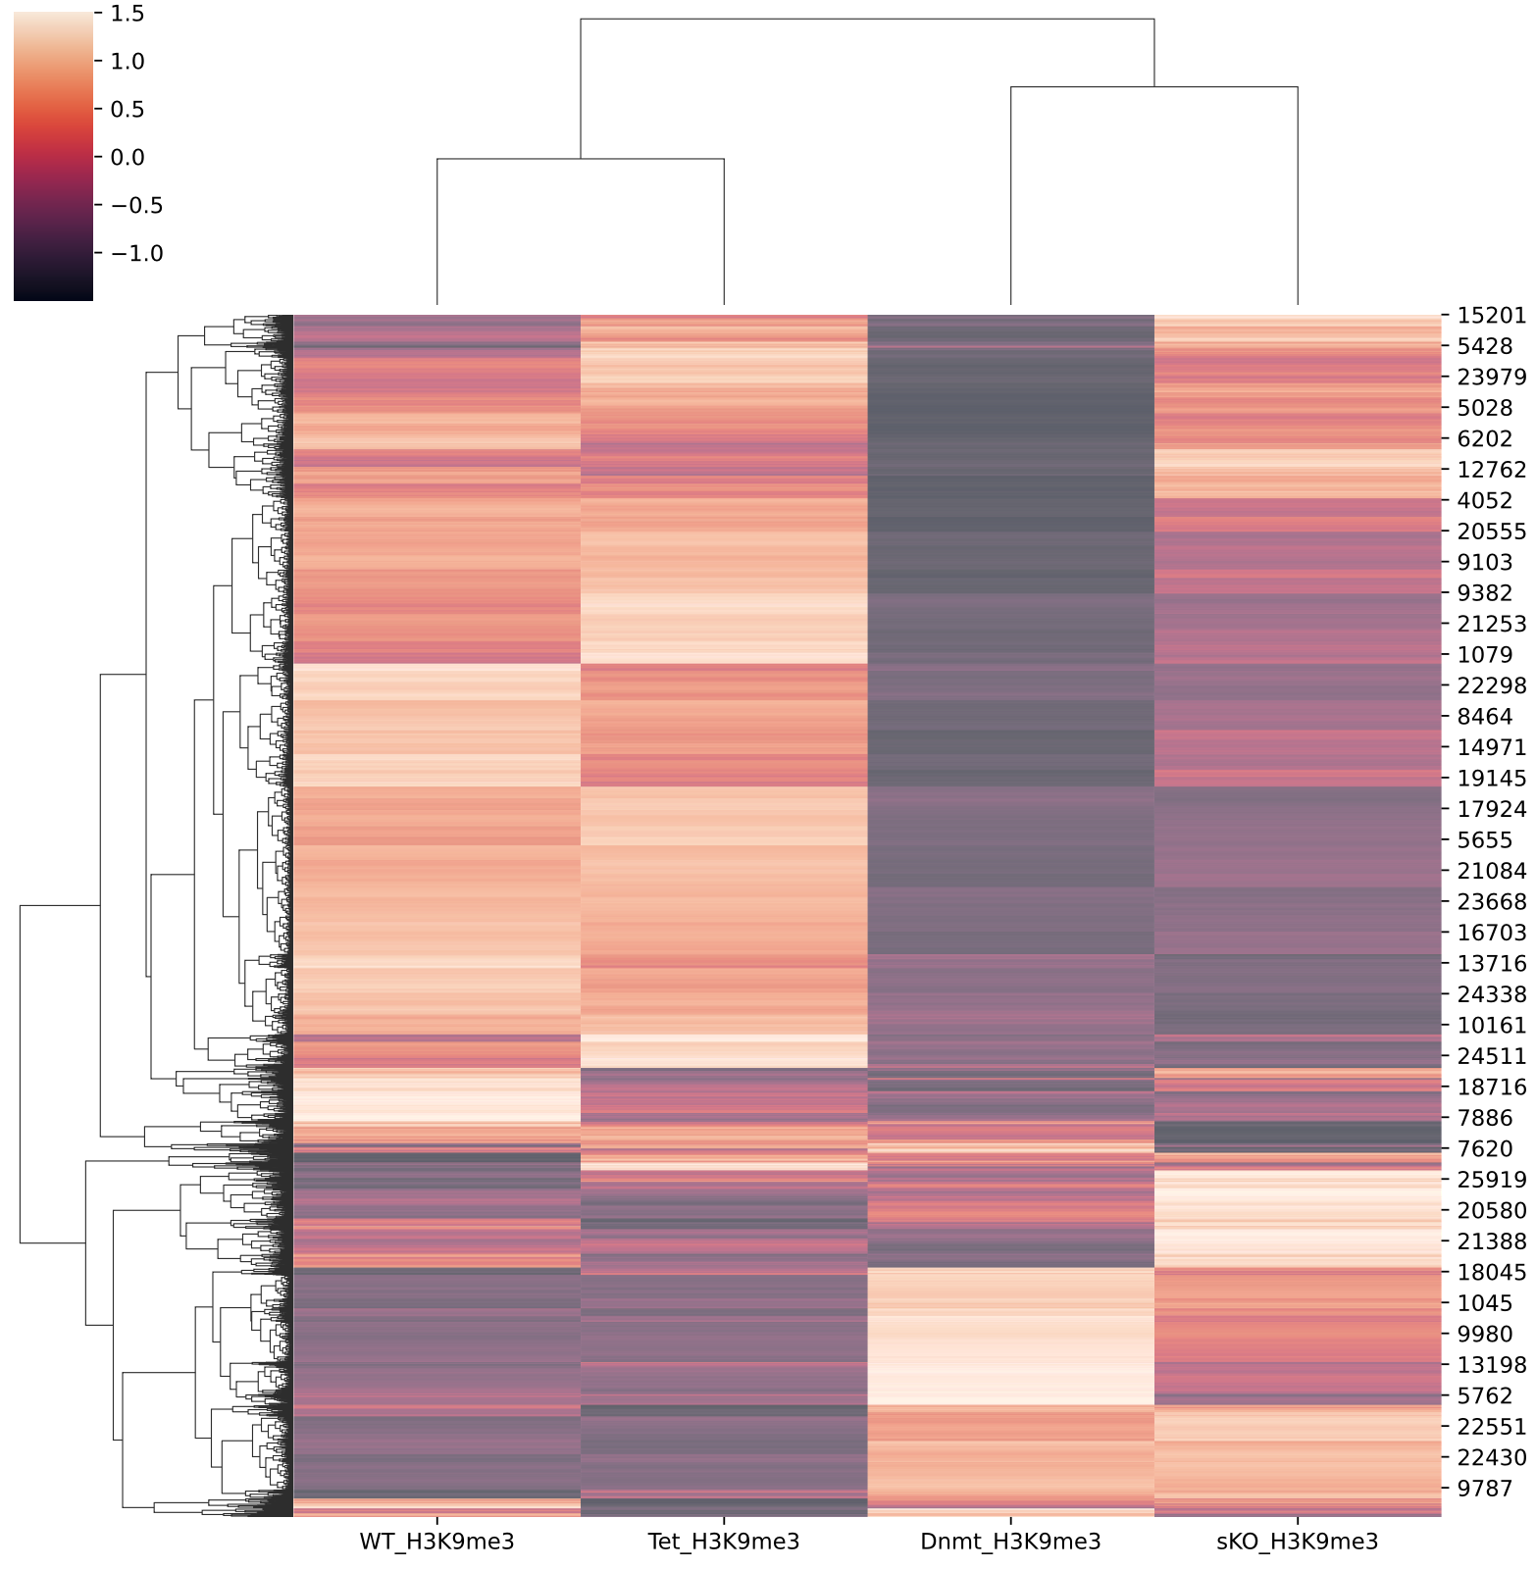
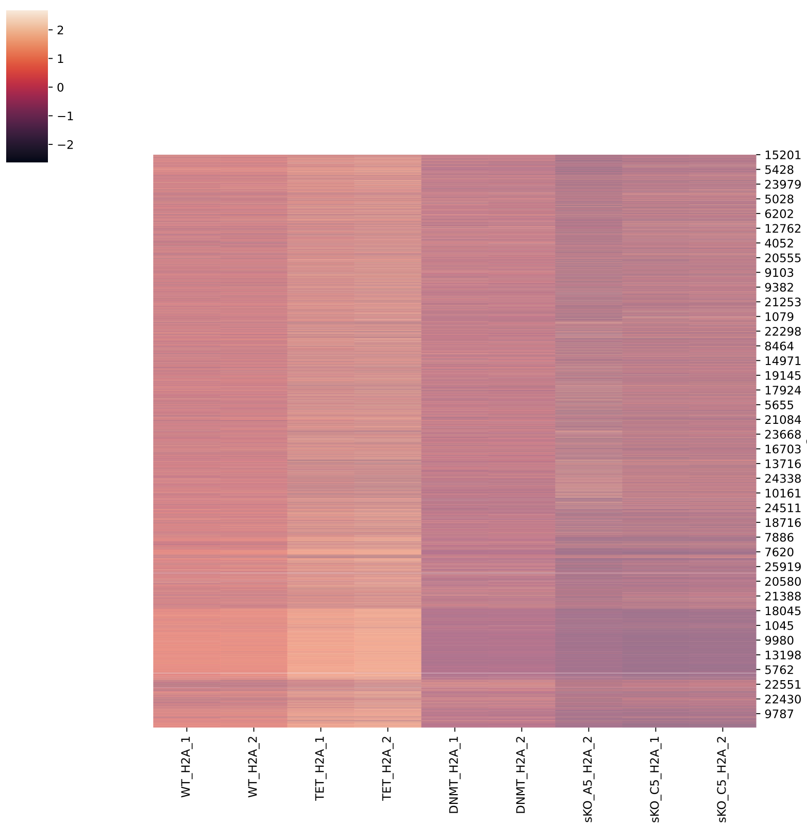
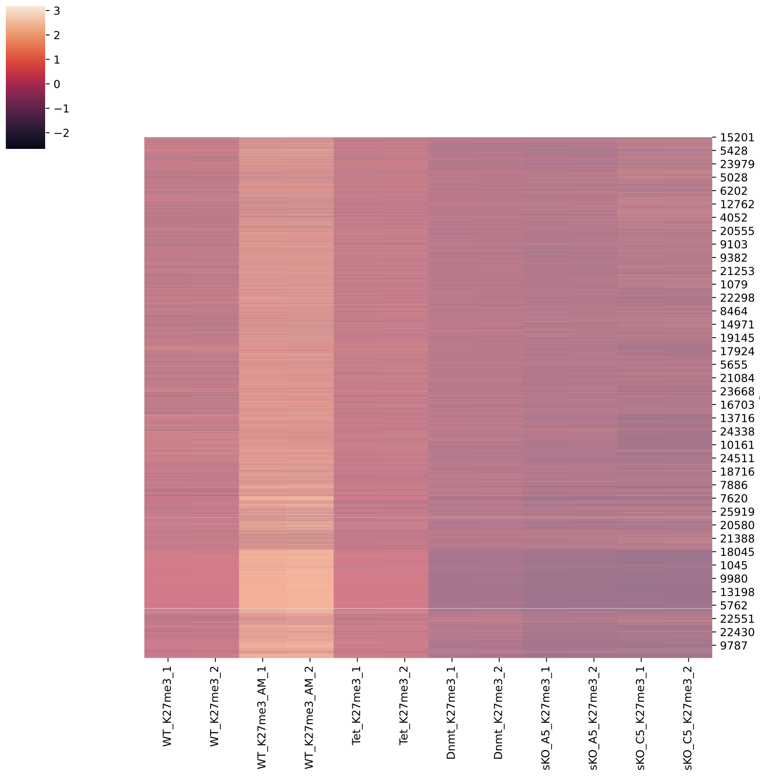
Heatmap in K9me3 Order

Slide 57
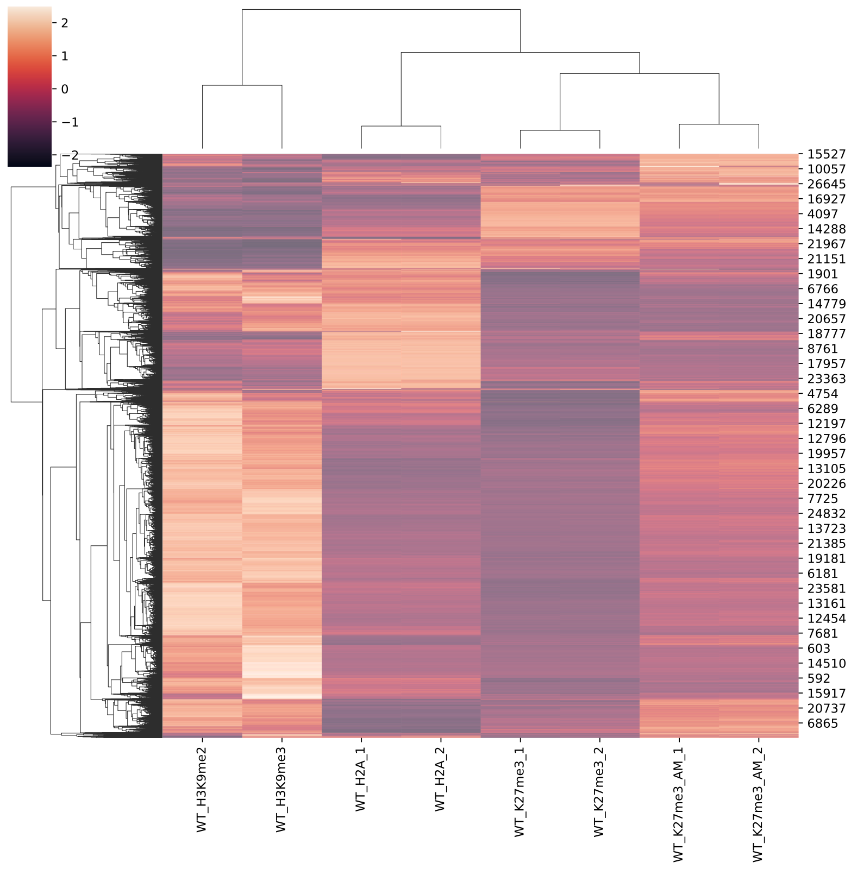
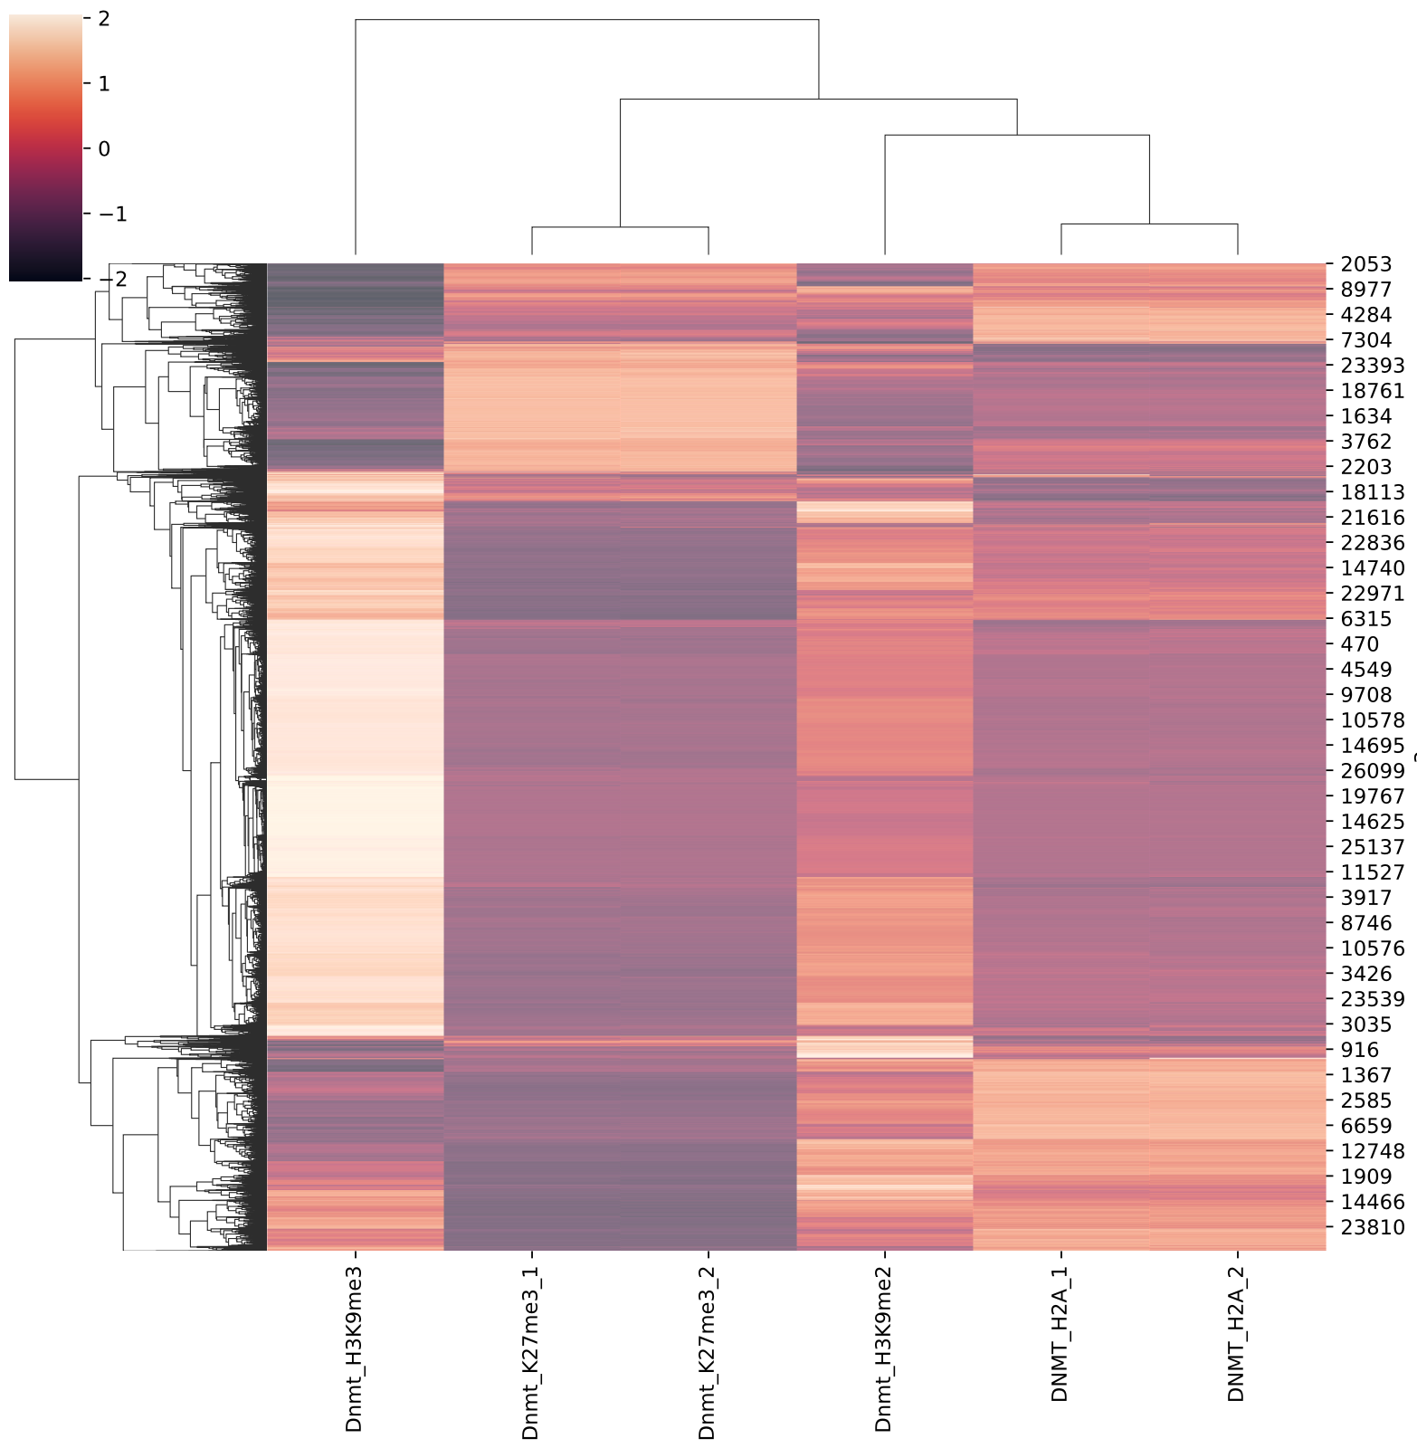
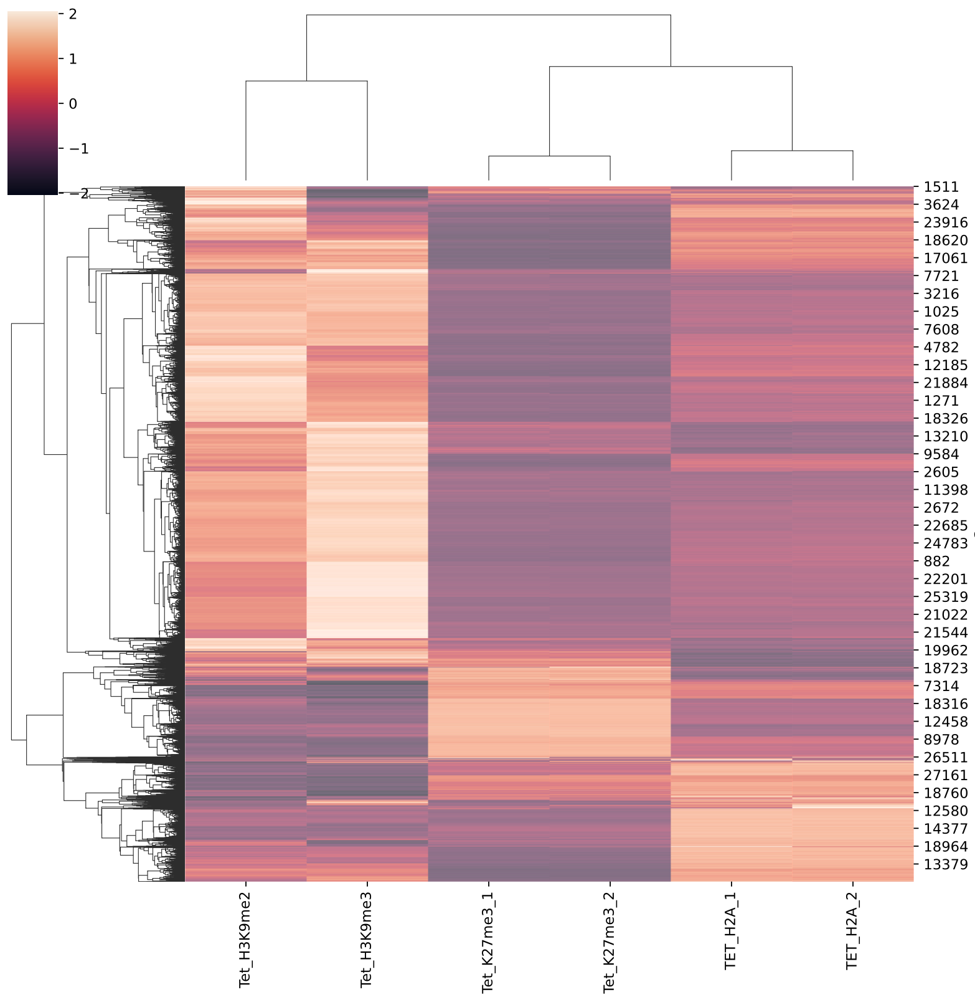
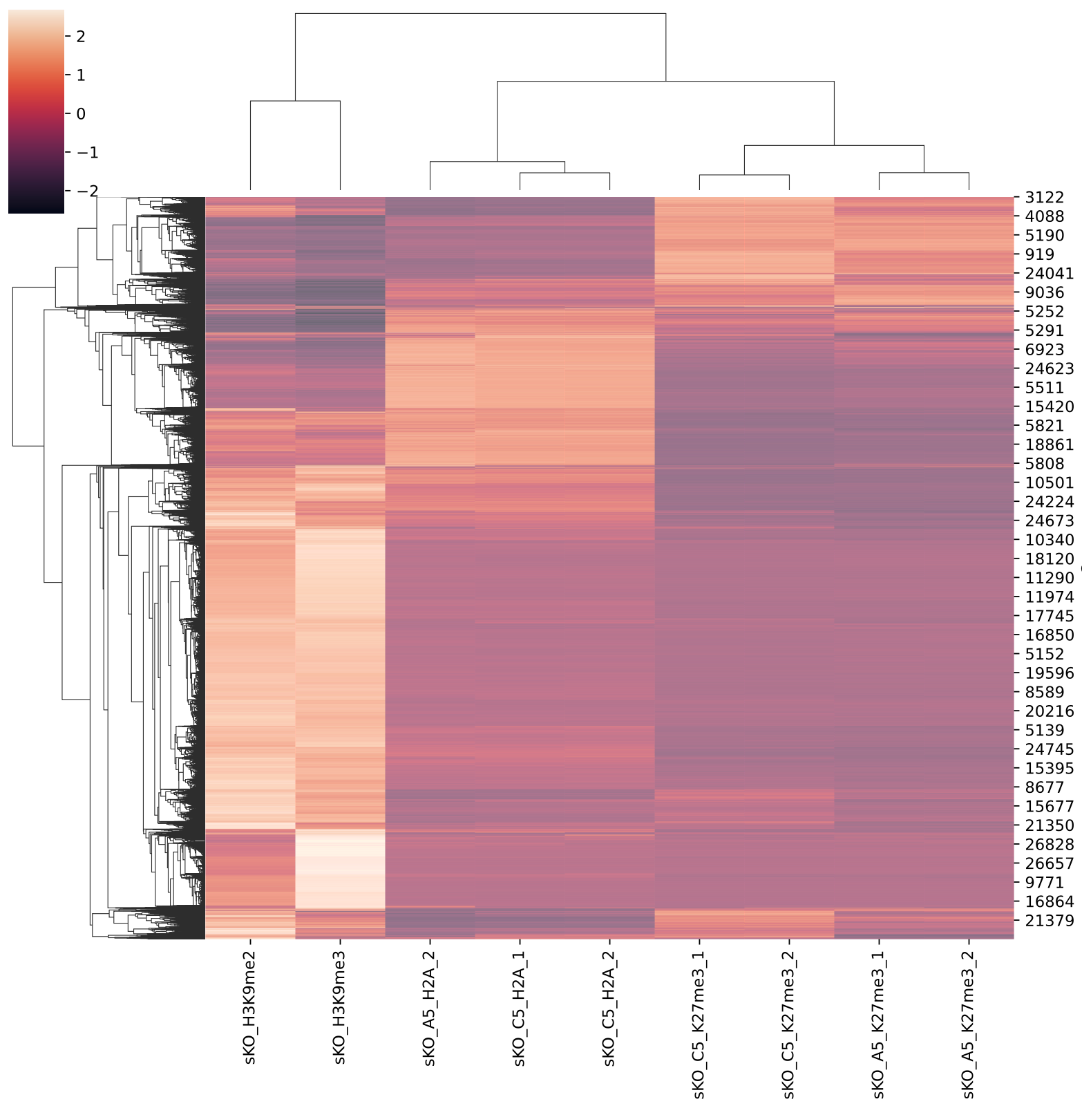
Heatmap in Same Condition

Slide 58
LogFC

Slide 59
LogFC

Slide 60
LogFC

Slide 61
Markers Correlation
Based on 100K RPKM

Slide 62
Markers Correlation
Based on 100K RPKM log2ratio

