Slide 1
HiChIP

Slide 2
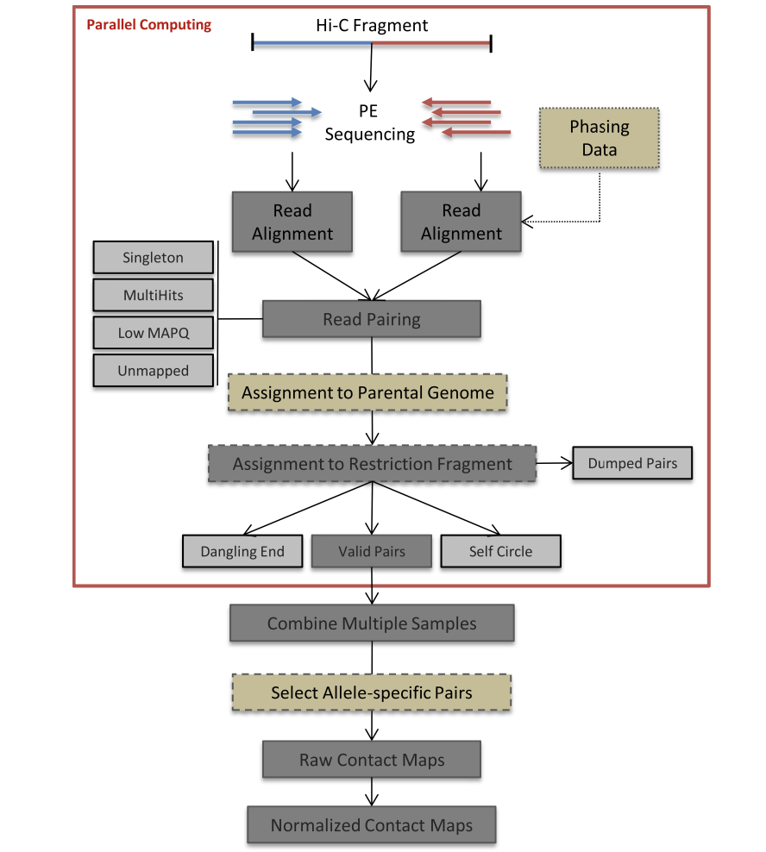
HiC-Pro
Reads Mapping
  R1/R2 Independantly aligned on the reference genome
  Two-step alignment
    End-to-end aligner
    Trimmed reads spanning the ligation junction from 3’ end, aligned back on the genome.
Fragment assignment and filtering
  For no restriction enzyme: MIN_CIS_DIST
Quality Controls
Map builder
ICE normalization

Slide 3
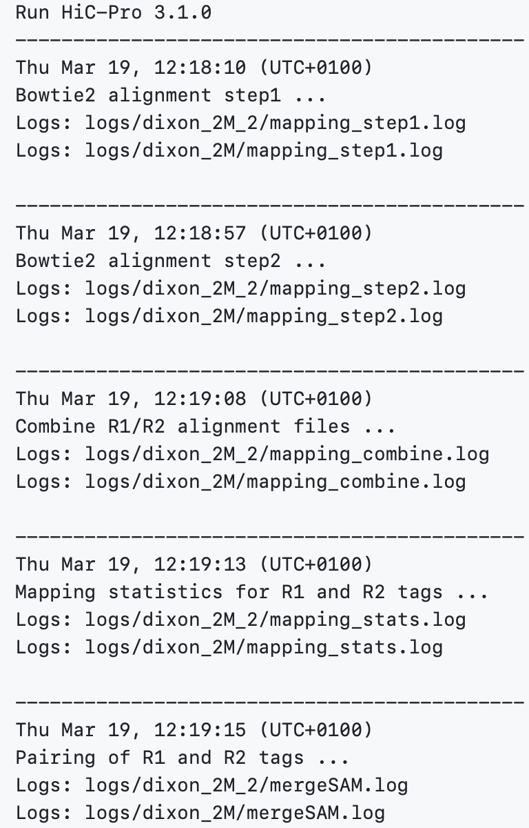
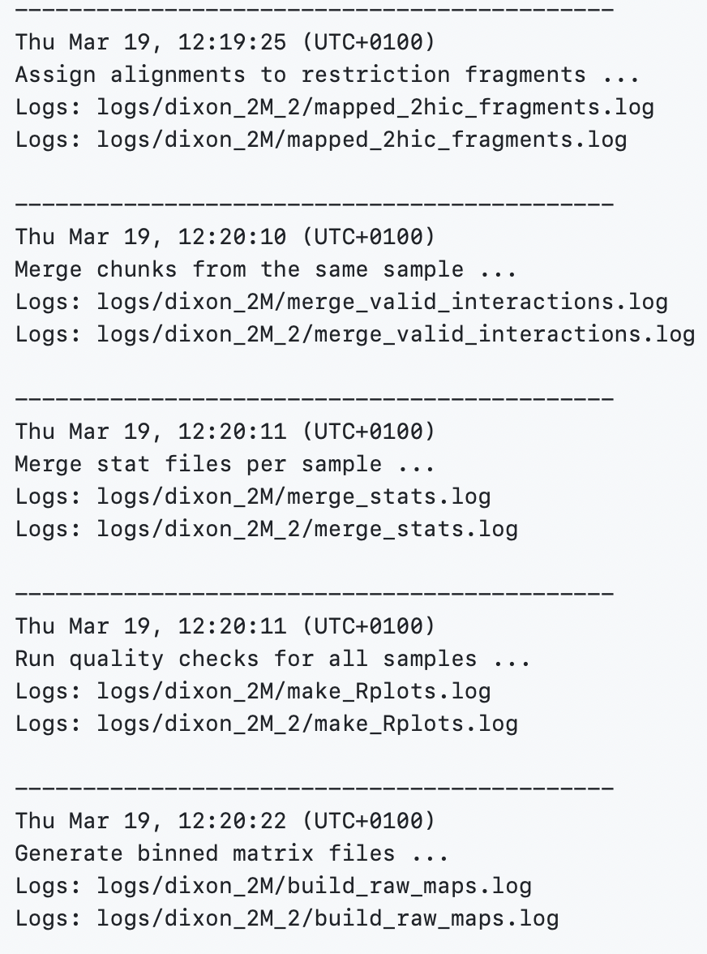
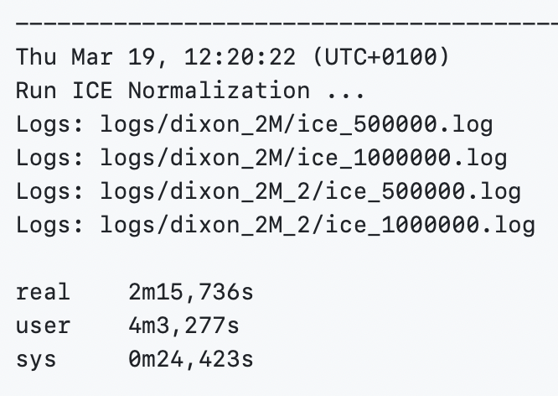

Slide 4
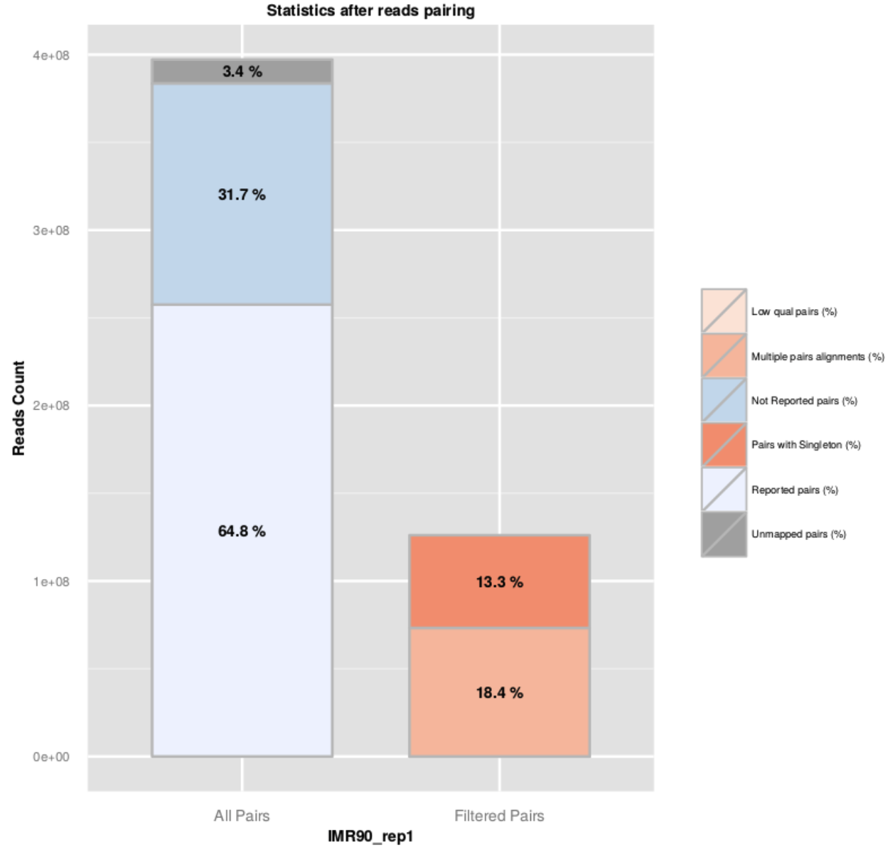
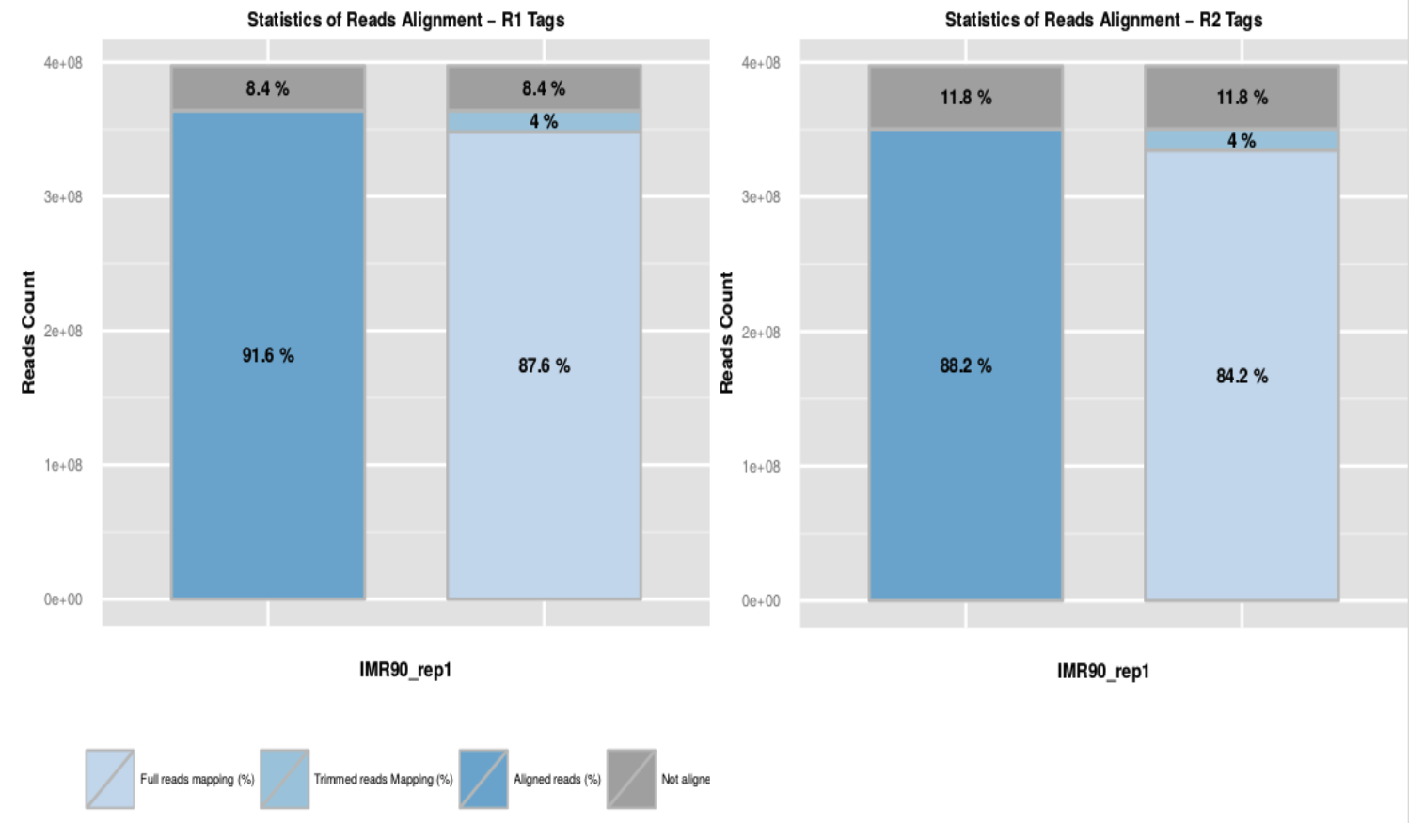
Example QC
Notes:
80-90% of alignment rate

Slide 5
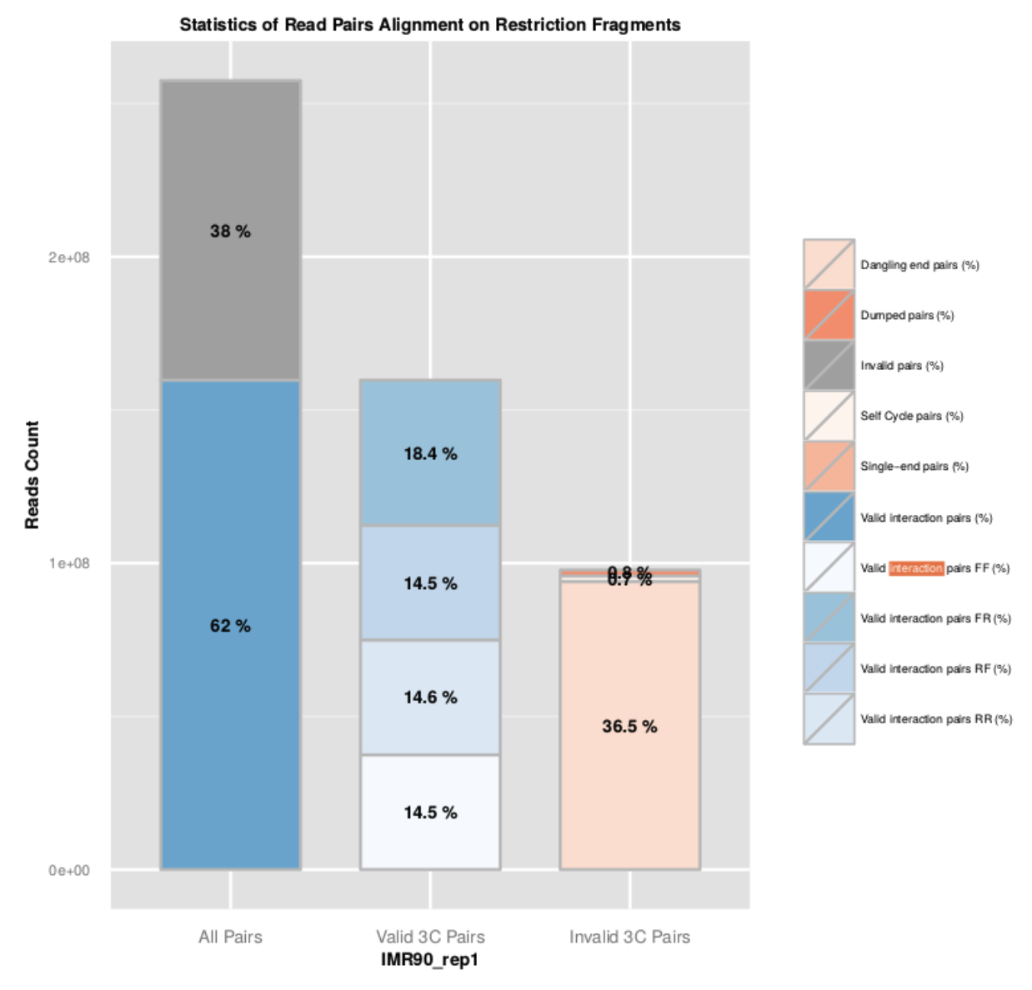
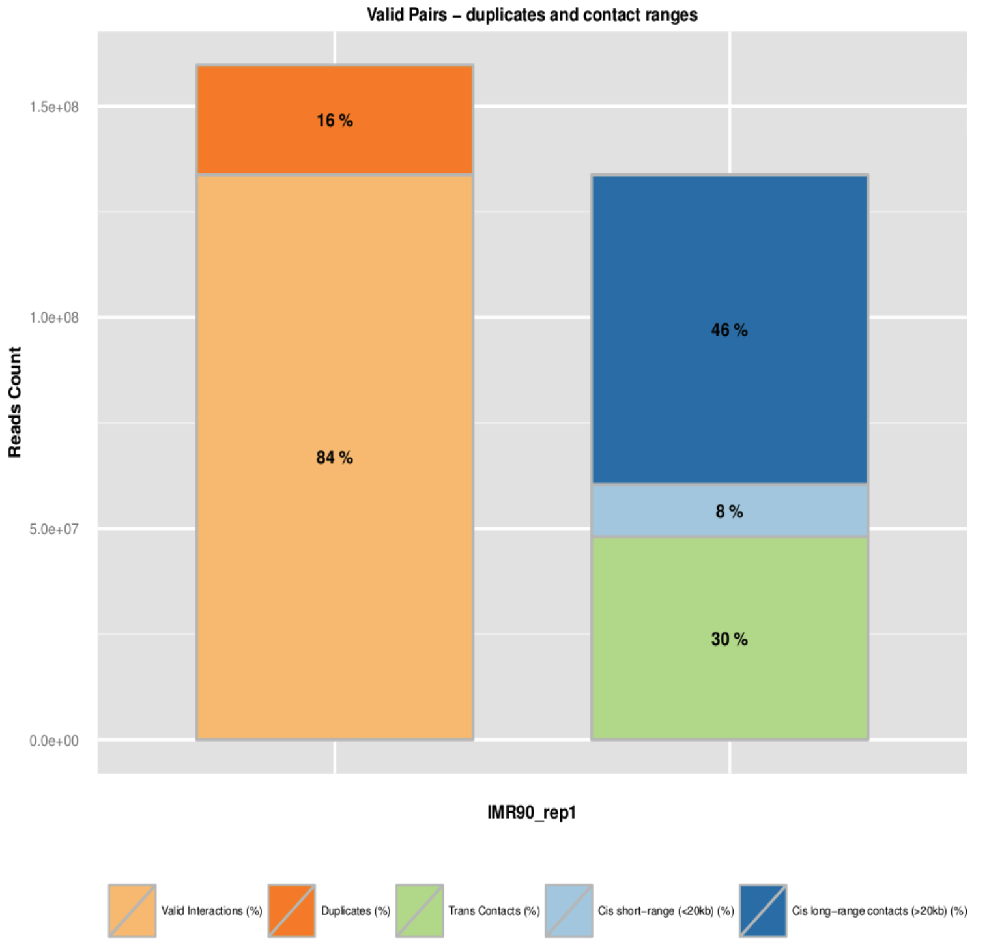
Example QC

Slide 6
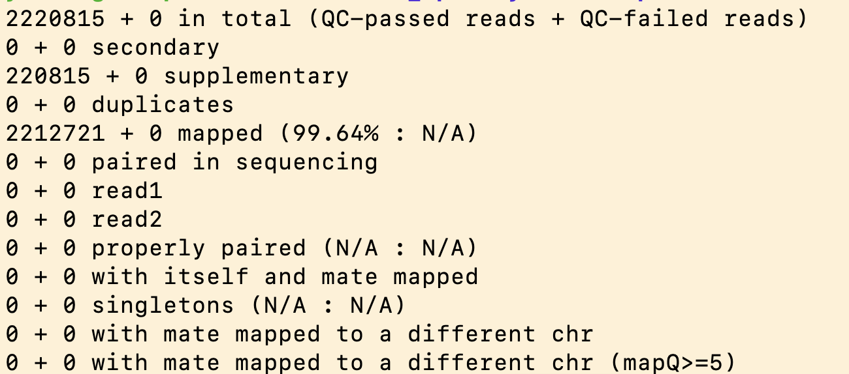
Alignment Rate
--very-sensitive -L 30
--score-min L,-0.6,-0.2 --end-to-end --reorder
BWA -MEM

Slide 7
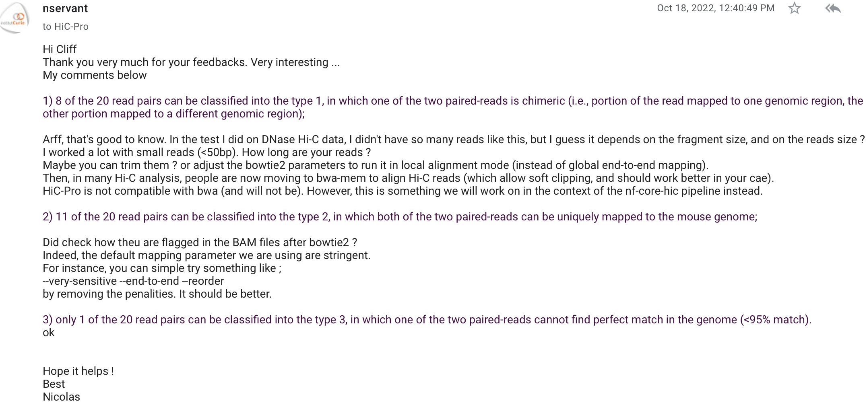

Slide 8
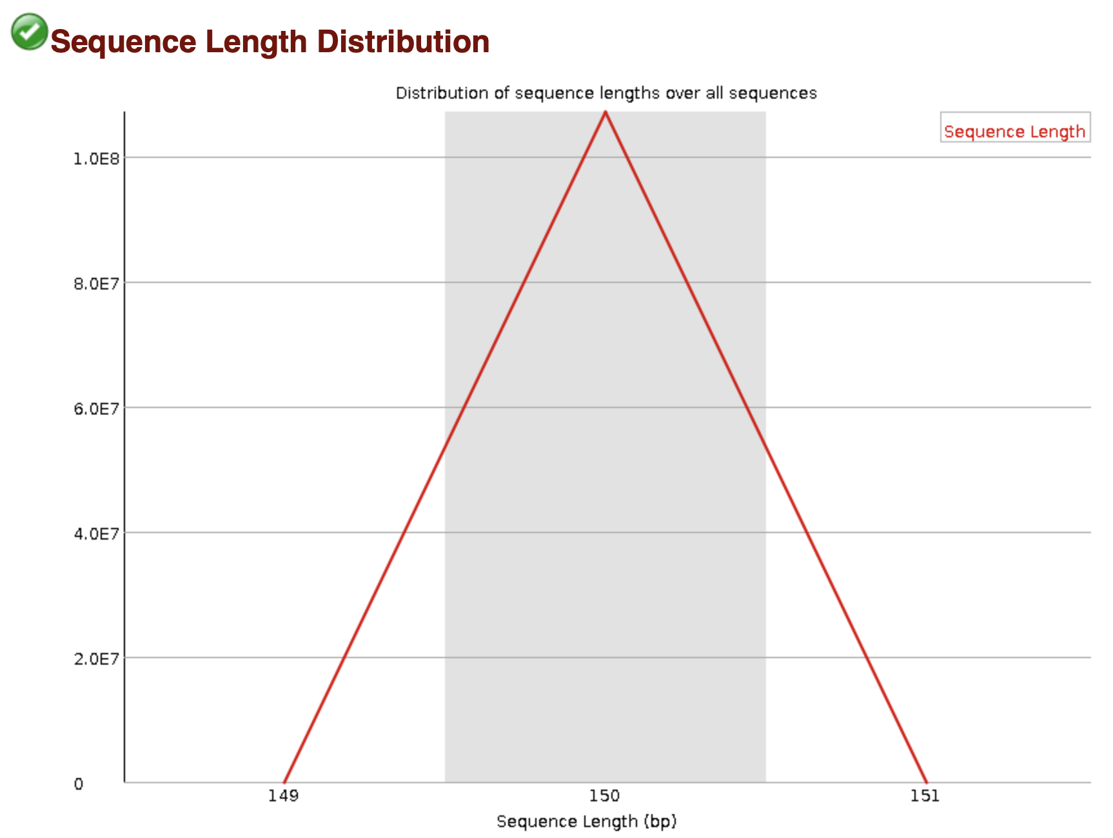
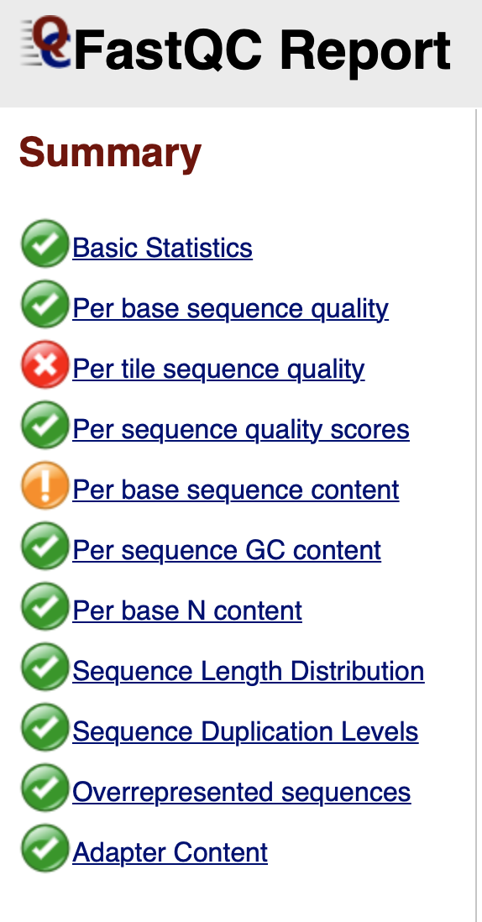
FastQC

Slide 9
QC

Slide 10
QC

Slide 12
FitHiChip 5k/10k resolution
TH779 WT 5k
10k
P-value < 0.01: 22839
Q-value < 0.01: 3373
P-value < 0.01: 21404
Q-value < 0.01: 4998
Notes:
780: 23391, 3649
781: 18751, 2385
782: 20970, 3167
783: 19962, 2732

Slide 13
FitHiChip 5k/10k resolution
TH780 Dnmt-TKO 5k
10k
P-value < 0.01: 23391
Q-value < 0.01: 3649
P-value < 0.01: 20654
Q-value < 0.01: 5068

Slide 14
FitHiChip 5k/10k resolution
TH781 Tet-TKO 5k
10k
P-value < 0.01: 18751
Q-value < 0.01: 2385
P-value < 0.01: 16223
Q-value < 0.01: 3111

Slide 15
FitHiChip 5k/10k resolution
TH782 Dnmt-TKO_and_Tet-TKO 5k
10k
P-value < 0.01: 20970
Q-value < 0.01: 3167
P-value < 0.01: 19108
Q-value < 0.01: 4530

Slide 16
FitHiChip 5k/10k resolution
TH783 Dnmt-TKO_and_Tet-TKO 5k
10k
P-value < 0.01: 19962
Q-value < 0.01: 2732
P-value < 0.01: 17610
Q-value < 0.01: 3790

Slide 17
Insulation Score
2500
5000
20000
20k cutoff: 5
14435 merged TADs
4505 TADs overlapped with wt chipseq peaks
TH779 WT
Notes:
20k cutoff: 5 -> 14435 merged TADs
20k 50k 100k, line chart to determine the cutoff

Slide 18
Insulation Score
2500
5000
20000
20k cutoff: 5
14280 merged TADs
3586 TADs overlapped with Dnmt-TKO chipseq peaks
TH780 Dnmt-TKO

Slide 19
Insulation Score
2500
5000
20000
20k cutoff: 5
11470 merged TADs
3284 TADs overlapped with Tet-TKO chipseq peaks
TH781 Tet-TKO

Slide 20
Insulation Score
2500
5000
20000
20k cutoff: 5
12577 merged TADs
3263 TADs overlapped with Dnmt-Tet-TKO chipseq peaks
TH782 Dnmt-TKO_and_Tet-TKO

Slide 21
Insulation Score
2500
5000
20000
20k cutoff: 5
11367 merged TADs
2849 TADs overlapped with Dnmt-Tet-TKO chipseq peaks
TH783 Dnmt-TKO_and_Tet-TKO

Slide 22
11/07/2023

Slide 23
HiChIP Data
Sample number | Sample name | I7 Index
TH779 | WT-H3K9me3-HiCHIP | CTGATCGT
TH780 | Dnmt-TKO-H3K9me3-HiCHIP | ACTCTCGA
TH781 | Tet-TKO-H3K9me3-HiCHIP | TGAGCTAG
TH782 | Dnmt-TKO_and_Tet-TKO_C5_H3K9me3-HiCHIP | GAGACGAT
TH783 | Dnmt-TKO_and_Tet-TKO_A5-2_H3K9me3-HiCHIP | CTTGTCGA

Slide 24
HiC-Pro
Reads Mapping
  R1/R2 Independantly aligned on the reference genome
  Two-step alignment
    End-to-end aligner
    Trimmed reads spanning the ligation junction from 3’ end, aligned back on the genome.
Fragment assignment and filtering
  For no restriction enzyme: MIN_CIS_DIST
Quality Controls
Map builder
ICE normalization

Slide 25
QC
 | TH779_wt (%) | TH780_Dnmt-TKO (%) | TH781_Tet-TKO (%) | TH782_Dnmt-TKO_and_Tet-TKO (%) | TH783_Dnmt-TKO_and_Tet-TKO (%)
Total_pairs_processed | 100 (107,132,474) | 100 (93,655,898) | 100 (80,899,247) | 100 (93,676,023) | 100 (82,842,145)
Unmapped_pairs | 0.046 | 0.048 | 0.050 | 0.048 | 0.048
Low_qual_pairs | 39.167 | 35.465 | 35.791 | 36.205 | 39.263
Unique_paired_alignments | 59.607 | 63.169 | 62.859 | 62.462 | 59.556
Multiple_pairs_alignments | 0 | 0 | 0 | 0 | 0
Pairs_with_singleton | 1.180 | 1.317 | 1.300 | 1.284 | 1.133
Low_qual_singleton | 0 | 0 | 0 | 0 | 0
Reported_pairs | 59.607 | 63.169 | 62.859 | 62.462 | 59.556

Slide 26
QC

Slide 27
QC

Slide 28
QC

Slide 29
Loop Calling
Tool
  FitHiChIP
Bin size
  5 kb
Distance threshold of interaction between two segments
  >1 kp, and < 2 mb
Reference ChIP-seq peak
  ratio_WT_H3K9me3_merged.peak (59302 peaks)
Threshold for loop significance
  P-value < 0.01
Loop type
  Peak-to-peak, peak-to-all
number of significant loops
22839 TH779 (wt)
23391 TH780 (dnmt)
18751 TH781 (tet)
20970 TH782 (dnmt_tet)
19962 TH783 (dnmt_tet)

Slide 30
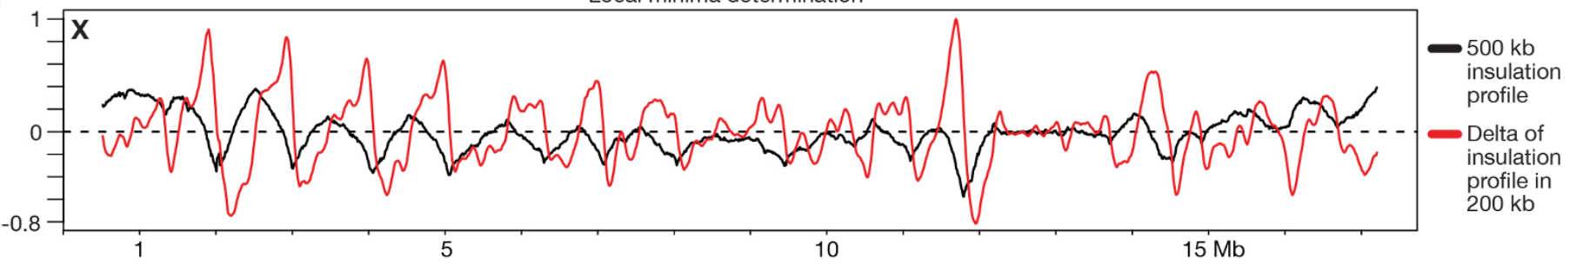
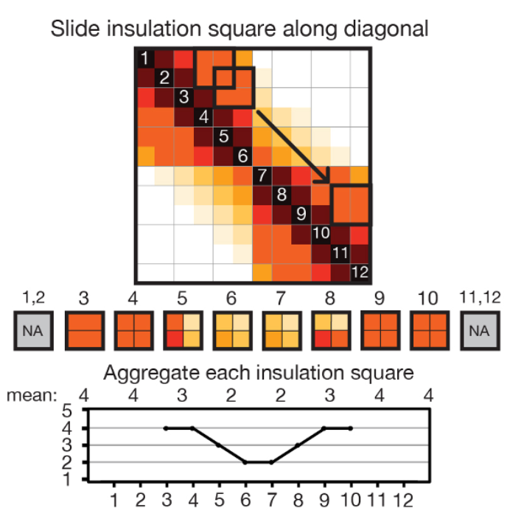
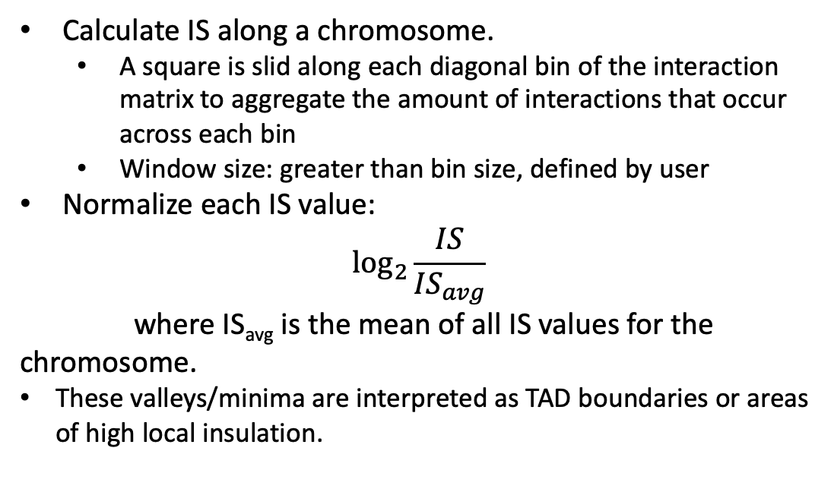
TAD - Insulation
Calculate IS along a chromosome.
  A square is slid along each diagonal bin of the interaction matrix to aggregate the amount of interactions that occur across each bin
  Window size: greater than bin size, defined by user
Normalize each IS value:
$$\log_{2}{\frac{IS}{{IS}_{avg}}}$$
where IS_{avg} is the mean of all IS values for the chromosome.
These valleys/minima are interpreted as TAD boundaries or areas of high local insulation.
Crane, E., Bian, Q., McCord, R. et al. Condensin-driven remodelling of X chromosome topology during dosage compensation. Nature 523, 240–244 (2015). https://doi.org/10.1038/nature14450
Notes:
Isavg: arithmetic mean was used here; maybe can try geometric mean

Slide 31
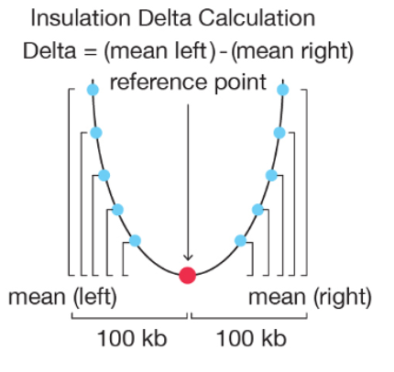
TAD - Insulation
Calculate delta values for each bin i.
  Delta = (mean left) - (mean right) at reference point
  Delta = 0 at all IS peaks and valleys (minimums)
Remove Zero-crossings occurring at peaks
TAD border is called at bin i if delta = 0 and S_{i} > 0.1
  S_{i} is called border (boundary) strength, was defined as the difference in the delta vector between the local maximum to the left and local minimum to the right of the boundary bin.
TAD is called between two borders.

Slide 32
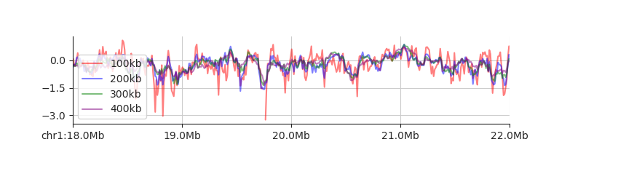
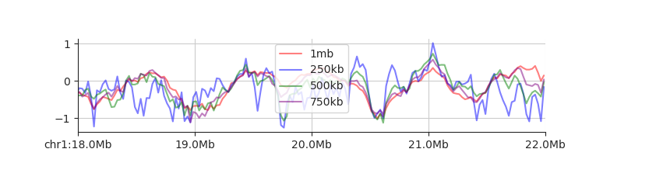
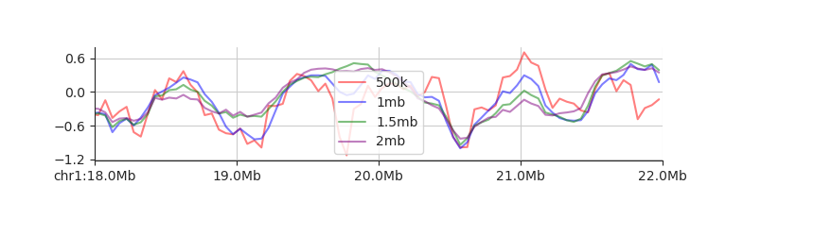
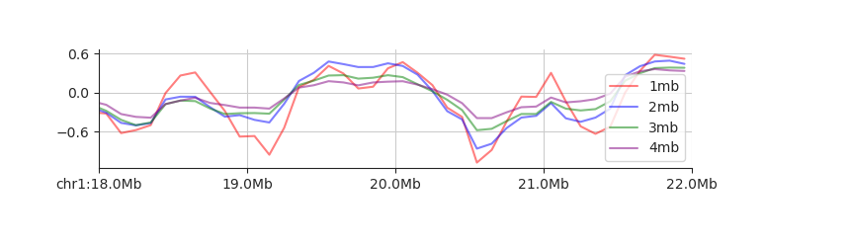
TH779 in 10k, 25k, 50k, 100k resolutions
Window size: 10x, 20x, 30x, 40x
10k
25k
50k
100k

Slide 33
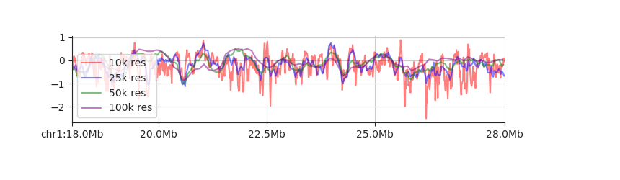
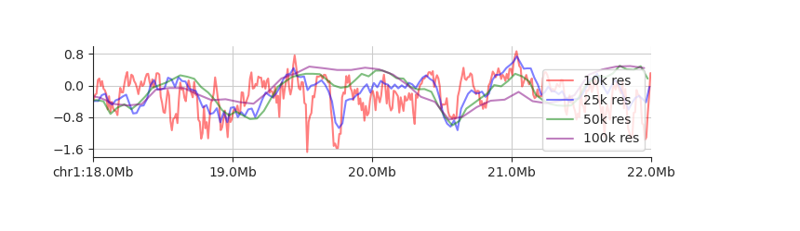
TH779 in 10k, 25k, 50k, 100k resolutions
Window size: 20x

Slide 34
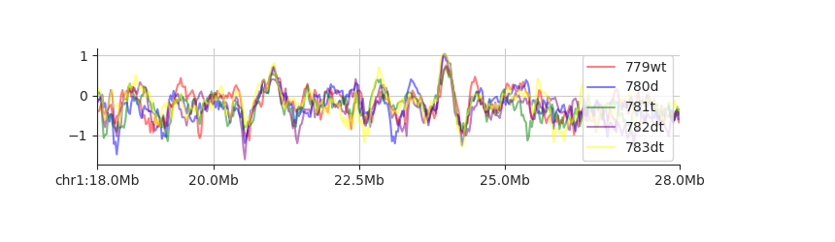
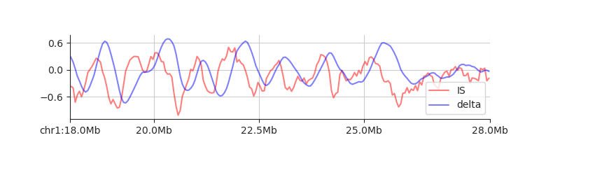
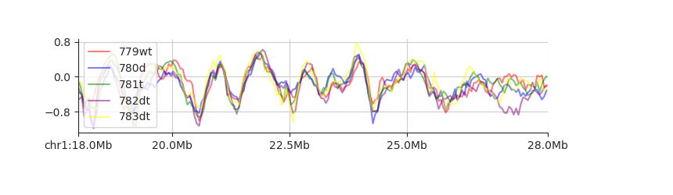
All samples in 25k, 50k resolutions
Window size: 20x
samples_25kb_20x
samples_50kb_20x

Slide 35
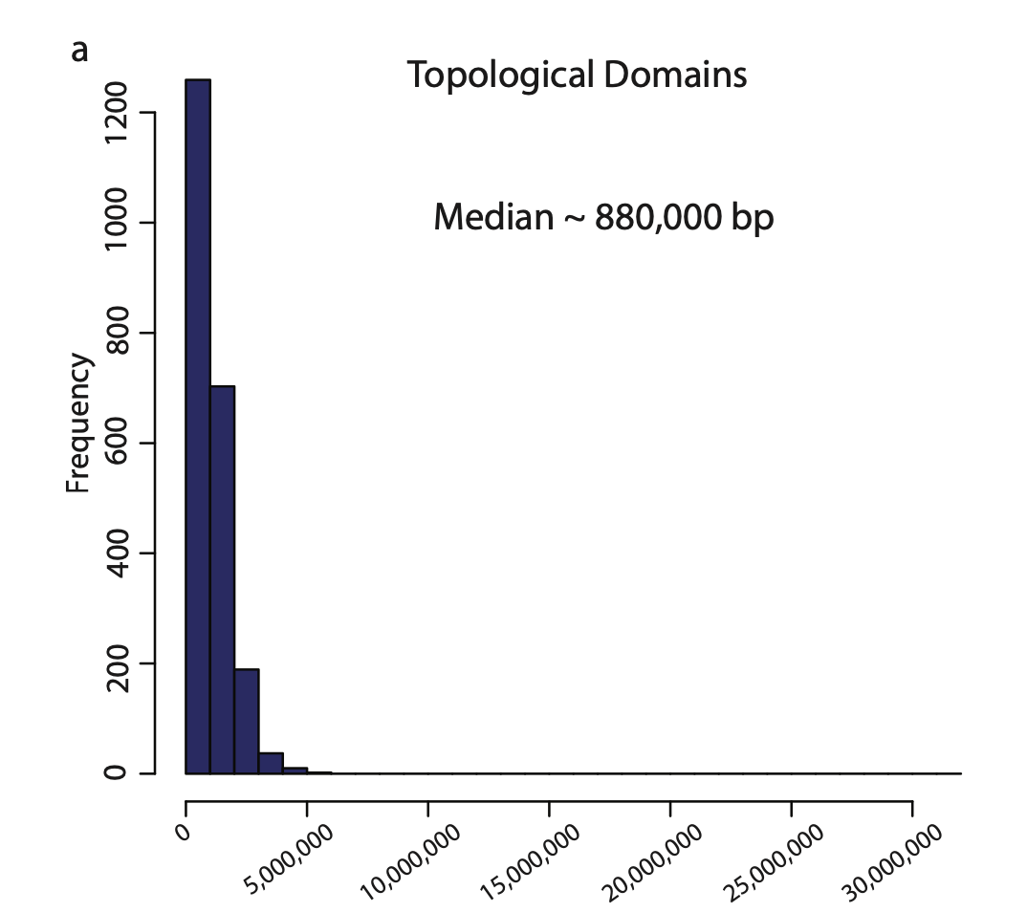
TAD
TAD length distribution
TH 779 wt: 2542 median: 950 kb
TH 780 dnmt-tko: 2573 median: 900 kb
TH 781 tet-tko: 2448 median: 1 mb
TH 782 dnmt-tet-tko: 2557 median: 950 kb
TH 783 dnmt-tet-tko: 2522 median: 950 kb
mESC: 2200 TADs
Dixon, J., Selvaraj, S., Yue, F. et al. Topological domains in mammalian genomes identified by analysis of chromatin interactions. Nature 485, 376–380 (2012). https://doi.org/10.1038/nature11082

Slide 36
TAD
Distance between
TAD boundaries of TH779 WT
TAD boundaries of downloaded mESC hic
Median: 133 kb

Slide 38
PCA - TAD ChIP-seq counts
Collecting ChIP-seq counts of 2542 TADs
TADs are from TH779 H3K9me3 WT
Notes:
Density of counts (RPKM)
Me2: domain enriched, by ratio Tet / wt

Slide 39
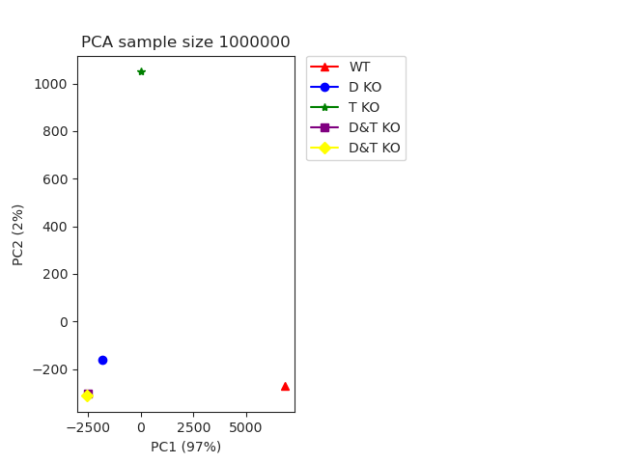
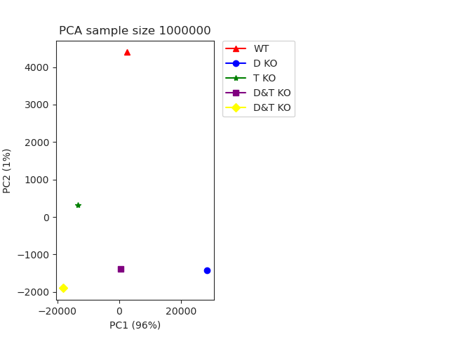
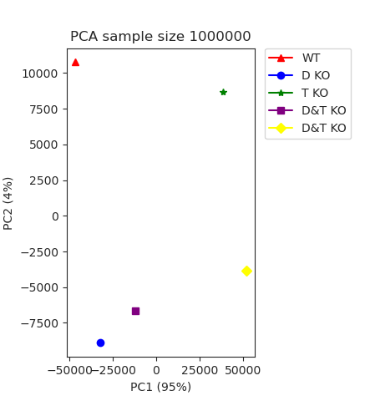
HiChIP PCA
Resolution: 5k, 50k, 1mb
Notes:
Domain contact map

Slide 40
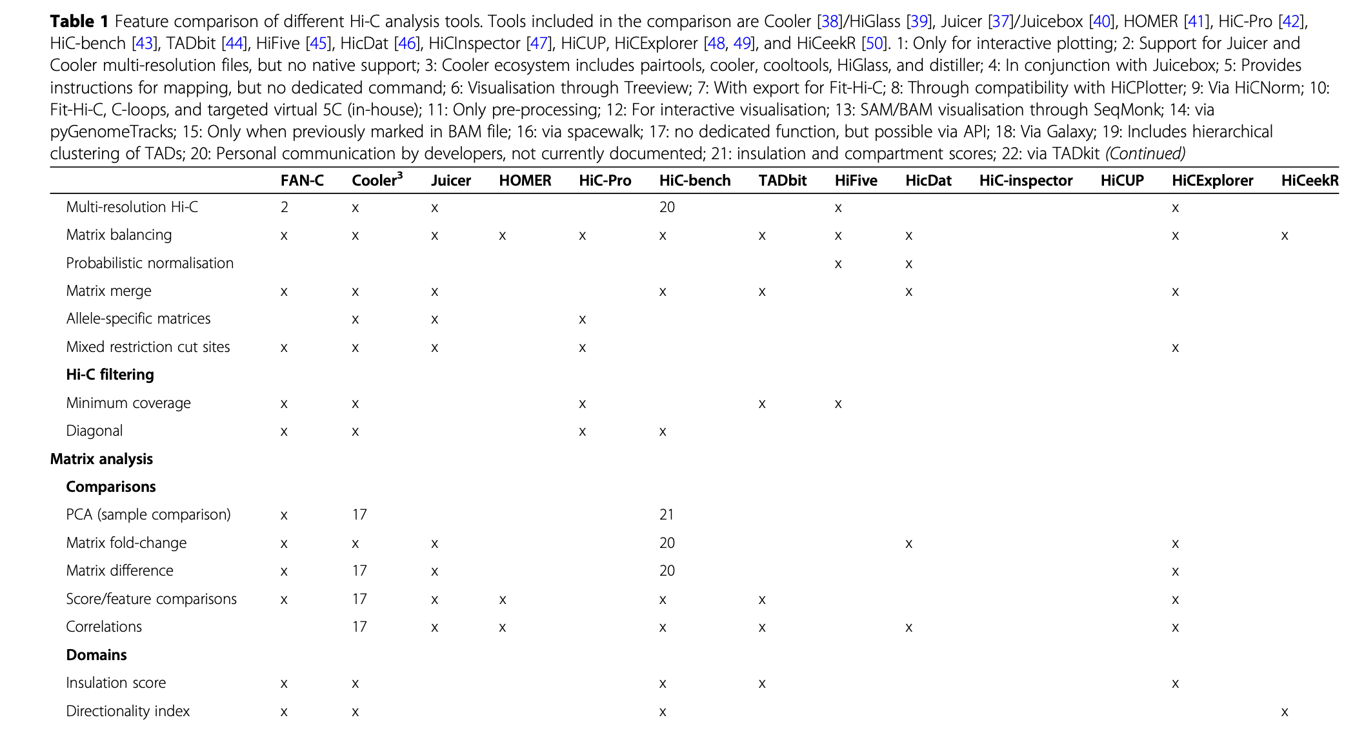
HiC tools

Slide 41
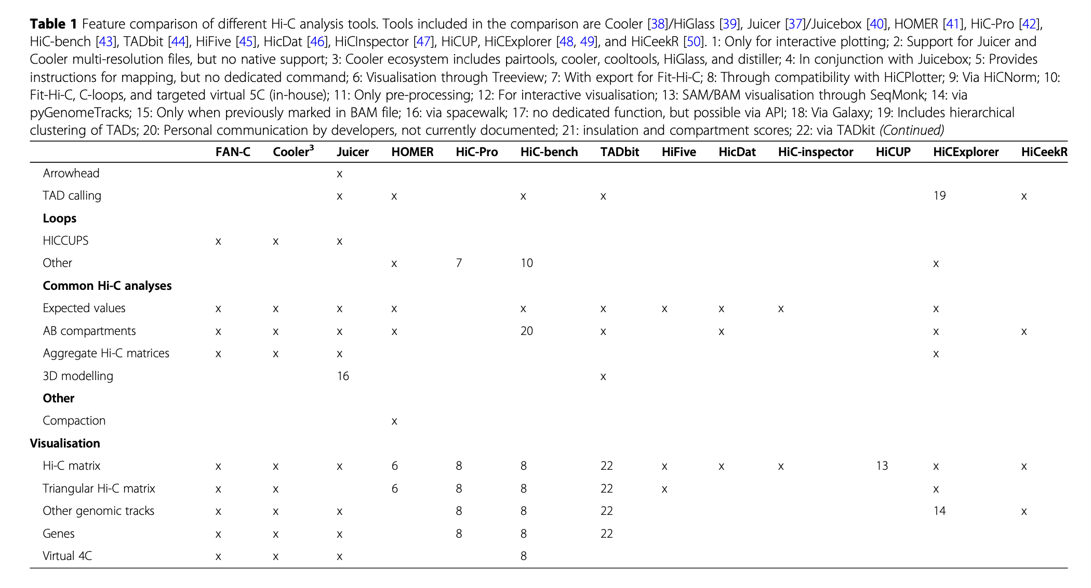
HiC tools

Slide 42
#TAD boundaries with different Si
 | NO Si | Si > 0.1 | Si > 0.2 | Si > 0.3
TH779 WT | 2489 | 2342 | 2222 | 2074
TH780 DNMT | 2512 | 2386 | 2282 | 2114
TH781 TET | 2390 | 2271 | 2157 | 2035
TH782 D&T | 2491 | 2371 | 2239 | 2119
TH783 D&T | 2460 | 2363 | 2253 | 2105

Slide 43
Updated TAD with Si > 0.1
TAD length distribution
TAD median length
779 WT: 1 MB
780 DNMT: 950 KB
781 TET: 1.05 MB
782 D & T 1 MB
783 D & T 1 MB

Slide 44
Updated TAD with Si > 0.1
PCA of ChIP-seq counts in TADs
Collecting ChIP-seq counts of 2395 TADs
TADs are from TH779 H3K9me3 WT

Slide 45
Updated TAD with Si > 0.1
Density of ChIP-seq RPKM in TADs
H3K9me2
H3K9me3

Slide 46
Domain count map
Count valid pairs in domains
 | TAD_1082 | TAD_1083 | TAD_1084 | TAD_1085 | TAD_1086 | TAD_1087 | TAD_1088 | TAD_1089 | TAD_1090
TAD_1082 | 2316 | 182 | 143 | 28 | 17 | 15 | 6 | 14 | 16
TAD_1083 | 0 | 2002 | 274 | 23 | 11 | 11 | 20 | 5 | 8
TAD_1084 | 0 | 0 | 8400 | 307 | 123 | 68 | 56 | 42 | 64
TAD_1085 | 0 | 0 | 0 | 4729 | 357 | 111 | 45 | 29 | 73
TAD_1086 | 0 | 0 | 0 | 0 | 2881 | 236 | 66 | 41 | 49
TAD_1087 | 0 | 0 | 0 | 0 | 0 | 2236 | 190 | 41 | 56
TAD_1088 | 0 | 0 | 0 | 0 | 0 | 0 | 2467 | 168 | 81
TAD_1089 | 0 | 0 | 0 | 0 | 0 | 0 | 0 | 1875 | 181
TAD_1090 | 0 | 0 | 0 | 0 | 0 | 0 | 0 | 0 | 3983
Notes:
Consistency of TAD: conserved and dynamic
Density plot of non-diagonal counts to identify background
Ways to normalize counts
Domain-wise: normalize by the library size and the length (how to determine domain length when they have different lengths)
Bin-wise: normalize by the library size

Slide 47
Density plot

Slide 48
Summation of count map
Sample | # all valid pairs | # pairs mapped to TAD | Percentage
TH779 | 37068630 | 35344939 | 95.35%
TH780 | 34808065 | 33340893 | 95.78%
TH781 | 29535065 | 28109621 | 95.17%
TH782 | 34191388 | 32698160 | 95.63%
TH783 | 29161181 | 27899088 | 95.67%

Slide 49
Boundary correction
Use wt as reference, correct the other sample in the following way:
If the distance between wt border is within 100k, correct it to wt
Else: keep the original border
Notes:
Use wt as reference, correct the other sample in the following way:
If the distance between wt border is within 100k, correct it to wt
Else: keep the original border

Slide 50
Compared with WT
Correct Borders based on WT condition
Obtain TAD based on corrected borders
Compare other conditions to WT
  Conserved
  Dynamic
    Split from WT TADs
    Merged from WT TADs
    Rearranged from WT TADs
Get count map of corrected TADs
Determine conserved and dynamic (after correction)
Conserved: TAD with same coordinates in both ends
Dynamic
  Merged: less TADs between two conserved TADs compared with WT
  Split: more TADs between two conserved TADs compared with WT
  Rearranged: number of dynamic TADs between two conserved TADs remains same

Slide 51
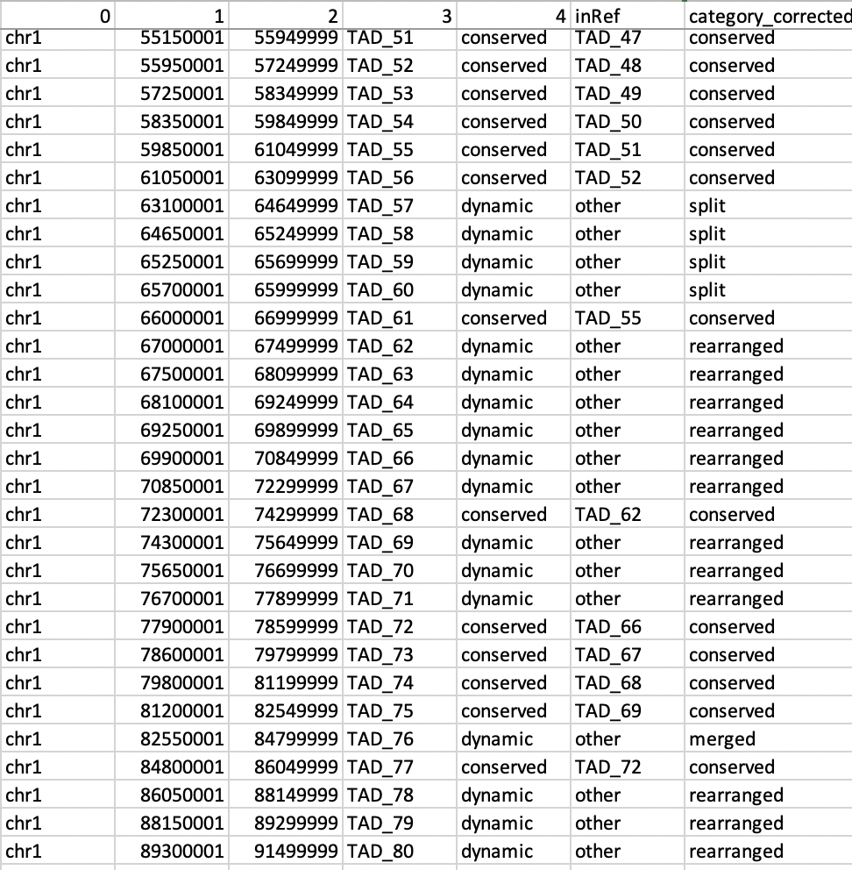
Compared with WT
Sample 783
Determine conserved and dynamic (after correction)
Conserved: TAD with same coordinates in both ends
Dynamic
  Merged: less TADs between two conserved TADs compared with WT
  Split: more TADs between two conserved TADs compared with WT
  Rearranged: number of dynamic TADs between two conserved TADs remains same

Slide 52
Compared with WT

Slide 53
Compared with WT: TAD changes
Resolution: 50k
Si > 0.1
Correction range: 100k
Notes:
Try different parameters:
First Si > 0.3, and then check the other parameters, such as correction range, resolution..

Slide 54
Compared with WT: TAD changes
Resolution: 50k
Si > 0.1
Correction range: 100k
Resolution: 50k
Si > 0.1
Correction range: 150k
Resolution: 50k
Si > 0.1
Correction range: 200k
Notes:
Try correction range 200k,
Swap

Slide 55
783: D&T as reference
779: WT as reference
Resolution: 50k
Si > 0.1
Correction range: 200k
783: D&T as reference
Resolution: 50k
Si > 0.1
Correction range: 200k

Slide 56
Compared with WT: TAD changes
Resolution: 50k
Si > 0.3
Correction range: 100k
Resolution: 50k
Si > 0.3
Correction range: 150k
Resolution: 50k
Si > 0.3
Correction range: 200k

Slide 57
Compared with WT: TAD changes
Resolution: 25k
Si > 0.3
Correction range: 50k
Resolution: 25k
Si > 0.3
Correction range: 100k

Slide 58
Conserved TAD across samples
Number of conserved TADs
780: 973
781: 1039
782: 984
783: 1014
Number of common conserved TADs
780 & 781: 694
780 & 782: 658
780 & 783: 680
781 & 782: 695
782 & 783: 687
780 & 781 & 782 & 783: 448
Resolution: 50k
Si > 0.3
Correction range: 200k

Slide 59
HiCExplorer
median
TH779 800000.0
TH780 800000
TH781 850000.0
TH782 800000
TH783 800000.0
Resolution: 50k
Correction range: 200k

Slide 60
Comparison with mESC
Density plot of the closest distance between WT and mESC boundaries
Median:
108,505
Medain:
84,919
Boundaries from scripts
Res 50k, si > 0.3
Boundaries from HiCExplorer
Res 50k, most parameters are default

Slide 61
12/15/2023

Slide 62
TAD
TAD boundaries with different S_{i}
 | NO Si | Si > 0.1 | Si > 0.2 | Si > 0.3
TH779 WT | 2489 | 2342 | 2222 | 2074
TH780 DNMT | 2512 | 2386 | 2282 | 2114
TH781 TET | 2390 | 2271 | 2157 | 2035
TH782 D&T | 2491 | 2371 | 2239 | 2119
TH783 D&T | 2460 | 2363 | 2253 | 2105
  S_{i} (boundary strength)
  The difference in the delta vector between the local maximum to the left and local minimum to the right of the boundary bin.

Slide 63
TAD
TAD with Si > 0.1
TAD length distribution
TAD median length
779 WT 1 MB
780 DNMT 950 KB
781 TET 1.05 MB
782 D & T 1 MB
783 D & T 1 MB

Slide 64
TAD
TAD with Si > 0.1
PCA of ChIP-seq counts in TADs
Collecting ChIP-seq counts of 2395 TADs
TADs are from TH779 H3K9me3 WT

Slide 65
TAD
Boundary correction
Boundary
Chromosome
Correction range
Use WT as reference to correct the other samples
  If the border is within correction range, correct it to wt
  If the border is out of correction range, keep the original border
Obtain TAD based on corrected borders
Notes:
Use wt as reference, correct the other sample in the following way:
If the distance between wt border is within 100k, correct it to wt
Else: keep the original border

Slide 66
TAD
Comparison between each condition vs WT after correction
Compare other conditions to WT to determine conserved and dynamic TAD
  Conserved: TAD with same coordinates in both ends
  Dynamic
    Merged: less TADs between two conserved TADs compared with WT
    Split: more TADs between two conserved TADs compared with WT
    Rearranged: number of dynamic TADs between two conserved TADs remains same
conserved
merged
split
rearranged

Slide 67
TAD
Compared with WT: TAD changes
Resolution: 50k
Si > 0.1
Correction range: 100k
Resolution: 50k
Si > 0.1
Correction range: 150k
Resolution: 50k
Si > 0.1
Correction range: 200k
Notes:
Try correction range 200k,
Swap

Slide 68
TAD
Compared with WT: TAD changes
Resolution: 50k
Si > 0.3
Correction range: 100k
Resolution: 50k
Si > 0.3
Correction range: 150k
Resolution: 50k
Si > 0.3
Correction range: 200k

Slide 69
TAD
Fixed TAD
Merge all valid pairs of 5 samples
Calculate insulation index of merged data at 50kb resolution and 1mb window size (fanc)
Calculate TAD boundaries with S_{i} > 0.3
Obtain regions between boundaries as TAD
2145 TADs
Median length: 1.1mb

Slide 70
TAD
Fixed TAD
TAD countmap
Density plot of off-diagonal normalized value
 | TAD_1 | TAD_2 | TAD_3 | TAD_4
TAD_1 | 3774 | 334 | 59 | 28
TAD_2 | 0 | 10513 | 440 | 128
TAD_3 | 0 | 0 | 6214 | 326
TAD_4 | 0 | 0 | 0 | 3162
Normalized by
1000000*(count/total_count)
 | TAD_1 | TAD_2 | TAD_3 | TAD_4
TAD_1 | 106.363979 | 9.413240 | 1.662818 | 0.789134
TAD_2 | 0.000000 | 296.291603 | 12.400676 | 3.607469
TAD_3 | 0.000000 | 0.000000 | 175.131363 | 9.187773
TAD_4 | 0.000000 | 0.000000 | 0.000000 | 89.115766
Notes:
How many interactions within TAD or between different TADs
Background subtraction (keep top 10%)
Boxplot of (top 5) logCPM in all conditions

Slide 71
TAD
Fixed TAD
TAD countmap
Ratio: other conditions vs WT
 | TAD_1 | TAD_2 | TAD_3 | TAD_4
TAD_1 | 1.17690 | 1.18468 | 1.42041 | 1.40179
TAD_2 |  | 1.07363 | 1.05599 | 0.87020
TAD_3 |  |  | 1.05620 | 1.03803
TAD_4 |  |  |  | 1.01250
Based on the ratio density plots,
ratio > 5, ratio < 0.2
are selected as cutoff

Slide 72
TAD
Fixed TAD
TAD countmap
Ratio: Other conditions vs WT
TAD A |  |  |  | TAD B |  |  |  | Ratio
TAD_1 | chr1 | 3700001 | 4449999 | TAD_187 | chr2 | 52050001 | 53299999 | 5.304087769429362
TAD_1 | chr1 | 3700001 | 4449999 | TAD_373 | chr3 | 100800001 | 101999999 | 7.425722877201106
TAD_1 | chr1 | 3700001 | 4449999 | TAD_545 | chr4 | 150200001 | 151049999 | 5.304087769429362
TAD_1 | chr1 | 3700001 | 4449999 | TAD_547 | chr4 | 152000001 | 152549999 | 9.547357984972852
TAD_1 | chr1 | 3700001 | 4449999 | TAD_600 | chr5 | 62750001 | 63799999 | 5.304087769429362
TAD_1 | chr1 | 3700001 | 4449999 | TAD_663 | chr5 | 132150001 | 133049999 | 11.668993092744595
ratio > 5: the interaction between the 2 TADs is stronger than WT
ratio < 0.2: the interaction between the 2 TADs is weaker than WT
Notes:
20639 up_ratio_780.txt
26302 up_ratio_781.txt
22229 up_ratio_782.txt
29964 up_ratio_783.txt
22222 down_ratio_780.txt
19486 down_ratio_781.txt
24444 down_ratio_782.txt
18377 down_ratio_783.txt

Slide 73
1/5/2024

Slide 74
Low-frequency TAD Interactions Filtering
Top 10% interactions were kept for each sample
  779: 513,706 (threshold: 13)
  780: 509,139 (threshold: 12)
  781: 522,461 (threshold: 10)
  782: 517,047 (threshold: 12)
  783: 488,574 (threshold: 11)
Common interactions of above were acquired for the following steps
  257,484 common interactions
Boxplot of normalized count of common interactions in 5 samples.

Slide 75
Ratio of Other Conditions Versus WT
780 DNMT vs WT
  up: 3263 down 2936
781 TET vs WT
  up: 1534 down 3534
782 DNMT&TET vs WT
  up: 4695 down 2941
783 DNMT&TET vs WT
  up: 5143 down 1709
Density plot of ratios between other conditions vs WT
for common interactions.

Slide 76
Low-frequency TAD Interactions Filtering
Top 1% interactions were kept for each sample
  779: 21,646 (threshold: 57)
  780: 21,301 (threshold: 55)
  781: 20,989 (threshold: 46)
  782: 21,420 (threshold: 55)
  783: 20,997 (threshold: 48)
Total unique interactions of above were acquired for the following steps
  30, 463 unique interactions
Boxplot of normalized count of unique interactions in 5 samples.

Slide 77
Ratio of Other Conditions Versus WT
780 DNMT vs WT
  up: 530 down 160
781 TET vs WT
  up: 63 down 222
782 DNMT&TET vs WT
  up: 666 down 301
783 DNMT&TET vs WT
  up: 592 down 110
Density plot of log2ratios between other conditions vs WT
for unique interactions.
Notes:
Overlaps between 782 & 783: up 315, down 20

Slide 78
1/22/2024

Slide 79
TAD
Fixed TAD
TAD countmap
 | TAD_1 | TAD_2 | TAD_3 | TAD_4
TAD_1 | 3774 | 334 | 59 | 28
TAD_2 | 0 | 10513 | 440 | 128
TAD_3 | 0 | 0 | 6214 | 326
TAD_4 | 0 | 0 | 0 | 3162
Merge all valid pairs of 5 samples
Calculate insulation index of merged data at 50kb resolution and 1mb window size (fanc)
Calculate TAD boundaries with S_{i} > 0.3
Obtain regions between boundaries as TAD
2145 TADs
Median length: 1.1mb
Normalized by
1000000*(count/total_count)
 | TAD_1 | TAD_2 | TAD_3 | TAD_4
TAD_1 | 106.363979 | 9.413240 | 1.662818 | 0.789134
TAD_2 | 0.000000 | 296.291603 | 12.400676 | 3.607469
TAD_3 | 0.000000 | 0.000000 | 175.131363 | 9.187773
TAD_4 | 0.000000 | 0.000000 | 0.000000 | 89.115766

Slide 80
Low-frequency TAD Interactions Filtering
Top 1% interactions were kept for each sample
  779: 21,646 (threshold: 57)
  780: 21,301 (threshold: 55)
  781: 20,989 (threshold: 46)
  782&783: 22,007 (threshold: 99)
Total unique interactions of above were acquired for the following steps
  29,007 unique interactions
Boxplot of normalized count of unique interactions.

Slide 81
Ratio of Other Conditions Versus WT (782, 783 merged)
780 DNMT vs WT
  up: 501 down 159
781 TET vs WT
  up: 61 down 203
782&783 D&T vs WT
  up: 479 down 55
Density plot of log2ratios between other conditions vs WT
for unique interactions.
Cutoff: |log2ratro| > 1

