Slide 1



Bioinformatics how-to series:
Introduction to ATAC-seq data analysis
Bo Zhang
Bioinformatics Research Core
Center of Regenerative Medicine
Department of Developmental Biology
Jun/5/2024

Slide 2
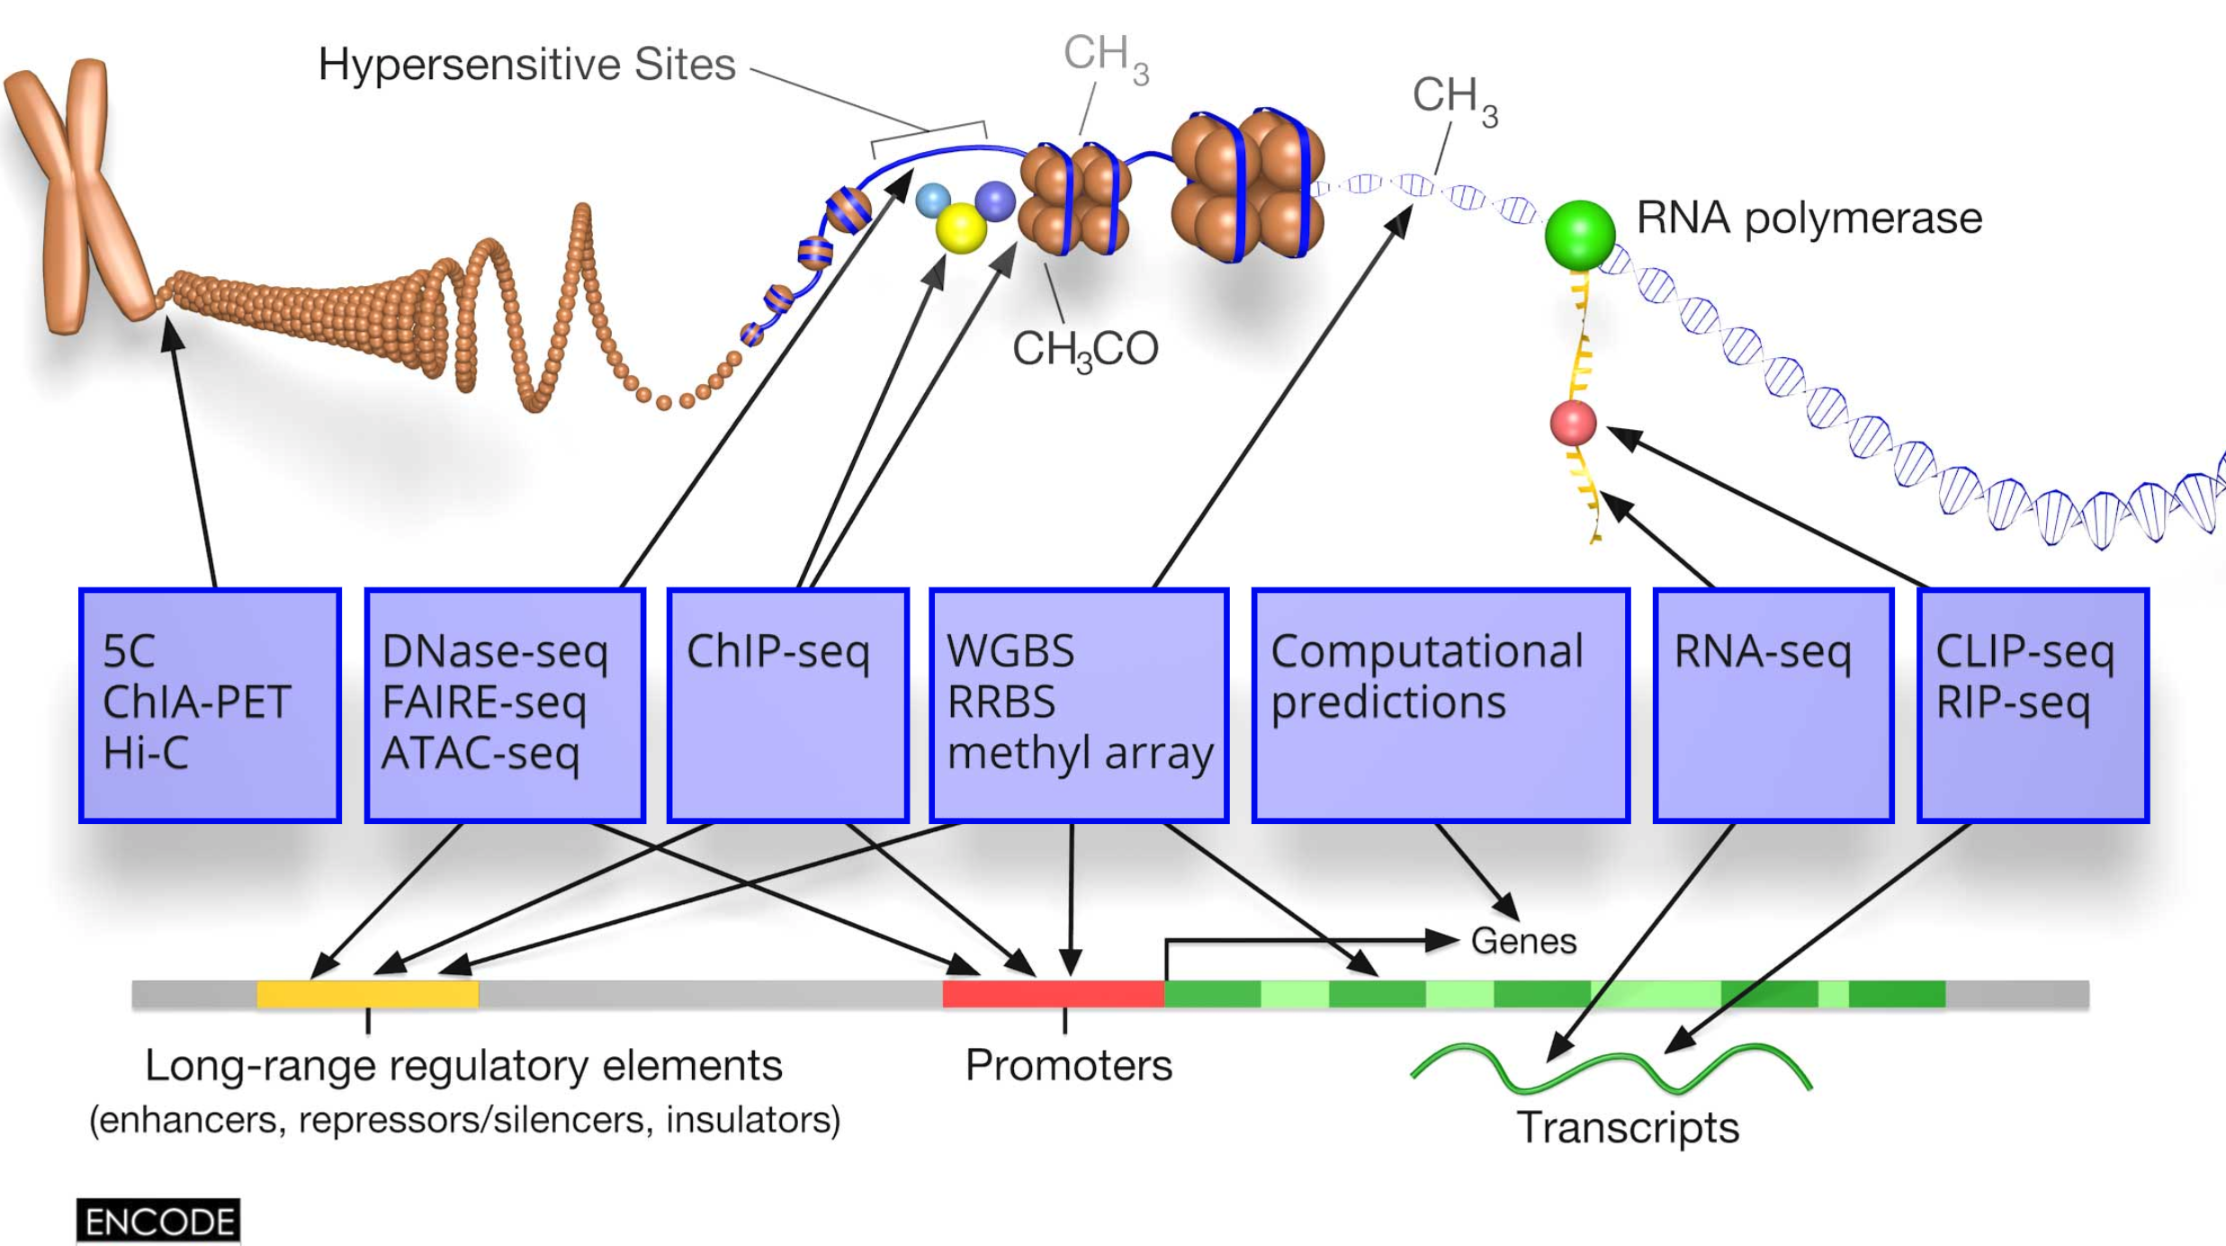
Epigenetic modifications on different levels:
Genome organization: Chromatin 3D structure
Nucleosome: Histone protein modification
DNA molecular: DNA methylation
RNA molecular: RNA methylation
Open chromatin
DNA methylation
3D structure
Histone
modification
Epitranscriptome

Slide 3
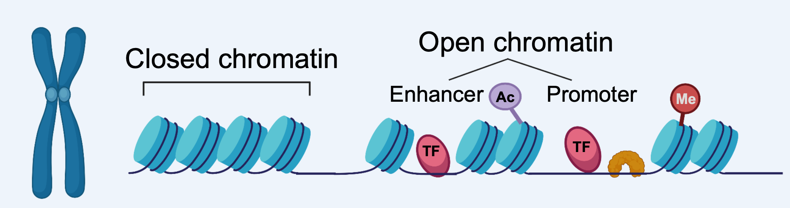
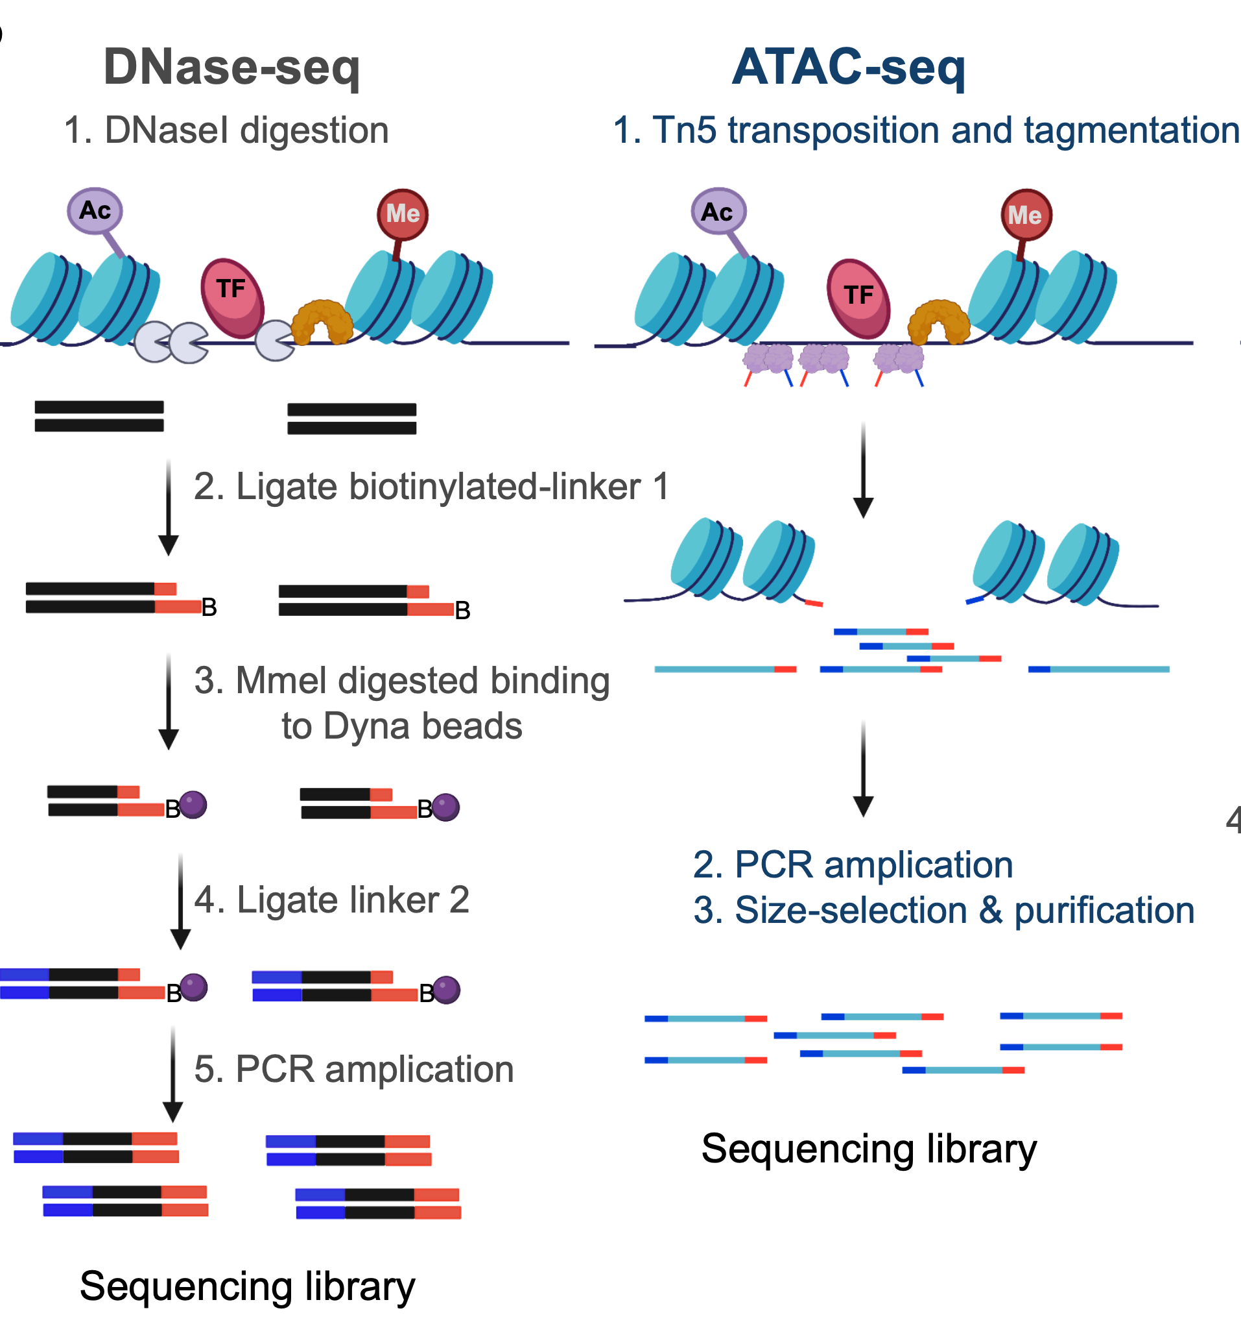
Open chromatin: chromatin accessibility
Chromatin accessibility is the degree to which transcription factors are able to contact chromatinized DNA physically. It is determined by the topological organization of nucleosomes and other chromatin-binding factors that occlude access to DNA.
ATAC-seq is based on Tn5 transposase, which is now widely applied to genetics (single molecular amplification, long-fragment seq), 3D genome structure, spatial transcriptome, and epigenetics ( CUT&Tag, Tn5mC-sesq, CoBATCH, etc).

Slide 4
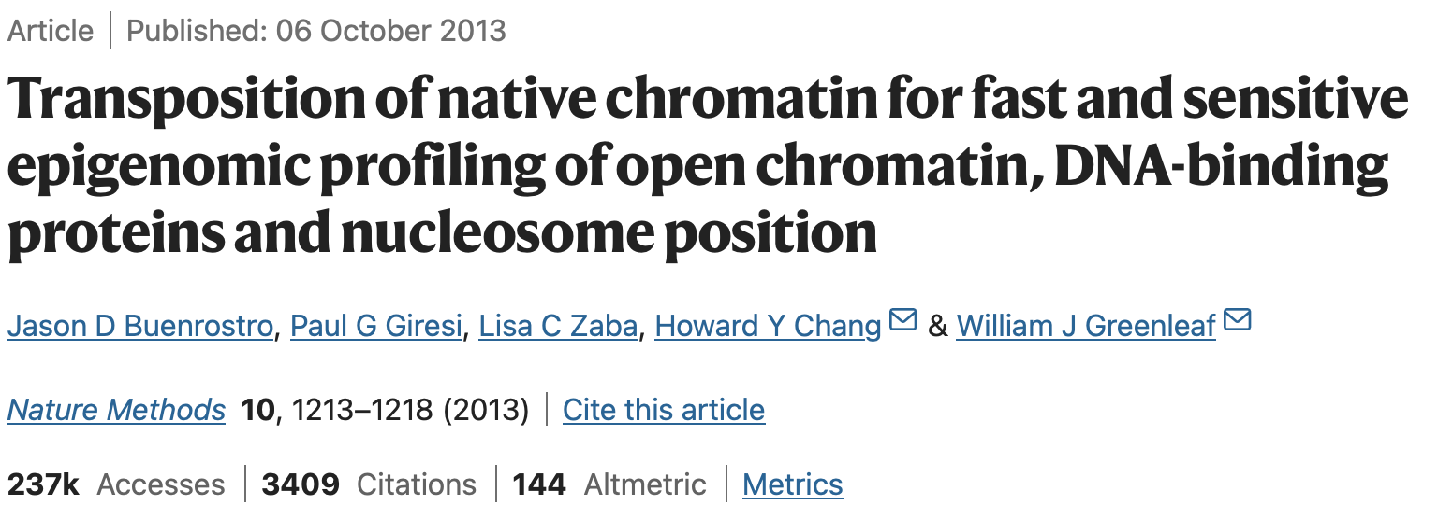
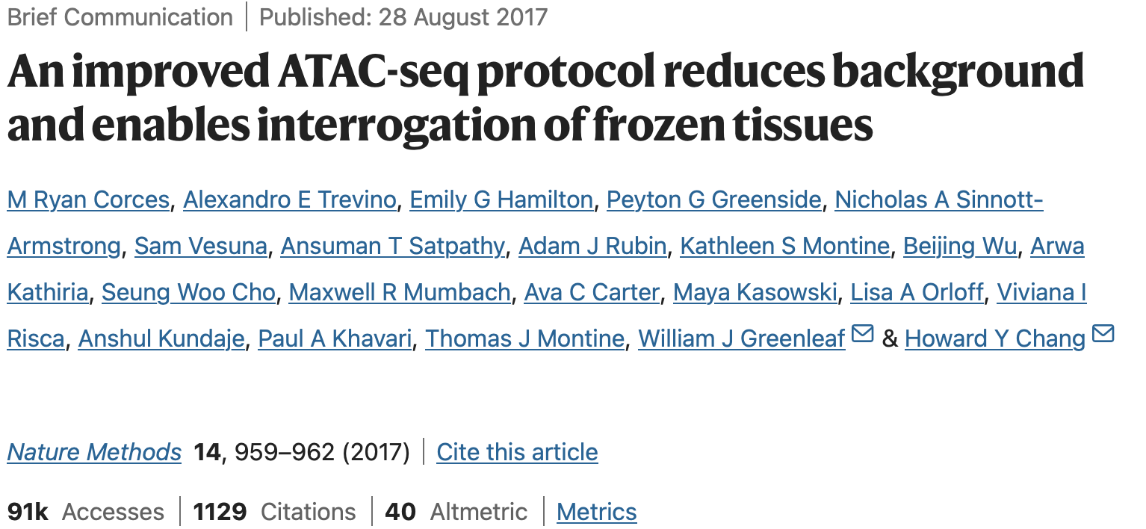
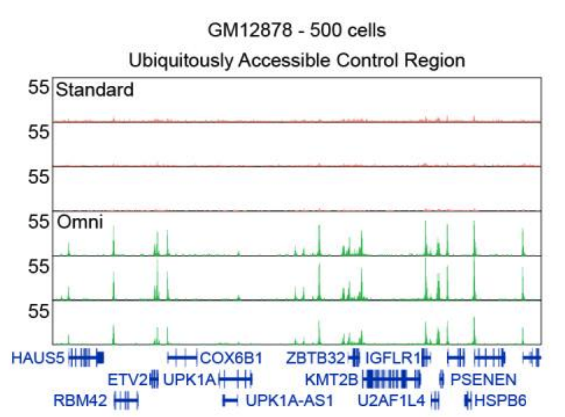
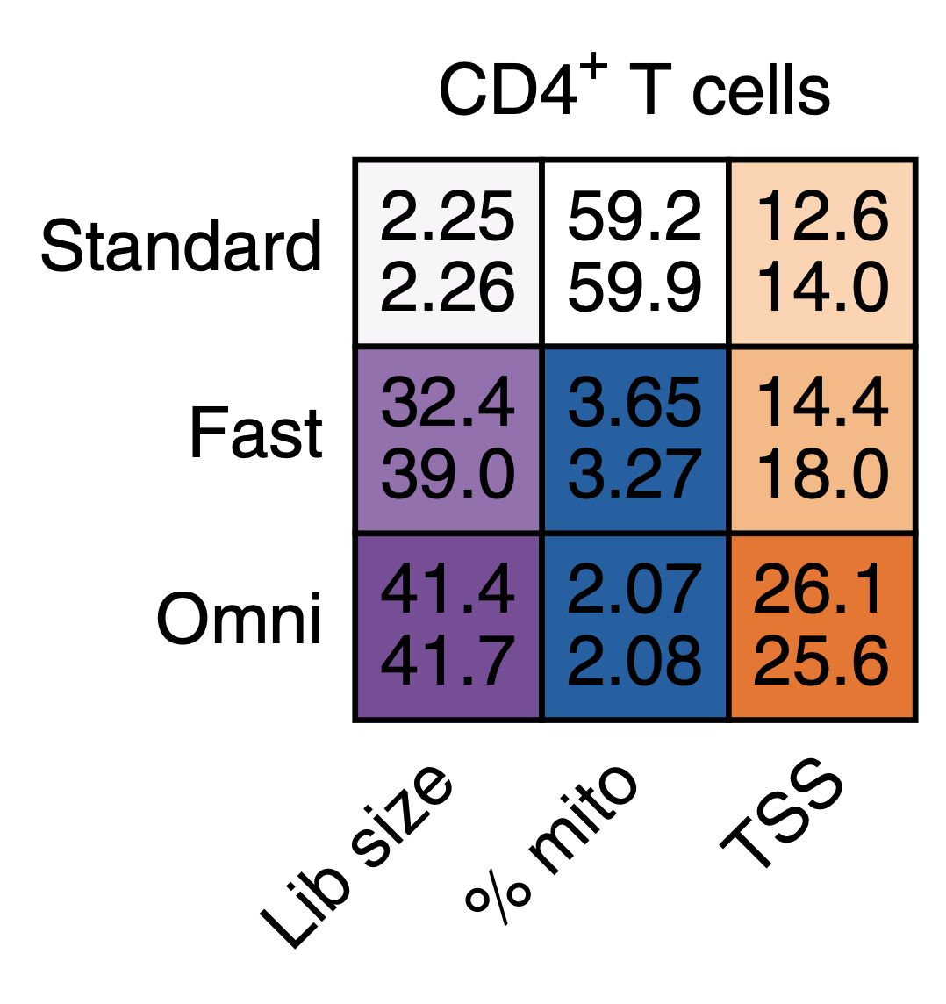
Reduced mitochondrial contamination
Better enrichment and library complexity
50,000 cells ->500 cells

Slide 5
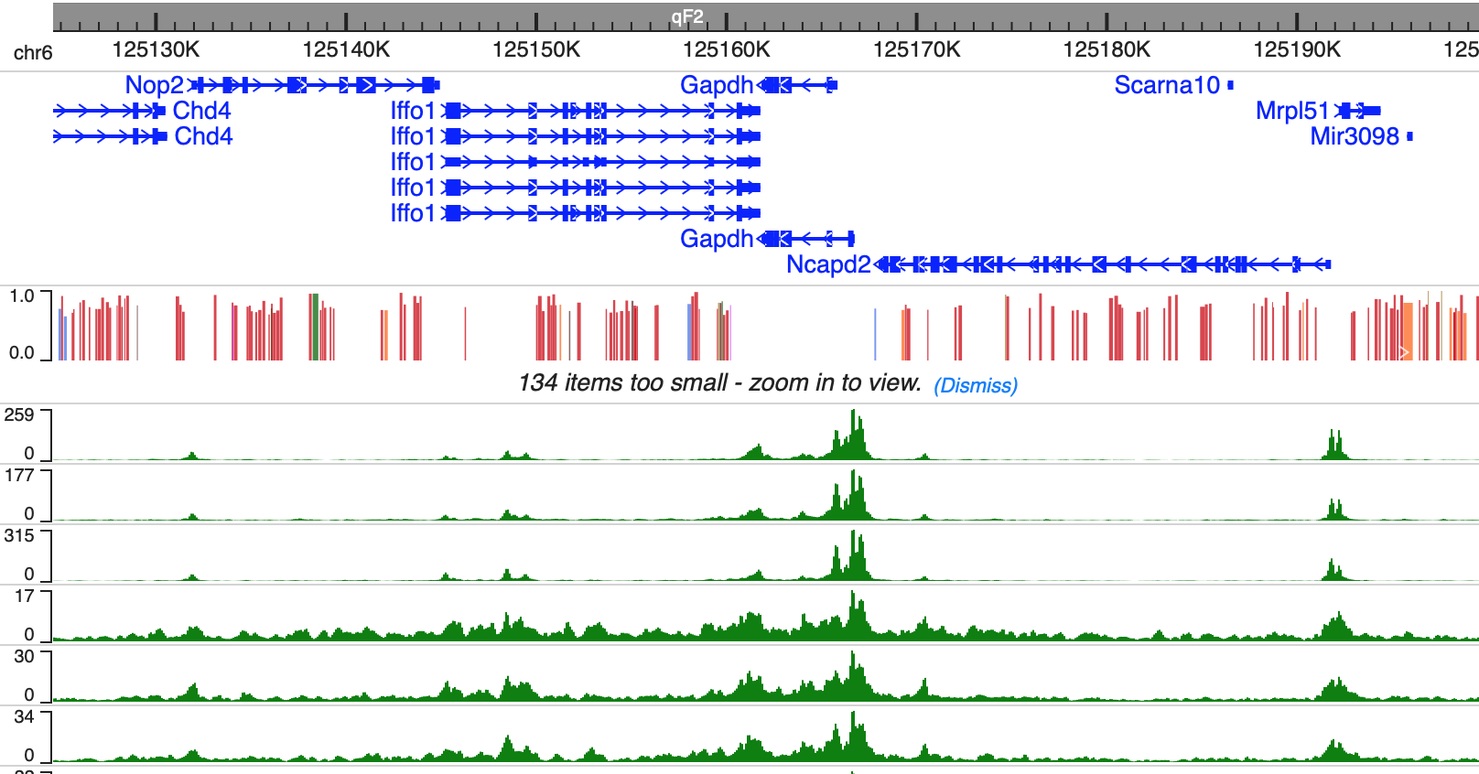
Quality control

Slide 6
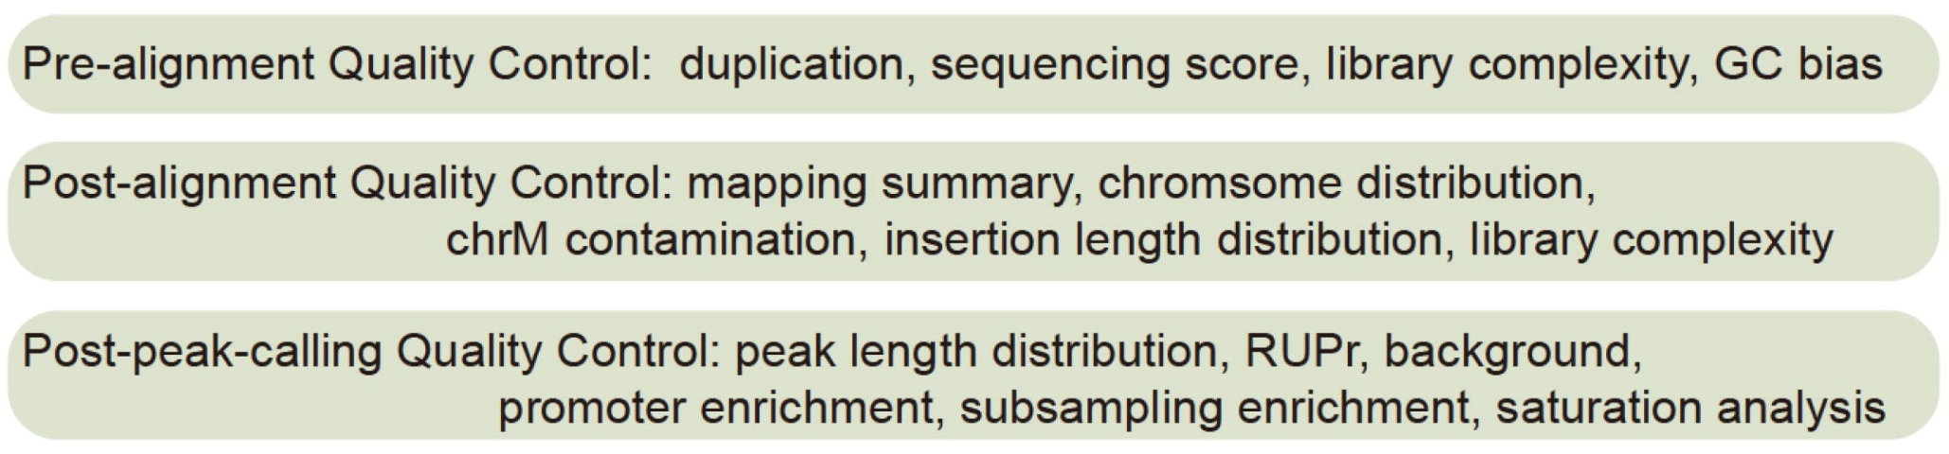
Multi-level quality control in ATAC-seq data
Percentage of all useful reads that fall into the called peak regions with at least 50% overlap
Reads Under Peak ratio (RUPr)
Percentage of 50,000 randomly selected genomic regions (500 bp each) with the ATAC-seq signal over the theoretical threshold
Background (BG)
Promoter enrichment (ProEn)
ATAC-seq useful ends enriched on detected promoters (+/− 1 kb around transcription start sites )
Subsampling enrichment (SubEn)
10 million down-sampled useful reads from the complete dataset to perform peak calling and calculate genome-wide enrichment
Liu et al. Genomics, Proteomics & Bioinformatics. 2021

Slide 7
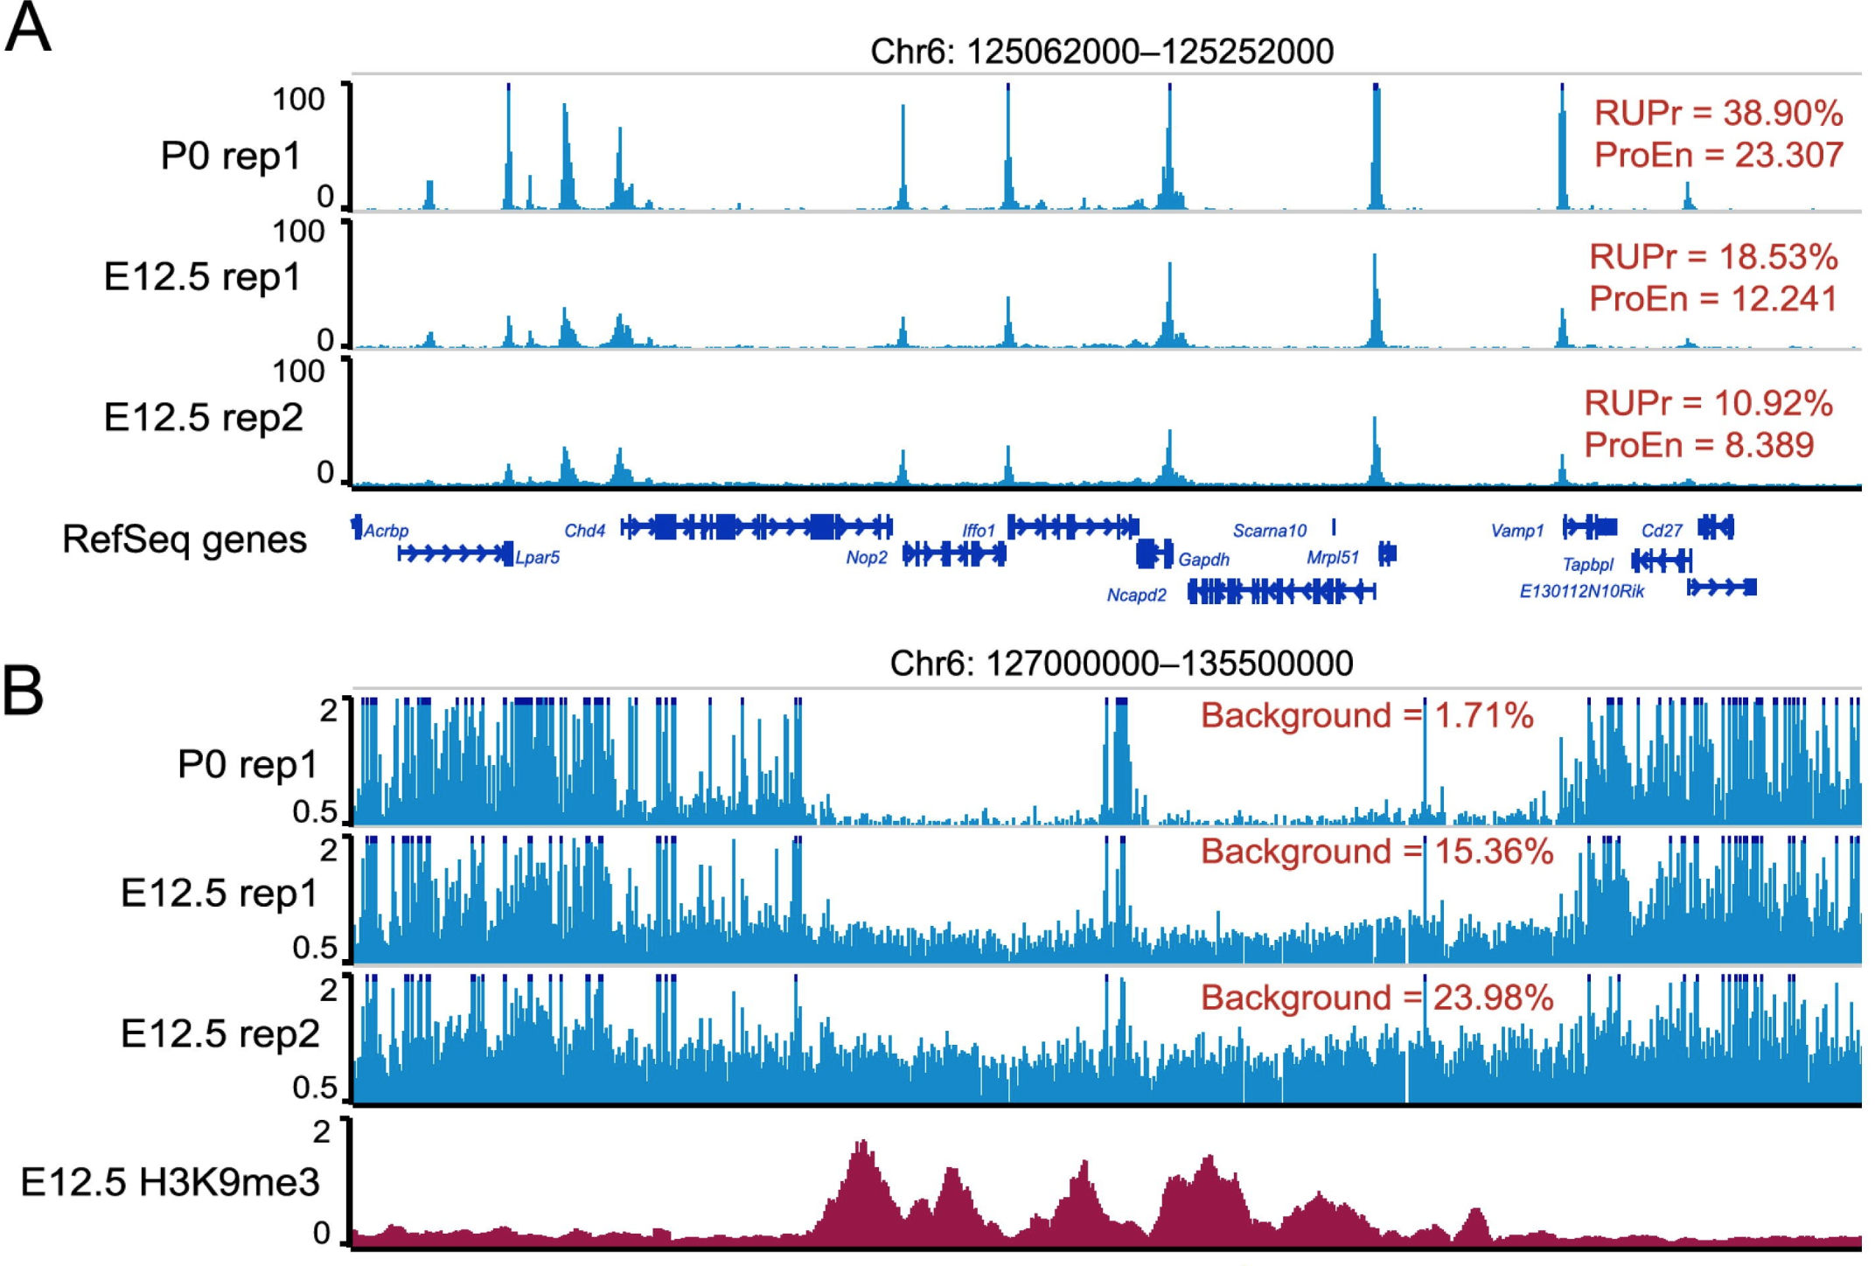
Higher RUPr & ProEn indicated better signal enrichment.
Lower background indicated lower false signals.
Forebrain ATAC-seq datasets (sequencing depth normalized to 10 million reads) with distinct RUPr, ProEn, and background.

Slide 8
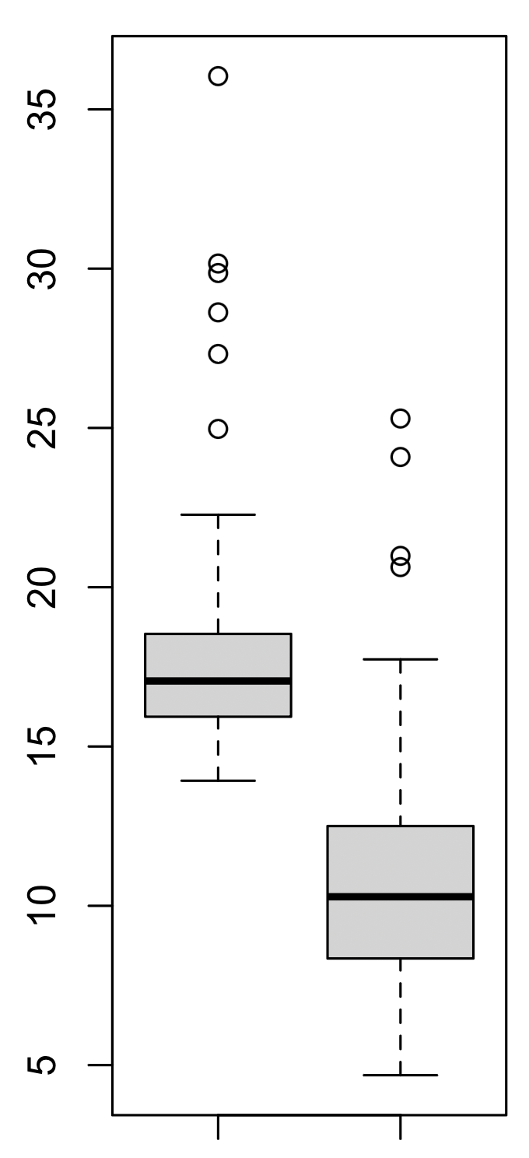
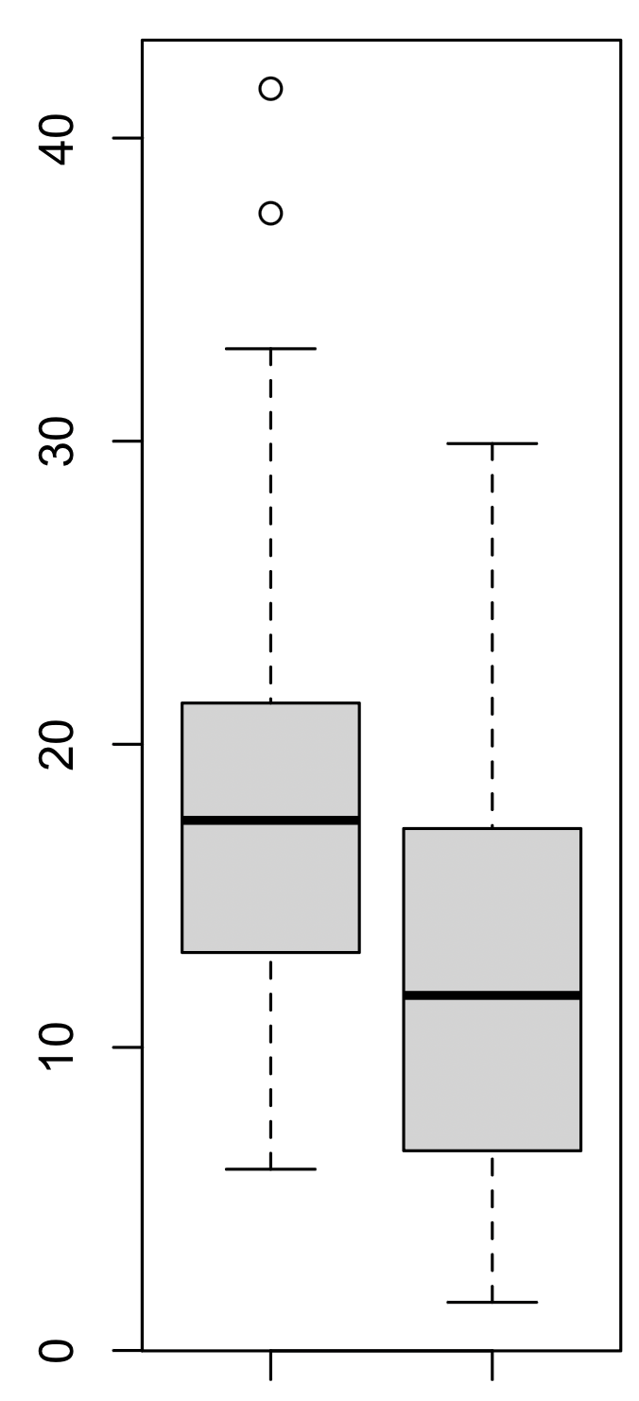
QC metrics of 70 ENCODE ATAC-seq data
Recommended QC metrics (mean of ENCODE):
Non_redundant_uniq_mapped_reads: 30M
SubEn= 18
ProEn= 11
RUPr = 18%
Background = 12%
SubEn
ProEn
RUPr
Background

Slide 9
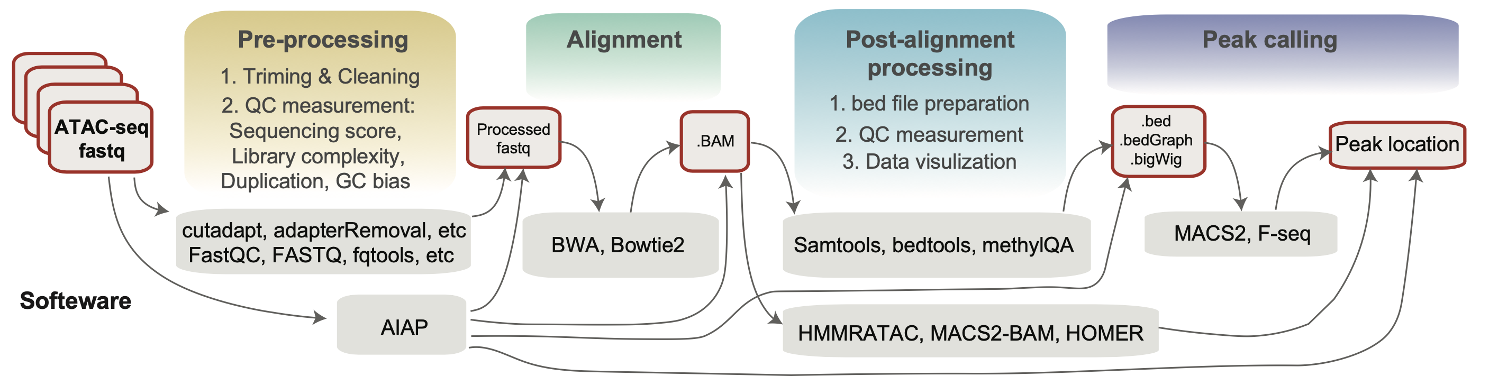
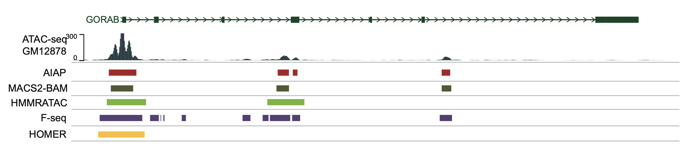
General ATAC-seq data analysis steps:

Slide 10
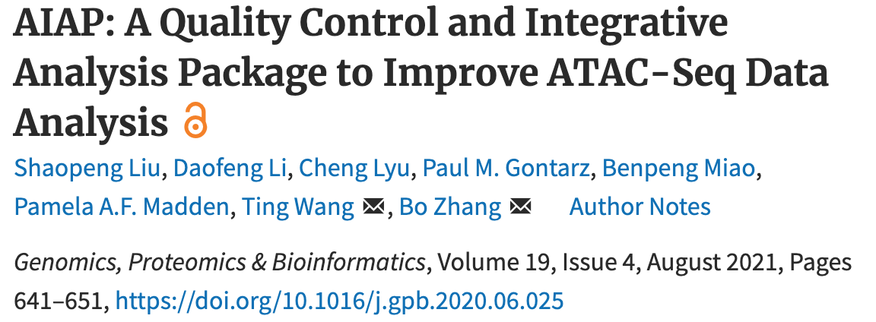
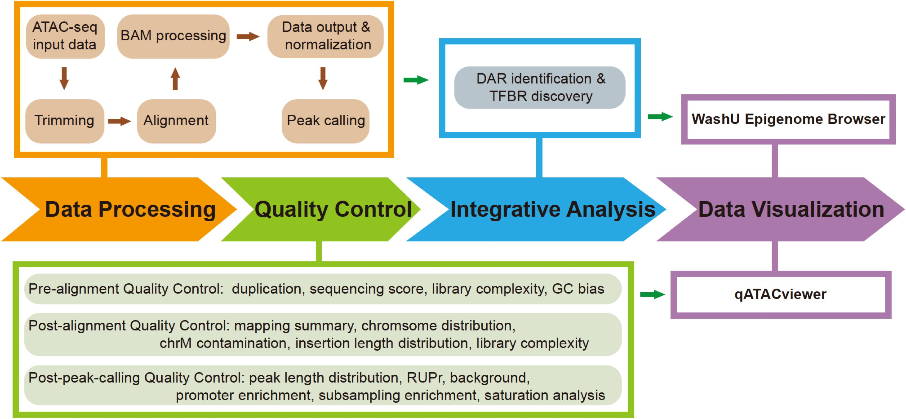
Processing ATAC-seq in an easy way:
https://github.com/Zhang-lab/ATAC-seq_QC_analysis

Slide 11
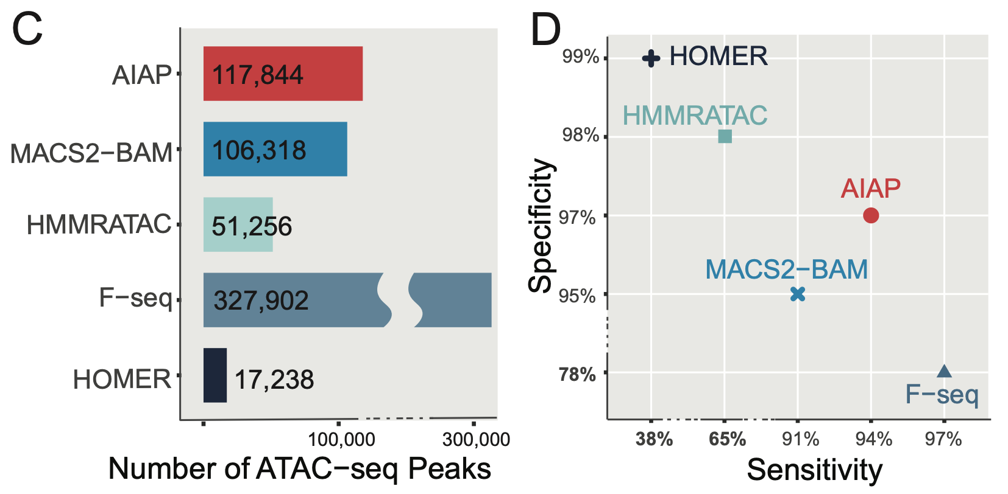
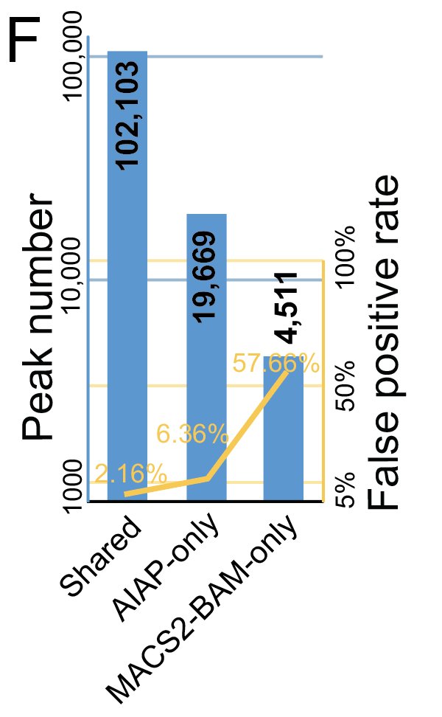
AIAP has better peak-calling performance
Chen et al. Genomics, Proteomics & Bioinformatics (accepted)

Slide 12
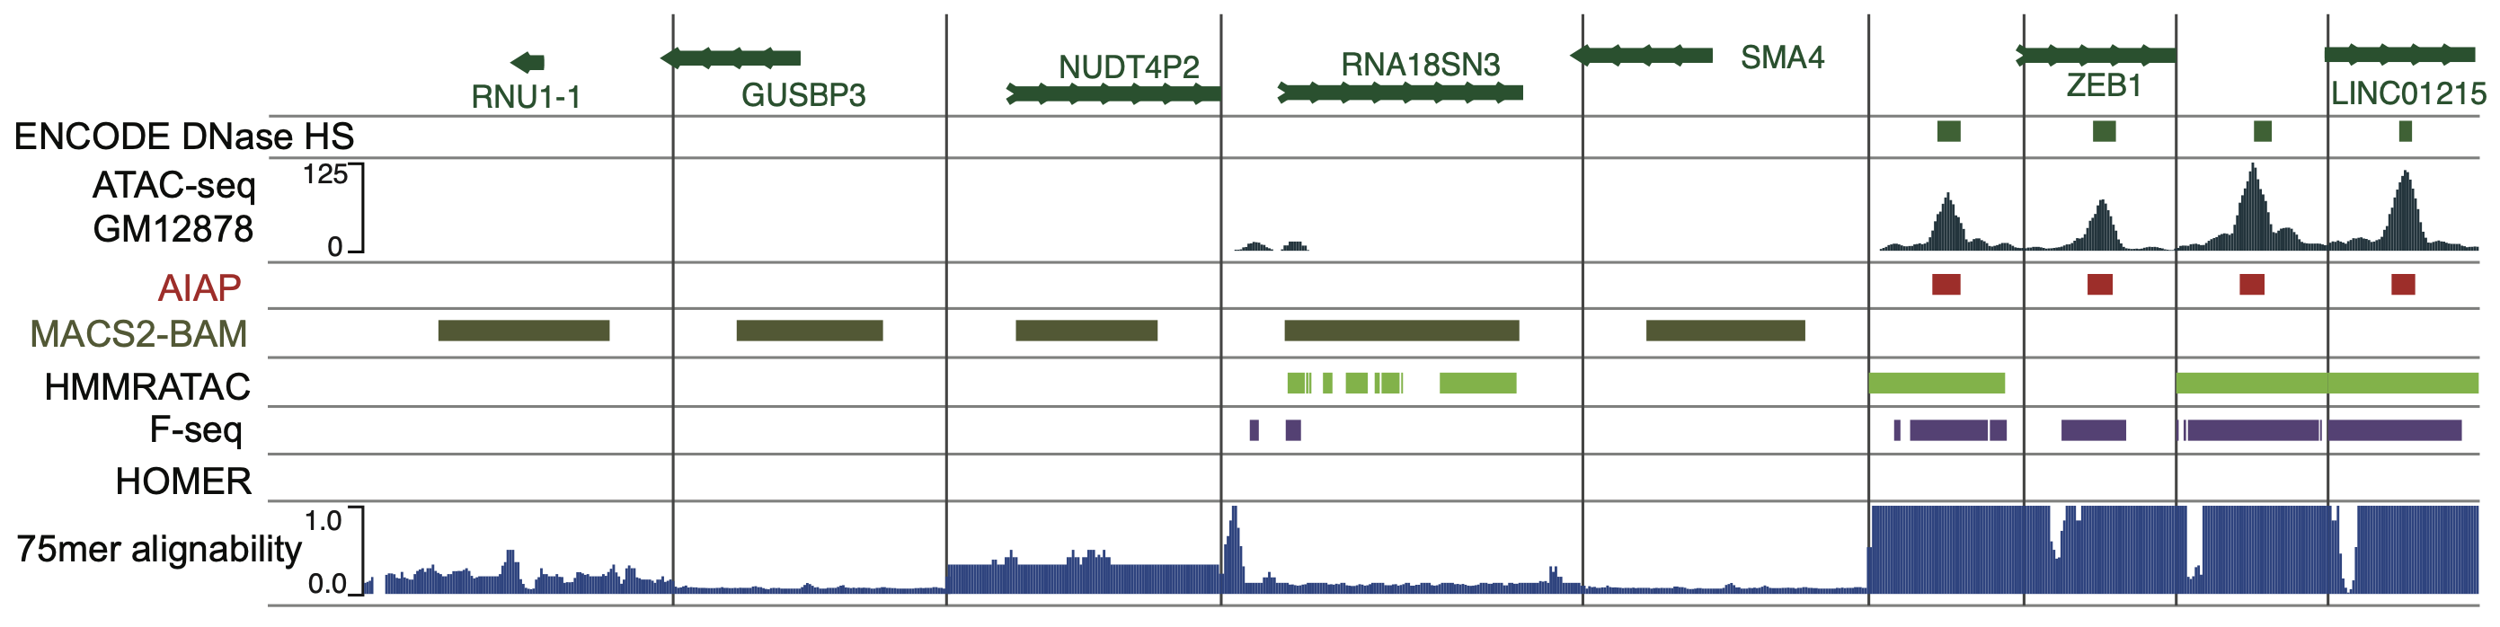
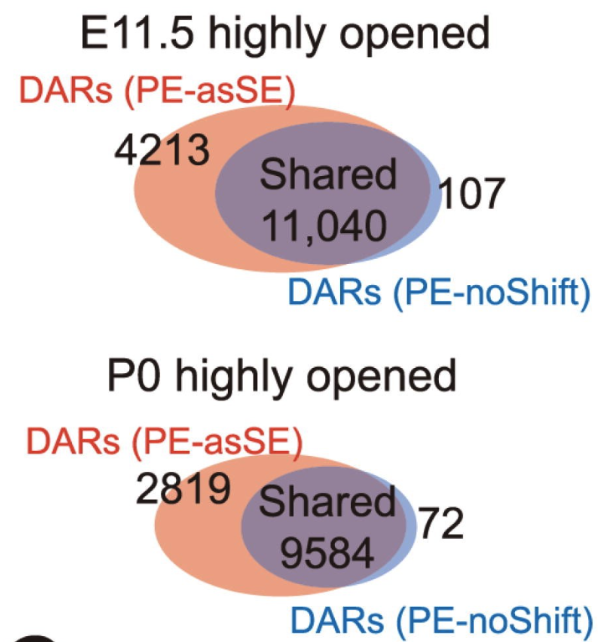
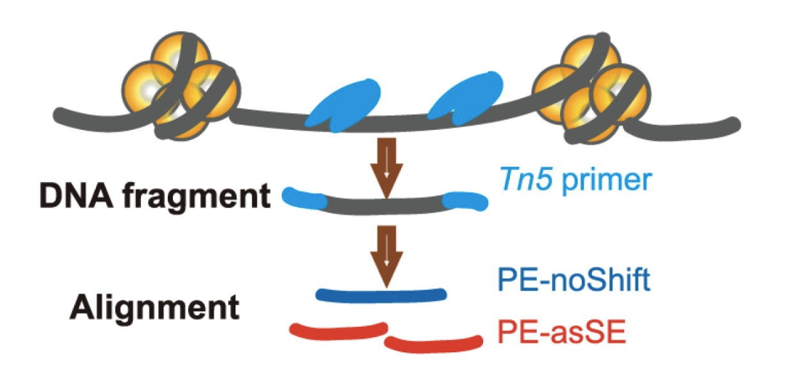
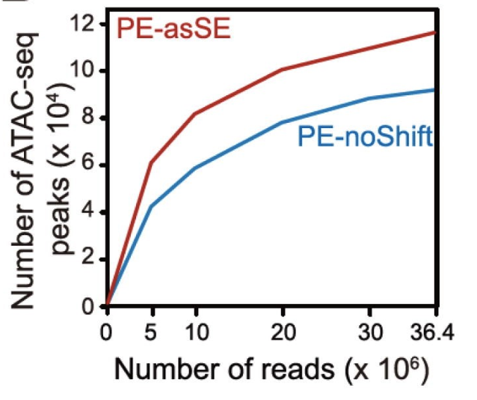
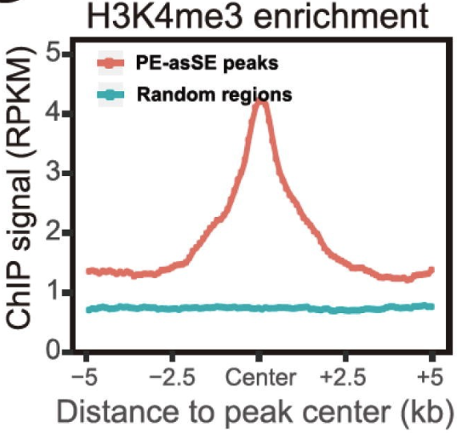
False positive peaks called by MACS2-BAM could be associated with genome alignability.
In different datasets, AIAP improved 20%~55% sensitivity to identify novel OCRs, which enriched distinct histone modification markers.
AIAP also improved the sensitivity of down-stream DAR identifications.

Slide 13


How to use AIAP to process the ATAC-seq data?
First, better to have one account on linux server!
BRC clusters:
Regmedhpc1/2/3, Regmedsrv1/2/3
Get one server for yourself!

Slide 14
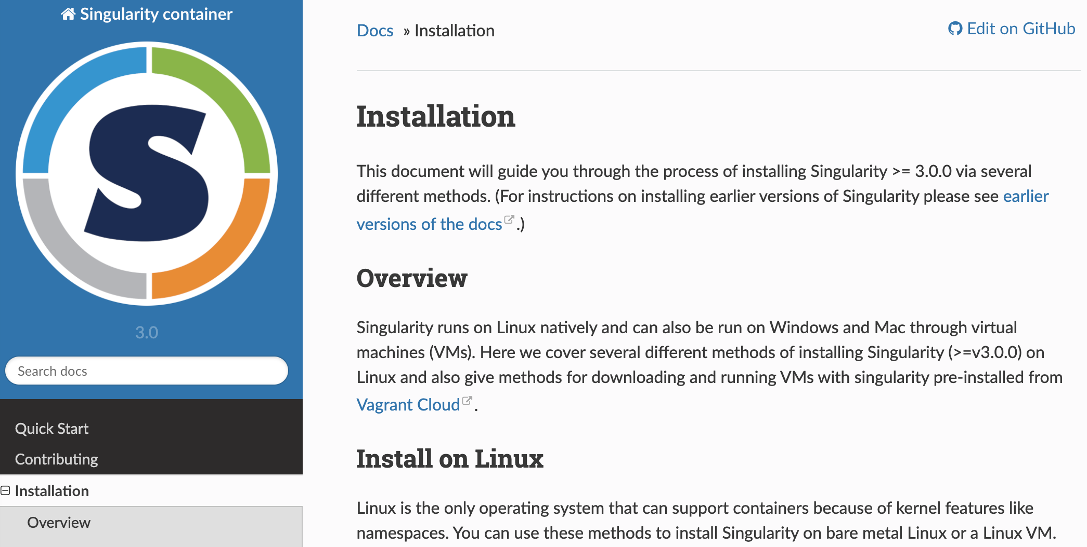
How to use AIAP to process the ATAC-seq data?
Use AIAP singularity image
https://docs.sylabs.io/guides/3.0/user-guide/installation.html

Slide 15
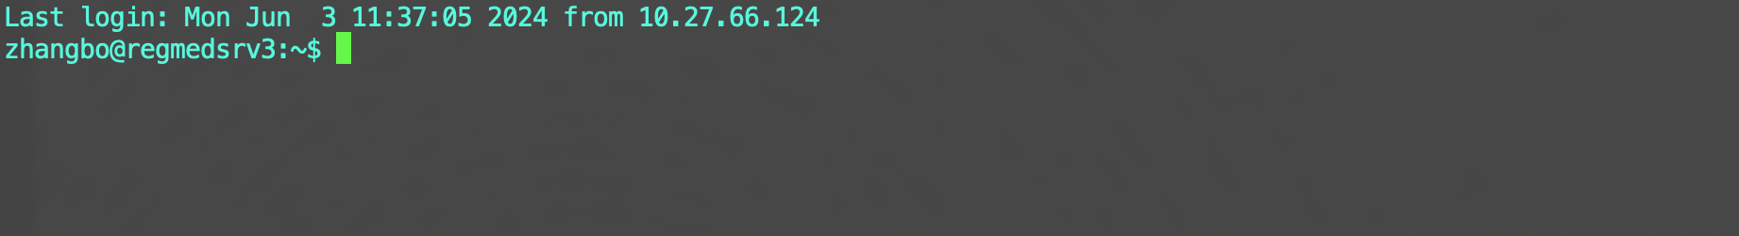
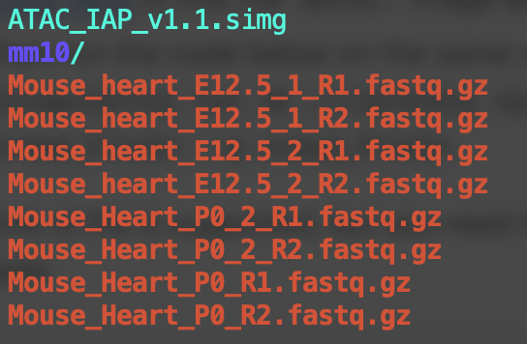
Login your account
https://github.com/Zhang-lab/ATAC-seq_QC_analysis
1: Download the singularity image:
wget https://regmedsrv1.wustl.edu/Public_SPACE/resources/pipeline/atac-seq/ATAC_IAP_v1.1.simg
2. Download the reference files of different genomes:
wget ttps://regmedsrv1.wustl.edu/Public_SPACE/resources/pipeline/atac-seq/ref_file/atac_mm10_ref.tar.gz
3. Decompress the reference files and put to your own folder:
tar -xzf atac_mm10_ref.tar.gz
4. Download your data:
GloBus or wget: wget https://www.encodeproject.org/files/ENCFF655OFT/@@download/ENCFF655OFT.fastq.gz
(Heart P0 vs 12.5), then rename: mv ENCFF655OFT.fastq.gz Mouse_Heart_P0_R1.fastq.gz

Slide 16


5. Run AIAP
singularity run -B ./:/process -B ./:/atac_seq/Resource/Genome ./ATAC_IAP_v1.1.simg -r PE -g mm10 -t 12 -o Mouse_heart_E12.5_1_R1.fastq.gz -p Mouse_heart_E12.5_1_R2.fastq.gz
singularity run -B ./:/process -B ./:/atac_seq/Resource/Genome ./ATAC_IAP_v1.1.simg -r PE -g mm10 -t 12 -o Mouse_heart_E12.5_2_R1.fastq.gz -p Mouse_heart_E12.5_2_R2.fastq.gz
singularity run -B ./:/process -B ./:/atac_seq/Resource/Genome ./ATAC_IAP_v1.1.simg -r PE -g mm10 -t 12 -o Mouse_Heart_P0_1_R1.fastq.gz -p Mouse_Heart_P0_1_R2.fastq.gz
singularity run -B ./:/process -B ./:/atac_seq/Resource/Genome ./ATAC_IAP_v1.1.simg -r PE -g mm10 -t 12 -o Mouse_Heart_P0_2_R1.fastq.gz -p Mouse_Heart_P0_2_R2.fastq.gz
# AIAP default requires 24 cores, Use “–t” to change.
# Submit the job using “nohup”, then you can log off.
or
Notes:
E

Slide 17
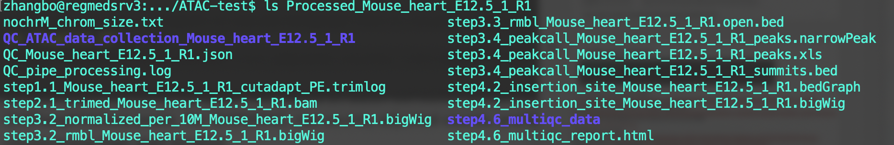
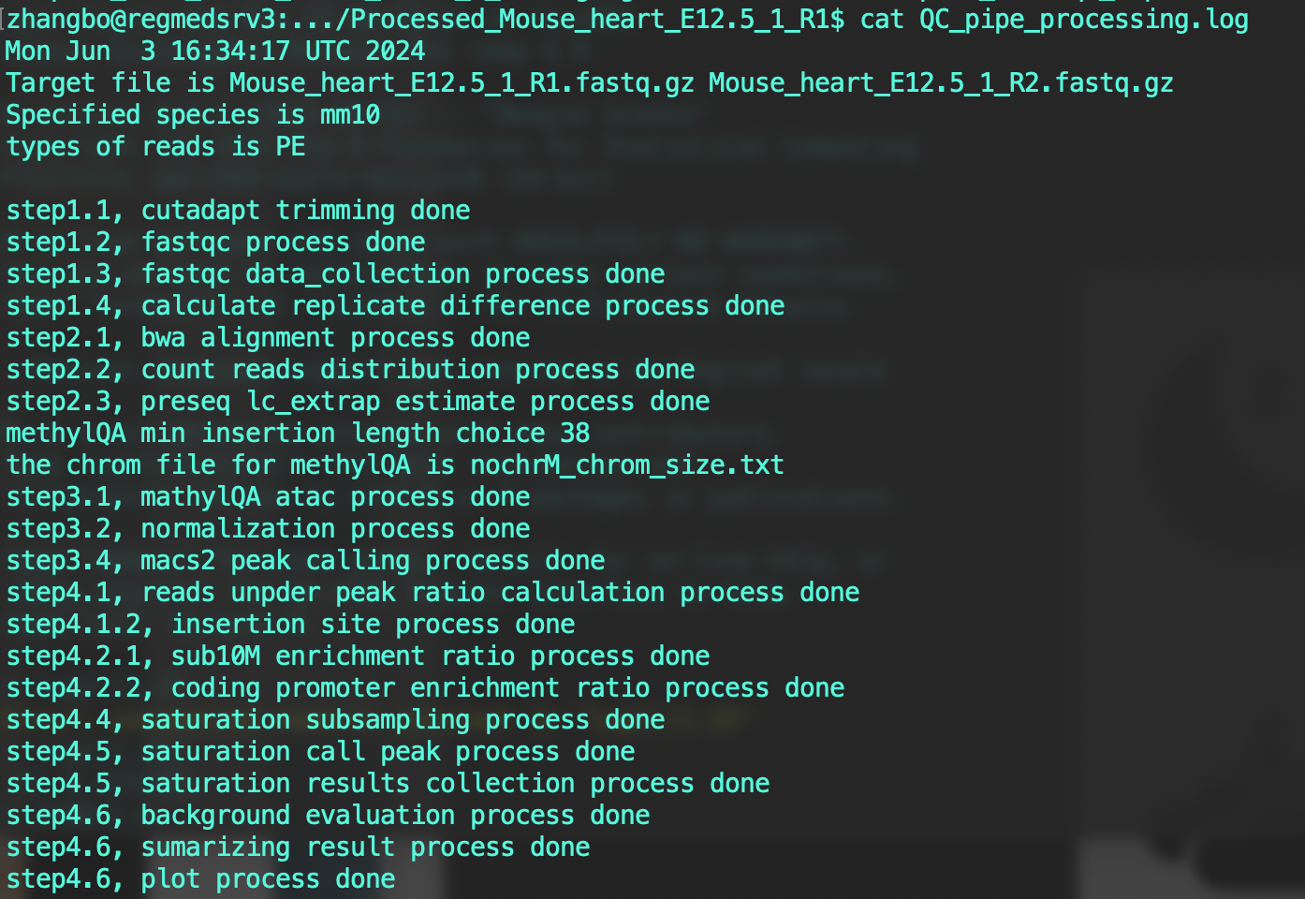
6. Check results
BigWig file for visualization
Open.bed file will be used for differential analysis
Peak-calling result: Open Chromatin Regions (OCRs)

Slide 18
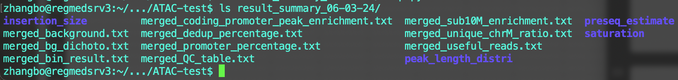
7. Check QC
singularity exec ./ATAC_IAP_v1.1.simg /atac_seq/pipe_code/batch_result_collection.sh

Slide 19

Life becomes easier …

Slide 20
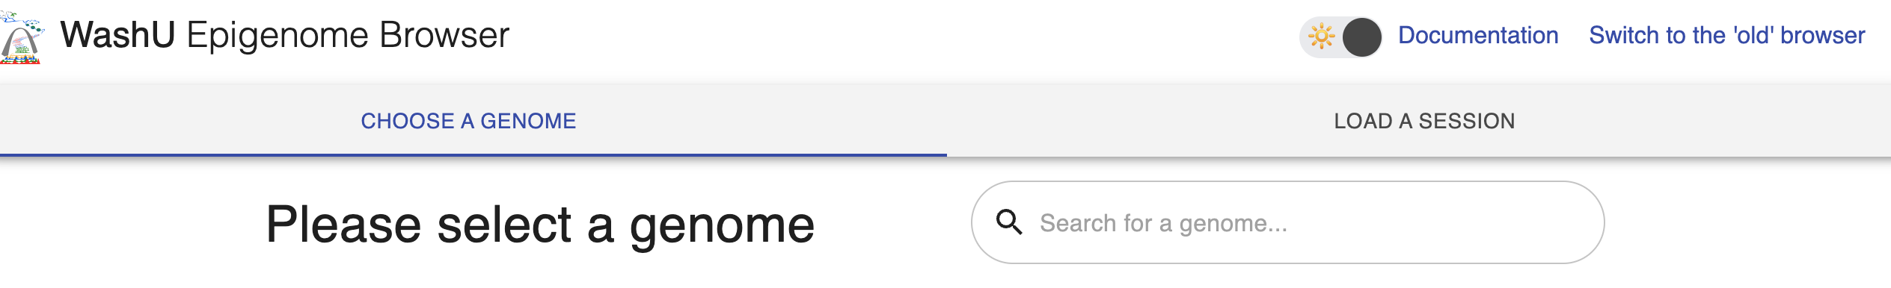
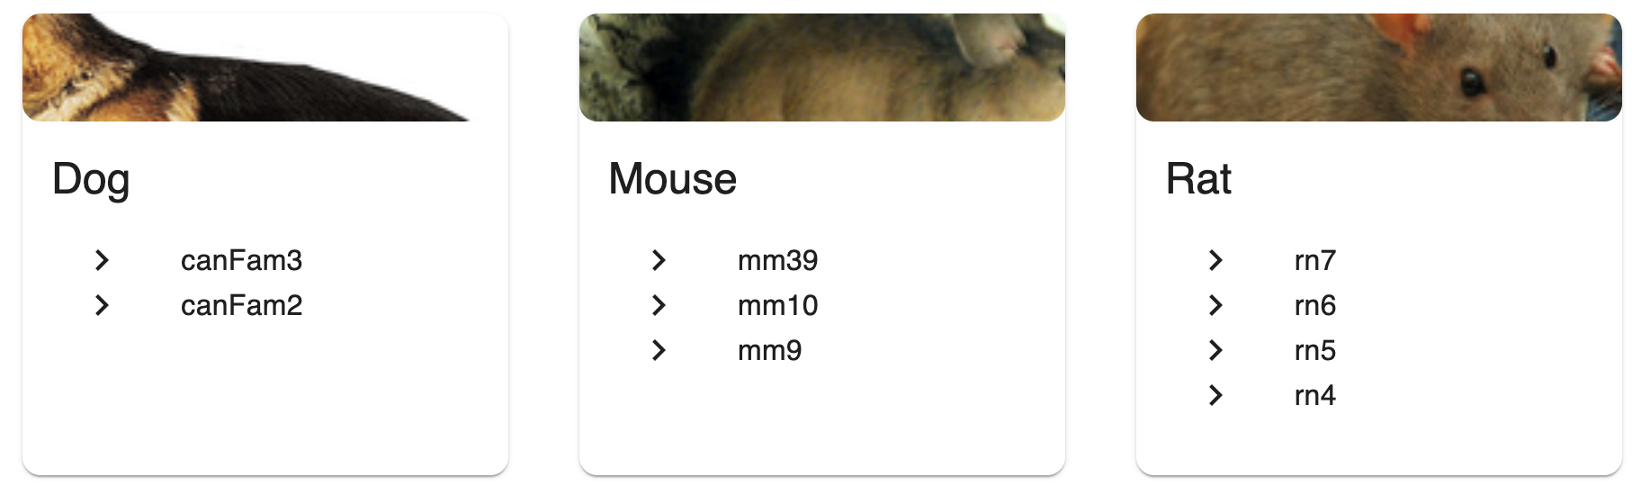
Visualization of ATAC-seq data
https://epigenomegateway.wustl.edu/

Slide 21
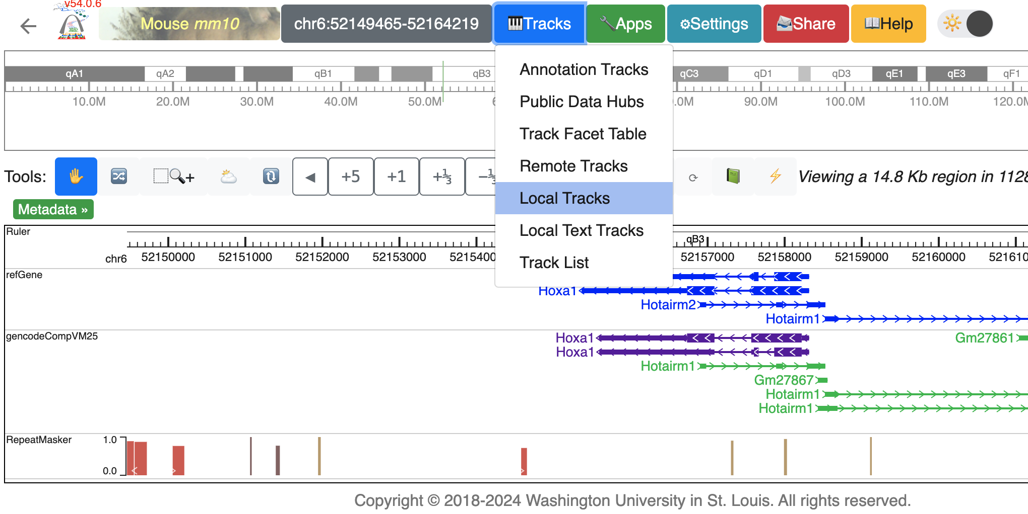
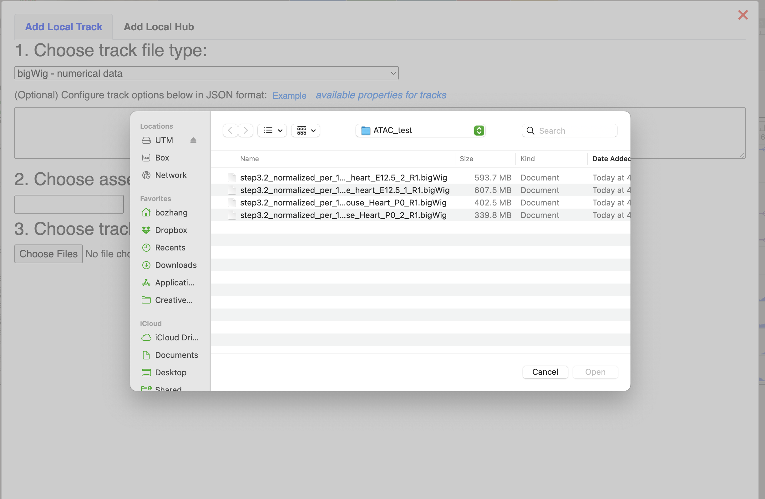
Upload bigwig tracks from local disk

Slide 22
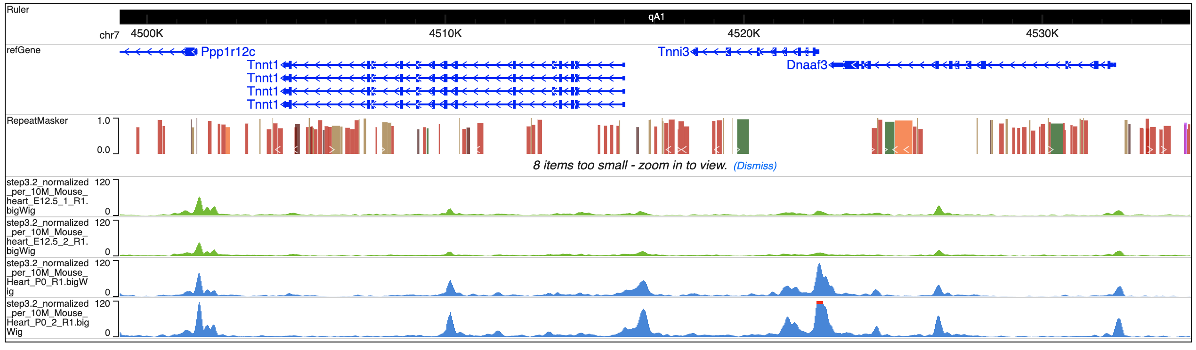
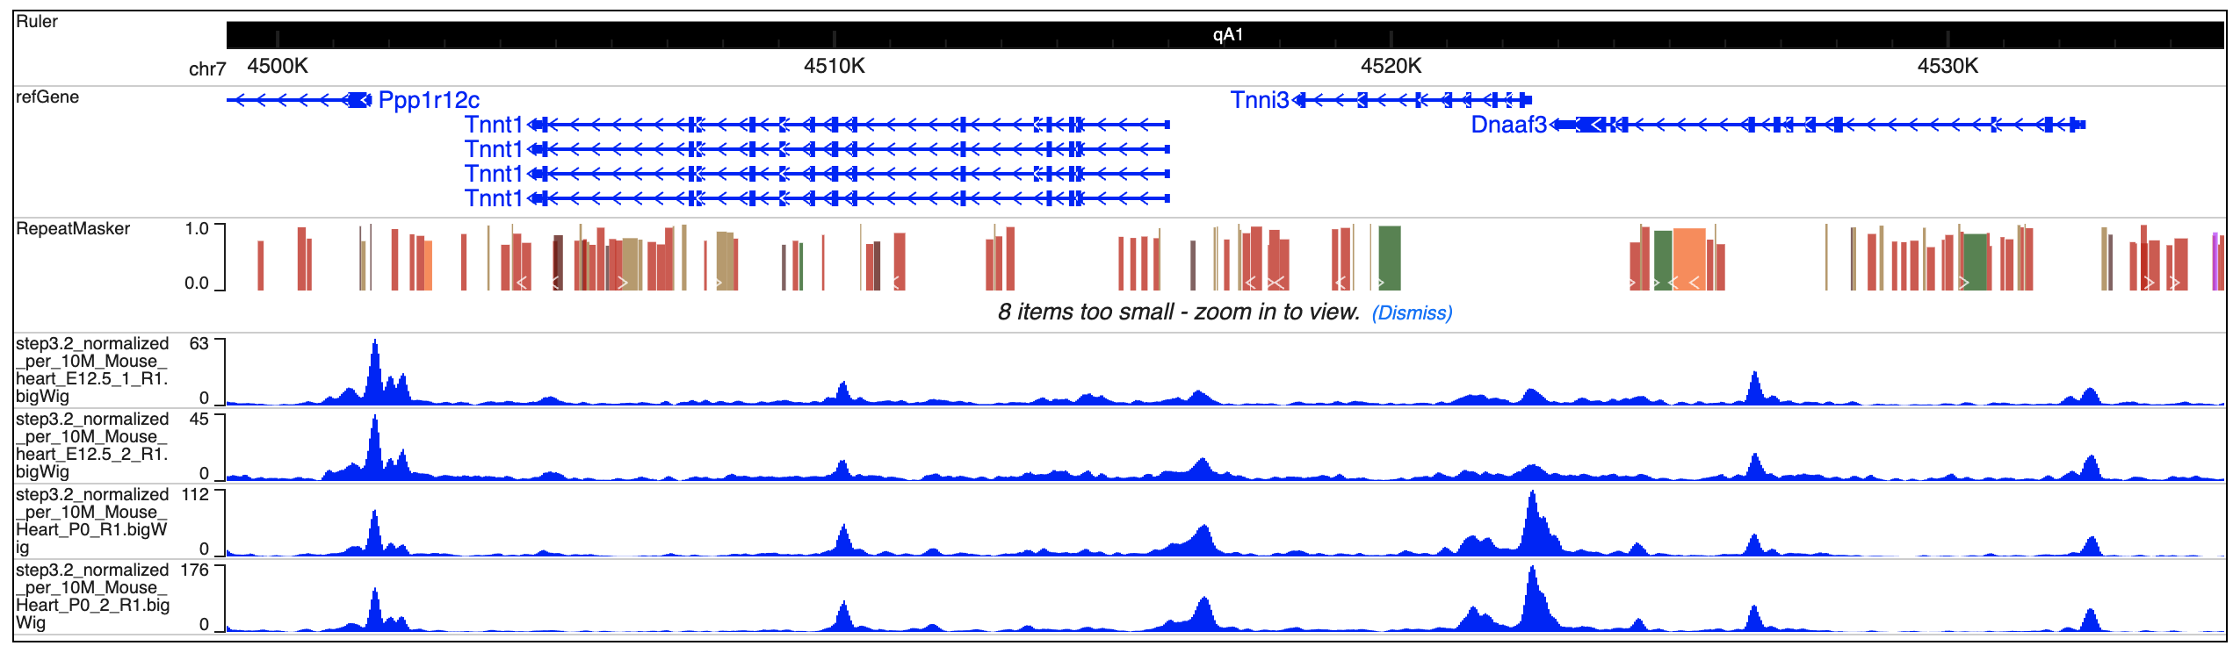
Let’s change color and set y-axis scale same. Looks better!
However, this browser session is not able to save and share.

Slide 23
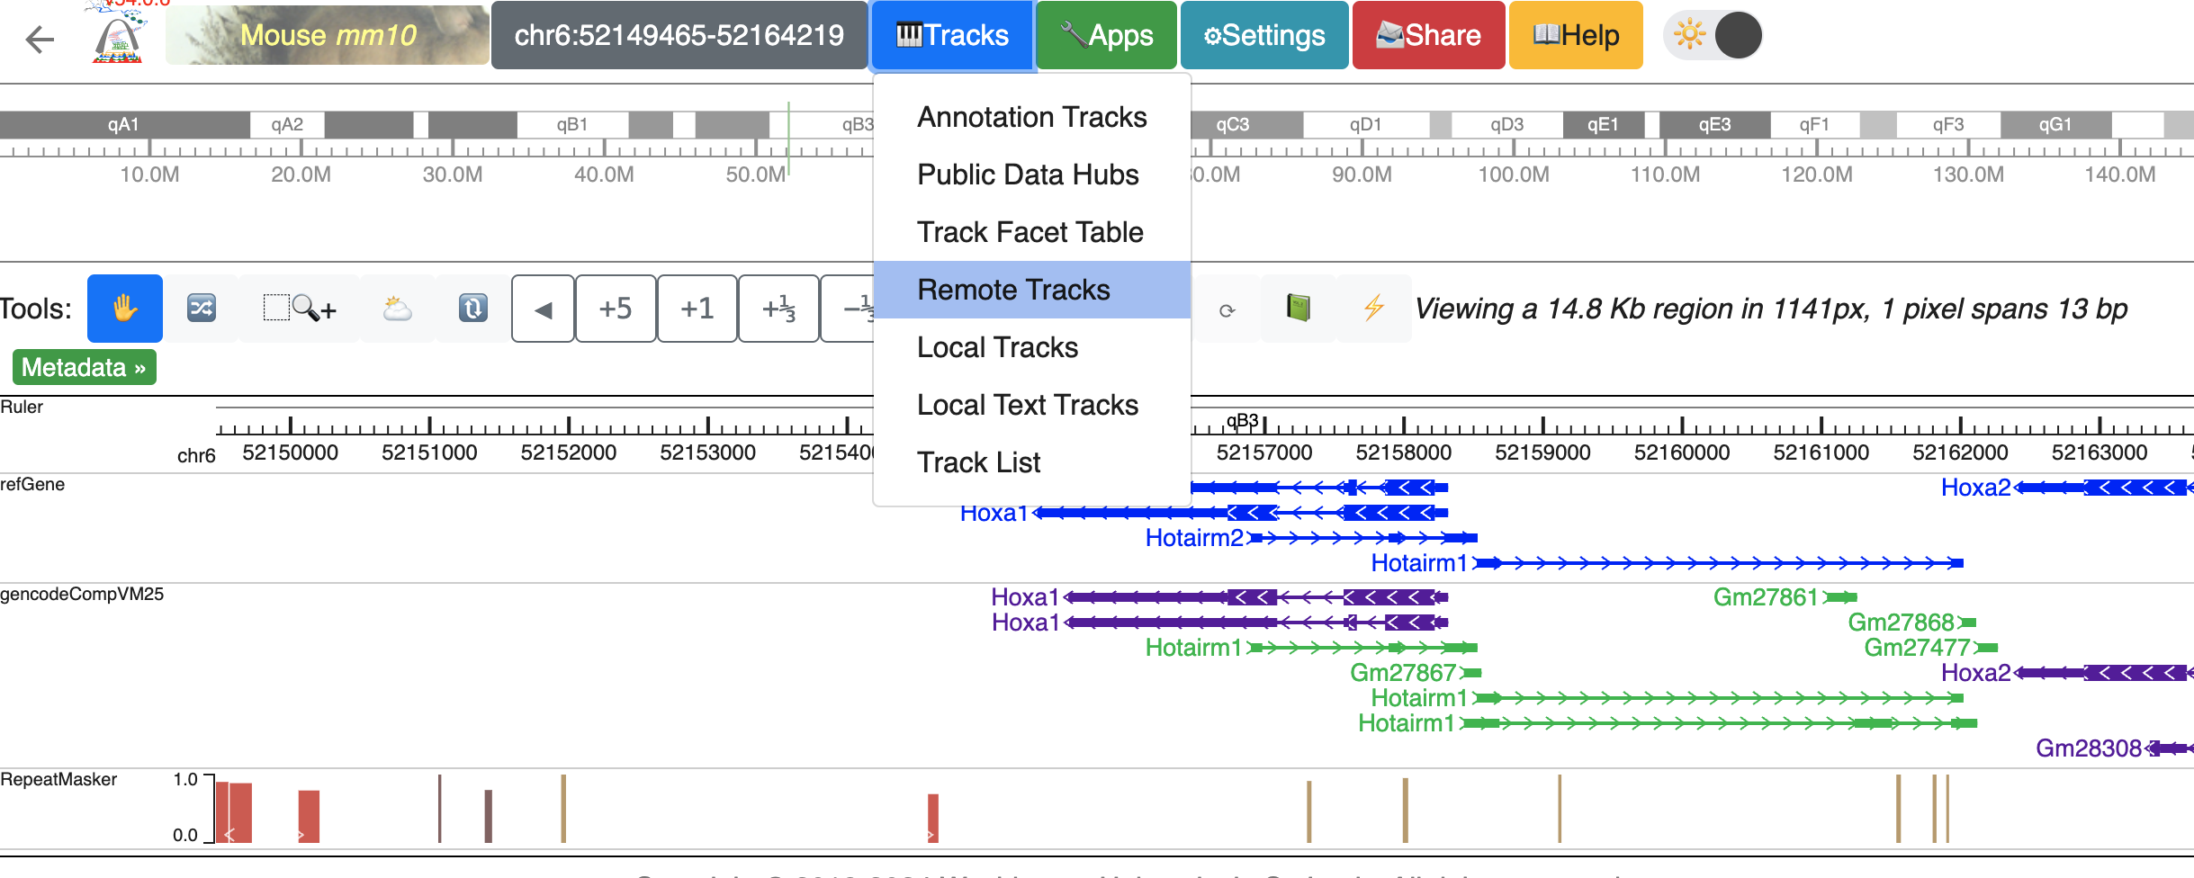
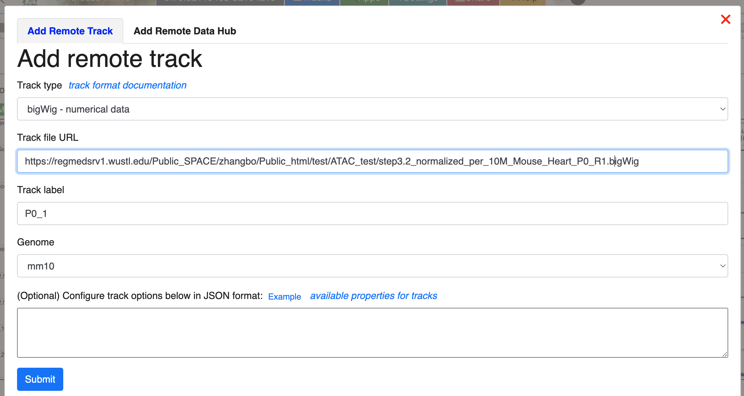
Add bigwig tracks from URL

Slide 24
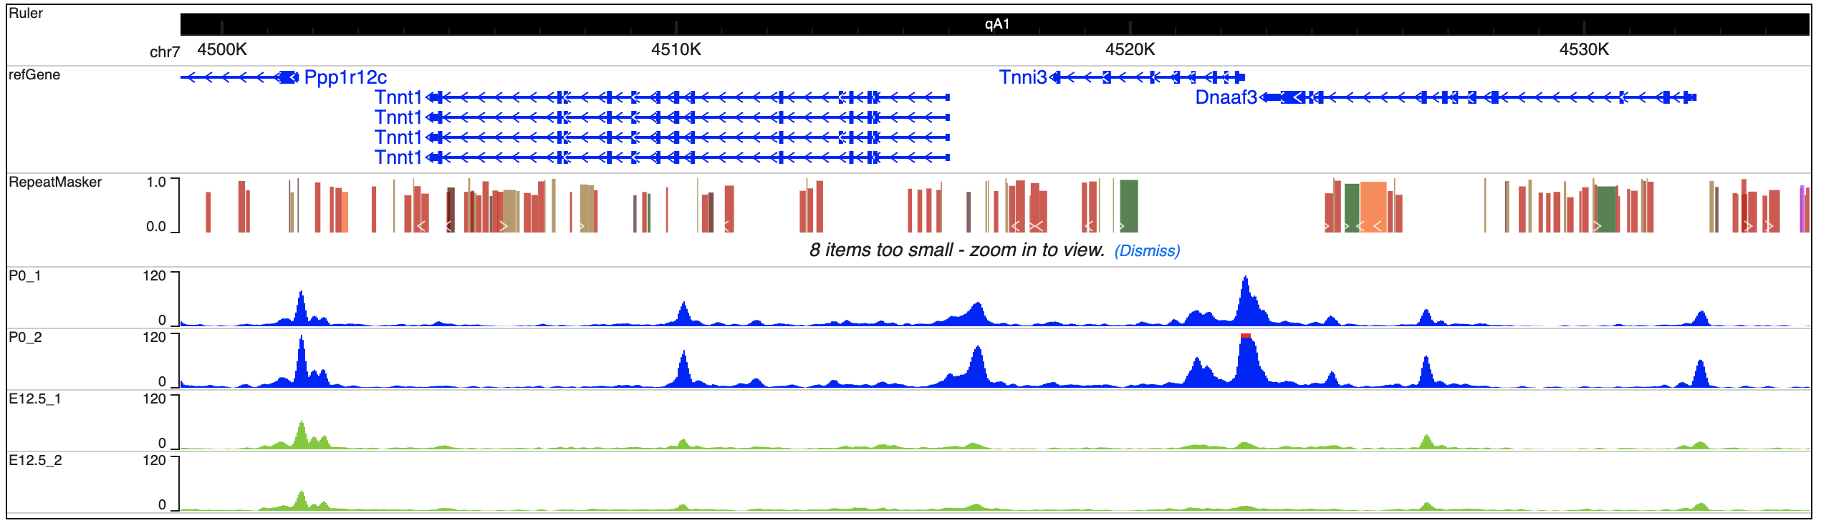
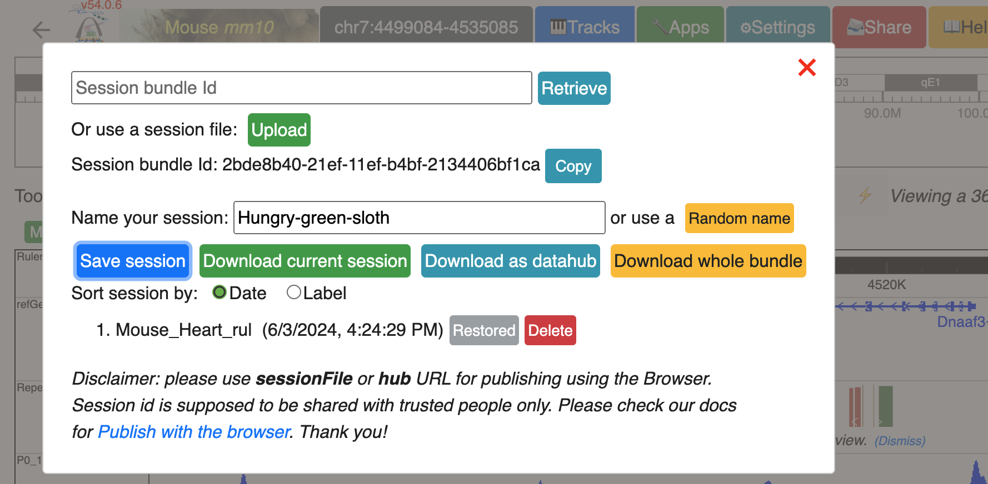
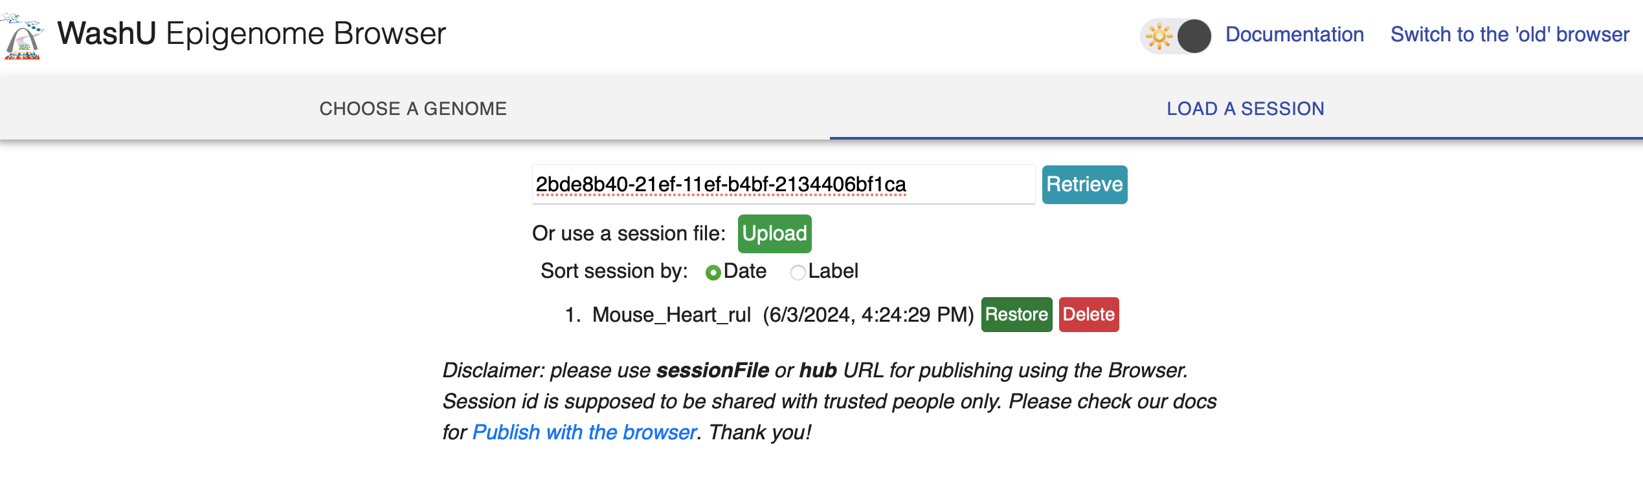
Now you can save and share this ATAC-seq data!

Slide 25
How to find differential accessible regions (DARs)?

Slide 26
Differential analysis of enrichment-based epigenetic sequencing data
ATAC-seq
ChIP-seq
MeDIP-seq
MRE-seq
DamID-seq
CUT&RUN
CUT*Tag
Group A
Group B
Strategy 1: binarized determination
Construct model to determine the epigenetic status (binarization) of given regions in both groups
With 1 replicate, this is the only choice
Directly compare the binarized status of given regions.
Strategy 2: statistical determination
Hypothesize the data distribution
Perform statistical test for given regions between two groups
Gaussian, Poisson, negative binomial
T-test, exact binomial test
Brief Bioinform. 2016 Nov; 17(6): 953–966.
Scientific reports.2020. 10 (1), 10150

Slide 27
How to perform differentially accessible regions (DARs) analysis?
Similar to RNA-seq differentially expressed genes (DEGs) analysis:
Generate OCRs x samples counting-table
Normalization, outlier detection, correction
Statistical test
Done!

Slide 28
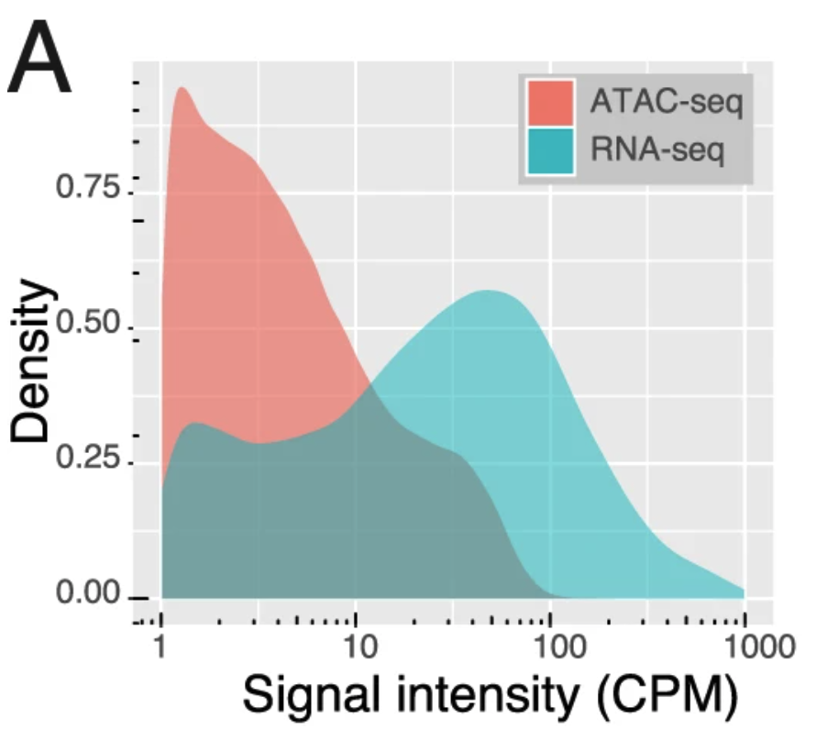
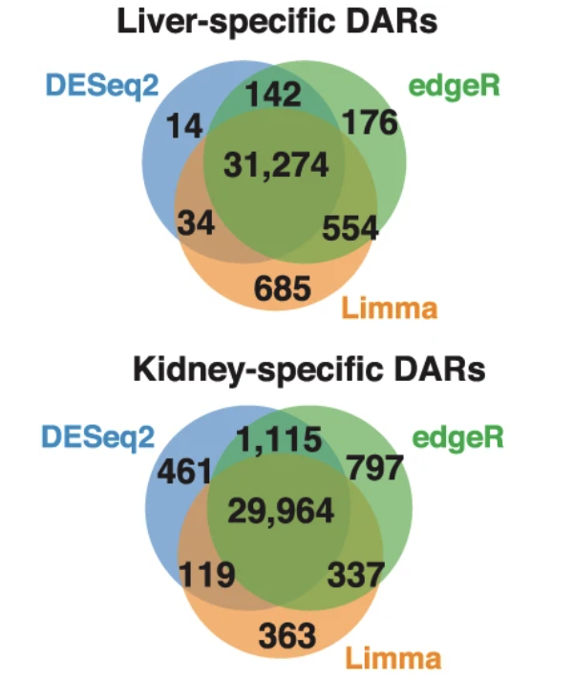
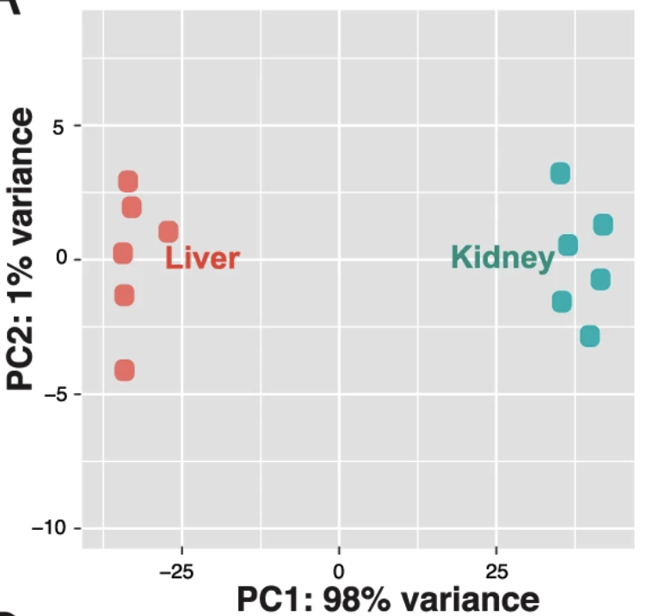
How to perform differentially accessible regions (DARs) analysis?
ATAC-seq signal distribution is different from gene expression.
Real data comparison for 3 methods.
With 6 replicates, 3 methods agreed with each other very well. (FDR/padj<0.01 with 100% signal difference)
Gontarz et al. Scientific Reports. 2020

Slide 29
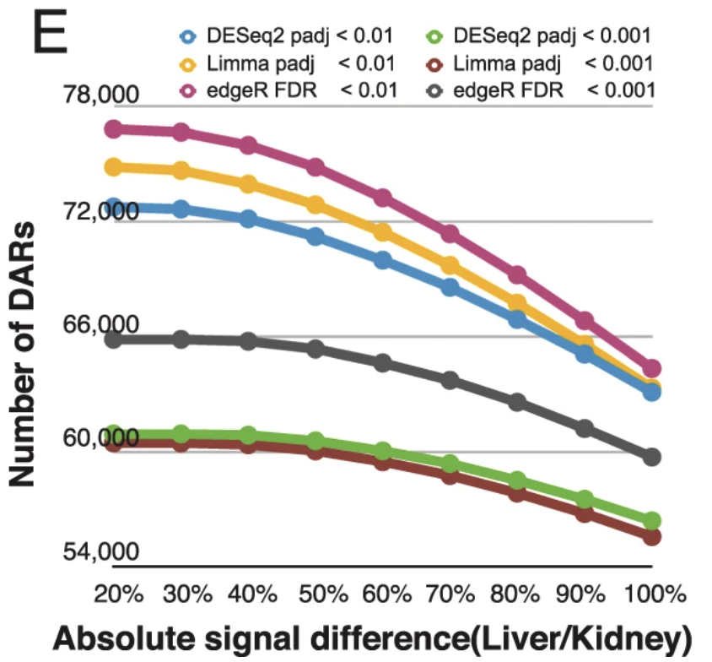
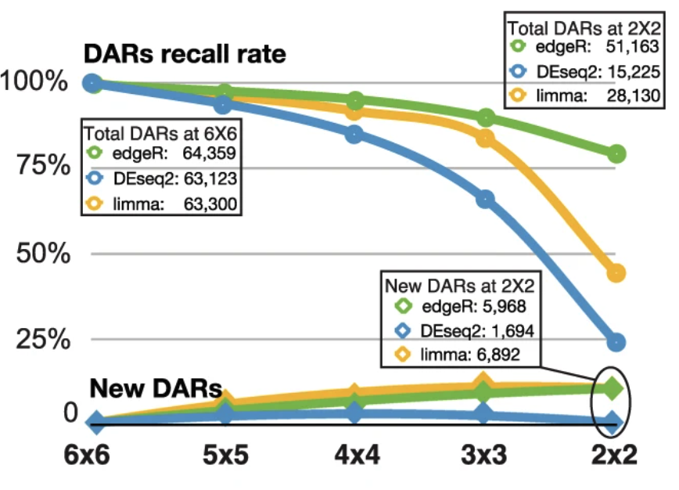
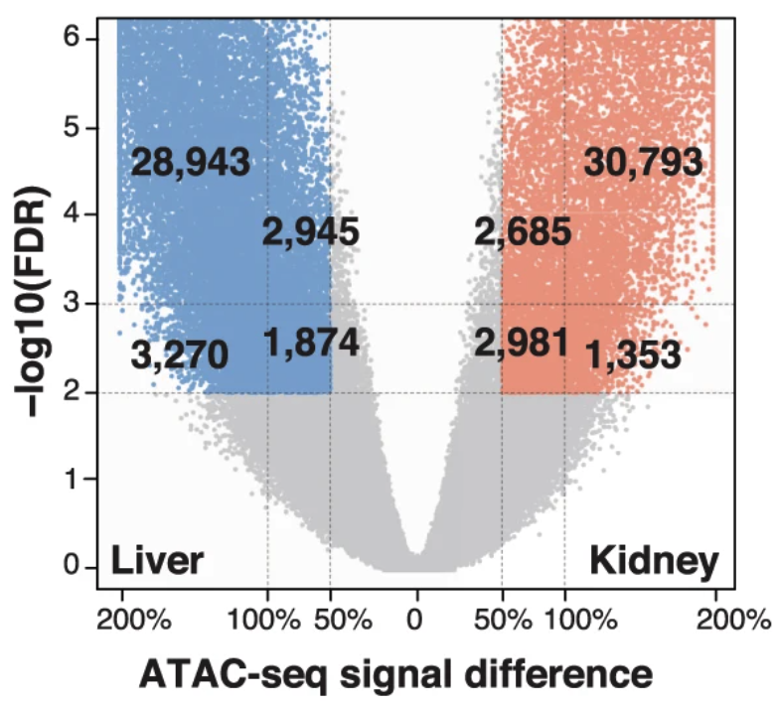
DESeq2 was very sensitive to the number of replicates. edgeR and limma had a relatively higher false positive rate.
# of DARs were linear in the 50%~100% range at 2 different padj/FDR cutoffs.
How to choose a good cutoff?
edgeR is recommended in ATAC-seq analysis with 50% signal difference at FDR 0.001.
Gontarz et al. Scientific Reports. 2020

Slide 30
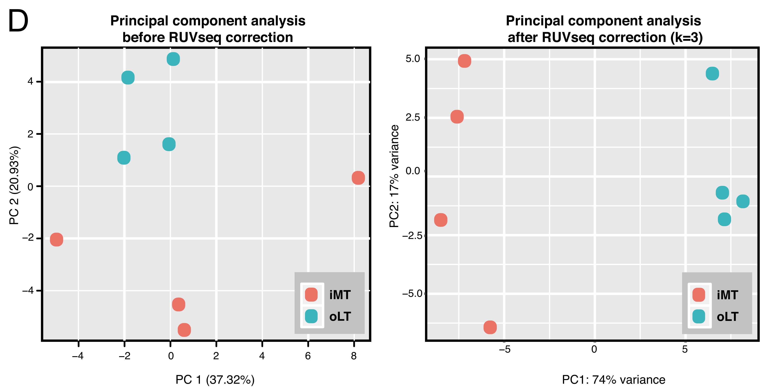
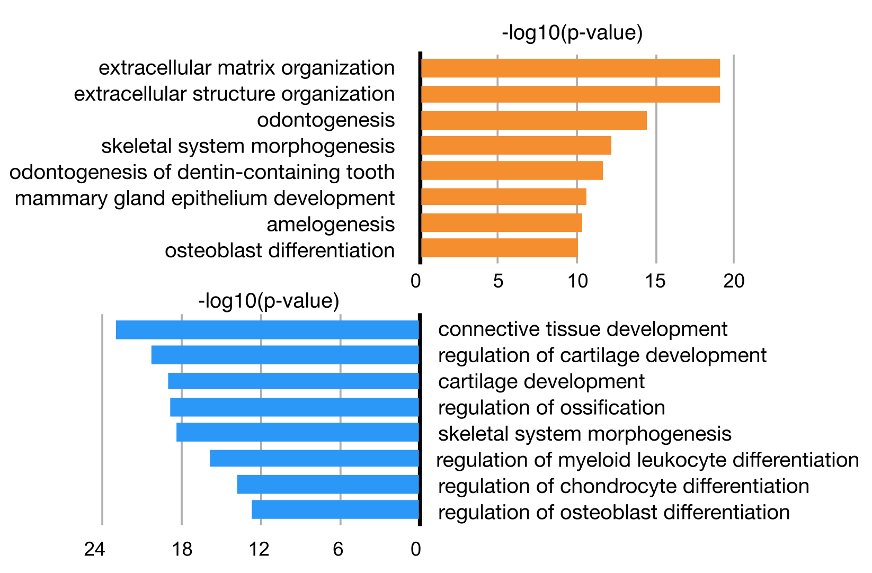
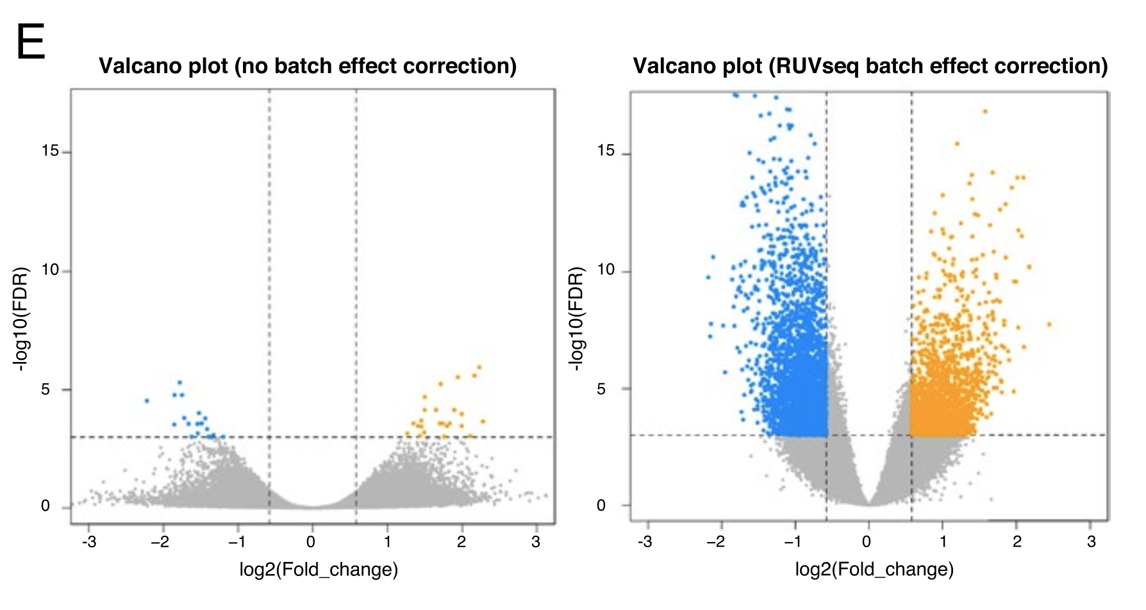
PCA can help better understand the data, to determine outliers* or data corrections.
Analysis of human healthy cartilage (oLT) and osteoarthritis cartilage (iMT)
*: outliers can be estimated by using robust principal component analysis in PcaGrid.
Chen et al. BMC Bioinformatics. 2020.
Gontarz et al. Scientific Reports. 2020

Slide 31
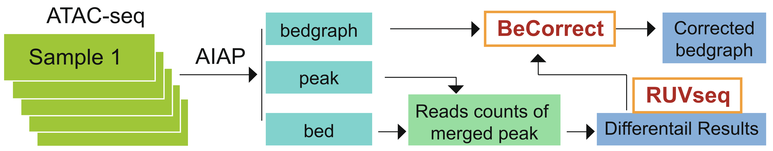

Match the corrected data analysis to visualization
BeCorrect (v1.1.0): A program to rescale bedgraph files to visually match batch correction using RUVSeq.
Usage: BeCorrect <raw_counts> <ruv_adjusted_counts> <chr.names> 1.bg ... n.bg
https://github.com/Zhang-lab/BeCorrect
Gontarz et al. Scientific Reports. 2020

Slide 32


Back to mouse heart ATAC-seq data
1. Make a new folder and move the necessary files.
2. Merge peak and generate non-redundant peaks.

Slide 33



3. Count read under each peak in all samples.
4. Copy back Counts files to your personal computer. High-computing operations are done!
5. Open R/Rstudio, perform DAR analysis.
Count_table

Slide 34


Generate PCA and check samples distributions

Slide 35



Slide 36




Slide 37
Down-stream analysis of ATAC-seq data
Genomic distribution
GO enrichment analysis
Motif analysis and footprinting analysis
Integration to RNA-seq and build a regulatory network
More and to be continued….

Slide 38


Question & discussion
Bioinformatics
Welcome to the deep see of big data

